Slide 1
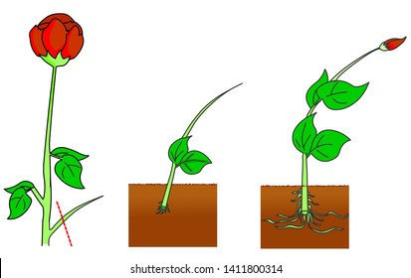
ASEXUAL REPRODUCTION
CUTTING

Slide 2
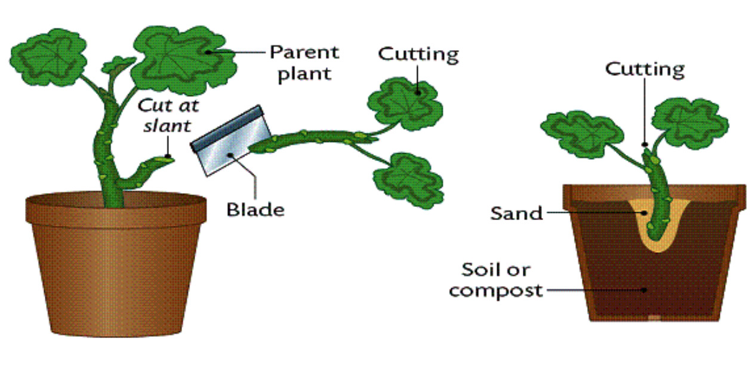
Cutting
Separation of a portion from mother plant and planting it in a medium suitably so that it may constitute a new plant successfully is termed as cutting.

Slide 3
Types of cutting
Stem cutting
Root cutting
Leaf cutting

Slide 4
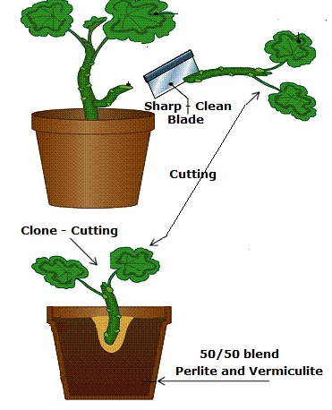
Stem cutting
A cutting taken from the main shoot of a plant or any side shoot growing from the same plant or stem.
four types of stem cuttings,
Hardwood cutting
Semi-hardwood cutting
Softwood cutting
Herbaceous cutting

Slide 5
Hardwood Cutting
Cutting from mature and lignified stem of shrubs and trees are called as hardwood cuttings.
One-year-old shoots are used for cutting.
Size of cuttings
10 to 45 cm in length and 0.5 to 2.5 cm in diameter
Each cutting should have at least three or more buds.
While preparing the cutting, a straight cut is given at the base of shoot- below the node while a slant cut of 1 to 2 cm above the bud is given at the top of cutting.
Grape, Kiwifruit, Hazel Nut, Chest Nut, Fig, Quince, Pomegranate, Mulberry, Plum, Olive, And Gooseberry

Slide 6
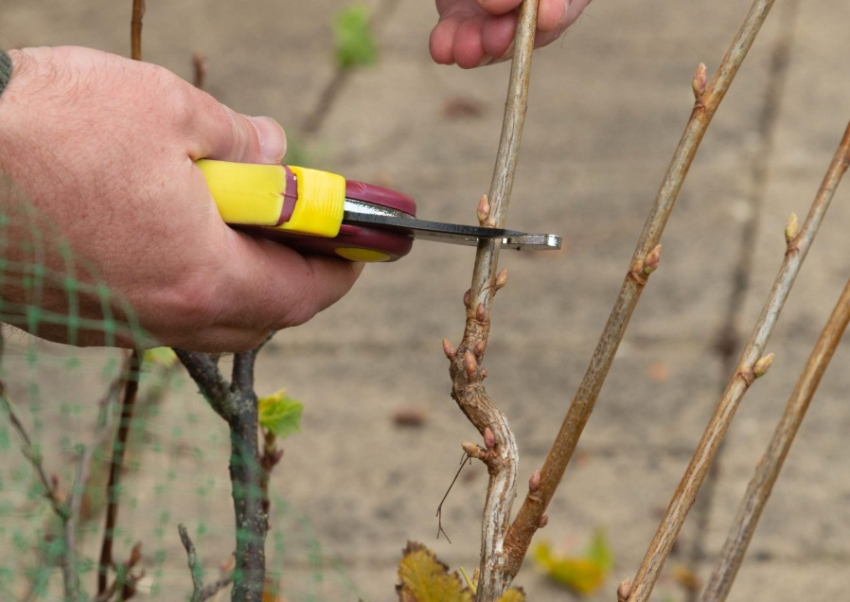
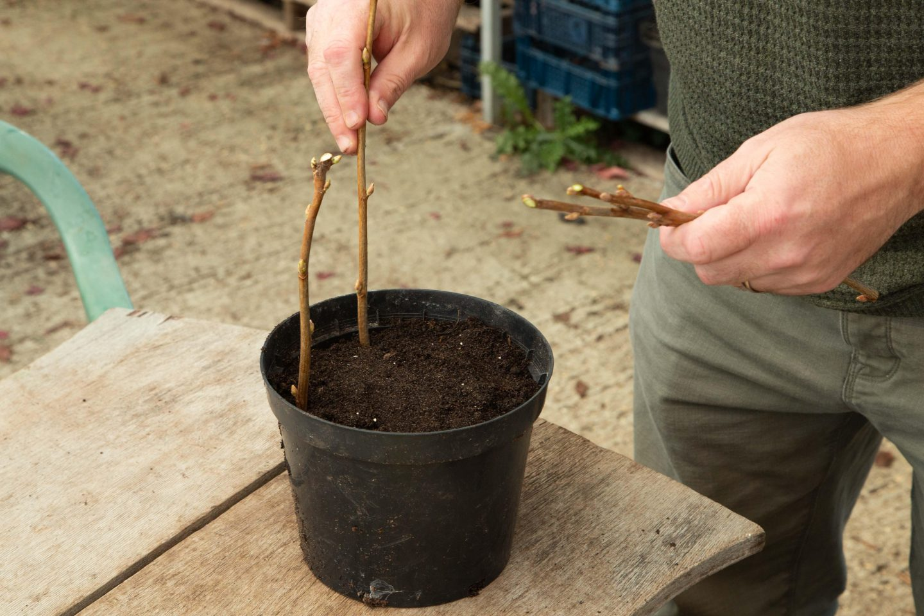

Slide 7
Semi-hardwood cutting
4-9 month old semi hardwood shoot are used.
The length of the cuttings varies from 7 to 20 cm.
Basal leaves are removed from the cutting leaving 2 to 4 terminal leaves intact.
Prepared during rainy season.
Ex: mango, guava, lemon, jackfruit etc

Slide 8
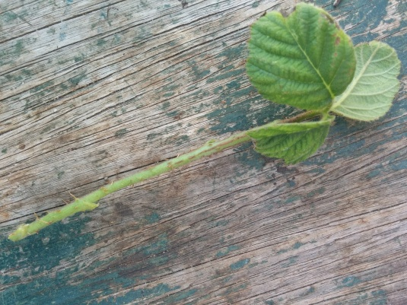
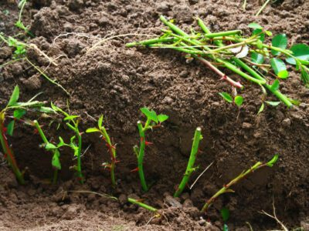
Semi hardwood cutting

Slide 9
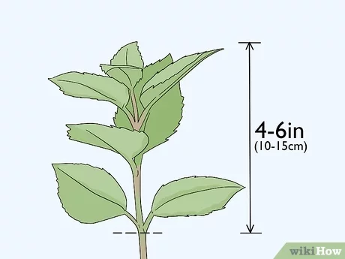
Softwood cutting
Cuttings prepared from the soft-succulent and non-lignified shoots
Shoots of 2-3 months old are selected.
Length of the cutting 10-15 cm.
It is practiced in mist chamber.

Slide 10
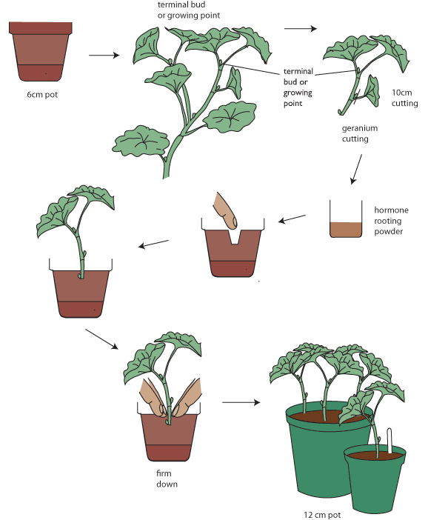

Slide 11
Herbaceous cutting
The cuttings are made from succulent non-woody plants.
Shoots of age 1-2 month are selected.
Ex: Coleus, Pilea, Eupatorium etc.

Slide 12
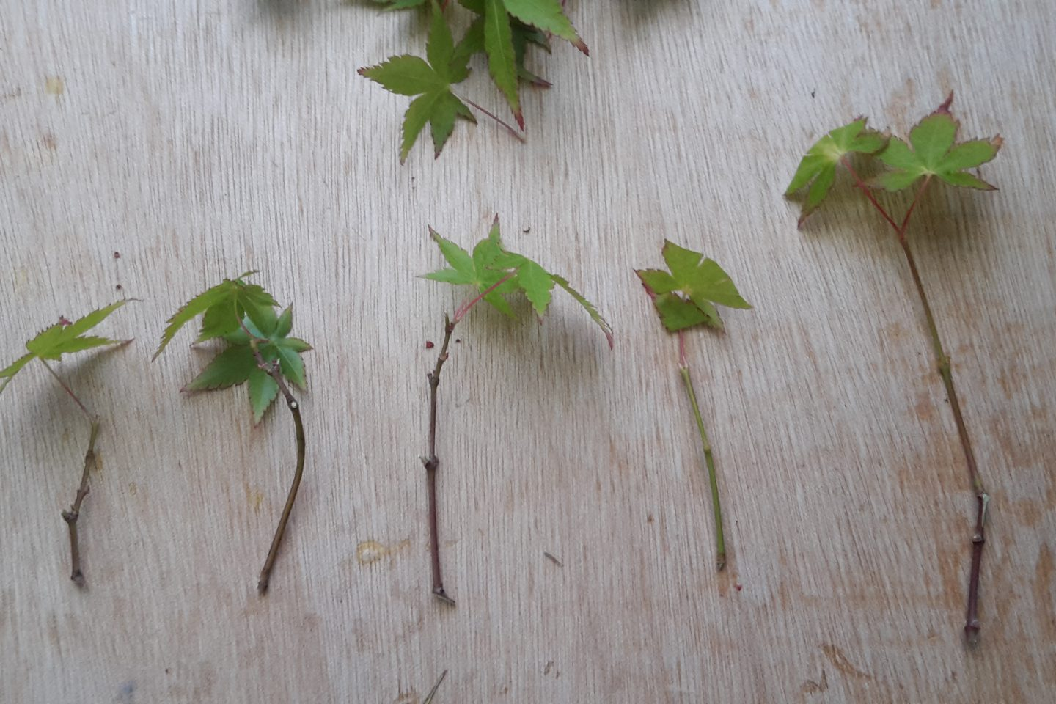
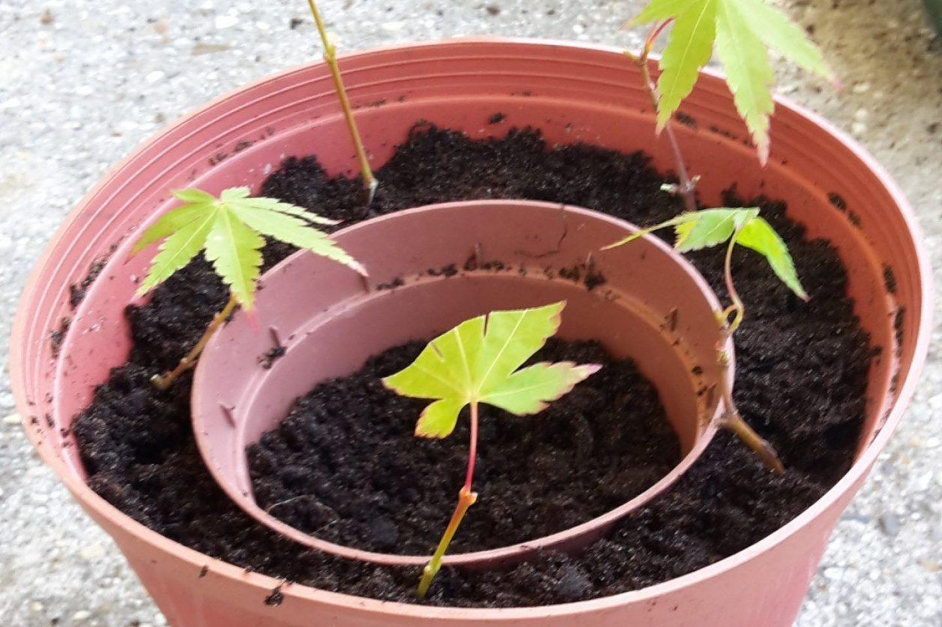

Slide 13
Root cutting
Plants capable of producing sucker are good for root cuttings.
Size of cuttings
2 - 3cm thick roots
10-15cm long roots
Slant cut is prepared on the proximal end (near to stem root junction) and round cut is made at the distal end.
Example : Apple, Pear, Guava etc.

Slide 14
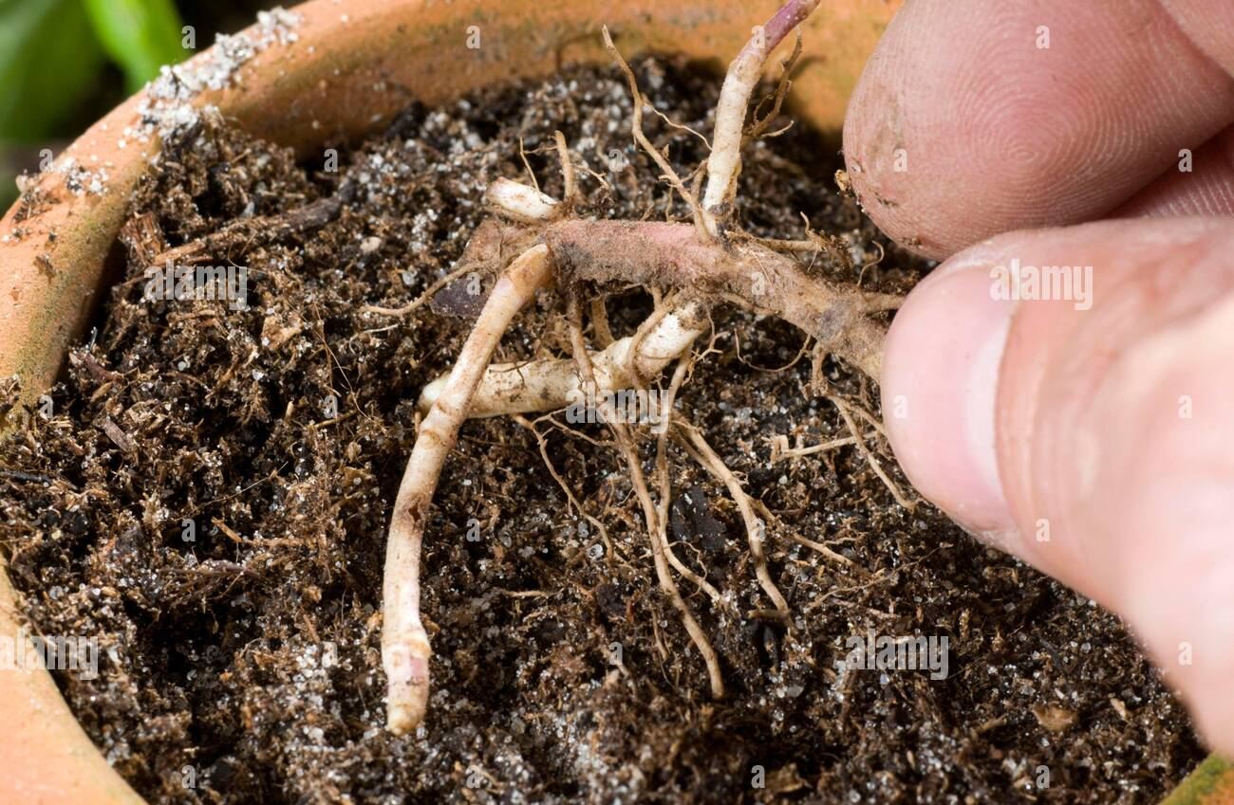

Slide 15
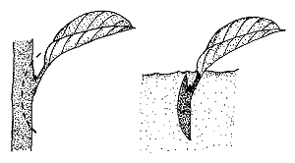
Leaf cutting
The leaf is separated from the mother plant and planted in suitable media.
Ex: Begonia, Sansevieria, Crassula etc.

Slide 16
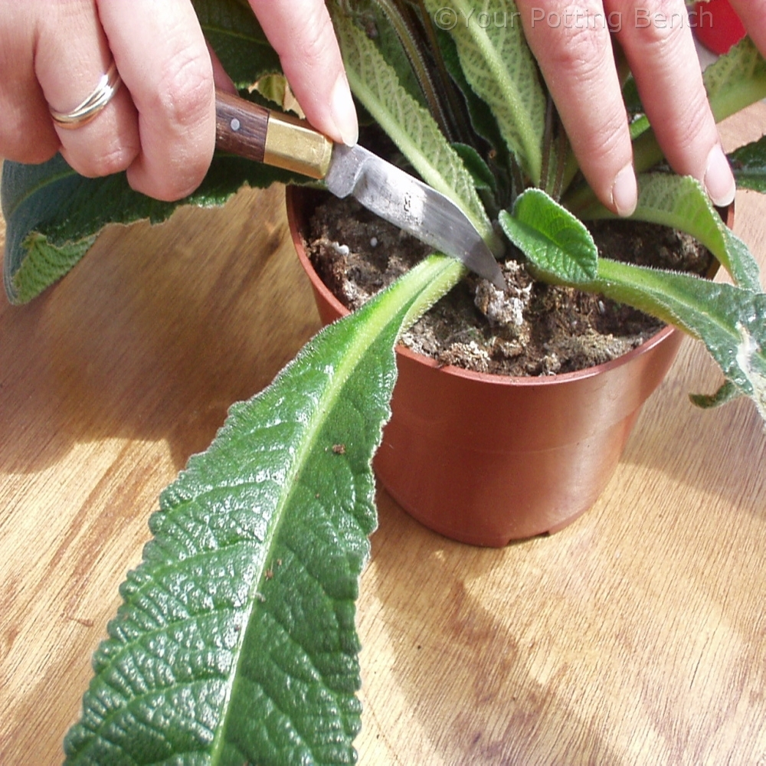
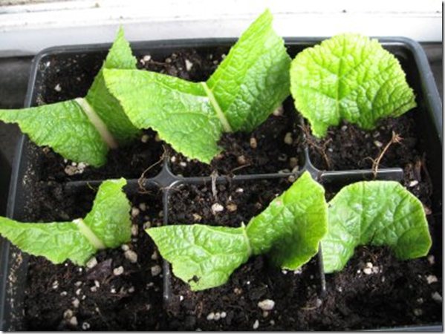
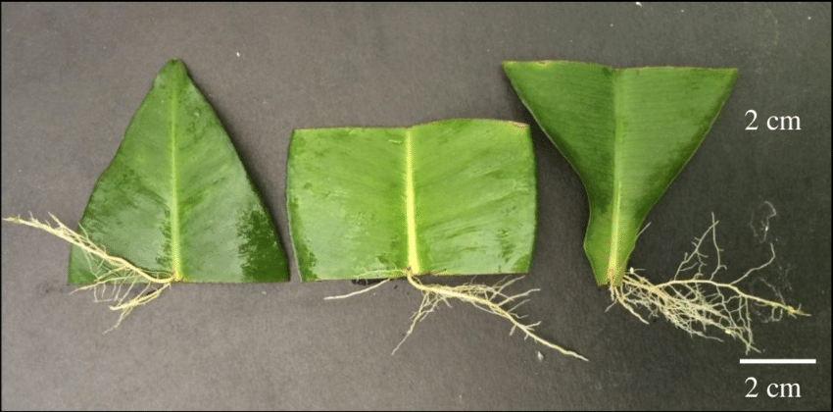

Slide 17
THANK YOU

