Slide 1
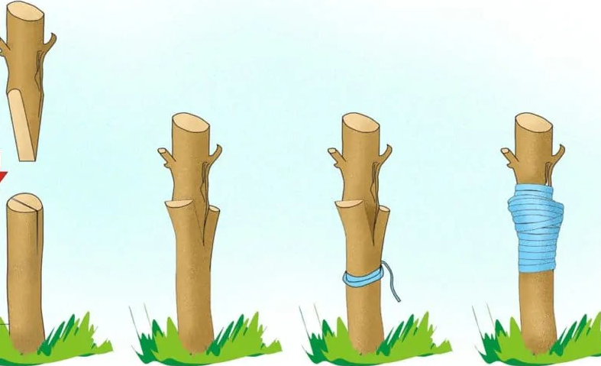
Asexual Reproduction
Grafting

Slide 2
GRAFTING
It is a technique of propagation in which scion stick (shoot containing more than one bud) and rootstock is connected in a manner such that they may unite and subsequently grow and develop as a successful plant.
The rootstock of 1 -2 year age having pencil thickness and desired attributes is selected fro grafting.

Slide 3
Types of grafting
Veneer grafting
Whip grafting
Tongue grafting
Cleft grafting
Wedge grafting
Bridge grafting
7. Epicotyl Grafting
9. Soft wood grafting
10. Inarching
11. Double working
12. Top working
13. Frame working

Slide 4
Veneer grafting
Scion – 10-15cm.
Defoliation of scion 10 days before grafting to promote bud growth.
V shaped cut is made on rootstock and similar cut is made on the scion.
It is wrapped with polythene tape.
Ex: Mango.

Slide 6
PREPARATION OF ROOTSTOCK
PREPARATION OF SCION
GRAFT UNION
WRAPPING

Slide 7
Whip grafting
One year old rootstock is used.
The scion should be the same size of the rootstock.
Graft union is fastened with polythene tape.
Ex: Walnut, Apple and Pear.

Slide 8
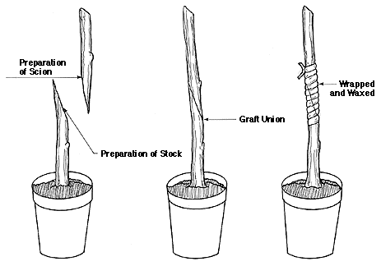

Slide 9
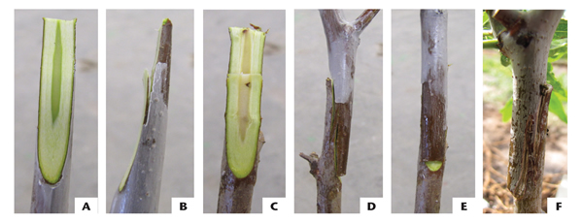

Slide 10
Tongue grafting
The first cut is a long sloping diagonal.
The second cut begins about 1/2 of the way down from the top of the first cut.
It begins vertically, then gradually becomes nearly parallel to the first cut surface, to create the "tongue".
Graft union is fastened with polythene tape.
Ex: Walnut, Apple and Pear.

Slide 11
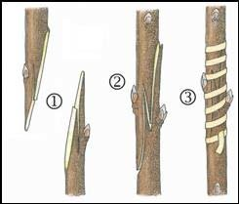
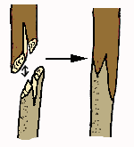

Slide 12
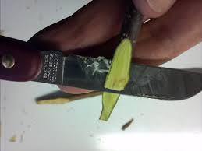
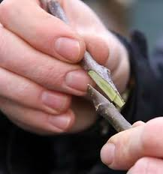
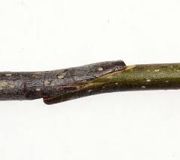

Slide 13
Cleft grafting
The root stock is split with help of a knife or a hammer.
Base of scion is cut to a V-shaped wedge for insertion into the stock.
Melted grafting wax or polythene tape is used to seal the graft union.
Ex: Mango, Pecanut, Hazelnut, Grape etc.

Slide 14
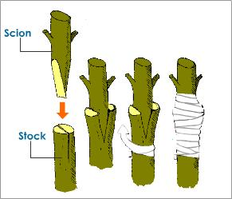
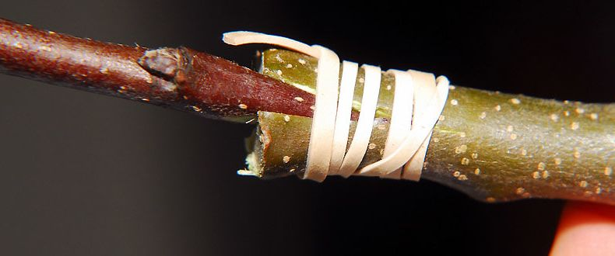

Slide 15
Wedge grafting
Terminal portion of the stock plant is removed with a horizontal cut.
Stock is split vertically, 5 cm deep.
Scion cut into a "V" shaped wedge
Scion is inserted into the stock, with care to align cambia.
Stock and scion are tied together with plastic strip or a budding rubber.

Slide 16
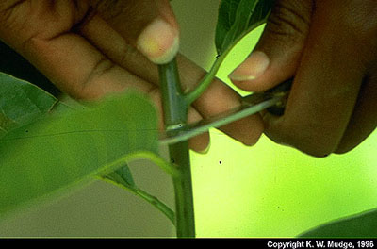
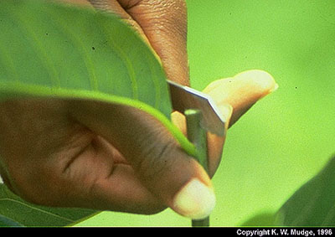
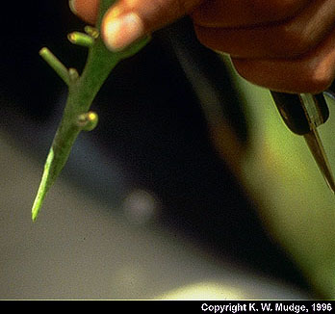
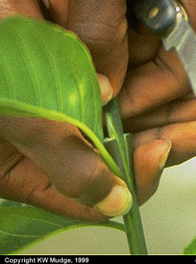
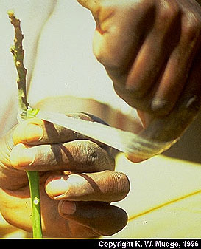

Slide 17
Bridge grafting
It a form of repair grafting only in plants (Rootstock), which have been damaged either by frost, rodents or insects.
The damaged part of rootstock is removed and a incision is made on the top and bottom of the rootstock.
The scion of suitable length is inserted into the incision and sealed with wax.
Ex: Apple, Pear, Cherry, Walnut etc.

Slide 18
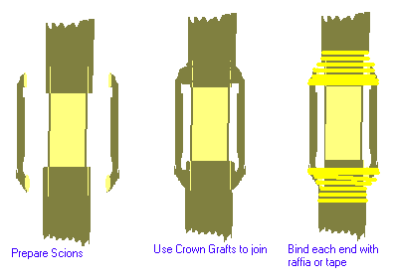

Slide 19
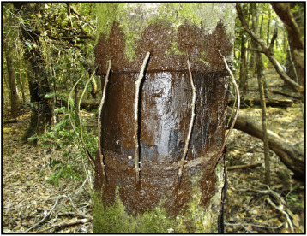

Slide 20
Epicotyl Grafting
It is also called as stone grafting.
The germinating seeds of less than two weeks old are wedge grafted with mature scion.
A 2- 4 cm long slanting cut is made on 2-3 month old scion.
The longitudinal transverse cut running 4-6 cm centrally down on the beheaded rootstock.
The graft union is wrapped with a polythene tape.
Ex: Mango.

Slide 21
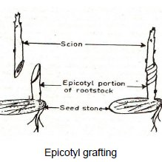

Slide 23
Soft wood grafting
This method of grafting is done when the rootstock is overgrown and thus not suitable for stone grafting.
Normally in this method, seedlings of 8-10 months old are selected.
The grafting is done on newly emerged flush. The scion wood to be used is defoliated 10 days prior to the grafting and has same thickness as that of terminal shoot.
The method of grafting is similar to stone grafting.
Ex: Mango.

Slide 24
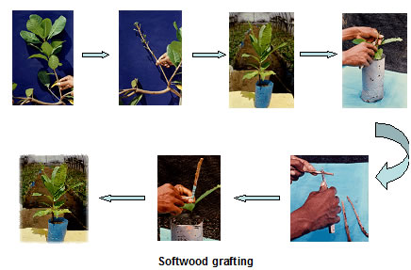

Slide 26
Inarching
This method is also known as approach grafting.
one-year-old seedlings are most suitable when they attain a height of about 30-45 cm and thickness ranging from 0.75 to 1.5 cm.
one-year-old twigs of the scion tree about 60 cm in length and nearly of the same thickness as that of the stock is chosen for grafting.
The cuts thus made should be absolutely flat, clean, boat shaped, even and smooth.
The cut surfaces of both, i.e., stock and scion are made to coincide facing each other so that there remains no hollow space between the two.
Polythene/alkathene strips of about 1.5 cm in width are tied around the union.
Ex: Mango, Jackfruit, Sapota, Loquat etc.

Slide 27
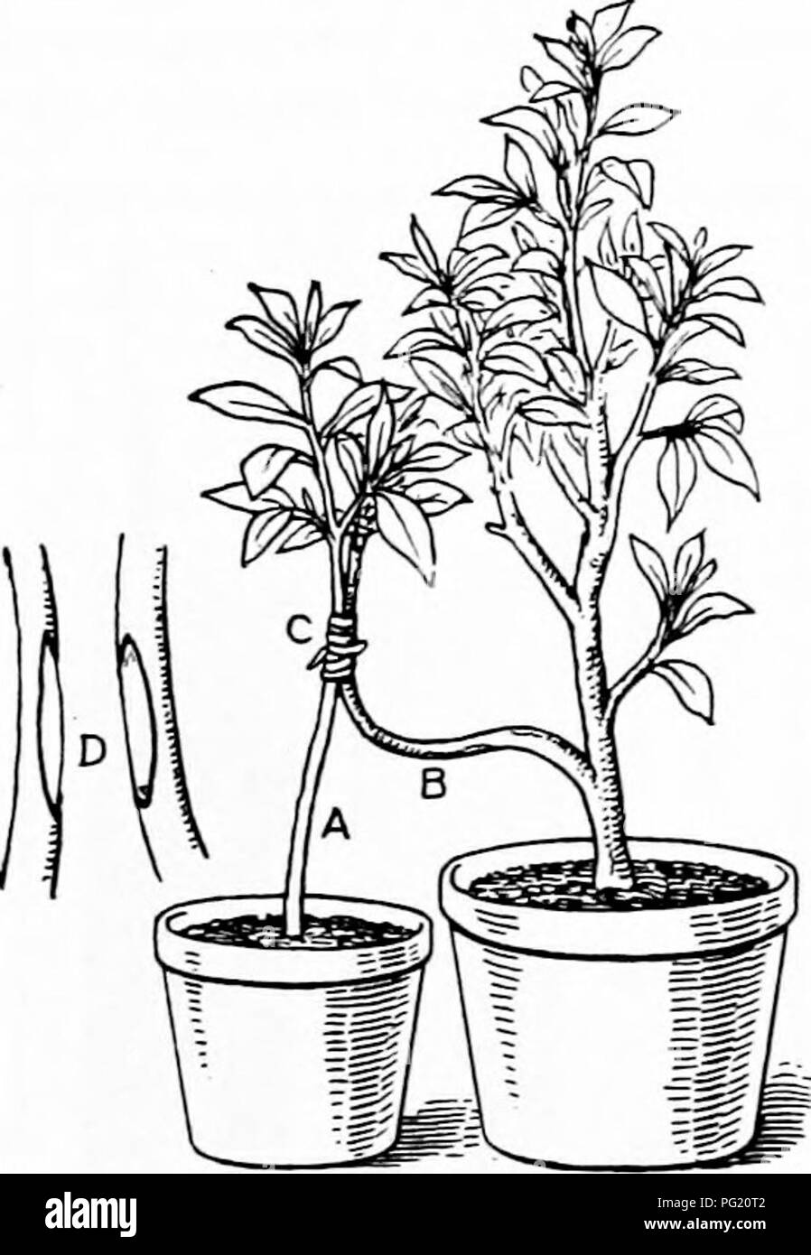

Slide 28
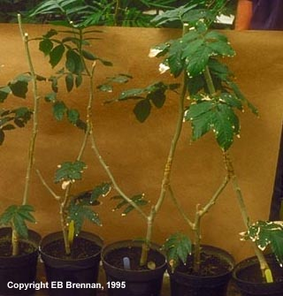
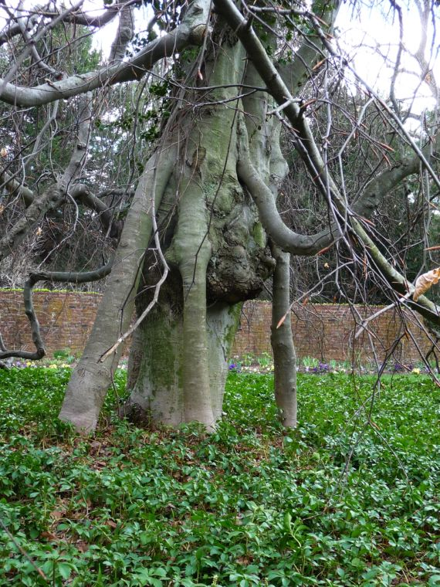

Slide 29
Double working
Double working involves placing an interstock between the scion and the rootstock.
This may be done in certain fruit tree grafts where the scion and rootstock are incompatible, but the inters tock is compatible with both the scion and rootstock.
Ex: Apple and Pear

Slide 30
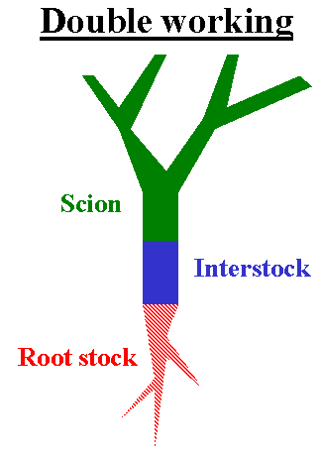

Slide 31
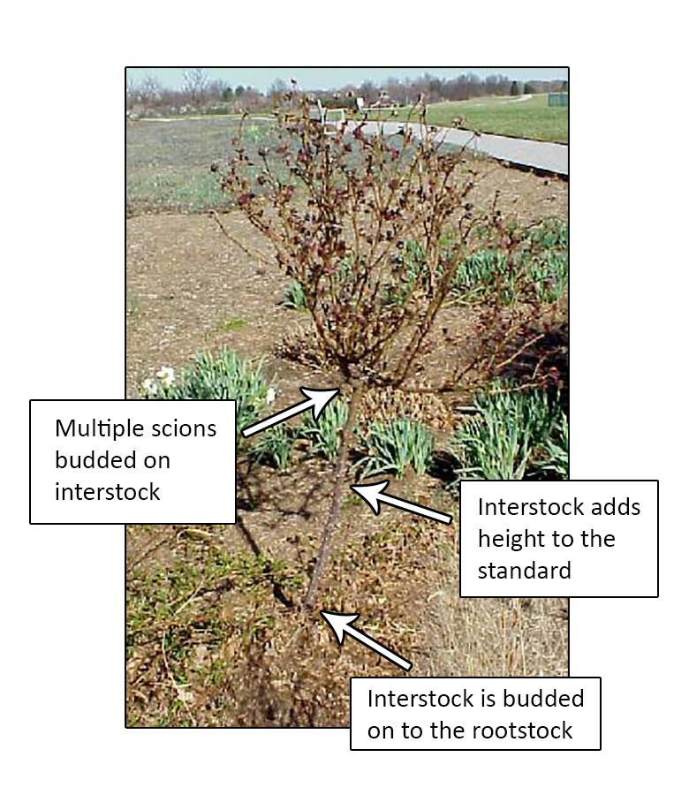

Slide 32
Top working
It is a process of converting an undesirable plant into desirable type.
It is a process of grafting new scions high up in the canopy of an established tree.

Slide 33
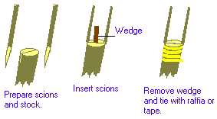

Slide 34
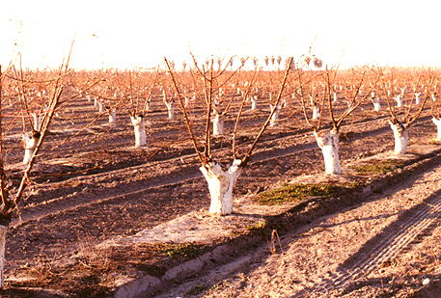
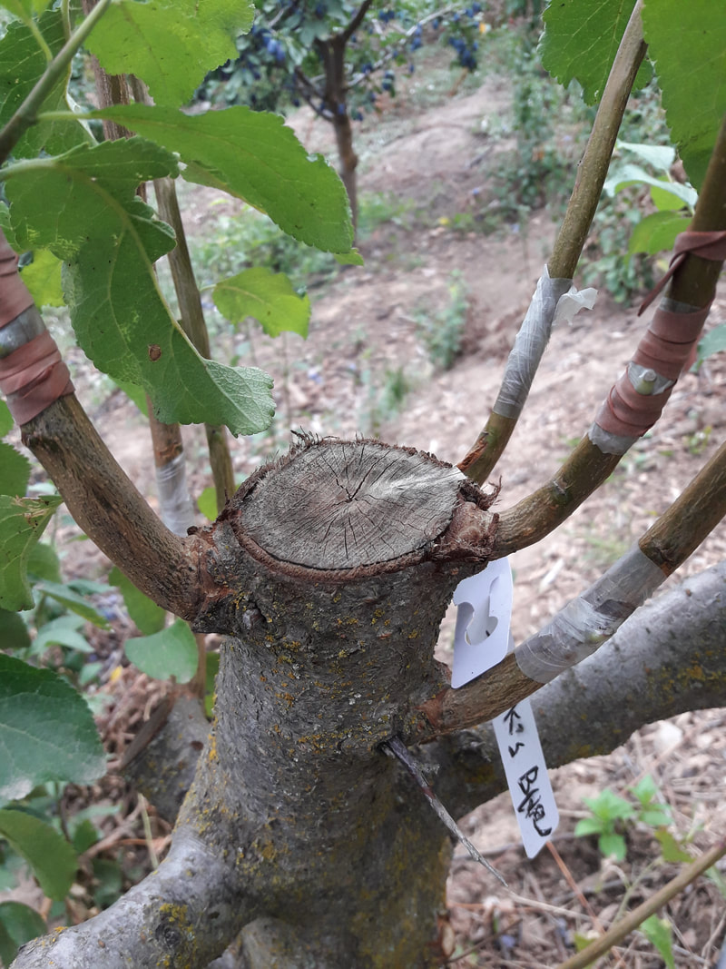
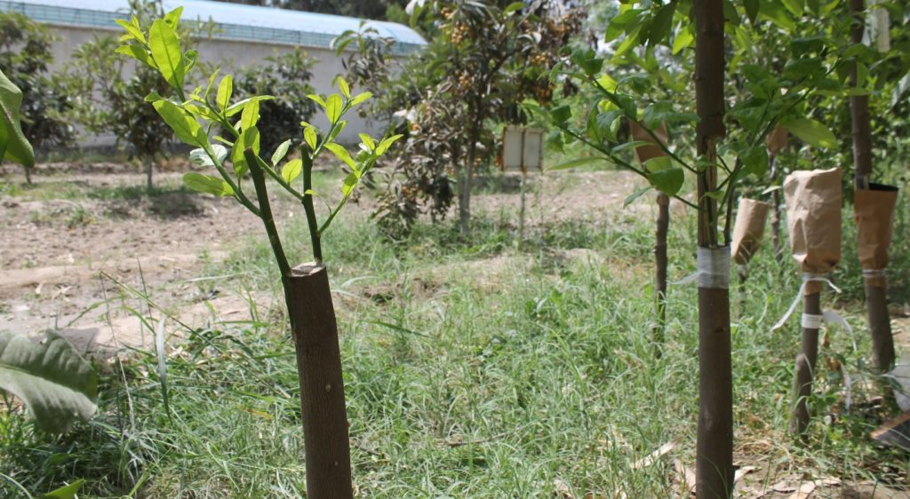

Slide 35
Frame working
Grafting many small scaffold branches high on the tree constitutes frame working.
It requires insertion of grafts throughout the main frame of the tree.
This technique is expensive and cumbersome

Slide 36
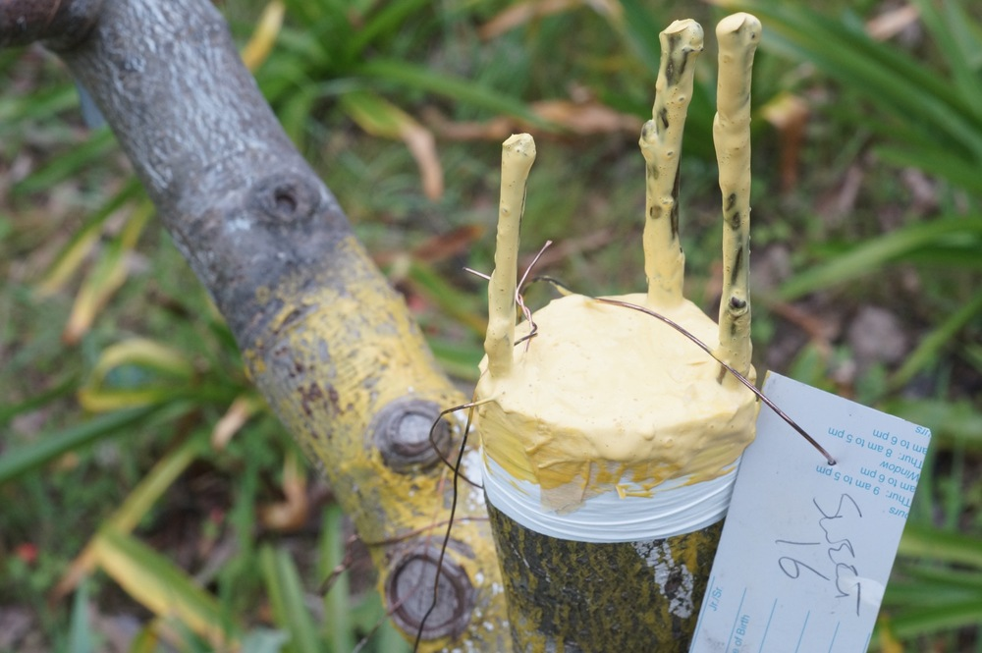
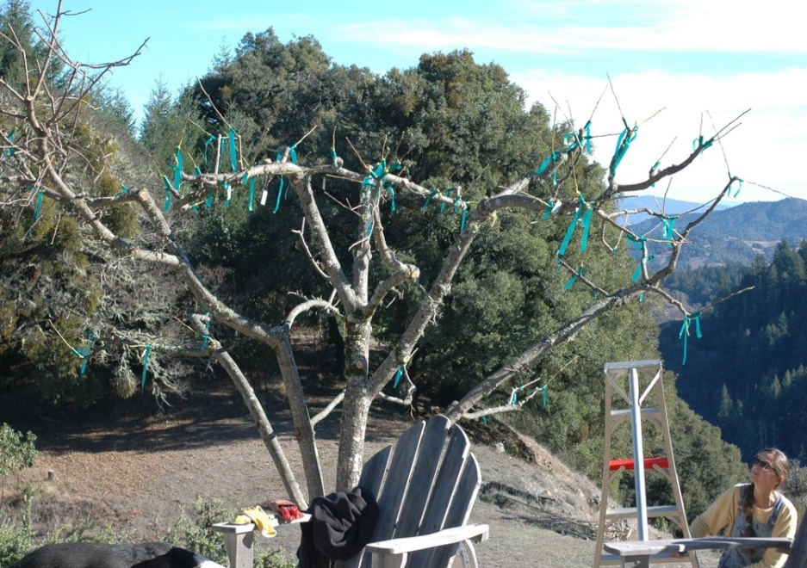
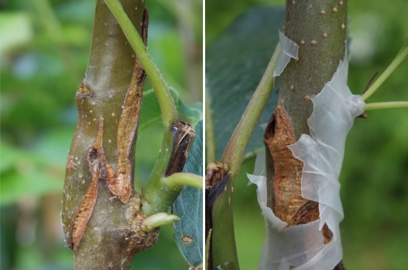
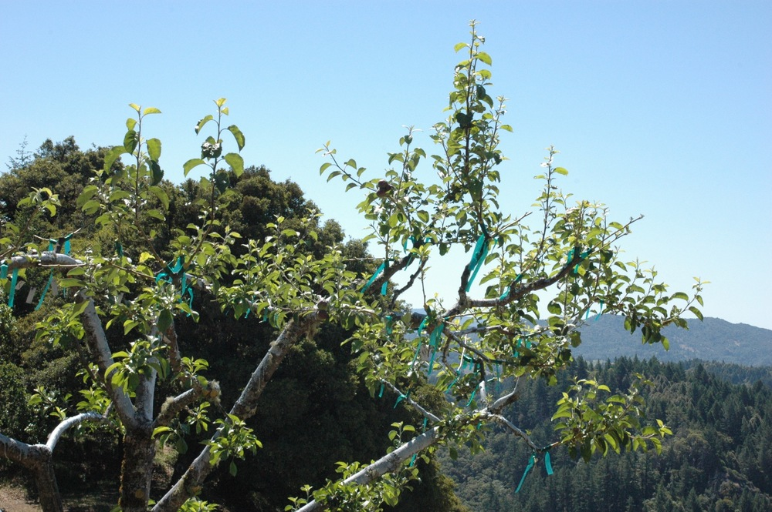

Slide 37
Thank you

