Slide 1
INCOMPLETE DOMINANCE & CO- DOMINANCE

Slide 2
DOMINANCE
Dominance is a relationship between alleles of one gene, in which one allele is expressed over a second allele at the same locus.
The first allele is dominant and the second allele is recessive.
Dominance is a key concept in Mendelian inheritance.

Slide 3
INCOMPLETE DOMINANCE
Incomplete dominance (also called partial dominance) occurs when the phenotype of the heterozygous genotype is distinct from and often intermediate to the phenotypes of the homozygous parental genotypes.
Examples are:
Snap Dragons or Four O’Clocks or Morning Glory or Primrose (Flowers)
A child with wavy hair as a result of one parent’s curly hair and the other’s straight hair.
Tay- Sachs disease

Slide 4
EXAMPLE OF INCOMPLETE DOMINANCE
A snapdragon flower that is pink flower as a result of cross- pollination between a red flower and a white flower when neither the white or the red alleles are dominant.
Genotypic ratio = 1RR: 2RW : 1WW Phenotypic ratio = 1Red : 2Pink : 1White

Slide 5
CO-DOMINANCE
When both alleles of a pair are fully expressed in a heterozygote, they are called co-dominant alleles.
Such alleles exhibit a unique pattern of expression with heterozygous being phenotypically distinguishable from both of the homozygous and expressing both alleles equally.
Examples are:
Roan coat color in horses and cattle
Chestnut and White color in horses are both dominant traits; the heterozygous individual is a palomino (golden).

Slide 6
EXAMPLE OF CODOMINANCE
C= Color gene
C^{R} C^{R} = Red C^{W} C^{W} = White
_{C}R _{C}W
= Red Roan
Genotypic Ratio = All C^{R} C^{W} Phenotypic Ratio = All Red Roan

Slide 7
EXAMPLE OF CODOMINANCE
Chestnut and White color in horses are both dominant traits; the heterozygous individual is a palomino (golden).

Slide 8
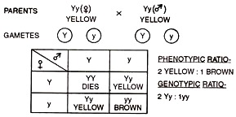
Dominant Lethal Gene effect:
Inheritance of yellow coated colour in mice. Mice with yellow coated colour are always heterozygous.

Slide 9
Although an organism can carry only two alleles of one gene, more than two alleles of a single gene can be present in population. This situation is called multiple allelism, and the set of alleles itself is called allelic series.
An example is Human Blood group system (ABO system),
Self-incompatability alleles (S gene having S1, S2, S3 alleles) in plants,
and the coat color in rabbits is also controlled by multiple alleles.

Slide 10
Human Blood group system (ABO system)
I gene having three alleles: I^{A}, I^{B}, i
O blood group: Universal Donor
AB Blood Group: Universal Acceptor and No antibodies.

Slide 11
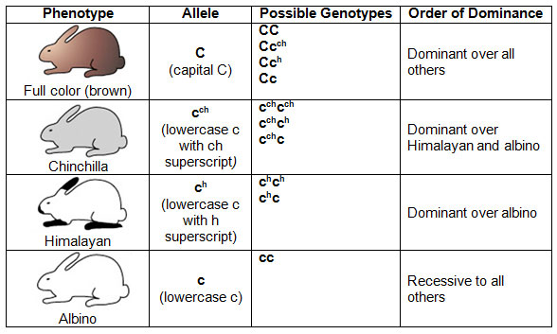
In rabbits, multiple alleles controls coat color.
C is dominant to all other alleles and causes full color (Agouti).
The chinchilla phenotype is due to the c^{ch} allele, which is dominant to all alleles except C.
The Himalayan coat color c^{h} allele for is dominant only to c (albino).
Thus, the order of dominance is C > c^{ch} > c^{h} >c.

Slide 12
Thank You

