Slide 1
ASEXUAL REPRODUCTION
LAYERING

Slide 2
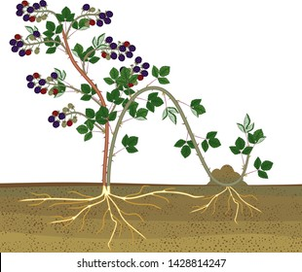
Layering
It is a technique of propagation in which a portion of plant is forced to produce adventitious root while it still remains attached to mother plant.

Slide 3
Types of layering
Simple layering
Compound/ serpentine layering
Trench Layering
Air layering
Mound/ Stool layering
Tip layering

Slide 4
Simple layering
Simple layer consists of bending an intact shoot to the ground to cause adventitious roots.
one-year-old shoot-branches of the plant
These shoots are bent and “pegged down” at a location 15 to 20 cm from the tip forming a “U”shape.

Slide 5
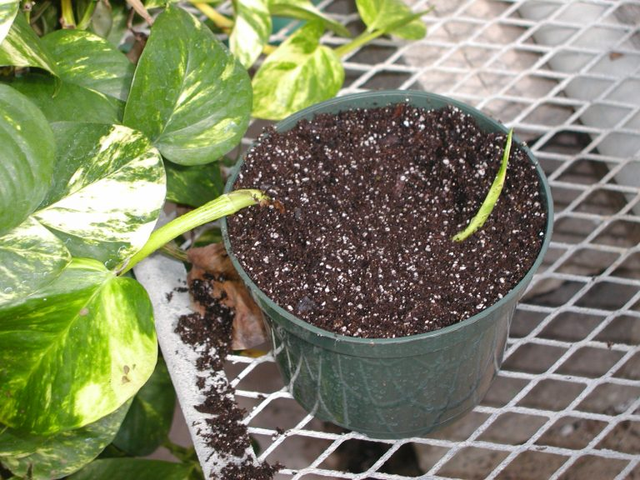
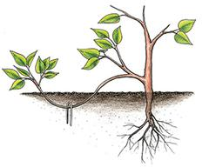

Slide 6
Serpentine layering
It is a modification of simple layering in which one-year-old branch is alternatively covered and exposed along its length.
The exposed portion of the stem should have at least one bud to develop a new shoot.
After rooting, the sections are cut and lined out in the field.

Slide 7
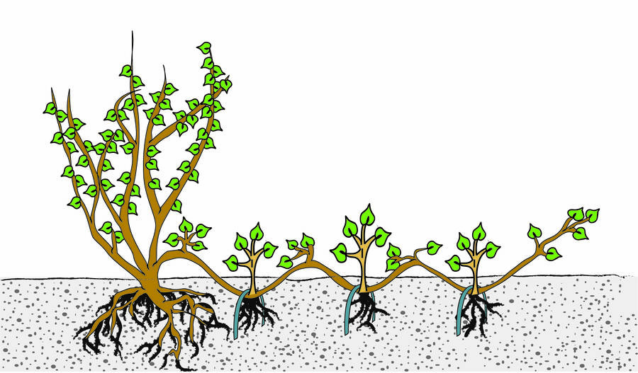
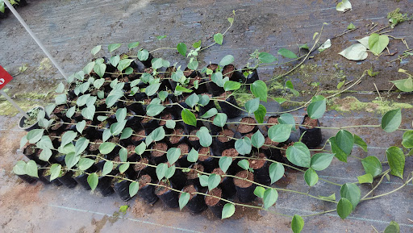

Slide 8
Trench Layering
The branch of the plant is bent downward in a horizontal position in a shallow trench.
The young shoots that arise from these plants are gradually mounded up with soil to a depth of 15-10 cm.
It is the most common method of propagation for woody plants like apple, pear and cherry.

Slide 9
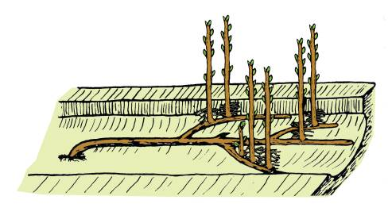
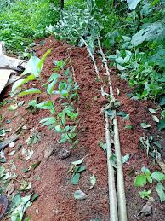
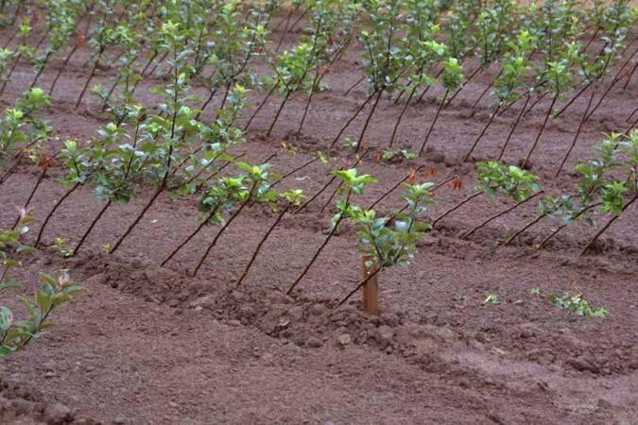

Slide 10
Air layering
It is known as Chinese layering, pot layering, Marcottage and Gootee
One year old shoot is selected.
Pencil size shoot is to be selected.
On the selected shoot, preferably on the basal portion, a ring of bark is removed and the exposed wood is scraped.
The exposed portion is further wrapped with moist inert rooting medium like Sphagnum moss, moist coir etc.
And covered with a polythene sheet making it air tight
This branch is left undisturbed on the mother plant for about 2-8 weeks depending on the species

Slide 11
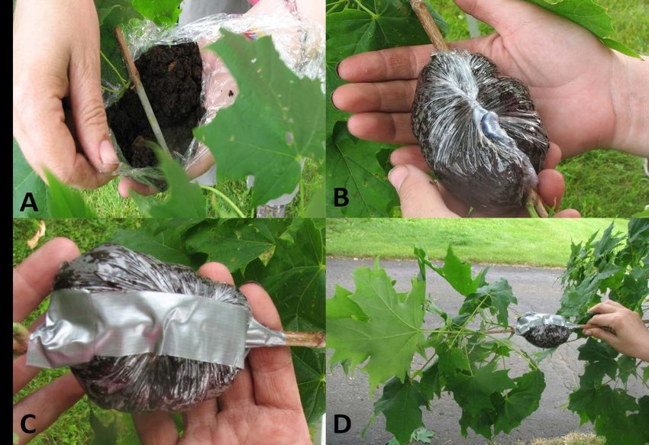

Slide 12
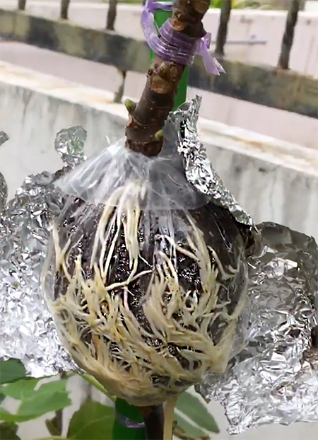
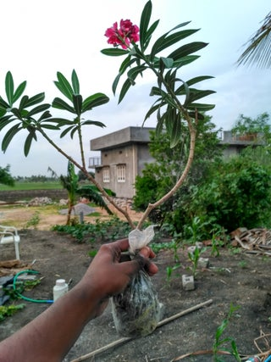

Slide 13
Mound/ Stool layering
In stooling, the mother plant is headed back to 15 to 20 cm above ground level during dormant season.
The new sprouts will arise within 2 - 4 months.
The sprouts are then girdled near the base.

Slide 14
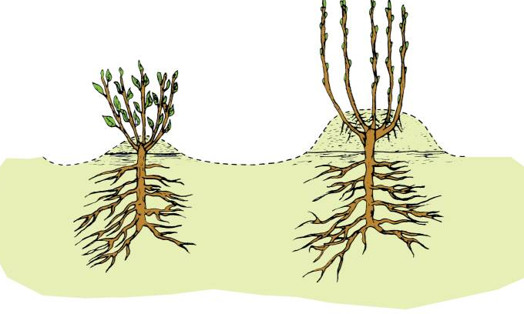

Slide 15
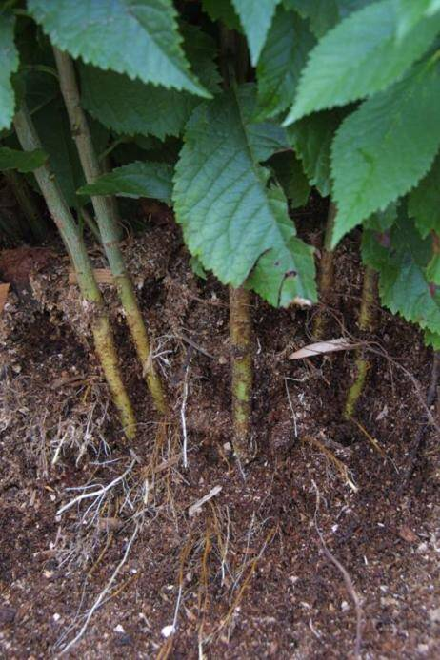
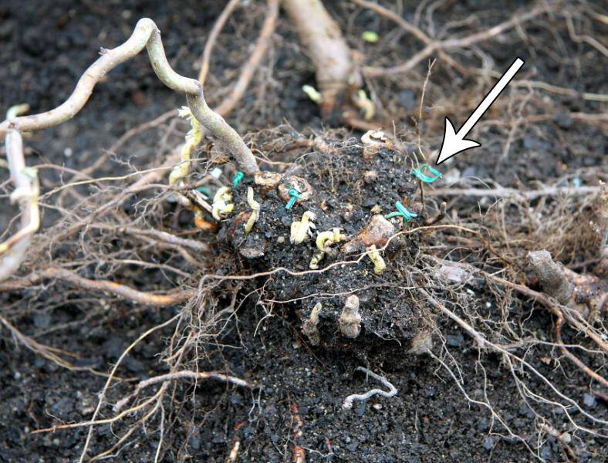
Girdling

Slide 16
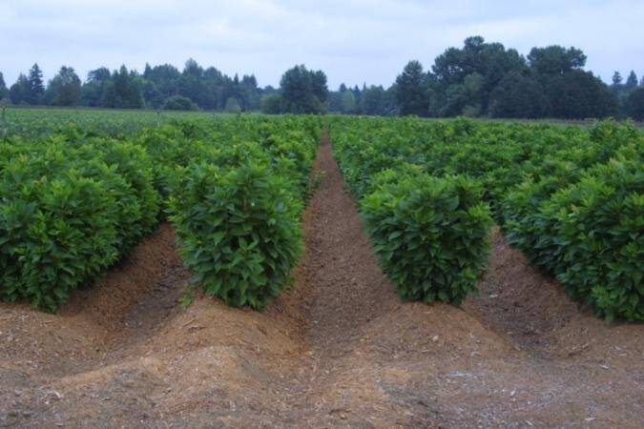

Slide 17
Tip layering
The tips of shoots are buried 2 to 5 cm deep in the soil.
Rooting in buried shoots takes place within a month.
The new plants (layers) may be detached and transplanted in the soil.
It is a natural method of propagation for black berries, raspberries etc

Slide 18
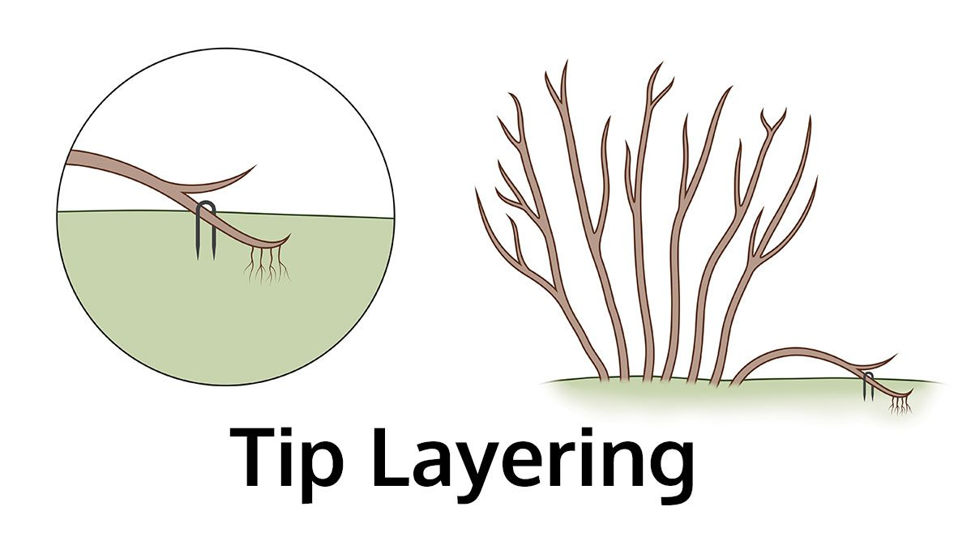
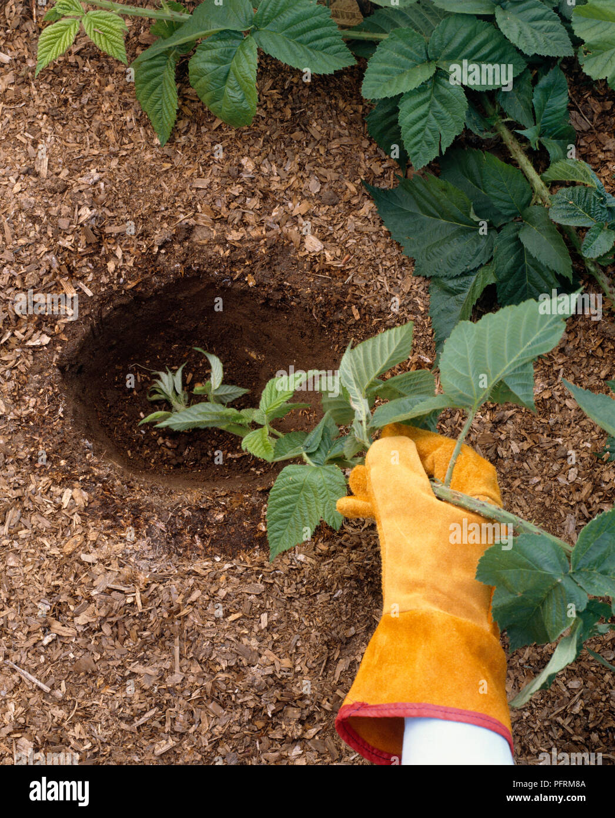

Slide 19
Thank you

