Slide 1
MAGNIFICATION

Slide 2




Slide 3
What is magnification ?
Magnification is a method of increasing the size of the image so that enough of the retina is stimulated to send an impulse through the optic nerve allowing an object to be perceived .
There are a number of different means via which this can be achieved:
Relative Size Magnification
Relative distance Magnification
Angular Magnification

Slide 4
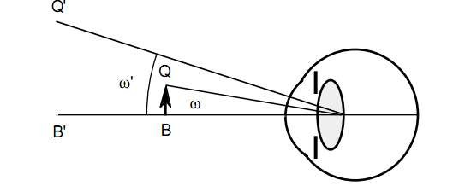
· Angular : it is the apparent size of the object compared with true size of the object seen without the device.eg.
Telescopic system
Angular magnification M = ω’/ ω

Slide 5
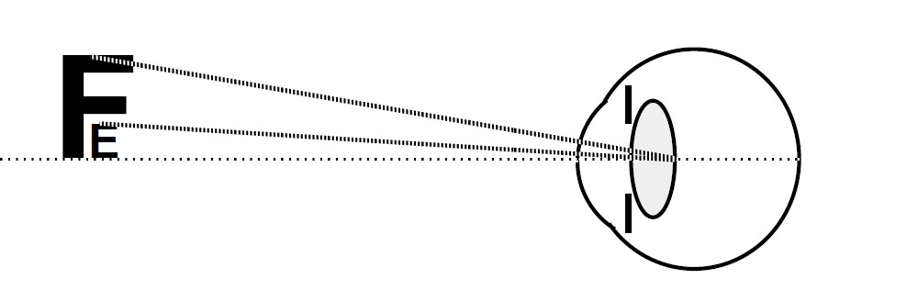
· Relative size: by making the object appear bigger (no accommodation required) eg. CCTV

Slide 6
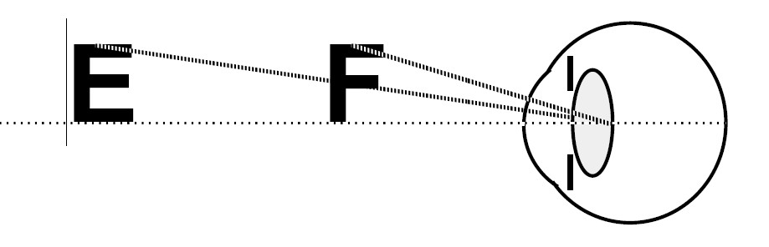
· Relative distance: by bringing the object closer (requires good accommodation) eg. magnifiers

Slide 7




Slide 8



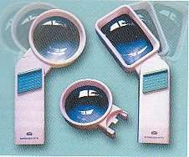
Useful for near work
Designed to be held close to the reading material to enlarge the image
The eye lens distance should be minimum to achieve larger magnification
Two types:
› Hand magnifier
› Stand magnifiers.

Slide 9
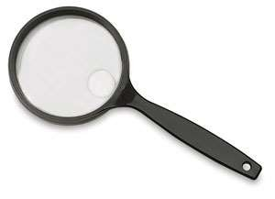


Available from + 4.0 to + 40.0 D.
Available in three designs:
› Aspheric – reduces thickness and peripheral distortion
› Aplantic – flat and wide distortion free field and good clarity
› Biaspheric – eliminating aberrations from both surfaces
· Most patients accept upto 6x magnification

Slide 10
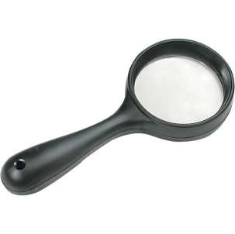
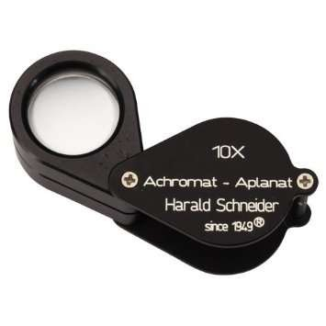
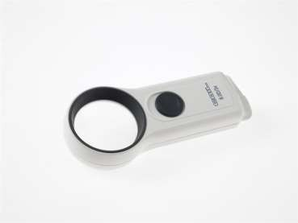
Aspheric
Aplanatic
Biaspheric

Slide 11
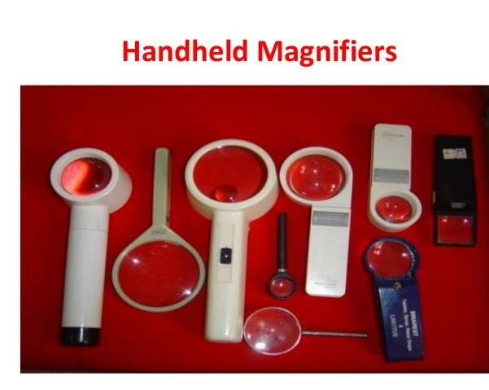


Slide 12
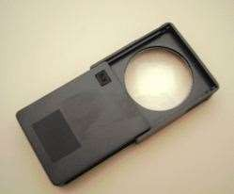
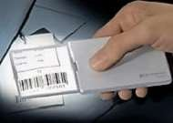
· Advantages
› The eye to lens distance can be varied
› Patient can maintain normal reading distance
› Work well with patients with eccentric viewing
› Some have light source which further enhances vision
› Easily available, over the counter
· Disadvantages:
› It occupies both hands
› Patients with tremors, arthritis etc have difficulty holding the magnifier
› Maintaining focus is a problem especially for elderly
› Field of vision is limited

Slide 13
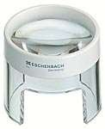


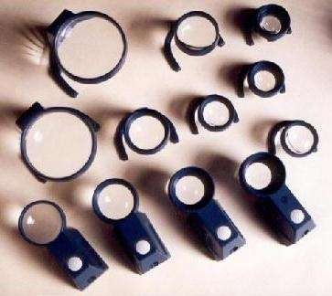
The magnifiers are stand mounted
The patient needs to place the stand magnifier on the reading material and move across the page to read
Has a fixed focus

Slide 14
Advantages :
› They are a choice for patients with tremors
› Arthritis and constricted visual fields.
Disadvantage:
› Field of vision is reduced
› Too close reading posture is uncomfortable for the patient
› Blocks good lighting unless self illuminated

Slide 15


It is a cylinder reading bar which lies flat on a page.
It elongate the letter but does not separate them

Slide 16
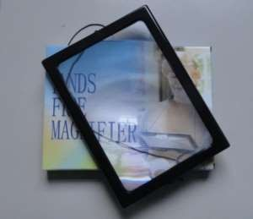
A Fresnel lens magnifier is a thin plastic in which the surface is reproduced in a series of rings or zones
It is produce in an expensive manner in almost any size.
The no. of rings per inches controls the resolution and effective magnification up to high as 19x for ophthalmic purpose

Slide 17



· Loupes are magnifying devices. A clip-on loupe attaches to glasses, and allows a person to be hands free while viewing text, the computer screen, sheet music, or hand work. Stronger loupes (over +10D, or diopters) can be used only with one eye, whereas weaker loupes can be used for both
Some advantages of clip-on loupes are:
They allow the person to retain their correction from their prescription glasses while using them. This is especially helpful if the person has strong myopia (nearsightedness) or astigmatism.
Your hands are free—not needing to hold a magnifier.
They are convenient and easy to use—flip them up when not using them, bring them down in front of your glasses when you are using them.
They are inexpensive.

Slide 18
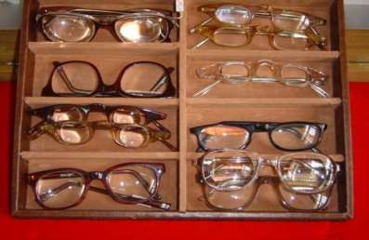

High plus reading glasses to magnify the images
Given as an add to the best distance refraction
Reading distance is calculated by 100 divided by add
Magnification is 1/4th the power of the lens.
Used for near work
Amount of add needed depends on the accommodation and the reading distance

Slide 19
i.e. the amount of add needed to read 1M print is the
inverse of the visual acuity fraction.
· Reading add can be predicted using the Kestenbaum rule
However usually greater add is required than predicted as the patient also has reduced contrast sensitivity
If the patient is monocular, the poorer eye may be occluded if it improves the functioning
When binocular corrections are needed :
  Base in prisms are added to compensate for convergence angle.
  Optical center may be decent red
Aspheric lenses may be used to reduce lenticular distortion

Slide 20
· Advantages :
› Hands are free
› Field of view larger when compared to telescope
› Greater reading speed
› Can be given in both monocular and binocular forms
› More portable
› Cosmetically acceptable
· Disadvantages:
› Higher the power, closer the reading distance
› Close reading distance causes fatigue and unacceptable posture
› Patients with eccentric fixation are unable to fix through these glasses

Slide 21

· Telemicroscopic glasses are telescopes that are adapted and made for tasks at near, rather than at distance, like most telescopes. They are available in many different designs. Telemicroscopic glasses, in contrast to strong magnifying reading glasses, allow a more comfortable working distance when reading, using the computer, seeing sheet music, doing hand work, playing cards, and other tasks.
Some advantages of telemicroscopic glasses are:
They provide a more comfortable working distance than magnifying
reading glasses or clip-on loupes.
Your hands are free—not needing to hold a magnifier.
They usually have excellent optics, and provide an image that is very crisp.

Slide 22




Slide 23
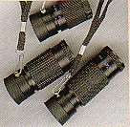


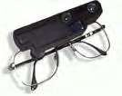
· Work on the principle of angular magnification
Telescopes with magnification power from 2x to 10x are prescribed
They can be prescribed for near, intermediate and distant tasks
Field of view decreases with magnification
Types:
› Hand held monocular
› Clip on design
› Bioptic design: mounted on a pair of eyeglasses

Slide 24
· Principal
› Telescopes consist of two lenses (in practice two optical systems) mounted such that the focal point of the objective coincides with the focal point of the ocular.
› Objective lens is a converging lens
Galilean telescope | Keplerian telescope
The eye piece is a negative lens and the objective is a positive lens | Both eye piece and objective are positive lens
Resultant image is virtual and erect | Resultant image is real and inverted. Prisms are incorporated to erect the image
Loss of light reduces brightness of the image | Loss of light is more in this system
Field quality is poor | Field quality is relatively good

Slide 25
Magnification of a telescope is given by the formula M = f_{o}/f_{e}
Telescopes can be used to focus near objects by
› changing the distance between objective and ocular lens
› Increasing the power of the objective lens

Slide 26



Objective
Eye piece
a
β f_{o}
f_{e}

Slide 27

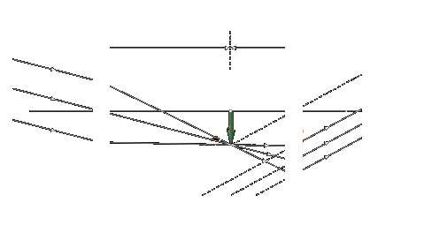
Objective
Eyepiec
α
β

Slide 28
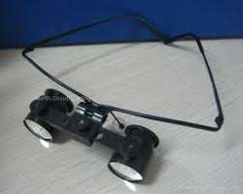
Advantages:
› Only possible device to enhance distant vision
Disadvantage:
› Restriction of the field of view
› Appearance and apprehension
› Expensive and costly
› Depth perception is distorted

Slide 29



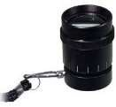
· A hand-held telescope is called a telescopic "monocular," because it is used with one eye and has a single eyepiece. Generally, it is used for short viewing periods, such as reading a street sign, house number, menu board in the restaurant, aisle number in the grocery store, or white board in school. Some people may also use it for tasks that are fairly close, such as reading the bathroom scale, or a price on a shelf in the grocery store.
Some advantages:
They can be very helpful for viewing a wide range of items at distance, and
even some things fairly close up.
They are fairly inexpensive and are portable.
They are available in a range of magnification powers.
They can be kept on a cord around your neck, in a pocket, or purse, for use when desired for "spot" viewing, such as reading street signs outdoors or aisle numbers in a store.

Slide 30
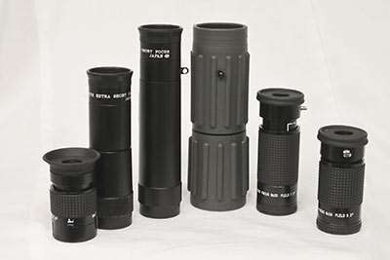
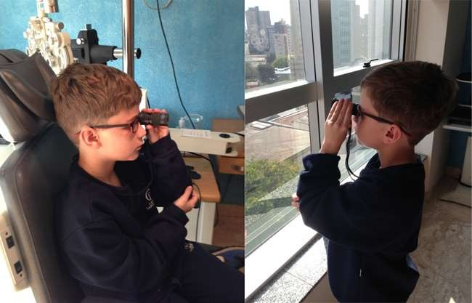

Slide 31



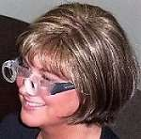
· Spectacle-mounted telescopes are permanently attached to the lens of your eyeglasses.
Some advantages:
They leave both hands free, as opposed a monocular telescope.
Therefore, they can be used for longer viewing periods, like viewing television, a program, ball game, or movie, as opposed to a monocular, which can be tiring to hold and difficult to hold steady.
They appear to bring things closer and magnify things nicely.
They can be binocular (for both eyes) or monocular (for one eye).
They are available in a range of magnification powers.

Slide 32



Bioptic telescopic glasses are a type of spectacle- mounted telescopic glasses. They are mounted in the upper part of eyeglass lenses.
Bioptic telescopes in place on eyeglass lenses
This placement allows the user to look through the bottom half of the lens while seeing most items at distance, and looking through the telescopes at the top of the glasses to see a magnified image.
Some states, under strictly specified conditions, allow some persons with low vision to use bioptic telescopes for driving.
In states where this is not legal, some persons with low vision use bioptic telescopes for reading, doing hand work, or other tasks.

Slide 33

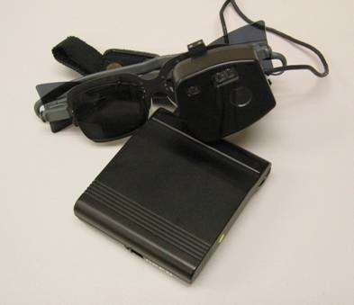
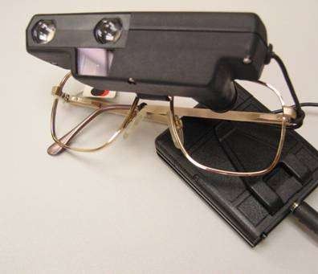
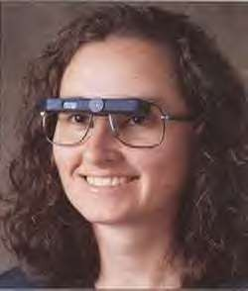

Slide 34
· It allows 3.5X magnification for distance and 4.7X for
reading. It focuses automatically from near to far.
It is more costly
It does not constitute the first choice prescription for
children.

Slide 35
Various forms are available
  Powers usually available are +4.0,
+12.0, +16.0, 20.0 and +24.0
+5.0, +6.0, +10.0 ,
2. Binocular corrections are needed –Base in prisms are
added to compensate for convergence angle.
Optical quality of the lens should be an aspheric design to eliminate peripheral aberration and provide reasonable field.
The reading glass should be prescribed as an addition over the distance correction.

Slide 36
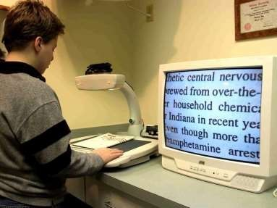
· Closed circuit television system-CCTV
› Provides projection magnification along with RDM
› Provides magnified image projected onto a monitor screen.

Slide 37

· An electronic magnification system for reading & writing
Incorporates both projection & RDM
consists of three major components:
·
camera monitor
movable reading platform
· Best for pt. Having constricted VF, decreased VA decreased contrast sensitivity secondary to glaucoma, RP, ION.

