Slide 1
LEAF SPOT OF MAIZE
ECONOMIC IMPORTANCE
In Andhra Pradesh, it is severe in the districts of Warangal, Karimnagar, Medak,Nizamabad, Adilabad and Ranga Reddy.
SYMPTOMS
Disease is characterized by long elliptical grayish green or tan lesions on the leaves measuring 2.5 to 25 cm in length and upto 4 cm in width.
The fungus affects the maize plant at young stage. Small yellowish round to oval spots are seen on the leaves.
The spots gradually increase in area into bigger elliptical spots and are straw to grayish brown colour in the centre with dark brown margins.
The spots coalesce to form bigger spots and gives blighted appearance.
The surface is covered with olive green velvety masses of conidia and conidiophores.
Under high humidity the whole leaf area becomes necrotic and plant appears as dead. Lesions may be extended to husk.

Slide 2
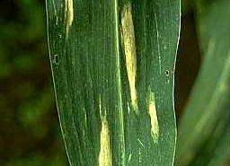
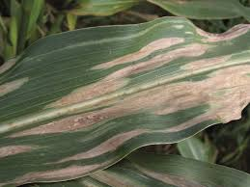
LEAF SPOT OF MAIZE

Slide 3
PATHOGEN: IMPERFECT STAGE: Helminthosporium turcicum (Syn : H. Maydis)
(Sub-division-Deuteromycotina,Order-Moniliales,Family-Moniliaceae)
PERFECT STAGE:Trichometasphaeria turcica
Conidiophores are in group, geniculate, mid dark brown, pale near the apex and smooth.
Conidia are distinctly curved, fusiform, and pale to golden brown with 5-11 pseudosepta.
DISEASE CYCLE
Fungus survives in plant debris, seed and collateral hosts.
The fungus is externally seed borne.
It also infects Sudan grass, Johnson grass, sorghum, wheat, barley, oats, sugarcane and spores of the fungus are also found to associate with seeds of green gram, black gram, cowpea.
Secondary spread is through wind borne conidia.
FAVOURABLE CONDITIONS
Optimum temperature for the germination of conidia is 18 to 27OC provided with free water on the leaf.
Infection takes place early in the wet season.
MANAGEMENT
Crop rotation
Grow resistant hybrids like DHM-1
Treat the seeds with Captan or Thiram at 4 g/kg
Spray Mancozeb@0.25%

Slide 4
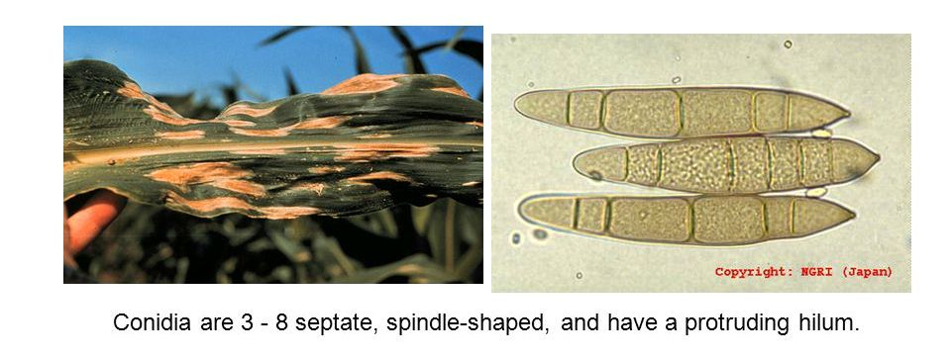
SYMPTOM AND CONIDIA OF HELMINTHOSPORIUM TURCICUM

Slide 5
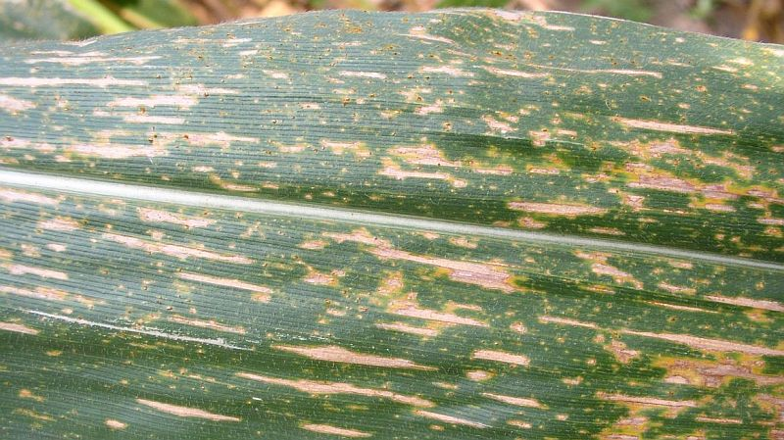
SOURTHEN LEAF SPOT

Slide 6
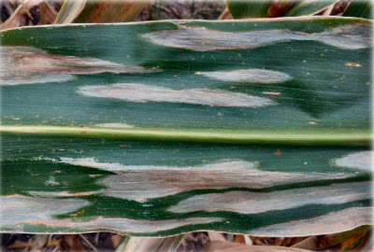
NORTHEN LEAF SPOT

Slide 7
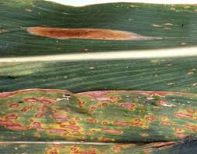
COMPARISION SOURTHEN AND NORTHEN LEAF BLIGHT OF MAIZE

