Slide 1
Factors affecting primary productivity

Slide 2
Primary production

Slide 3
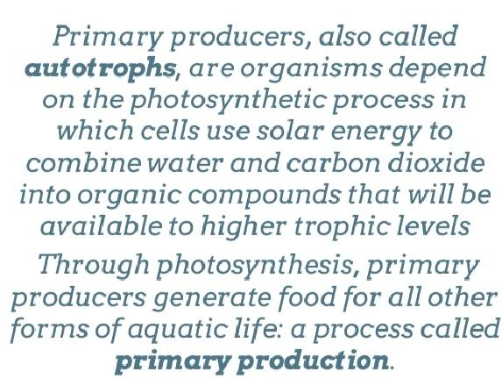

Slide 7
Primary productivity

Slide 12
Factors affecting primary productivity
Water
Sunlight
Temperature
Nutrient
Organic substance
Salinity
Grazing

Slide 13
LIGHT
Photosynthesis is directly proportional to light intensity of solar radiation.
About 80% incident visible light reaches 120m depth in a clear offshore waters and 10-20 m in turbid inshore waters.
Of the incident light that falls on the surface of the sea only 0.02 to 2% of light will be used by most plants.
Light inhibition occurred at light greater than saturation levels.
Photoinhibition :Photoinhibition has been defined as the inhibition of photosynthesis caused by excessive radiance; it may damage the photosynthetic apparatus, causing the (photo)destruction of the photosynthesizing pigments.
Photoadaptation :Photoadaptation is the adaptation of phytoplanktons to suitable light intensities.

Slide 14
Solar radiation attenuates with depth (as a function of particulate and dissolved materials) so that there is delimited zone where phytoplankton photosynthesis can occur-the euphotic zone.
Plant growth or occurs when photosynthesis exceeds respiration.
The depth at which photosynthesis and respiration equal is called compensation depth (CD).
Below the CD there is no net production even though photosynthesis still occurs; the CD varies with incident radiation and transparency.
The area above the CD is aften referred to as euphotic zone with an average depth of 80 m (varied between-0-100m depending upon the suspended particles matter load.

Slide 15
TEMPERATURE
It is known that many algal species have increased gross primary productivity (GPP) at higher temperatures , but net primary productivity (NPP) can be affected by different light environments and larger increases in respiration rates.
Metabolic processes such as primary productivity and respiration typically increase with temperature, known as the Q10 effect (the rate of change in processes over 10°C).
Metabolic processes are enhanced by rising temperature, and usually double with every 10°C rise in temperature (i.e., have a Q10 of 2).
At very high light intensities, photoinhibition can be intensified with rising temperatures, resulting in a large decline in photosynthesis.

Slide 16
SALINITY
Salinity is the main factor for the process of giving life to plants and can cause retardation of central metabolic activities such as photosynthesis .
Microalgae differ in their adaptability to salinity and based on their tolerance as they are grouped as halophilic and halotolerant.
Species richness is decreased with increasing salinity.
As water becomes more salty its ability to hold oxygen decreases.

Slide 17
NUTRIENTS
The principle limiting nutrients in the aquatic environments are nitrogen, phosphorus and silicon(marine).
It is generally seen that if their concentration is low, phytoplankton cannot increase their biomass and photosynthesis remains low.
On the other hand, when nutrient concentration increases (eg., due to agricultural run off in coastal areas or upwelling effect) total photosynthesis and therefore phytoplankton bloom will increase.
Silicon is a nutrient only for specific plankton taxa-diatoms (autotrophic phytoplankton), silicoflaggellates, and radiolaria (heterotrophic zooplankton) — which use it to make hard parts.

Slide 18
MINOR NUTRIENTS
Minor nutrients such as Fe, Mn, Cu, Zn, vanadium, cobalt and molybdenum are known to limit primary production.
Lower concentration of Iron is known to limit plant growth particularly in Neritic waters.
Neritic species such as Skeletonema costatum requires high concentrations iron along with PO4 and NO3
Calcium, magnesium, potassium, sodium ions are required by plants in trace quantities.
These elements will help to keep ionic regulation of cells and the formation of hard parts, enzymatic activity etc.

Slide 19
ORGANIC SUBSTANCES
Organic substances are known to influence the plant growth.
Organic substances such as carbohydrates, amino acids, fatty acids, organic acids, vitamins are present at lower concentration in the sea waters.
Organic substance is mainly produced by decomposition and excretion of organisms.
Diatoms, coccolithophorids and dinoflagellats, bacteria, fungi etc, present below the euphotic zone can utilize dissolved organic matter in the water.
Some algae can utilize organic carbon such as glucose and lactate.
Some diatoms, flagellates can utilize nitrogen as aminoacid, urea, uric acid etc.

Slide 20
GRAZING
The microzooplankton effectively graze these phytoplanktons , preventing their biomass from accumulating and sinking directly.

Slide 21
REFERENCE
https://www.nature.com/scitable/knowledge/library/the-biological-productivity-of-the-ocean-70631104/
http://ecoursesonline.iasri.res.in/course/view.php?id=582
https://sciencing.com/factors-affecting-primary-productivity-13659267.html
https://www.tandfonline.com/doi/pdf/10.1080/07438148409354524
https://www.ncbi.nlm.nih.gov/pmc/articles/PMC3772813/
https://course-notes.org/print/12970

