Slide 1
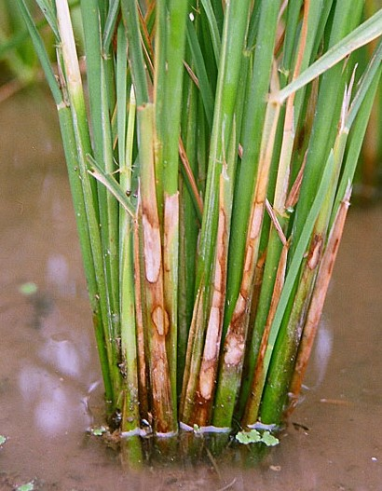
Sheath blight disease
This is a fungal disease
Symptoms
The fungus causes spots or lesions mostly on leaf sheaths and leaf blades.
Firstly the spots are greenish grey, ellipsoid or ovoid and then the spots enlarge and become greyish white with brown margins and irregular in outline.
In advanced stage brown sclerotia are
formed on the spots
Eventually the whole sheath rots,
leafs become totally blighted and the
plant dies

Slide 2
Etiology
Rhizoctonia solani (Sub-division: Deuteromycotina)
Sexual stage: Thanatephorus cucumeris
Disease cycle
Primary infection – Sclerotia present in the soil
Secondary infection – sclerotia floating in the irrigation water and infecting the plants
Epidemiology
High relative humidity (96-97 %), and warm temperature (30-32 ⁰C)
Closer planting and heavy doses of nitrogenous fertilizers.

Slide 3
Management
Avoid excess doses of fertilizers and adopt optimum spacing.
Elimination of weed hosts.
Avoid flow of irrigation water from infected fields to healthy fields.
Deep ploughing in summer and burning of stubbles.
Grow disease tolerant varieties
Application of Validamycin @0.2%
Seed treatment with Pseudomonas fluorescens @ 10g/kg of seed
Soil application of P. fluorescens @ of 2.5 kg/ha after 30 days of transplanting .

Slide 4
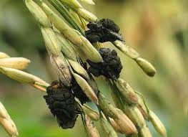
False smut of rice
This is a fungal disease
First reported from Tamil Nadu but is mainly prevalent in east Indian states
Symptoms
The fungus transforms individual grains into greenish spore balls of velvety appearance which are small at first and become longer at later stages.
Only a few grains in a ear are affected
The glumes are covered superficially with the green mass of spores
At early stages the spore balls are covered by a membrane which bursts with further growth

Slide 5
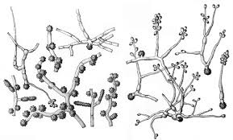
Causal organism
Ustilaginoidea virens (Subdivision- Deuteromycotina)
P.S: Claviceps oryzae - sativa (Ascomycotina)
Rough, olive green conidiospores are formed laterally or terminally on short sterigmata on hyphae
They germinate to give pear shaped secondary conidia
Sclerotia forms as the survival structure

Slide 6
Disease Cycle
Primary infection – Sclerotia overwintering in soil
Secondary infection – Air borne Chlamydospores
Favourable Condition
Rainfall and cloudy weather during the flowering and maturity periods of the grains favours disease incidence.
Management
Seed disinfection with copper oxychloride reduces disease incidence
Application of Carbendazim + Mancozeb @0.2% at panicle emergence stage

