Slide 1
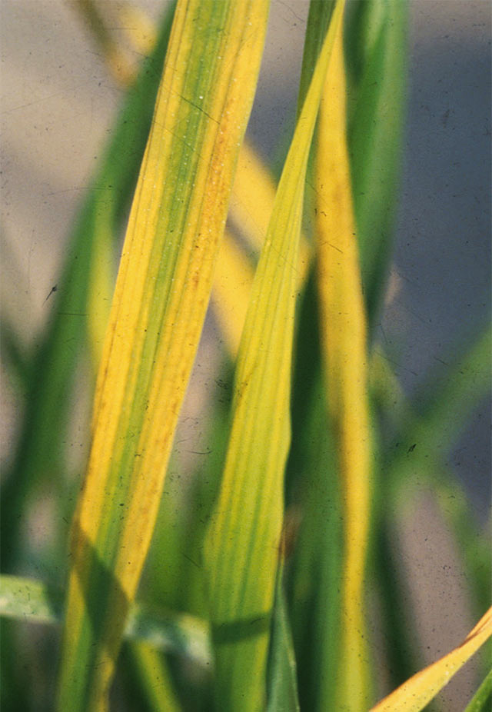
Rice Tungro disease
This is a viral disease
Symptoms
Stunting of the plants occur with reduced tillering
Discoloration of leaves from yellow to orange color and rusty spots spreading from leaf tip to downwards
Young leaves become mottled and slightly twisted while old leaves become rusty colored
In severe infection in early stages the plant dies before flowering

Slide 2
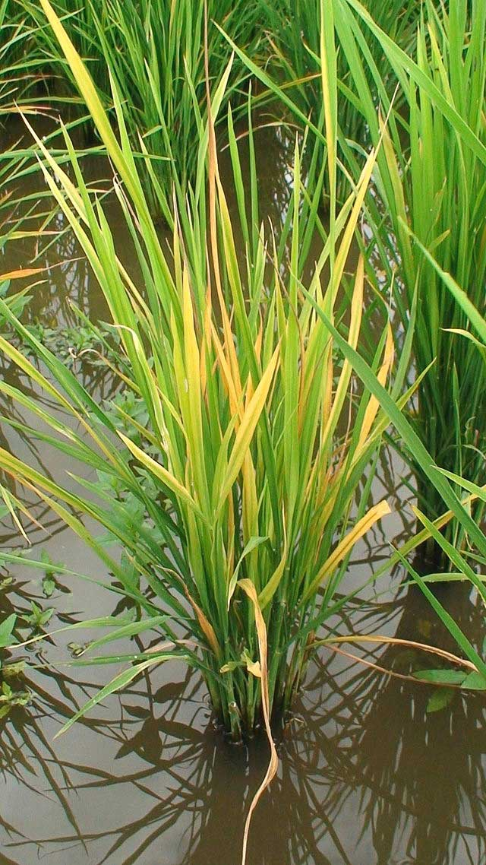

Slide 3
Causal organism
Rice Tungro Bacilliform Virus (RTBV) and Rice Tungro Spherical Virus (RTSV)
RTBV contains ds DNA and RTSV contains ssRNA
Disease Cycle
Primary infection – virus surviving in collateral hosts (Eleusine indica, Echinochloa colonum, Echinochloa crusgalli)
Secondary infection – carried by leafhoppers, the most efficient being Nephotettix virescens. Other vectors are N. nigropictus, N. parvus, N.malayanus transmit the virus

Slide 4
Management
Destroy weed hosts of the virus and vectors.
Grow disease tolerant cultivars like MTU 9992, 1002, 1003, 1005, Suraksha, Vikramarya, Bharani, IR 36, IET 2508, RP 4-14, IET 1444, IR50 and Co45.
Control the vectors in the nursery by application of carbofuran granules @10kg/ac in main field
Spray Dimethoate @ 0.2% in the main field 15 and 30 days after transplanting to control leaf hoppers.

Slide 5
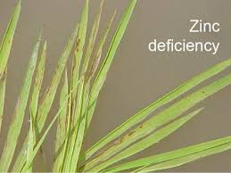
Khaira disease

