Slide 1
ANTHRACNOSE OR RED LEAF SPOT
OF SORGHUM
ECONOMIC IMPORTANCE
This is wide spread and prevalent in all sorghum growing areas.
In India anthracnose is severe in Andhra Pradesh, Madhya Pradesh, Rajasthan, Tamil Nadu and Delhi.
SYMPTOMS
The fungus causes both leaf spot (anthracnose) and stalk rot (red rot) in sorghum.
The disease appears as small red coloured spots on both surfaces of the leaf.
The centre of the spot is white in colour encircled by red, purple or brown margin.
Numerous small black dots are seen on the white surface of the lesions which are the fruiting bodies (acervuli) of the fungus.
Many lesions coalesce and kill large leaf portions.
In midrib region, elongate elliptical, red or purple regions with black acervuli are formed.
Stalk and inflorescence infection can be characterized externally by the development of circular cankers.
Infected stem when split open shows discoloration, which may be continuous over a large area or more generally discontinuous giving the stem a marbled appearance.
The stem lesion also shows acervuli.

Slide 2
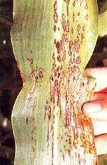
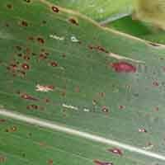
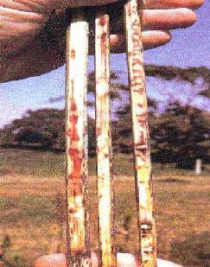
SYMPTOMS
ANTHRACNOSE LEAF SPOT ON SORGHUM LEAF
STALK ROT

Slide 3
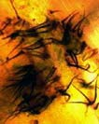
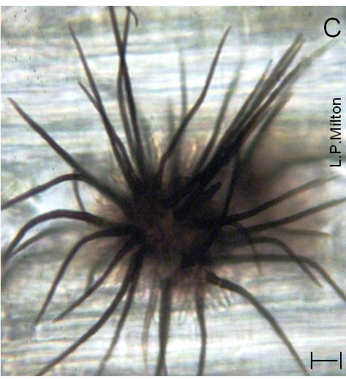
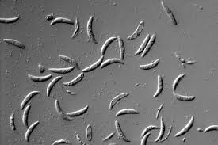
PAHOGEN
BLACK ACERVULI
FALCATE CONIDIA

Slide 4
ETIOLOGY
CAUSAL ORGANISIM:Colletotrichum graminicola
The mycelium of the fungus is localized in the spot.
Acervuli with long dark setae arise through epidermis.
The conidiophores are short, single celled and colourless.
Conidia are short, hyaline, single celled, vacuolate and falcate in shape.
DISEASE CYCLE
Fungus has wide host range and survives on Johnson grass, Sudan grass, maize, barley and wheat.
Also survives in seed and infected plant debris.
Primary infection is from the conidia produced on the infected plant debris and infected seed.
Disease spread within the season is through air borne conidia, which are produced on first infected plants.
FAVOURABLE CONDITIONS
Continuous rain, temperature of 28-300C and high humidity aggravates the disease.
MANAGEMENT
Destruction of infected plant debris and collateral hosts.
Crop rotation with non-host crops.
Grow resistant varieties like SPV 162, CSV 17, Texas Milo and Tift sudan etc.
Treat the seeds with Captan or Thiram @3 g/kg.
Spray the crop with Mancozeb @0.25% or carbendazim@0.1%

