Slide 1
Motor
ELECTRICAL ENERGY
Mechanical Energy

Slide 2
Synchronous Motor
Synchronous Motor-Intro
Synchronous Motor-principle
Changing the Load
Starting Torque
Improvement of starting torque
Synchronous Machine Construction
V curves
Torque versus Speed
Summary

Slide 3
Synchronous Motor- Intro
The synchronous motor rotates at the synchronous speed i.e. the speed of the RMF.
Stator is similar in construction to that of an induction motor, so same principle is applied to the synchronous motor rotor.
Field excitation is provided on the rotor by either permanent or electromagnets with number of poles equal to the poles of the RMF caused by stator

Slide 4
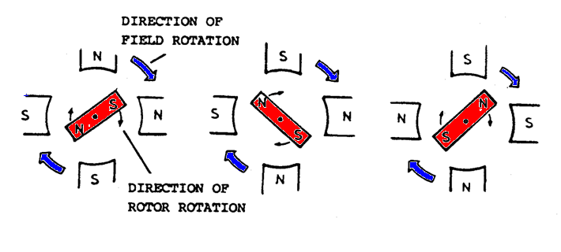
Synchronous Motor-Principle
The rotor acting as a bar magnet will turn to line up with the rotating magnet field. The rotor gets locked to the RMF and rotates unlike induction motor at synchronous speed under all load condition

Slide 5
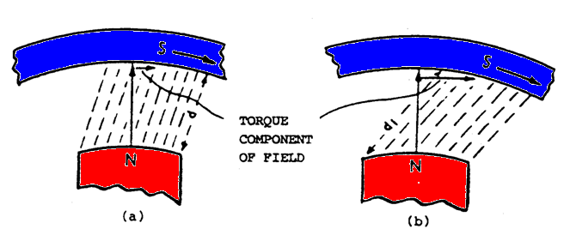
Changing The Load
An increase in the load will cause the rotor to lag the stator field but still maintain synchronous speed. Increase in load has increased the torque component, but the field strength has decreased due to the increase in length of the air gap between the rotor and the stator.
If the synchronous motor is overloaded it pulls out of synchronism and comes to rest. The minimum amount of torque which causes this is called the “ pull out torque”.
Lightly loaded motor
Heavily loaded motor

Slide 6
Starting Torque
It cannot be started from a standstill by applying ac to the stator. When ac is applied to the stator a high speed RMF appears around the stator. This RMF rushes past the rotor poles so quickly that the rotor is unable to get started. It is attracted first in one direction and then in the other and hence no starting torque.

Slide 7
Improvement of starting torque
It is started by using a squirrel cage within a rotor construction and therefore starts as an induction motor.
At synchronous speed the squirrel cage has no part to play.

Slide 8
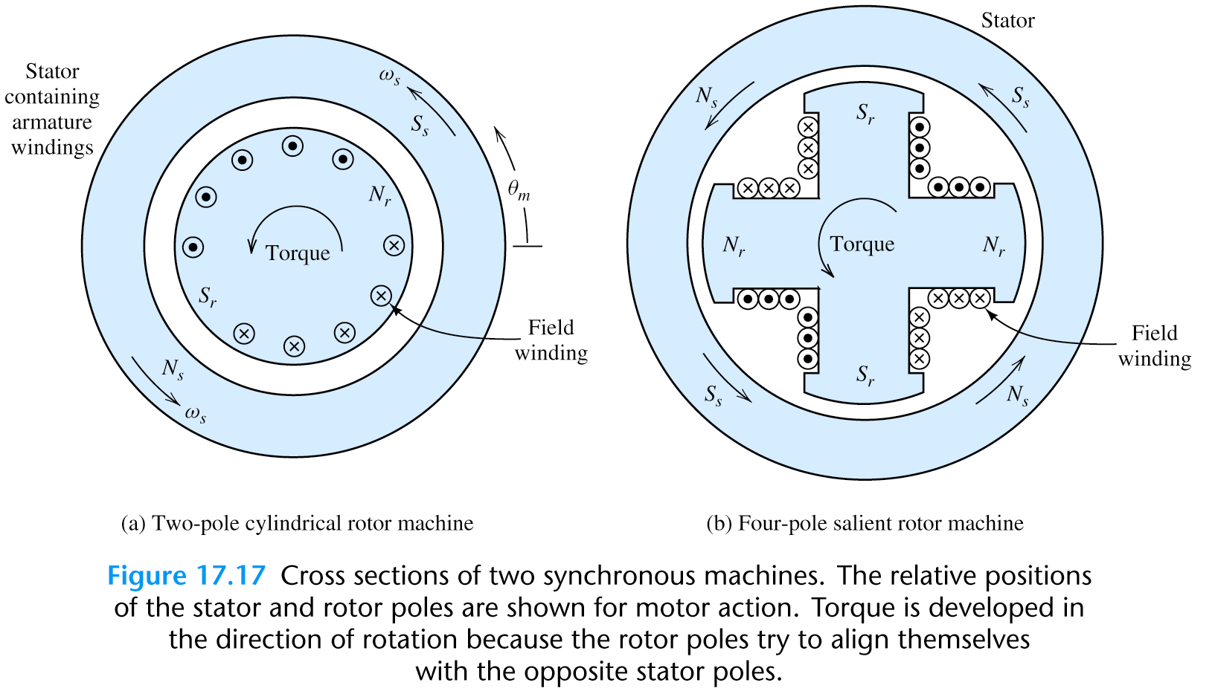
Synchronous Machine Construction

Slide 9
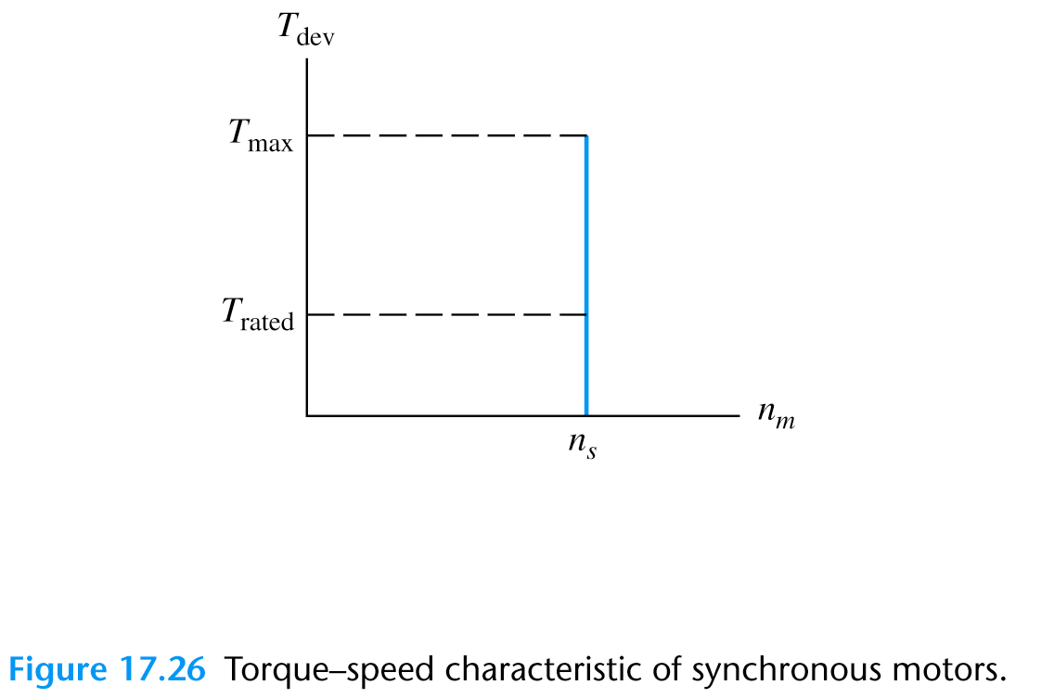
Torque versus Speed

Slide 10
Summary
The synchronous motor:
requires to be started by an external prime mover.
Runs only at synchronous speed, this is an advantage where continuous speed is required but a disadvantage where a variable speed is required.
Can be used to adjust the power factor of a system at the same time it is driving a mechanical load.

Slide 11
Maintenance Practices-A.C. Motors
Clean, but don’t forget to inspect before and after cleaning
Check electrical connections for security, the insulation to be in satisfactory condition.
Examine for signs of over heating
Check that the motor is secure
Do an audible check
Ensure that the motor is not over heating when operating, a rule of thumb is that if it is too hot for the hand, it is too high.
When replacing a motor always ensure that the load, valve has not seized.
Also ensure that the motor operates in the correct direction
End of Motors

