Slide 1

Industrial IoT and Automation

Slide 2
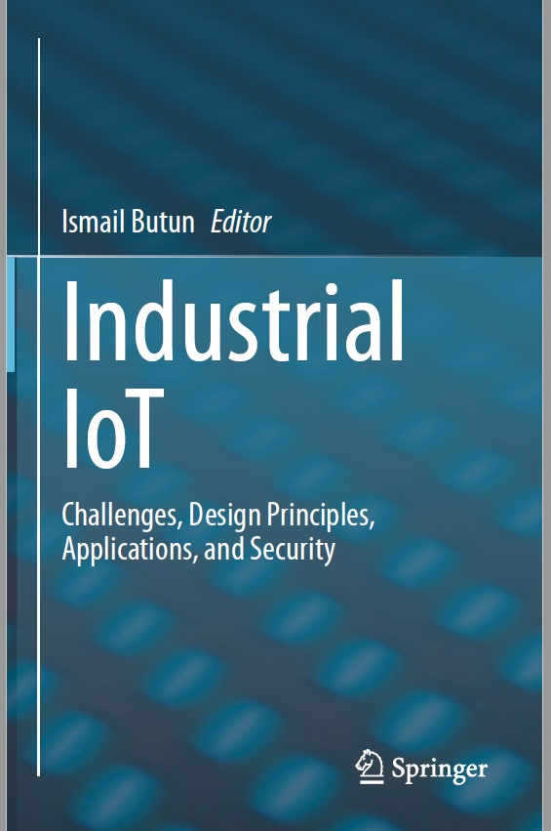
Reference Book
Reference Book
We are all living in a connected world and Cisco predicts 500 Billion things of the IoT to be further included in this connection; meaning more automation, remote access and control to be infused in our everyday routines.
This book, “Industrial IoT: Challenges, Design Principles, Applications, and Security,” aims at presenting the recent developments in the fields of industrial networks, IoT, and IIoT domains.
Since readers of this book are likely to come from various backgrounds, being aware of the implicit structure of this book might be helpful.

Slide 3
What’s inside this Book
The contributed chapters in this book cover a broad range of topics related to IIoT networks, including wired/wireless communication technologies, industrial applications, cyber-security, and intrusion detection.
The book consists of three parts and six chapters, which I find a convenient way of presenting the overall material:
We will start with introduction of preliminaries, design principles, and challenges of the IIoT.
Chapter 1 introduces an overview of most of the networking, communication, and ICT technologies available in the industrial networks,
whereas Chap. 2 presents wireless communication technologies that apply to IIoT and also discussed their unique challenges.

Slide 4
What’s inside this Book
Chaps. 3 and 4 to introduce automation trends and applications of IIoT.
Chapter 3 is dedicated to IoT-driven advances in industrial and commercial smart buildings, especially new advances at IoT-based industrial indoor/outdoor lighting systems.
Chapter 4 introduces the automation trends in industrial networks and IIoT, including the most famous digital twin concept.

Slide 5
What’s inside this Book
Chaps. 5 and 6 to stress on the cyber-security of IIoT.
Chapter 5 presents the security of IIoT networks, especially within the decentralized
cloud computing settings of the IIoT.
Chap. 6 concludes Part III and the book by stressing on the detection of intrusions with data streaming concept.

Slide 6
Industrial Networks and IIoT: Now and Future Trends

Slide 7
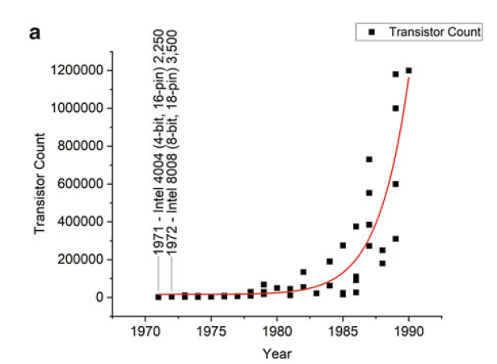
Introduction
Figure 1: Shows transistor counts in microprocessors by date between (a) 1971–1990

Slide 8
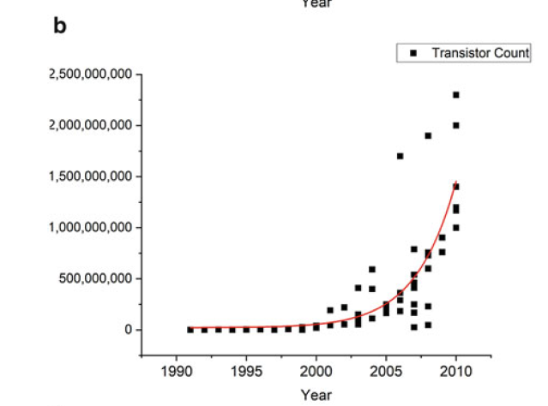
Introduction
Figure 2: Shows transistor counts in microprocessors by date between (b) 1991–2010

Slide 9
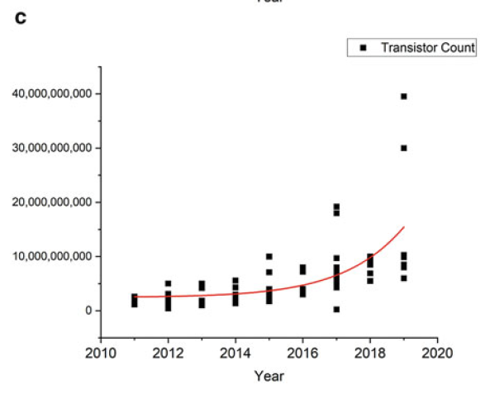
Introduction
Figure 3: Shows transistor counts in microprocessors by date between (c) 2010–2019

Slide 10
What’s the Industrial IoT?
Industrial IoT is nothing but IoT used in the Industrial Environment.
First came steam and the first machines that mechanized some of the work our ancestors did.
Next was electricity, the assembly line and the birth of mass production.
The third era of industry came about with the advent of computers and the beginnings of automation, when robots and machines began to replace human workers on those assembly lines.

Slide 11
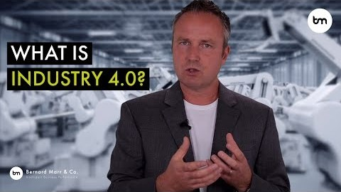
What’s the Industrial IoT?

Slide 12
Industrial Networks and IIoT
Industry 4.0 revolution can be summarized with one word: ‘Connectivity’.
Connectivity will enable intelligent production with the proliferation of IIoT, cloud and big
data.
Smart devices can collect various data about
indoor location,
outdoor position,
status information,
usage patterns of the clients, etc.
They have the ability not only in gathering information, but also sharing the information amongst intended peers.
This will be beneficial in building an efficient manufacturing process in industrial environments and also in helping with the planned preventative maintenance on machinery.

Slide 13
Industrial Networks and IIoT
The other benefit is in identifying errors in the production pipeline as quickly as possible since it is an important factor to reduce the production and maintenance costs.
Industry 4.0 is also focusing on optimization problems in the industry by using smart devices to utilize data-driven services.
Industry 4.0 and IIoT are used for
complex task sharing,
decision making based on collected data,
remote access to machinery.
Massive connectivity of the things and data collection/sharing capability of those promotes security to be a major requirement for the IIoT and Industry 4.0 concepts.

Slide 14
Industrial Networks and IIoT
But as with any major shift, there are challenges inherent in adopting an Industry 4.0 model:
Data security issues are greatly increased by integrating new systems and more access to those systems. Additionally, proprietary production knowledge becomes an IT security problem as well.
A high degree of reliability and stability are needed for successful cyber-physical communication that can be difficult to achieve and maintain.
Maintaining the integrity of the production process with less human oversight could become a barrier.
Loss of high-paying human jobs is always a concern when new automations are introduced.
And avoiding technical problems that could cause expensive production outages is always a concern.

