Slide 1

Industrial IoT and Automation

Slide 2
Enabling Technologies for Industrial Networks
Thoroughly describes most (if not all) of the enabling technologies for Industrial and IIoT Networks:
  DNP3 (Distributed Network Protocol-3),
  V2V (Vehicle-to-Vehicle),
  V2X (Vehicle-to-everything),
  V2I (Vehicle-to-Infrastructure),
  I2V (Infrastructure-to-Vehicle),
  V2P (Vehicle-to-Pedestrian),
  P2V (Pedestrian-to-Vehicle),
  V2N (Vehicle-to-Network),
  N2V (Network-to-Vehicle),
  I2N (Infrastructure-to-Network),
  N2I (Network-to-Infrastructure),
  ZigBee, and
  BACnet (Building Automation and Control Networks), .
Namely as follows:
  Ethernet,
  Transmission Control Protocol (TCP),
  Internet Protocol (IP),
  PROFINET,
  Component Based Automation (CBA),
  Modbus,
  EtherCAT,
  CANopen (Control Area Network open),
  NMT (Nordic Mobile Technology),
  Process data object (PDO),
  Ethernet Powerlink,
  DLMS/COSEM (Device Language Message
  Specification/COmpanion Specification for Energy Metering),

Slide 3
Enabling Technologies for Industrial Networks
Recent Developments in Industrial Networks
Industrial Automation Protocols
EtherCAT is Ethernet for Control Automation Technology.
Based on Ethernet and was developed specifically with industrial automation in mind.
EtherCAT use standard frames as well as the physical layer as characterized in IEEE 802.3 Ethernet Standard
However it addresses some specific concerns for industrial automation such as:
Rapid response times,
Minimal data requirements for each device,
Costs for implementation.

Slide 4
Enabling Technologies for Industrial Networks
Recent Developments in Industrial Networks
Industrial Automation Protocols
EtherCAT uses the same Physical and Data link Layers as Ethernet but the protocols deviate from there.
EtherCAT networks do not require external switches in the network.
Each EtherCAT device typically has two Ethernet ports
The EtherCAT slave will automatically return the frame, to the master, with an open port detected downstream, essentially, self-terminating.
EtherCAT networks can extend well beyond Star Topology with a Tree, Line, etc.

Slide 5
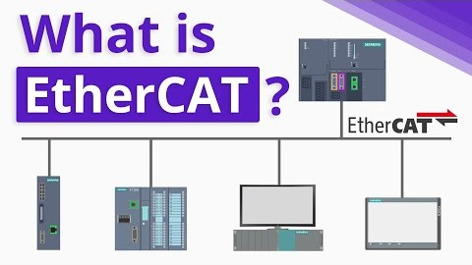
Enabling Technologies for Industrial Networks
Recent Developments in Industrial Networks

Slide 6
Enabling Technologies for Industrial Networks
Recent Developments in Industrial Networks
Even though Real-Time Ethernet technologies are widely used for industrial automation systems, application development is still challenging, due to their low-level complexity as well as their high expertise needed for their configuration.
Therefore, a higher layer of abstraction is required, which is typically found in application-layer protocols.
An increasingly popular application-layer Fieldbus protocol is CANopen, as it provides a vast variety of communication mechanisms, such as time or event-driven, synchronous or asynchronous as well as
additional support for time synchronization and network management.
Furthermore, it offers a high-degree of configuration flexibility, requires limited resources and has
therefore been deployed on many existing embedded devices.

Slide 7
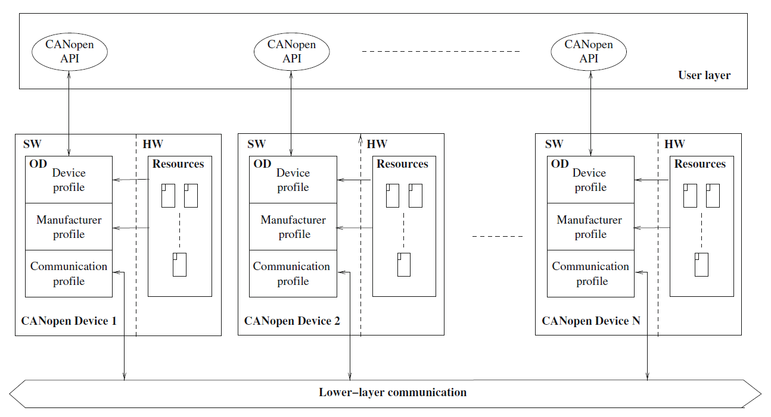
Enabling Technologies for Industrial Networks
Recent Developments in Industrial Networks
Figure 1: Communication in a CANopen system.

