Slide 1
Industrial IoT and Automation

Slide 2
Automation Network in Smart Industries
Level 0: Include the physical process devices and installation
Level 1: This level includes devices such as sensors,
actuators, or analyzers connected to the upper layer
Level 2: Used to be divided into two sub-levels, monitoring, and Control:
Automation pyramid

Slide 3
Enabling Technologies for Industrial Networks
Recent Developments in Industrial Networks
Industrial Automation Protocols
EtherCAT is Ethernet for Control Automation Technology.
Based on Ethernet and was developed specifically with industrial automation in mind.
EtherCAT use standard frames as well as the physical layer as characterized in IEEE 802.3 Ethernet Standard
However it addresses some specific concerns for industrial automation such as:
Rapid response times,
Minimal data requirements for each device,
Costs for implementation.

Slide 4
Enabling Technologies for Industrial Networks
Recent Developments in Industrial Networks
Industrial Automation Protocols
EtherCAT uses the same Physical and Data link Layers as Ethernet but the protocols deviate from there.
EtherCAT networks do not require external switches in the network.
Each EtherCAT device typically has two Ethernet ports
The EtherCAT slave will automatically return the frame, to the master, with an open port detected downstream, essentially, self-terminating.
EtherCAT networks can extend well beyond Star Topology with a Tree, Line, etc.

Slide 5
Enabling Technologies for Industrial Networks
Recent Developments in Industrial Networks

Slide 6
Enabling Technologies for Industrial Networks
Recent Developments in Industrial Networks
Even though Real-Time Ethernet technologies are widely used for industrial automation systems, application development is still challenging, due to their low-level complexity as well as their high expertise needed for their configuration.
Therefore, a higher layer of abstraction is required, which is typically found in application-layer protocols.
An increasingly popular application-layer Fieldbus protocol is CANopen, as it provides a vast variety of communication mechanisms, such as time or event-driven, synchronous or asynchronous as well as
additional support for time synchronization and network management.
Furthermore, it offers a high-degree of configuration flexibility, requires limited resources and has
therefore been deployed on many existing embedded devices.

Slide 7
Enabling Technologies for Industrial Networks
Recent Developments in Industrial Networks
Figure 1: Communication in a CANopen system.

Slide 8
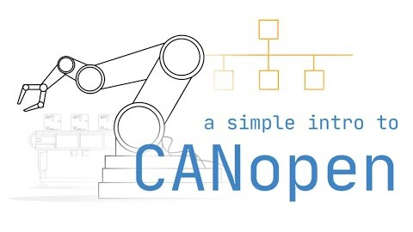
Enabling Technologies for Industrial Networks
Recent Developments in Industrial Networks

Slide 9
Enabling Technologies for Industrial Networks
Recent Developments in Industrial Networks

Slide 10
Enabling Technologies for Industrial Networks
Recent Developments in Industrial Networks

