Slide 1
Industrial IoT and Automation

Slide 2
Simulation of RFID using Matlab/Dymola
RFID
ABOUT RFID
Radio Frequency Identification (RFID)
The wireless non-contact use of radio frequency waves to transfer data.
Tagging items with RFID tags allows users to automatically and uniquely identify and track inventory and assets.
RFID takes barcode technology to the next level by allowing tags to be read without line of sight and, depending on the type of RFID, having a read range between a few centimeters to over 20+ meters.

Slide 3
RFID Spectrum

Slide 4
RFID (Low Frequency Range)

Slide 5
RFID (High Frequency Range)

Slide 6
RFID (Ultra High Frequency Range)

Slide 7
RFID in Application
RFID
Antenna
Reader
Tag
Computer/
Host

Slide 8
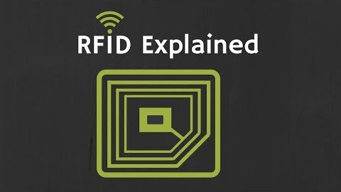
RFID based Attendance System
RFID

Slide 9
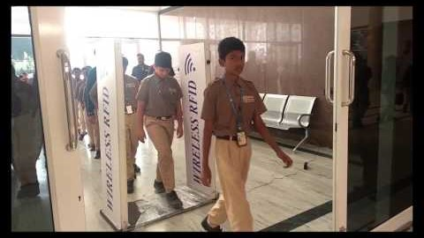
RFID based Attendance System
RFID

