Slide 1
Industrial IoT and Automation

Slide 2
Web Thing
It has three layers, namely, the perception, network, and application layers. The perception layer is the physical layer, which has sensors for sensing and gathering information about the environment.
Web of Things (WoT) is intended to enable interoperability across IoT platforms and application domains. Overall, the goal of the WoT is to preserve and complement existing IoT standards and solutions.

Slide 3
However, all complete IoT systems are the same in that they represent the integration of four distinct components: sensors/devices, connectivity, data processing, and a user interface.

Slide 4
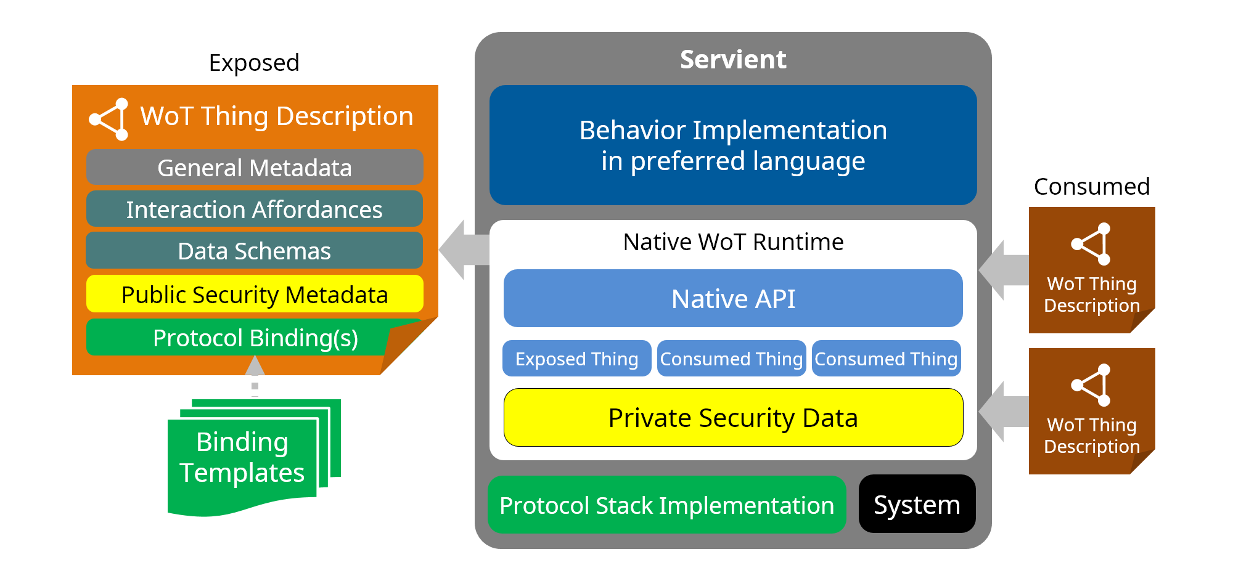
Architecture

