Slide 1
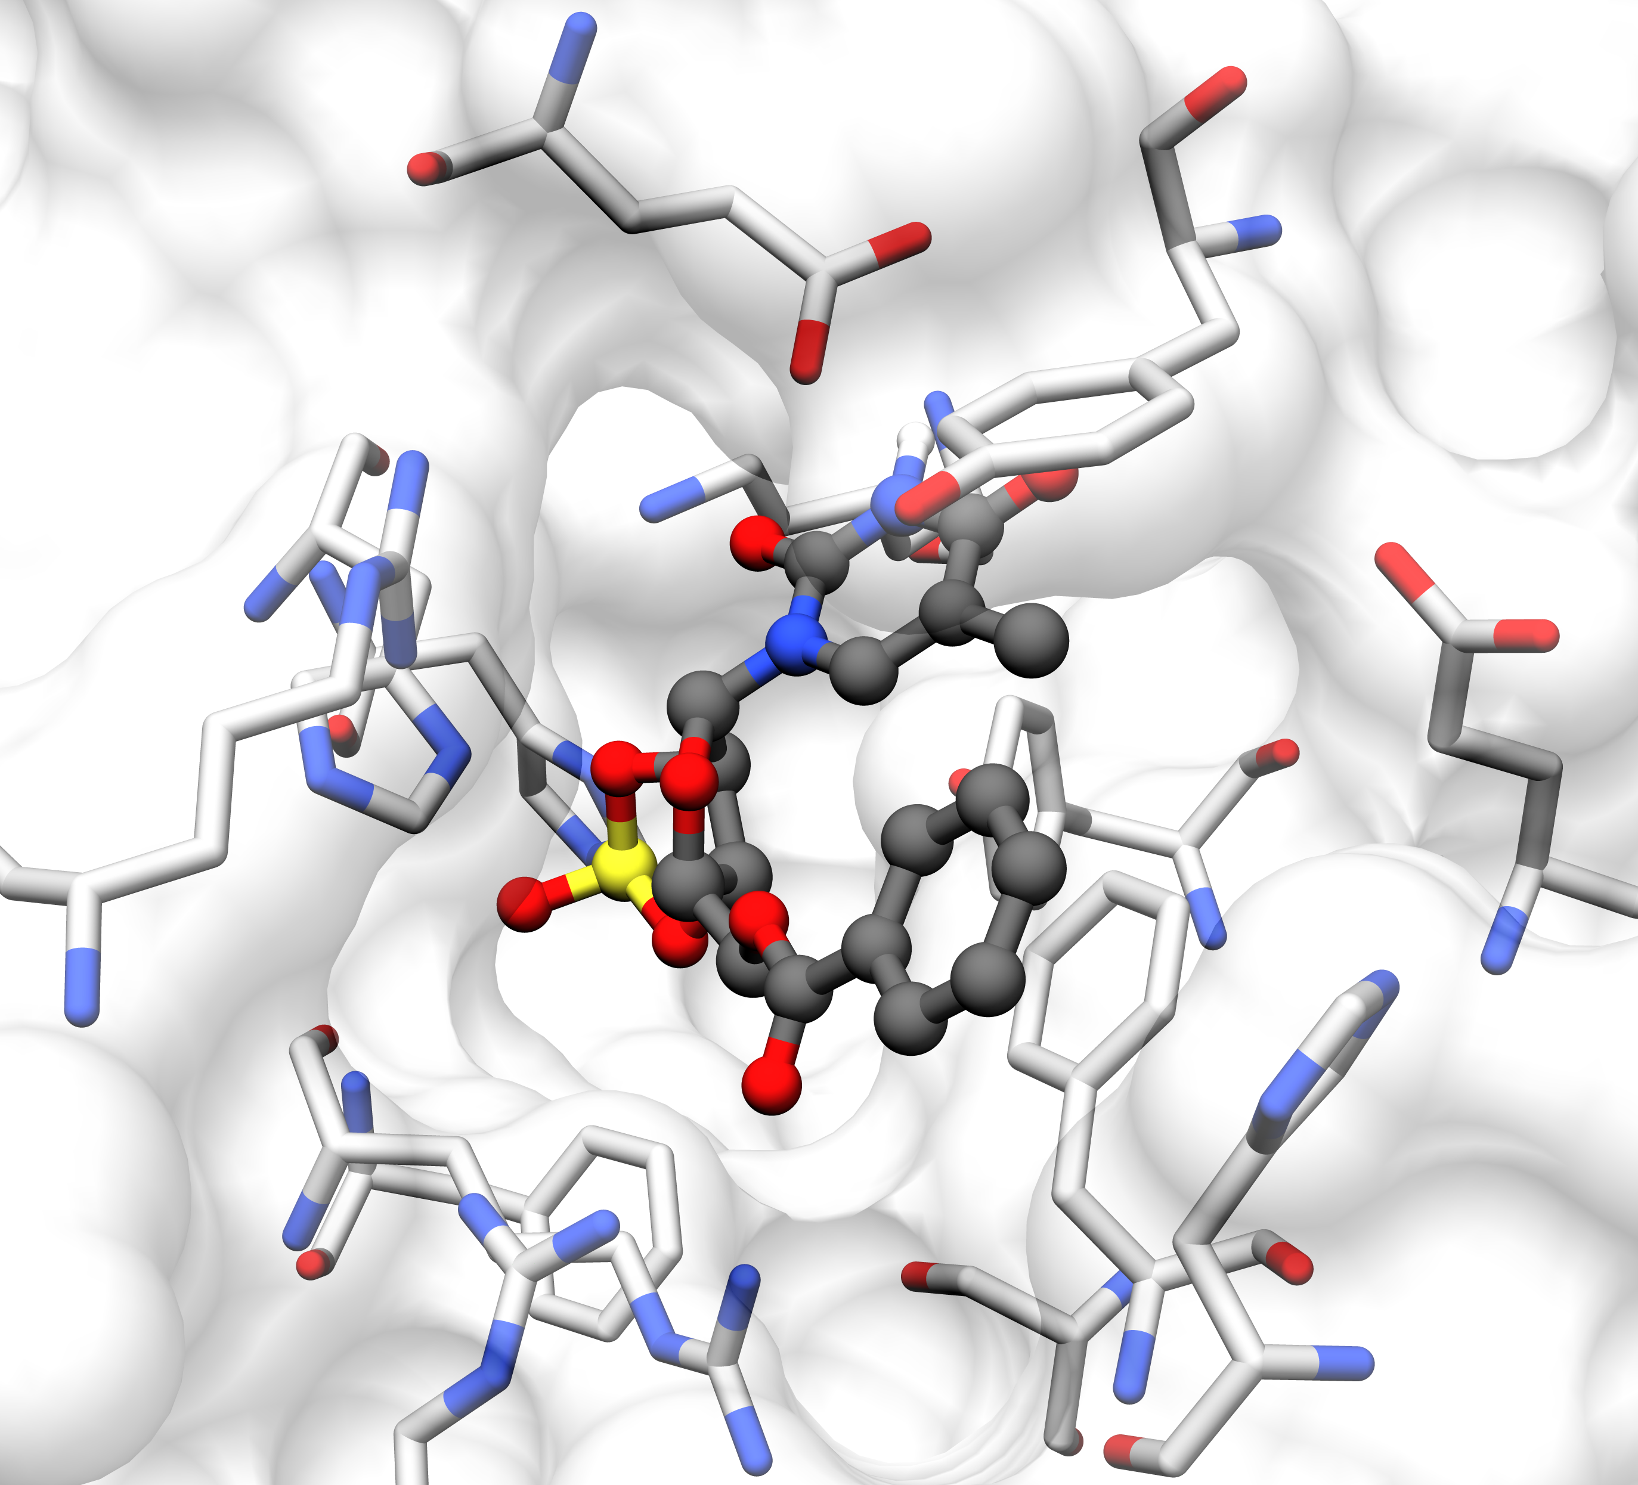
Bin1
Glu 143 A
Tyr 138 A
His 119
Arg 170 A
Glu 28 B
Tyr 132 A
His 62 A
Phe 26 B
Phe 121 A
His 19 B
Ser 51 A
Arg 23 B
Arg 59 A

Slide 2
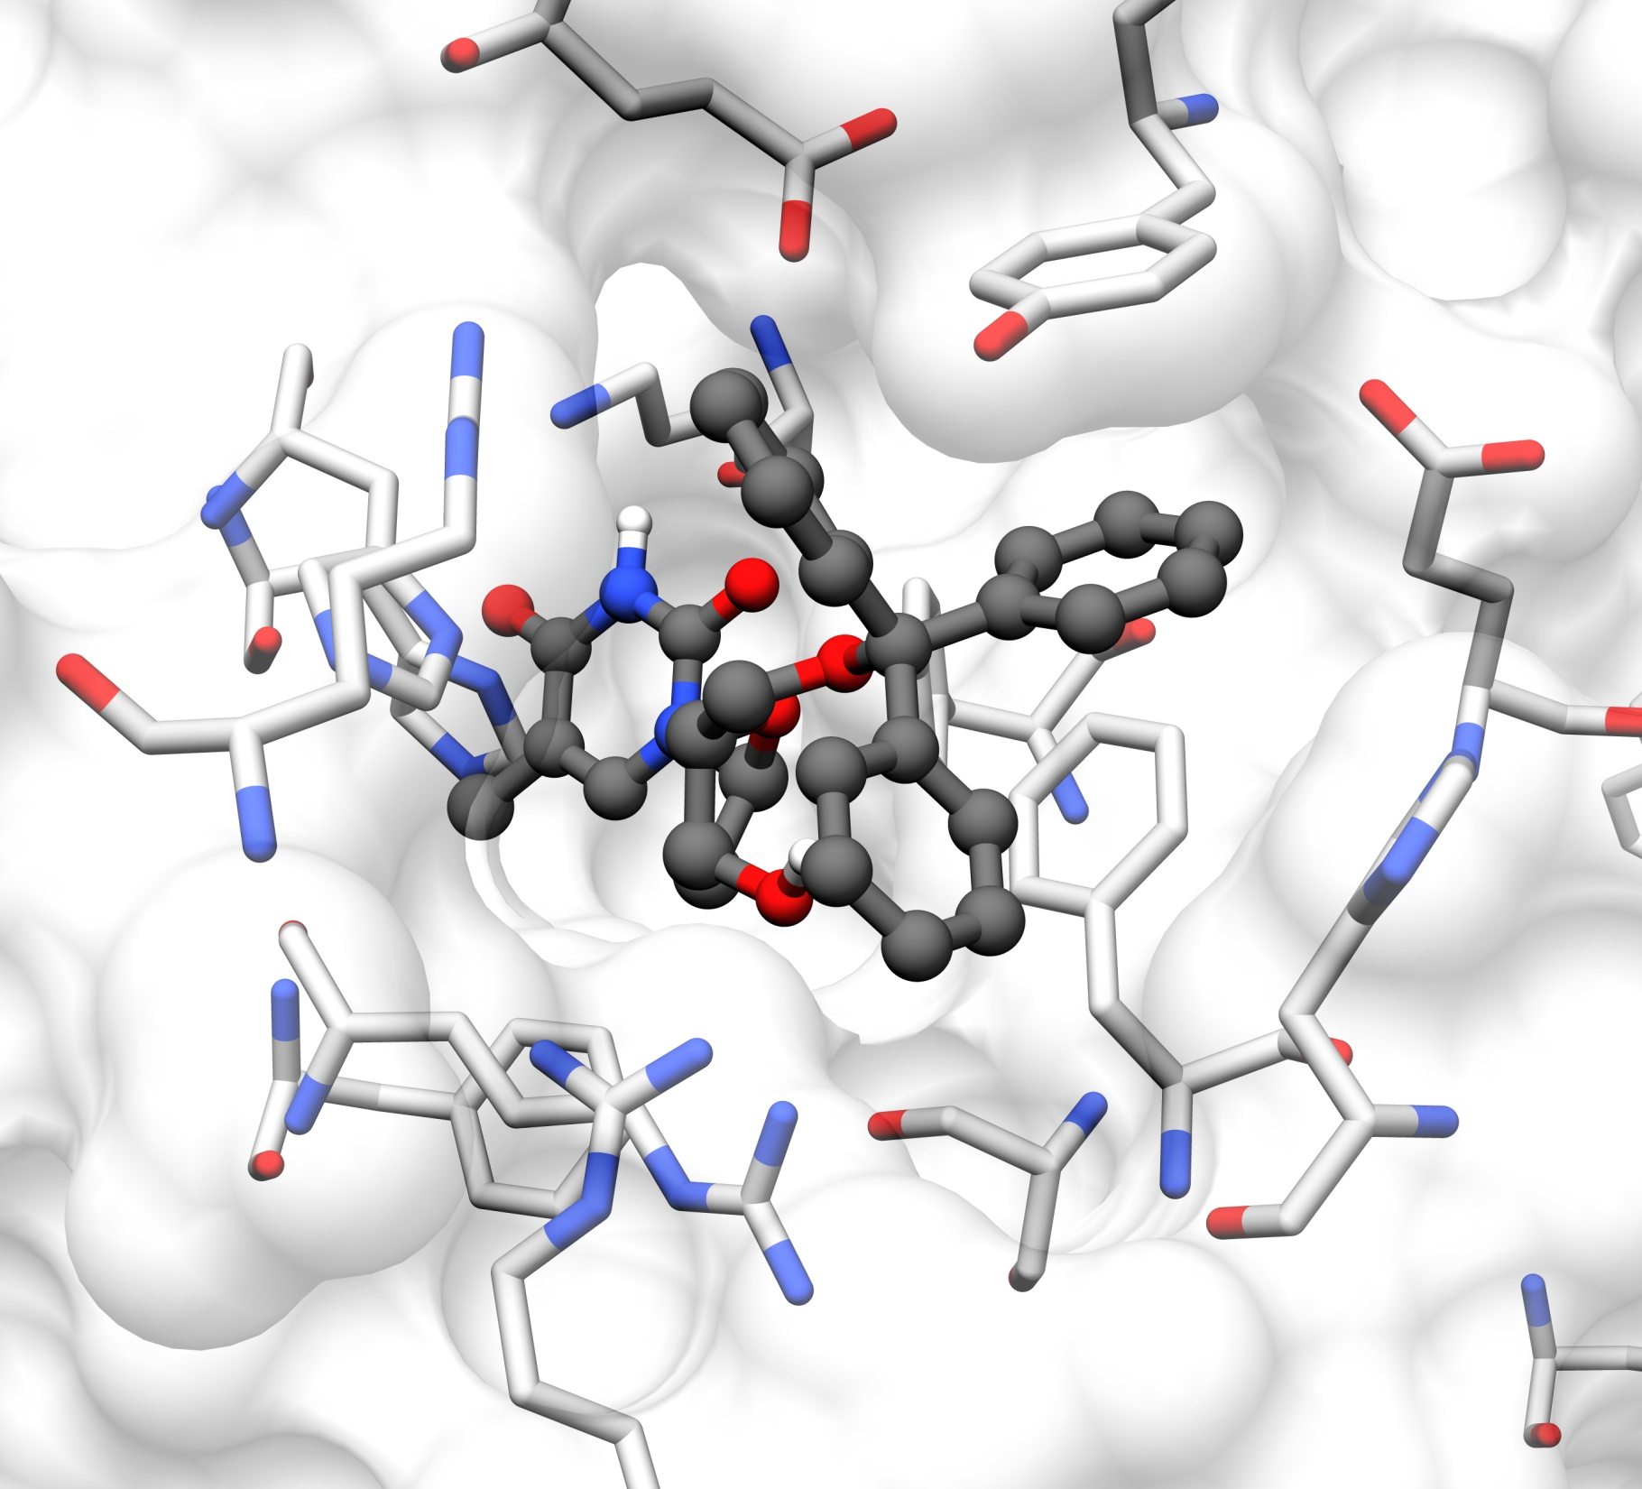
Glu 143 A
Bin2
Tyr 138 A
His 119
Glu 28 B
Tyr 132 A
Arg 170 A
His 62 A
His 19 B
Phe 26 B
Phe 121 A
Ser 51 A
Arg 59 A
Arg 23 B

Slide 3
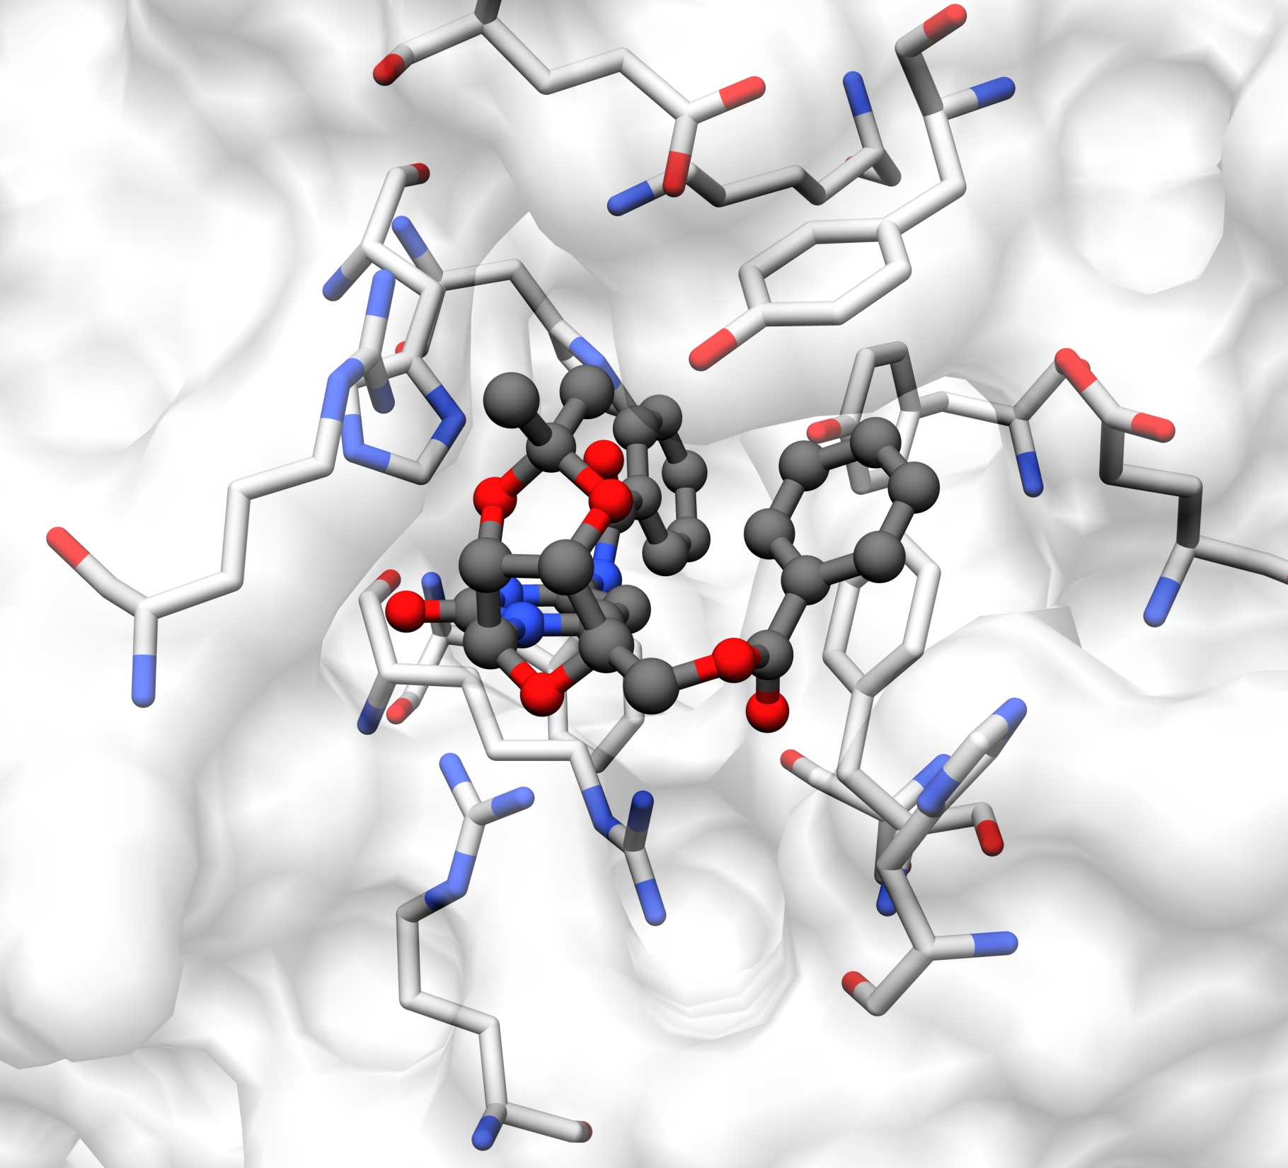
Glu 143 A
Bin3
Tyr 138 A
His 119
Tyr 132 A
His 62 A
Arg 170 A
Glu 28 B
Phe 26 B
Phe 121 A
His 19 B
Arg 59 A
Ser 51 A
Arg 23 B

Slide 4
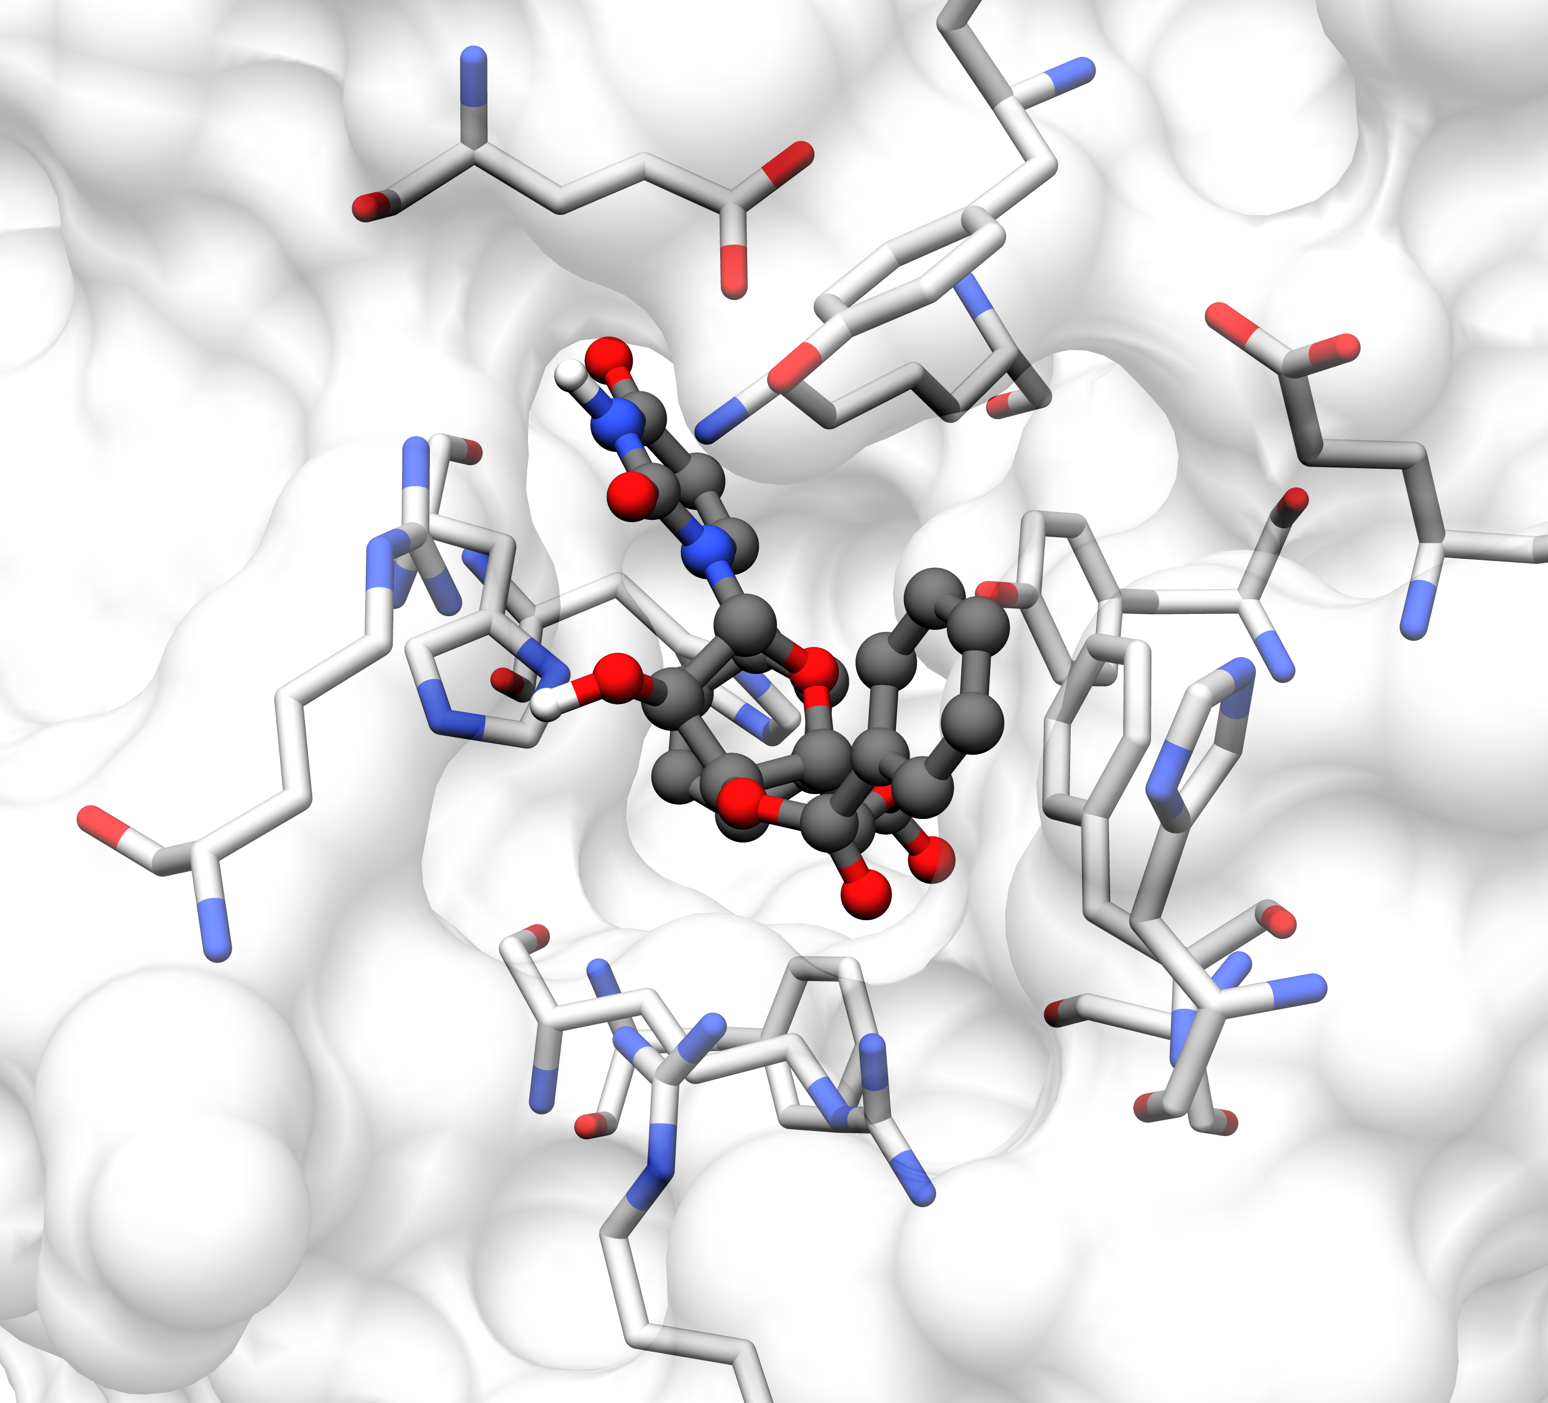
Glu 143 A
Bin4
Tyr 138 A
Glu 28 B
Tyr 132 A
His 119
His 62 A
His 19 B
Arg 170 A
Phe 26 B
Phe 121 A
Ser 51 A
Arg 59 A
Arg 23 B

Slide 5
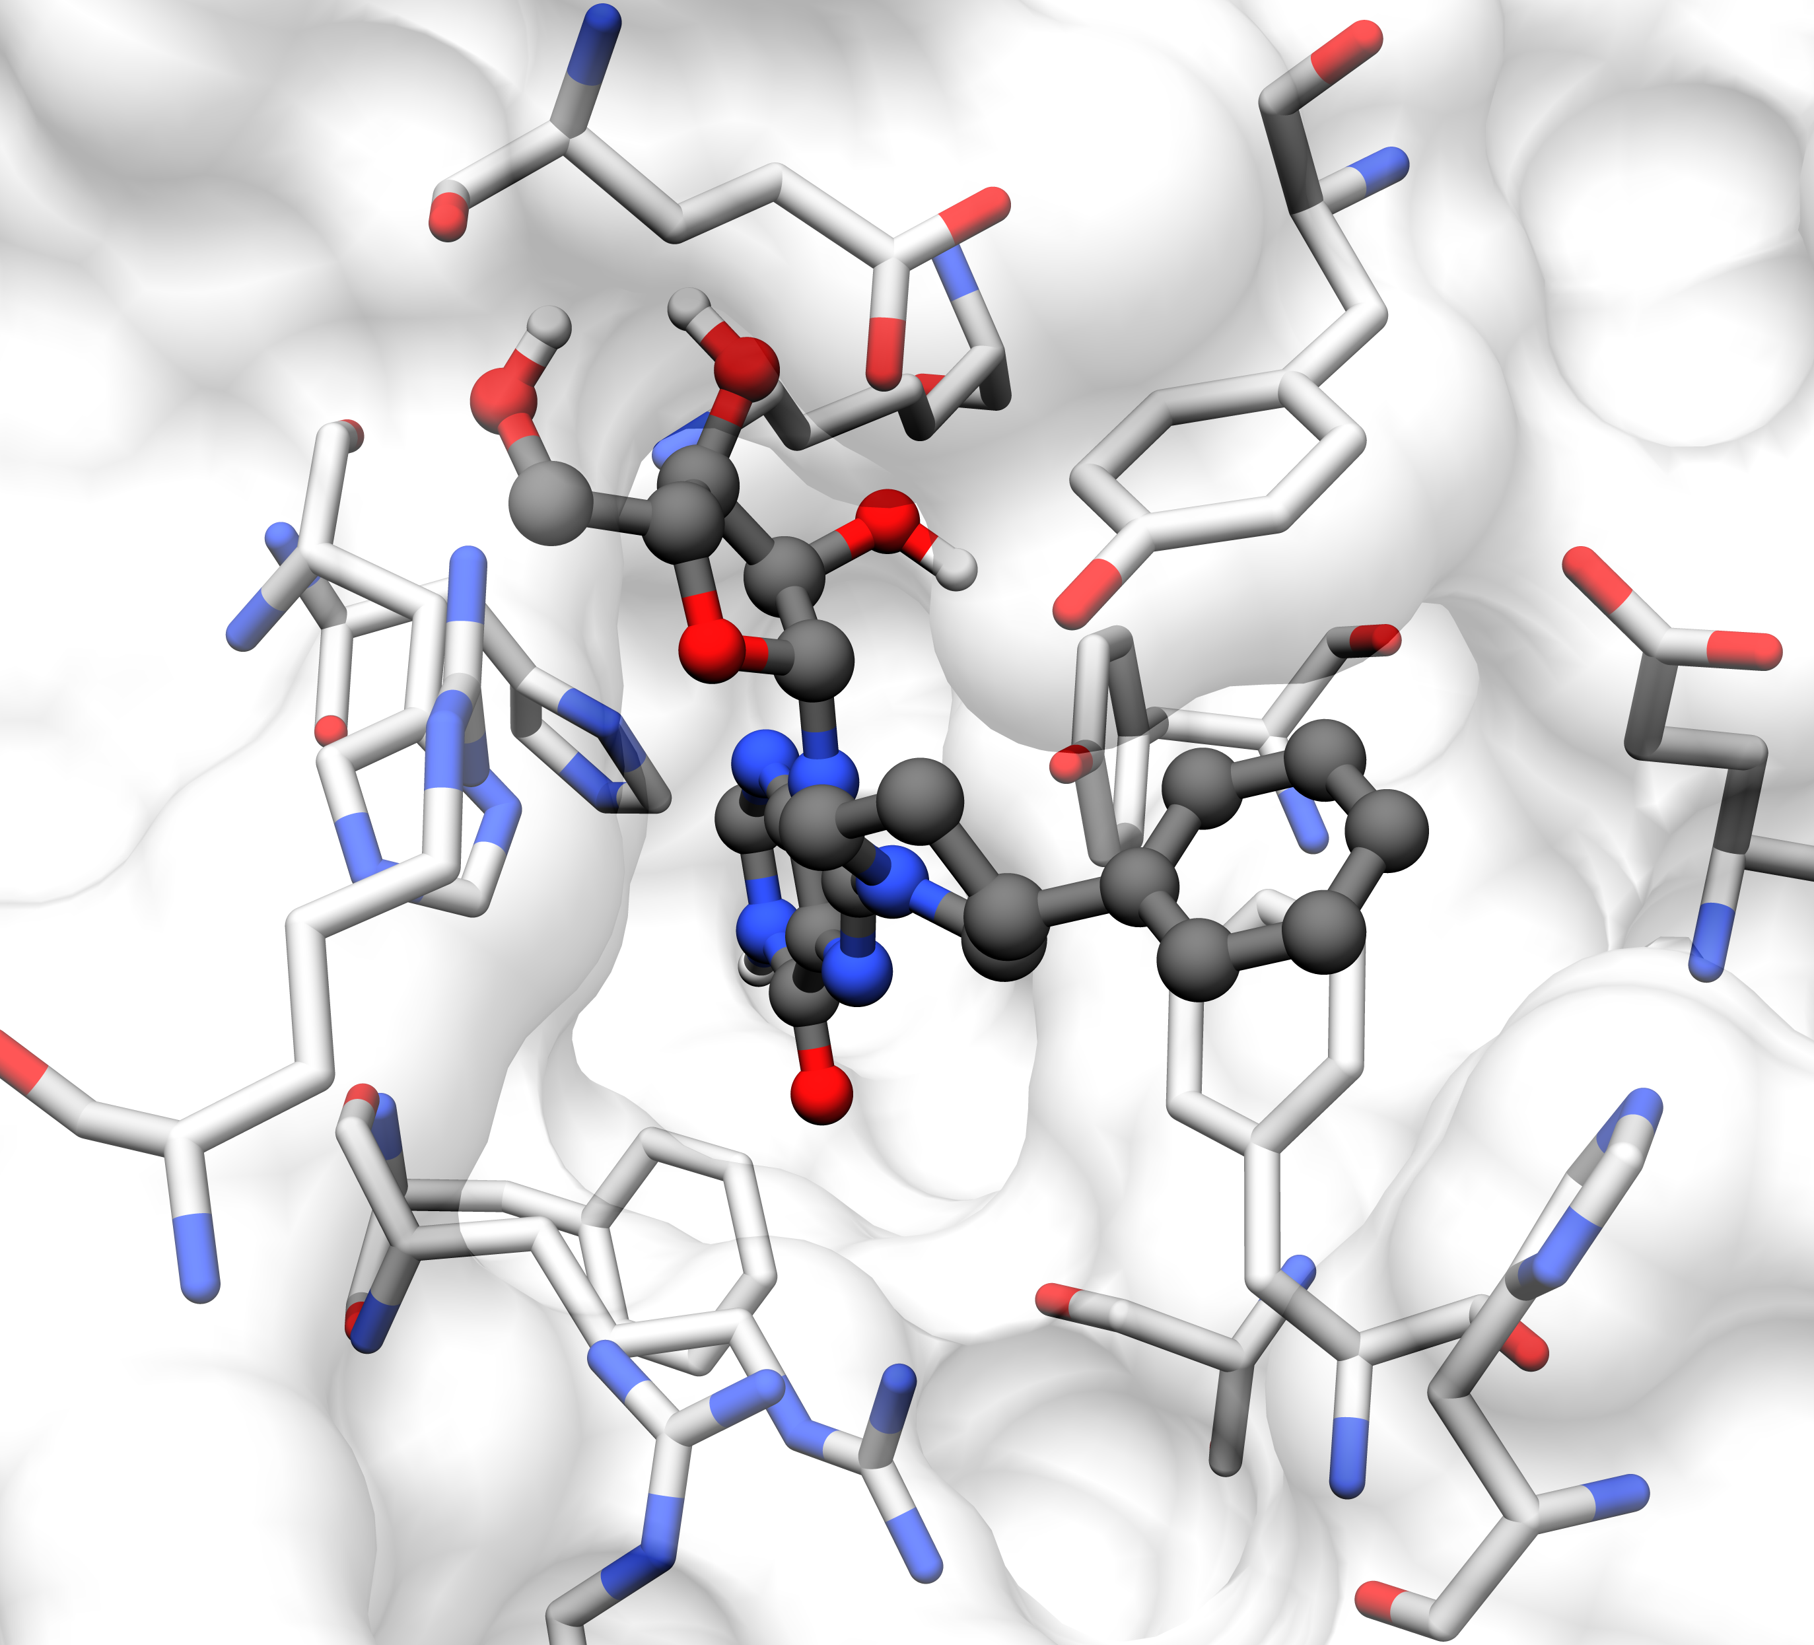
Glu 143 A
Bin 5
Tyr 138 A
Tyr 132 A
His 62 A
His 119 A
Glu 28 B
Arg 170 A
Phe 26 B
Phe 121 A
His 19 B
Ser 51 A
Arg 59 A
Arg 23 B

Slide 6
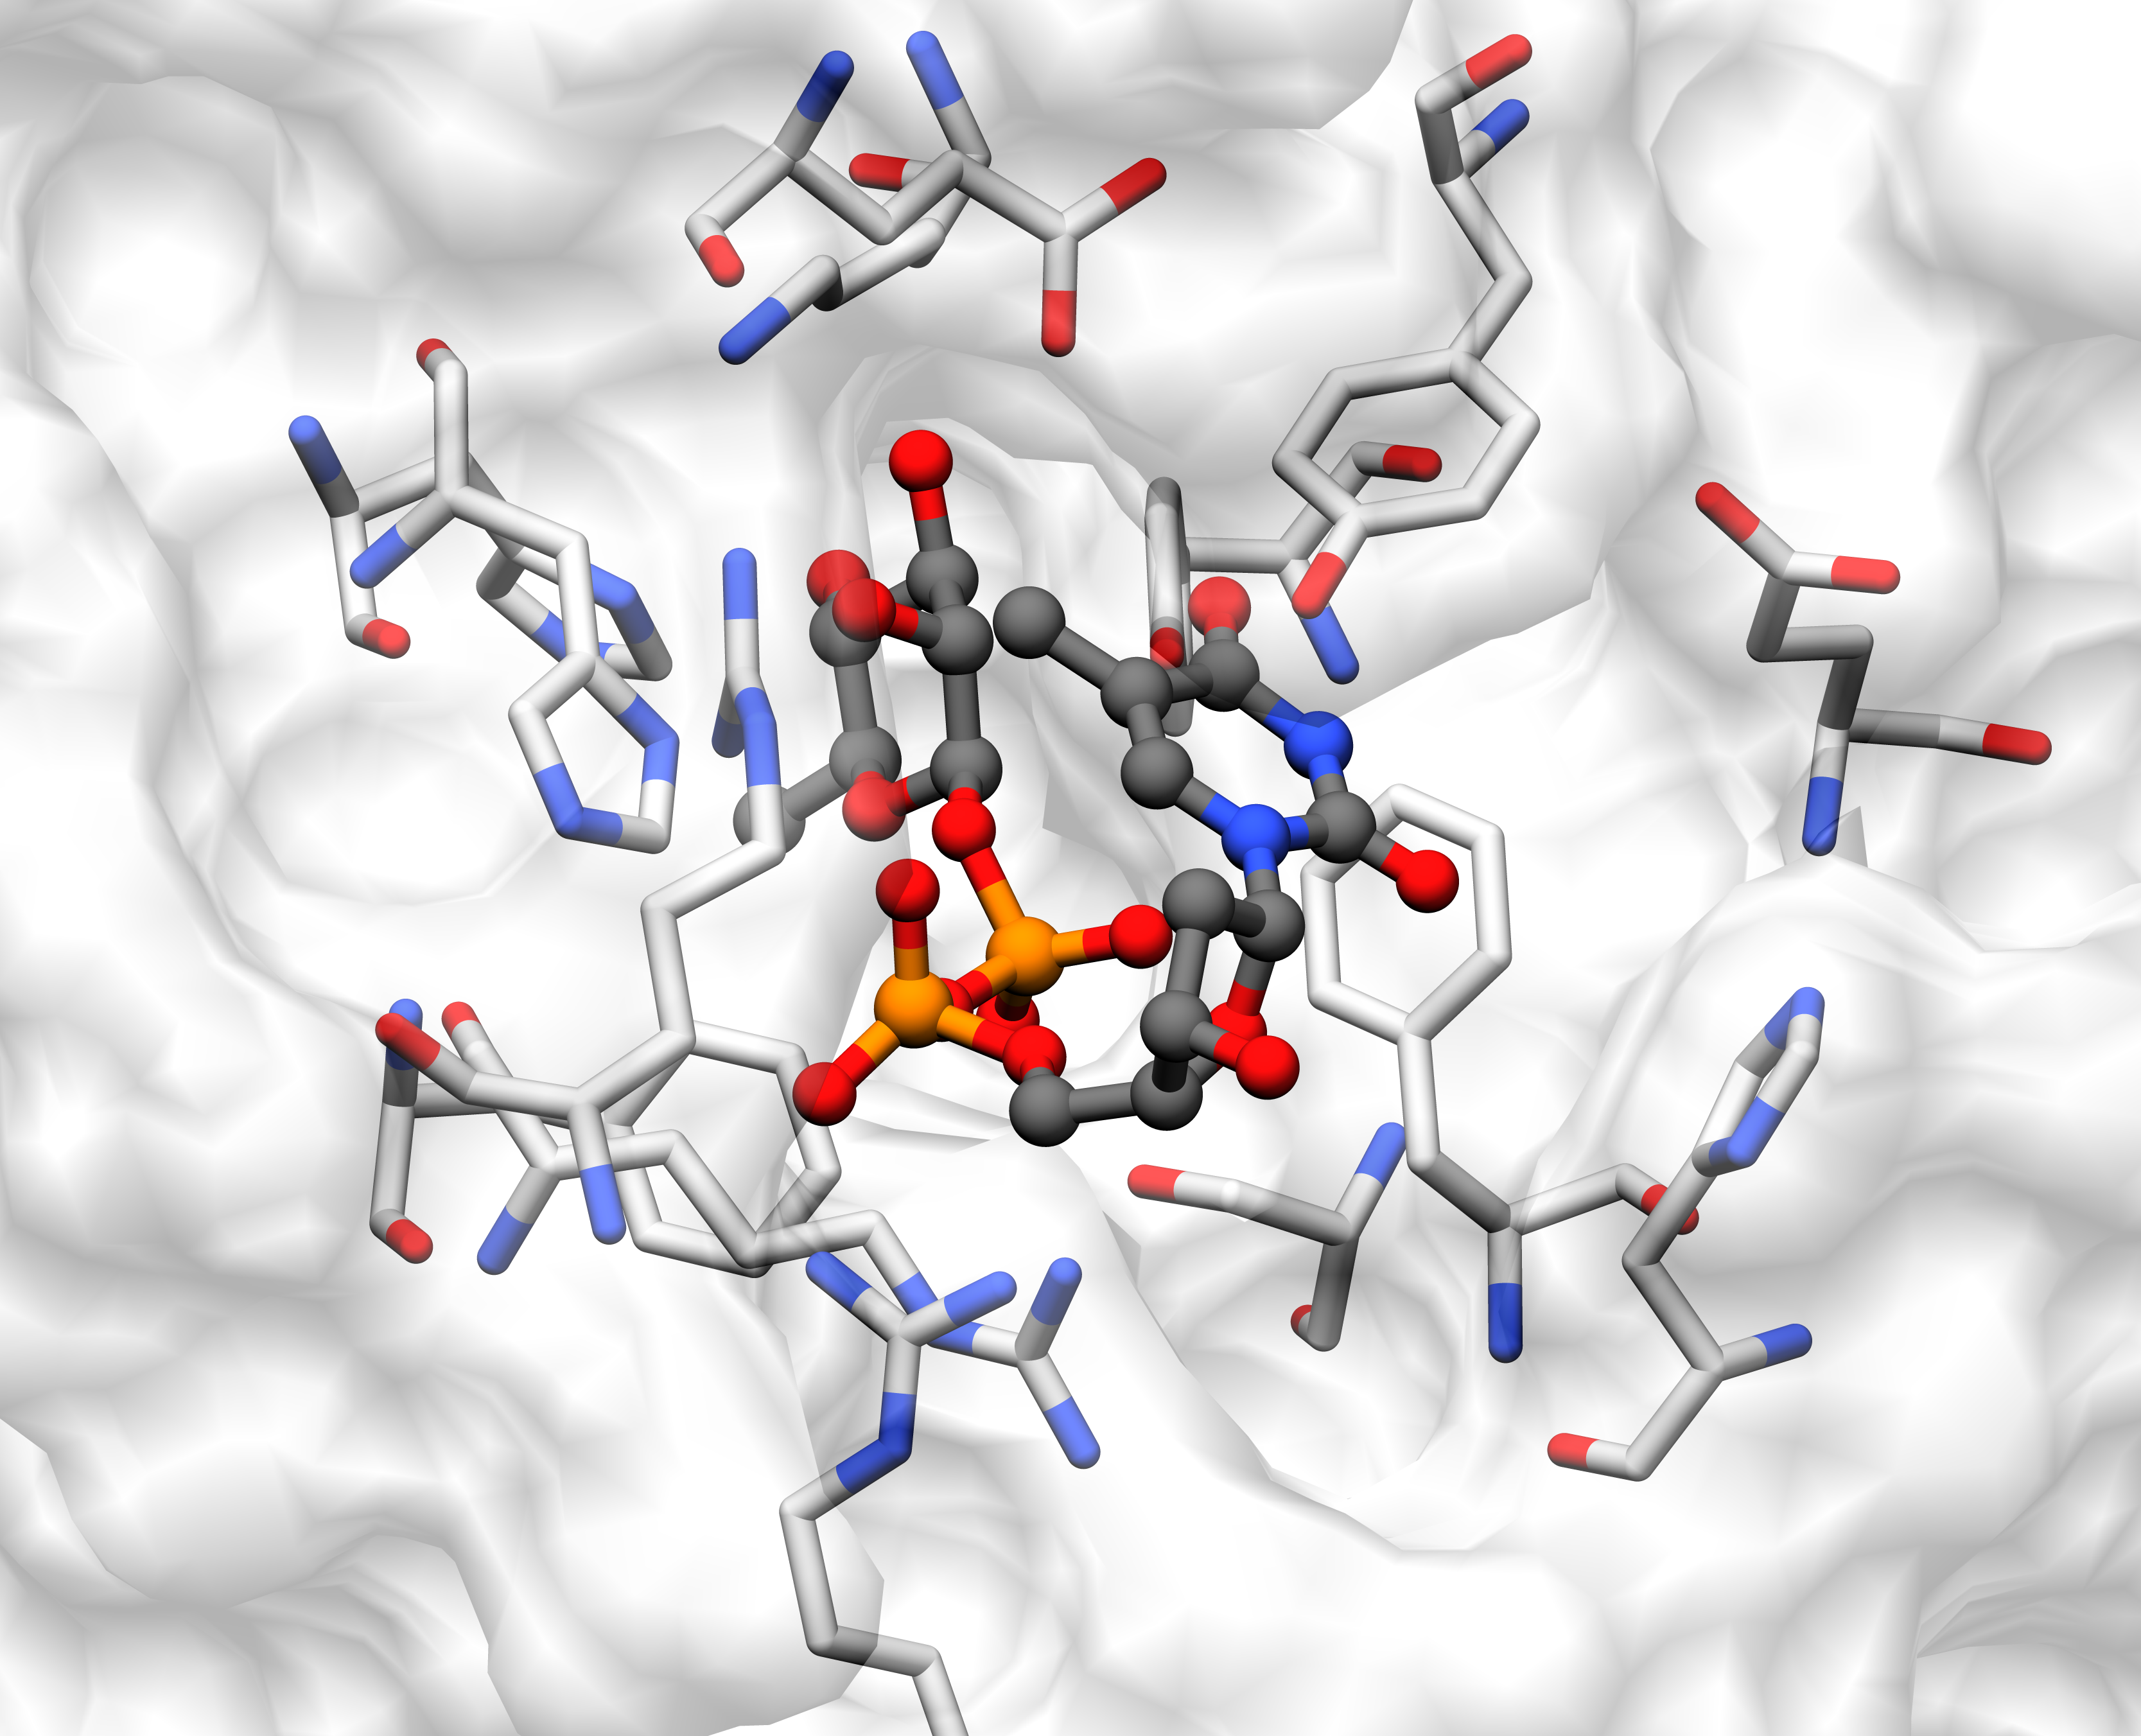
TRH
Glu 143A
Tyr 138A
Tyr 132A
His 119
Glu 28B
His 62A
Arg 170A
Phe 26B
Phe 121A
His 19B
Arg 59A
Ser 51A
Arg 23B

Slide 7
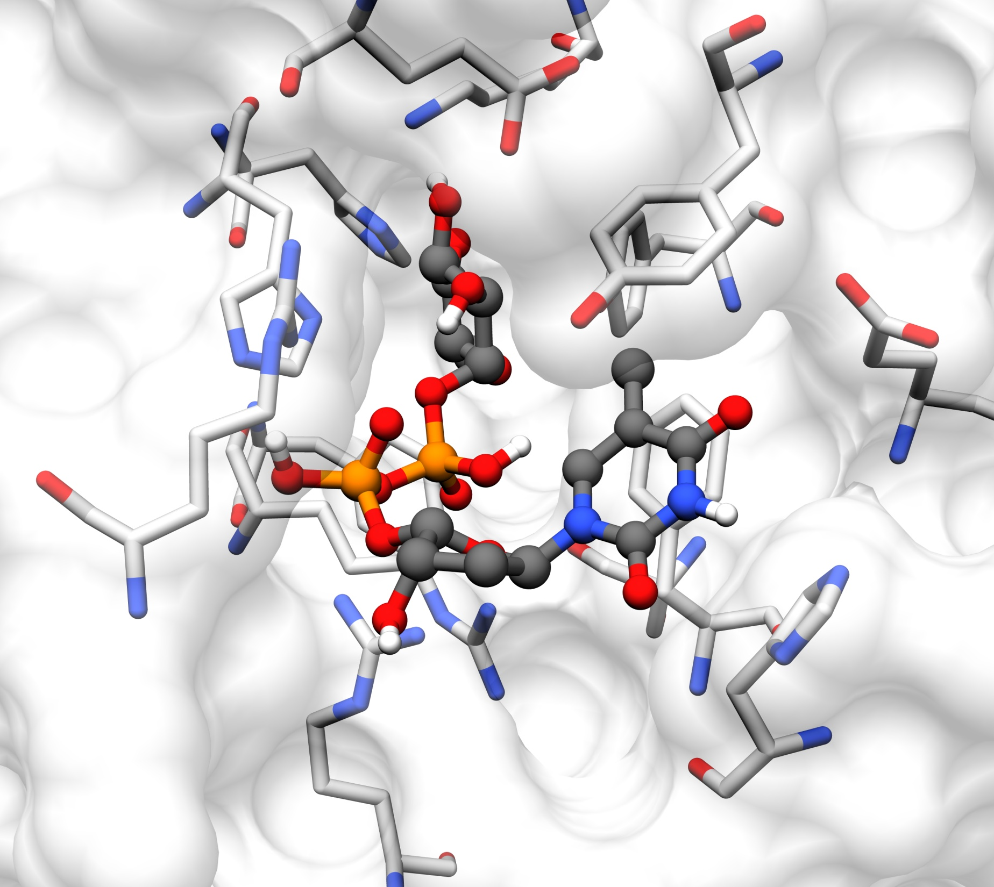
Glu 143A
Subs
Tyr 138A
His 119A
His 62A
Tyr 132A
Glu 28B
Arg 170A
Phe 26B
Phe 121A
Ser 51A
His 19B
Arg 59A
Arg 23B

Slide 8
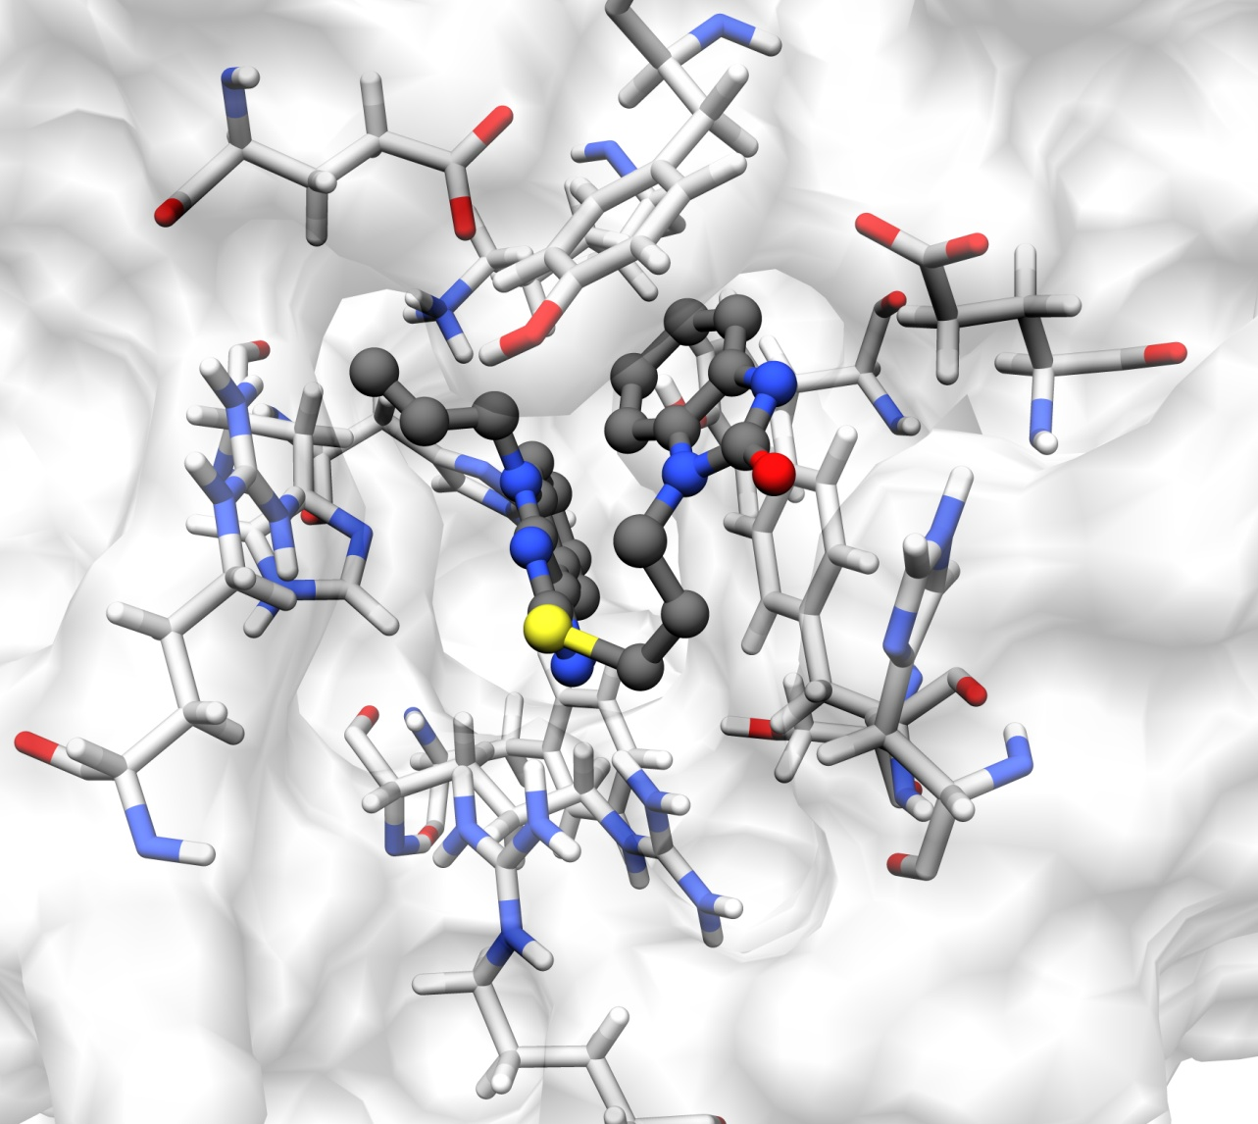
Glu 143A
CID
Tyr 138A
Tyr 132A
Glu 28B
His 119A
Phe 26 B
His 62A
Arg 170A
His 19B
Phe 121A
Arg 59A
Ser 51A
Arg 23B

Slide 9
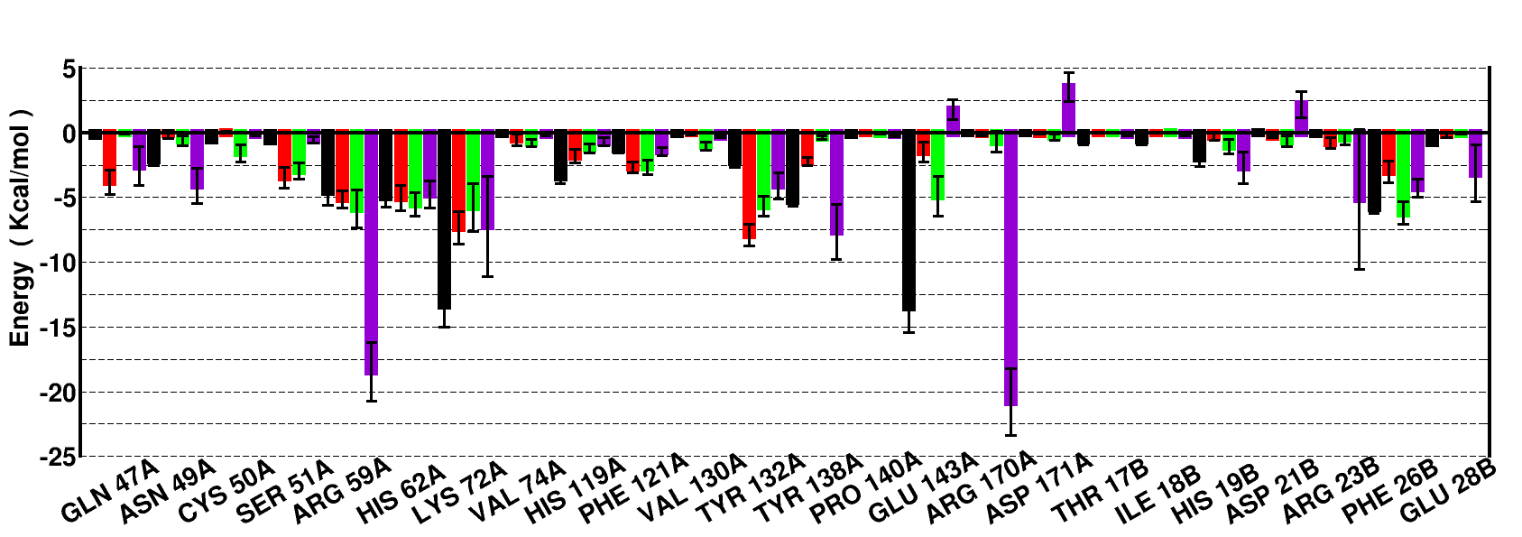
Residue wise decomposition Bin5 (Black) –bin1 (Red)-bin4 (Green)-trh (Violet)

