Slide 1
OPERATING SYSTEM

Slide 2
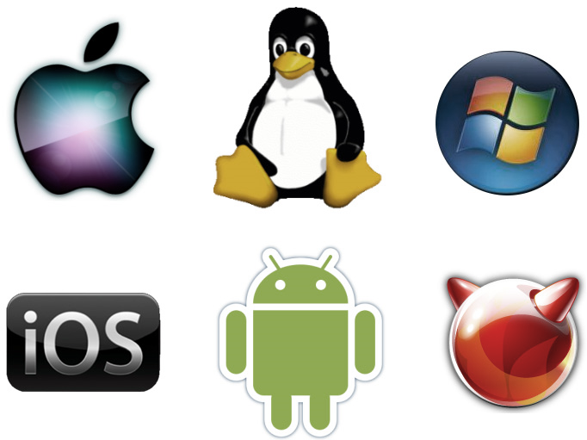
WHAT IS AN OPERATING SYSTEM?
A program that acts as an intermediary between a user of a computer and the computer hardware.
An operating System is a collection of programs that control a computer system’s operations.
Some examples of operating systems are
UNIX, Mach, MS-DOS, MS-Windows,
Windows/NT, Chicago,
OS/2, MacOS, VMS, MVS, and VM.

Slide 3
PURPOSE
The operating system, as its name implies, oversees all computer operations.
It coordinates the operations of hardware units such as CPU, memory, keyboard, video display system, and disk drives.
It provides an interface for users to communicate with the computer and run application programmes.
In Short
• Execute user programs and make solving user problems easier.
• Make the computer system convenient to use.
• Efficiently use computer hardware.

Slide 4
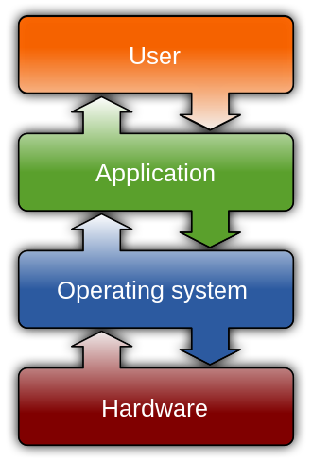
MAJOR FUNCTIONS OF AN OPERATING SYSTEM
Providing a user interface, either command-line or graphical, for communicating with the computer.
Managing the hardware devices of the computers.
Managing and maintaining the disk files
Supporting the running of application programmes.

Slide 5
COMPONENTS OF OS AND THEIR FUNCTIONS
The operating system comprises programmes and sub-programmes (routines)
designed to carry out various tasks.
They include:
Bootstrap programme
Diagnostic programmes
Monitor programme
BIOS programme
Utility programmes
File maintenance programmes

Slide 6
Bootstrap Program
Bootstrap loader programme is usually contained in the ROM
memory.
Its task is to load the main portion of the operating system residing in the secondary memory into the main memory when the
computer is first switched on.
This operation is known as booting the computer.

Slide 7
Diagnostic Program
These programs test the operation of the system components.
For instance, one programme may check the conditions of the disk while the other checks the RAM.
Monitor Program
This programme monitors and controls the activities of various units and assigns tasks to them. It also monitors user requests and schedules the execution of the application programs.
The monitor programme is also known as the operating system executive.

Slide 8
BIOS Program
This programme ( Basic Input/Output System ) contains a number of sub-programs that control some basic operations of input-output devices, such as reading from the keyboard and writing to the printer.
Utility Program
These programmes are used to perform 'housekeeping' functions such as formatting a disk, copying the contents of a disk, determining the space available in a disk and so on.
File Maintenance Program
These programs maintain files on the secondary storage units attached to the computer.
They enable users to create, read, and write files.

Slide 9
TYPES OF OPERATING SYSTEMS
Operating systems are designed not only to manage hardware but also to serve users in various environments.
Operating systems, depending on how they handle user programmes, may be categorised as follows:
Batch operating systems
Multi-user operating systems
Multitasking operating systems
Multiprocessing operating systems
Online operating systems
Real-time operating systems

Slide 10
INTRODUCTION TO WINDOWS OS
Windows comprises several proprietary graphical operating system families developed and marketed by Microsoft.
Each family caters to a certain sector of the computing industry.
For example, Windows NT for consumers, Windows Server for servers, and
Windows IoT for embedded systems.
Defunct Windows families include Windows 9x, Windows Mobile, and Windows Phone.

Slide 11
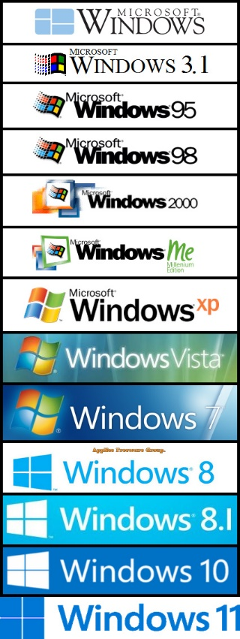
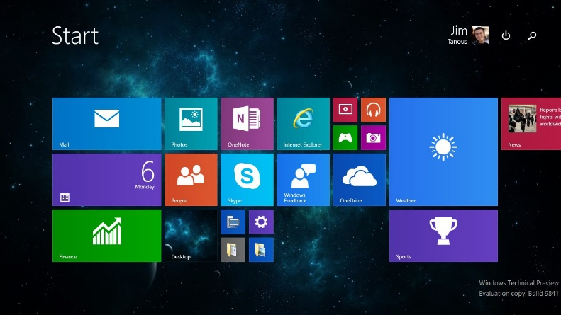
Versions of Windows
Components of Windows
Windows 3.0
Windows 3.1
Windows 95
Windows 98
Windows 2000
Window Millennium
Windows NT
Windows XP
Windows Vista
Windows 7
Windows 8
Windows 8.1
Windows 10
Windows 11
Desktop
Icons
My Computer
Network Neighborhood
The Internet
Recycle Bin

Slide 12
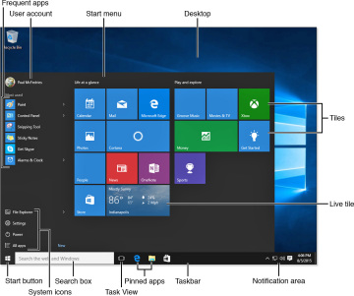
PARTS OF A WINDOWS IN COMPUTER
Microsoft Windows, the world's most widely used operating system, employs the metaphor of a window for navigation and file management.
Understanding the parts of a window is the first step to navigating the operating system.
LISTS OF PARTS OF A WINDOWS
The Title Bar
Minimize, Maximize, and Close Buttons
The Scroll Bar
The Menu Bar
The WorkSpace

Slide 13
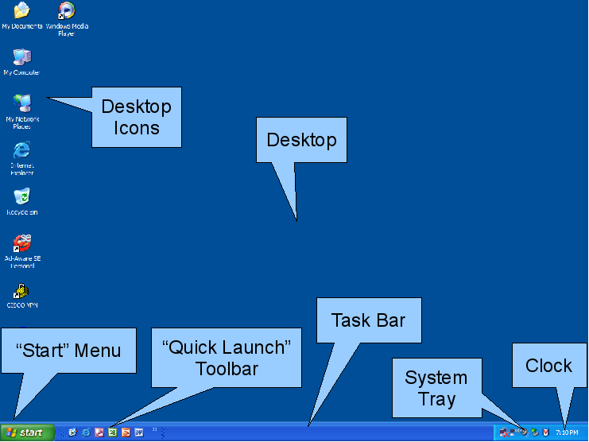

Slide 14
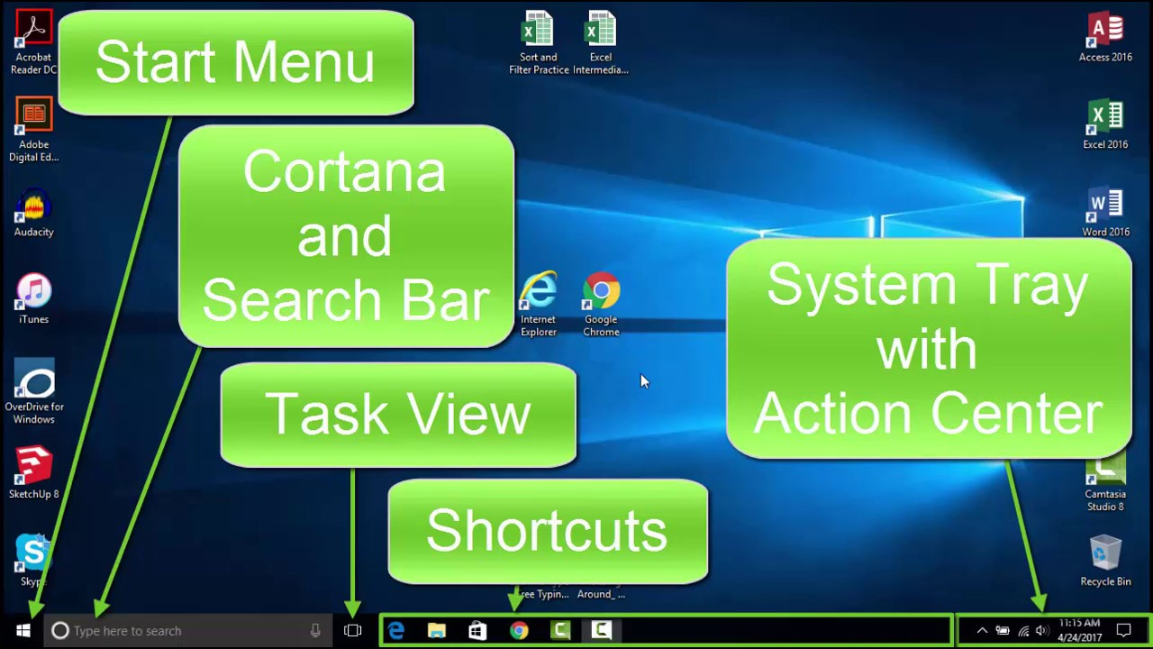

Slide 15
Topic of Presentation

