Slide 1
AWS Solution Architect

Slide 2
Session 1 & 2

Slide 3
On-premises data centers
"On-premise" refers to private data centers that companies house in their own facilities and maintain themselves.
On-premise infrastructure can be used to run private clouds, in which compute resources are virtualized in much the same way as those of public clouds (however, private clouds can also be run on leased third-party hardware).
On-Premise defined: A solution hosted in-house and usually supported by a third-party.
Off-Premise defined: A solution hosted by a third-party and usually supported by a different third-party.

Slide 4
What is cloud computing?
Cloud computing is the on-demand delivery of IT resources over the Internet with pay-as-you-go pricing. Instead of buying, owning, and maintaining physical data centers and servers, you can access technology services, such as computing power, storage, and databases, on an as-needed basis from a cloud service provider.

Slide 5
Cloud computing is a model for enabling ubiquitous, convenient, on-demand network access to a shared pool of configurable computing resources (e.g networks, servers, storage, applications, and services) that can be rapidly provisioned and released with minimal management effort or service provider interaction.

Slide 6
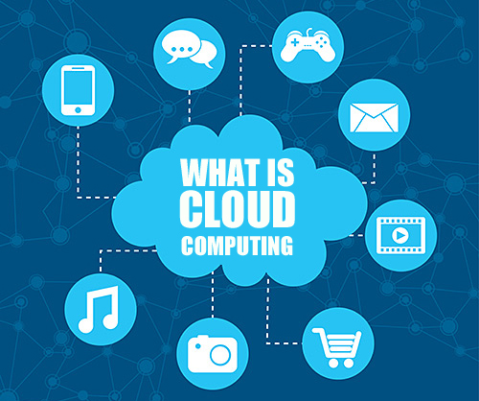

Slide 7
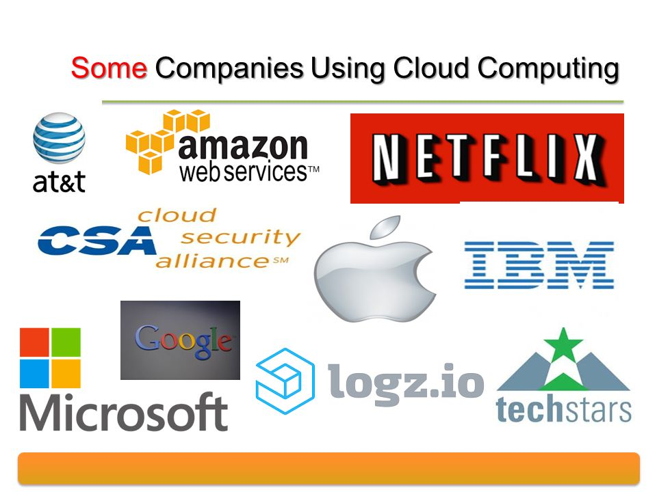

Slide 8
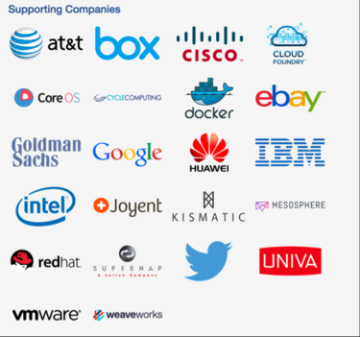

Slide 9
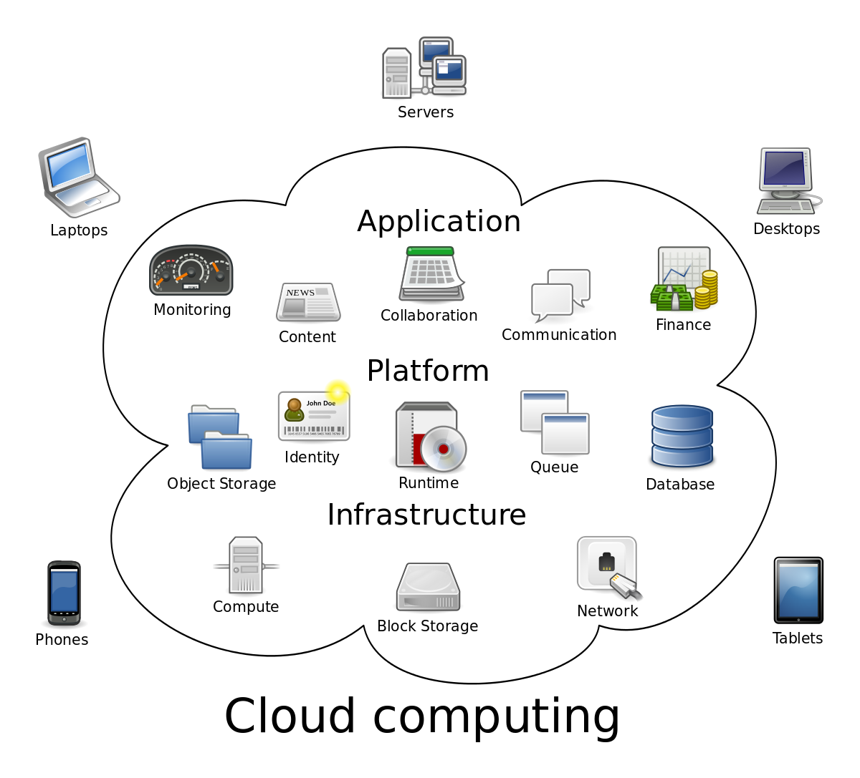

Slide 10
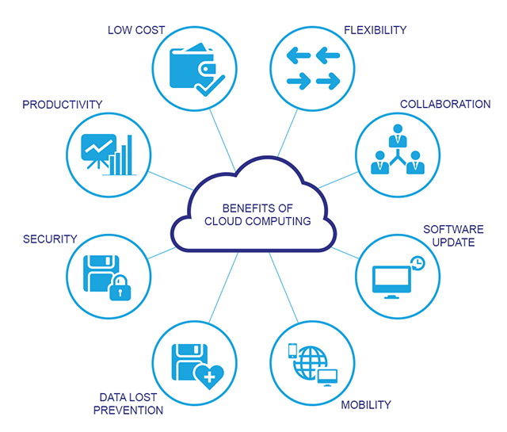

Slide 11
Common Characteristics
Massive Scale
Resilient Computing
Homogeneity
Geographic Distribution
Virtualization
Service Orientation
Low Cost Software
Advanced Security

Slide 12
Essential Characteristics
On-demand self-service
A consumer can unilaterally provision computing capabilities, such as server time and network storage, as needed automatically without requiring human interaction with each service provider.
Broad network access
Capabilities are available over the network and accessed through standard mechanisms that promote use by heterogeneous thin or thick client platforms (e.g., mobile phones, tablets, laptops, and workstations).
Resource pooling
The provider’s computing resources are pooled to serve multiple consumers using a multi-tenant model, with different physical and virtual resources dynamically assigned and reassigned according to consumer demand.

Slide 13
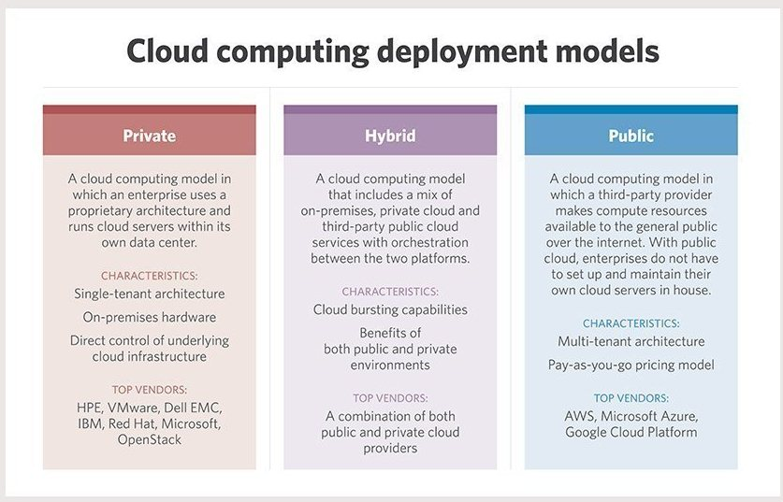

Slide 14
The public cloud is defined as computing services offered by third-party providers over the public Internet, making them available to anyone who wants to use or purchase them.
They may be free or sold on-demand, allowing customers to pay only per usage for the CPU cycles, storage, or bandwidth they consume.

Slide 15
Private cloud solutions are dedicated to one organization or business, and often have much more specific security controls than a public cloud.
Many medical offices, banking institutions, and other organizations who are required to meet federal and state guidelines for data controls use a private cloud.
Using private cloud storage allows them to control highly sensitive data by meeting regulations and industry-based criteria, whether that be medical records, trade secrets, or other classified information.

Slide 16
Hybrid cloud solutions are a blend of public and private clouds. This is a more complex cloud solution in that the organization must manage multiple platforms and determine where data is stored.
An example of a hybrid cloud solution is an organization that wants to keep confidential information secured on their private cloud, but make more general, customer-facing content on a public cloud.

Slide 17
Community cloud is a cloud infrastructure that allows systems and services to be accessible by a group of several organizations to share the information.
It is owned, managed, and operated by one or more organizations in the community, a third party, or a combination of them.

Slide 18
Session 3 & 4

Slide 19
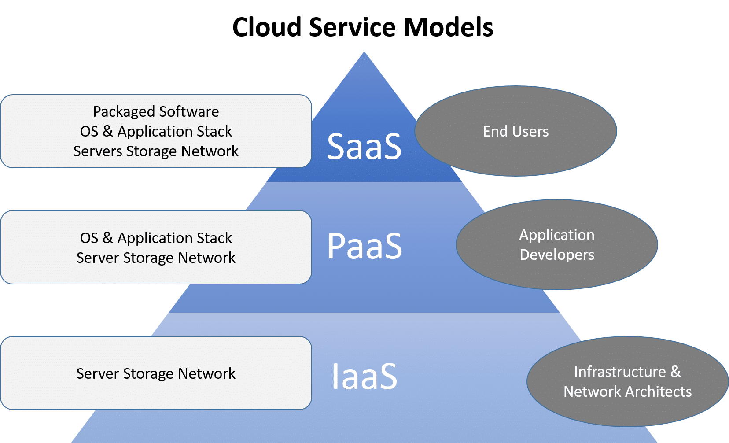

Slide 20
Infrastructure as a service (IaaS) is a cloud computing offering in which a vendor provides users access to computing resources such as servers, storage and networking. Organizations use their own platforms and applications within a service provider's infrastructure. A vendor provides clients pay-as-you-go access to storage, networking, servers and other computing resources in the cloud.
Platform as a service (PaaS) is a service provider offers access to a cloud-based environment in which users can build and deliver applications. The provider supplies underlying infrastructure.
Software as a service (SaaS) is a service provider delivers software and applications through the internet. Users subscribe to the software and access it via the web or vendor APIs.

Slide 21
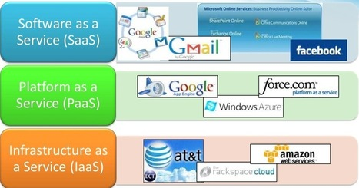

Slide 22
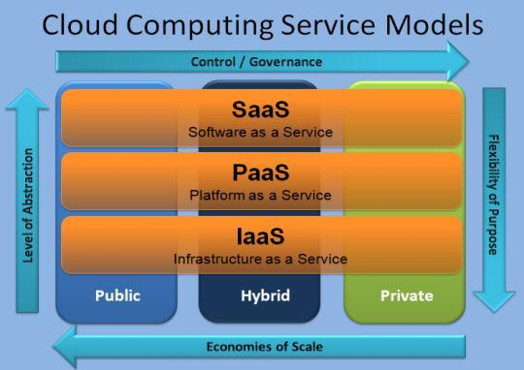

Slide 23
AWS Global Infrastructure
The AWS Global Cloud Infrastructure is the most secure, extensive, and reliable cloud platform, offering over 175 fully featured services from data centers globally.
Whether you need to deploy your application workloads across the globe in a single click, or you want to build and deploy specific applications closer to your end-users with single-digit millisecond latency, AWS provides you the cloud infrastructure where and when you need it.
With millions of active customers and tens of thousands of partners globally, AWS has the largest and most dynamic ecosystem. Customers across virtually every industry and of every size, including start-ups, enterprises, and public sector organizations, are running every imaginable use case on AWS.

Slide 24
Regions
AWS has the concept of a Region, which is a physical location around the world where we cluster data centers. We call each group of logical data centers an Availability Zone.
Each AWS Region consists of multiple, isolated, and physically separate AZ's within a geographic area. Unlike other cloud providers, who often define a region as a single data center, the multiple AZ design of every AWS Region offers advantages for customers.
Each AZ has independent power, cooling, and physical security and is connected via redundant, ultra-low-latency networks. AWS customers focused on high availability can design their applications to run in multiple AZ's to achieve even greater fault-tolerance. AWS infrastructure Regions meet the highest levels of security, compliance, and data protection.

Slide 25
Region Name | Region | Endpoint | Protocol
US East (Ohio) | us-east-2 | rds.us-east-2.amazonaws.com | HTTPS
US East (N. Virginia) | us-east-1 | rds.us-east-1.amazonaws.com | HTTPS
US West (N. California) | us-west-1 | rds.us-west-1.amazonaws.com | HTTPS
US West (Oregon) | us-west-2 | rds.us-west-2.amazonaws.com | HTTPS
Asia Pacific (Mumbai) | ap-south-1 | rds.ap-south-1.amazonaws.com | HTTPS
Asia Pacific (Osaka-Local) | ap-northeast-3 | rds.ap-northeast-3.amazonaws.com | HTTPS
Asia Pacific (Seoul) | ap-northeast-2 | rds.ap-northeast-2.amazonaws.com | HTTPS
Asia Pacific (Singapore) | ap-southeast-1 | rds.ap-southeast-1.amazonaws.com | HTTPS
Asia Pacific (Sydney) | ap-southeast-2 | rds.ap-southeast-2.amazonaws.com | HTTPS
Asia Pacific (Tokyo) | ap-northeast-1 | rds.ap-northeast-1.amazonaws.com | HTTPS
Canada (Central) | ca-central-1 | rds.ca-central-1.amazonaws.com | HTTPS
China (Beijing) | cn-north-1 | rds.cn-north-1.amazonaws.com.cn | HTTPS

Slide 26
Availability Zones
An Availability Zone (AZ) is one or more discrete data centers with redundant power, networking, and connectivity in an AWS Region.
AZ’s give customers the ability to operate production applications and databases that are more highly available, fault tolerant, and scalable than would be possible from a single data center.
All AZ’s in an AWS Region are interconnected with high-bandwidth, low-latency networking, over fully redundant, dedicated metro fiber providing high-throughput, low-latency networking between AZ’s.
All traffic between AZ’s is encrypted. The network performance is sufficient to accomplish synchronous replication between AZ’s. AZ’s make partitioning applications for high availability easy.

Slide 27
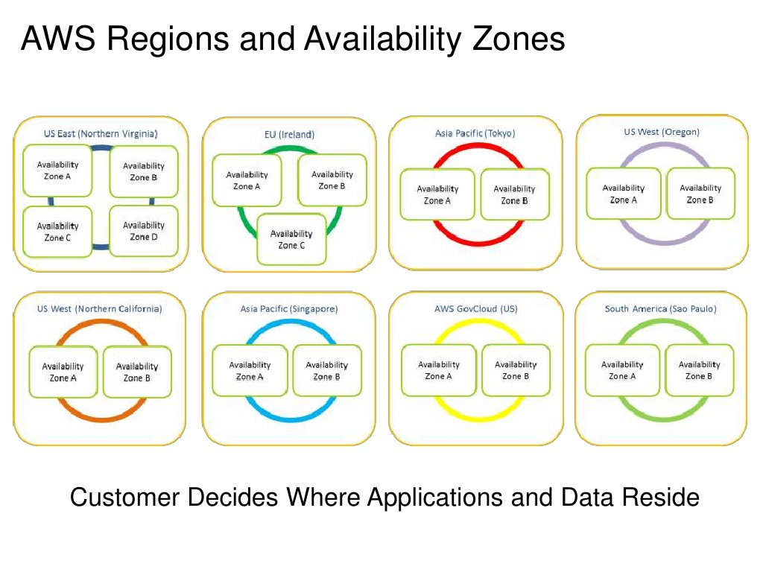

Slide 28
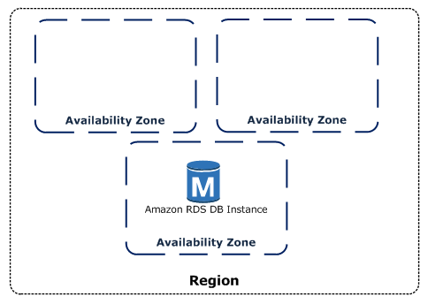

Slide 29
Amazon EC2
Amazon Elastic Compute Cloud (Amazon EC2) provides scalable computing capacity in the Amazon Web Services (AWS) cloud.
Using Amazon EC2 eliminates your need to invest in hardware up front, so you can develop and deploy applications faster.
You can use Amazon EC2 to launch as many or as few virtual servers as you need, configure security and networking, and manage storage.
Amazon EC2 enables you to scale up or down to handle changes in requirements or spikes in popularity, reducing your need to forecast traffic.

Slide 30
Features of Amazon EC2
Amazon EC2 provides the following features:
Virtual computing environments, known as instances
Preconfigured templates for your instances, known as Amazon Machine Images (AMIs), that package the bits you need for your server (including the operating system and additional software)
Various configurations of CPU, memory, storage, and networking capacity for your instances, known as instance types
Secure login information for your instances using key pairs (AWS stores the public key, and you store the private key in a secure place)
Storage volumes for temporary data that's deleted when you stop or terminate your instance, known as instance store volumes

Slide 31
Persistent storage volumes for your data using Amazon Elastic Block Store (Amazon EBS), known as Amazon EBS volumes
Multiple physical locations for your resources, such as instances and Amazon EBS volumes, known as Regions and Availability Zones
A firewall that enables you to specify the protocols, ports, and source IP ranges that can reach your instances using security groups
Static IPv4 addresses for dynamic cloud computing, known as Elastic IP addresses
Metadata, known as tags, that you can create and assign to your Amazon EC2 resources
Virtual networks you can create that are logically isolated from the rest of the AWS cloud, and that you can optionally connect to your own network, known as virtual private clouds (VPCs)

Slide 32
Session 5

Slide 33
Amazon Virtual Private Cloud (Amazon VPC) lets you provision a logically isolated section of the AWS Cloud where you can launch AWS resources in a virtual network that you define.
You have complete control over your virtual networking environment, including selection of your own IP address range, creation of subnets, and configuration of route tables and network gateways.
You can use both IPv4 and IPv6 in your VPC for secure and easy access to resources and applications.

Slide 34
You can easily customize the network configuration of your Amazon VPC.
For example, you can create a public-facing subnet for your web servers that have access to the internet. You can also place your backend systems, such as databases or application servers, in a private-facing subnet with no internet access.
You can use multiple layers of security, including security groups and network access control lists, to help control access to Amazon EC2 instances in each subnet.

Slide 35
A subnet is a range of IP addresses in your VPC. You can launch AWS resources into a specified subnet. Use a public subnet for resources that must be connected to the internet, and a private subnet for resources that won't be connected to the internet .
To protect the AWS resources in each subnet, you can use multiple layers of security, including security groups and network access control lists (ACL).

Slide 36
Route table concepts
The following are the key concepts for route tables.
Main route table—The route table that automatically comes with your VPC. It controls the routing for all subnets that are not explicitly associated with any other route table.
Custom route table—A route table that you create for your VPC.
Edge association - A route table that you use to route inbound VPC traffic to an appliance. You associate a route table with the internet gateway or virtual private gateway, and specify the network interface of your appliance as the target for VPC traffic.
Route table association—The association between a route table and a subnet, internet gateway, or virtual private gateway.
Subnet route table—A route table that's associated with a subnet.

Slide 37
Gateway route table—A route table that's associated with an internet gateway or virtual private gateway.
Local gateway route table—A route table that's associated with an Outposts local gateway. For information about local gateways, see Local Gateways in the AWS Outposts User Guide.
Destination—The range of IP addresses where you want traffic to go (destination CIDR). For example, an external corporate network with a 172.16.0.0/12 CIDR.
Propagation—Route propagation allows a virtual private gateway to automatically propagate routes to the route tables. This means that you don't need to manually enter VPN routes to your route tables. For more information about VPN routing options, see Site-to-Site VPN routing options in the Site-to-Site VPN User Guide.
Target—The gateway, network interface, or connection through which to send the destination traffic; for example, an internet gateway.
Local route—A default route for communication within the VPC.

Slide 38
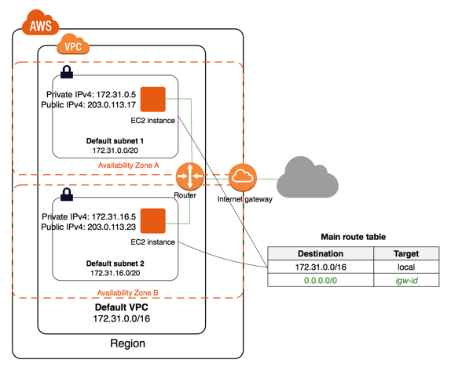

Slide 39
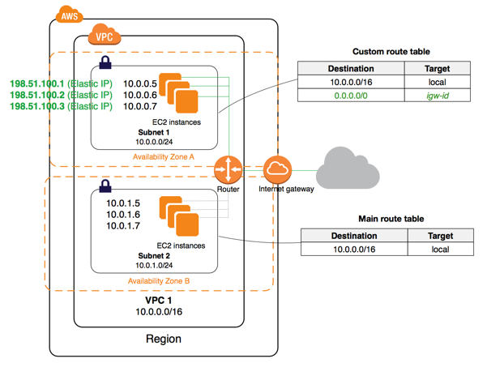

Slide 40
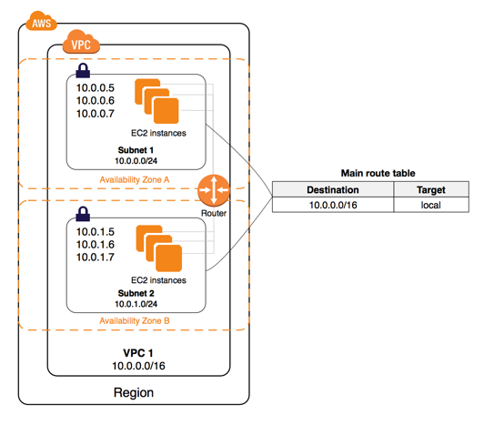

Slide 41
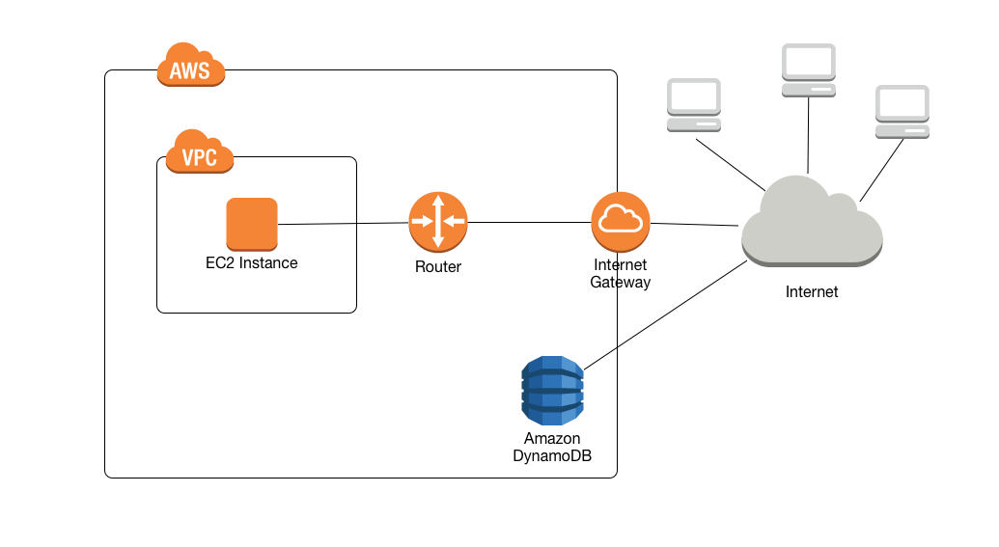

Slide 42
Session 6 & 7

Slide 43
Practice Session on:-
Configuring VPC, Subnet, NACL
IP Addressing

Slide 44
Session 8 & 9

Slide 45
VPC Security
AWS provides two features that you can use to increase security in your VPC: security groups and network ACLs. Security groups control inbound and outbound traffic for your instances, and network ACLs control inbound and outbound traffic for your subnets. In most cases, security groups can meet your needs; however, you can also use network ACLs if you want an additional layer of security for your VPC.
An instance that's launched into the VPC is automatically associated with the default security group if you don't specify a different security group during launch.

Slide 46
Security Groups:
WebServerSG: Specify this security group when you launch web servers in the public subnet.
DBServerSG: Specify this security group when you launch database servers in the VPN-only subnet.
NOTE: The instances assigned to a security group can be in different subnets. However, in this scenario, each security group corresponds to the type of role an instance plays, and each role requires the instance to be in a particular subnet. Therefore, in this scenario, all instances assigned to a security group are in the same subnet.

Slide 47
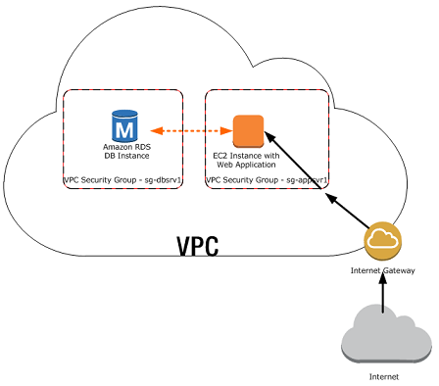

Slide 48
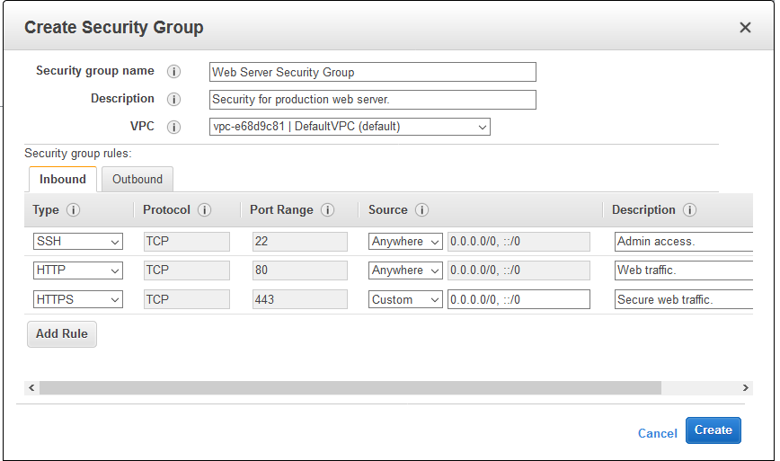

Slide 49
Inbound
Source | Protocol | Port range | Comments
The ID of your WebServerSG security group | TCP | 1433 | Allow inbound Microsoft SQL Server access from the web servers associated with the WebServerSG security group.
The ID of your WebServerSG security group | TCP | 3306 | Allow inbound MySQL Server access from the web servers associated with the WebServerSG security group.
Your network's IPv4 address range | TCP | 22 | Allow inbound SSH traffic to Linux instances from your network (over the virtual private gateway).
Your network's IPv4 address range | TCP | 3389 | Allow inbound RDP traffic to Windows instances from your network (over the virtual private gateway).
Outbound
Destination | Protocol | Port range |  | Comments
0.0.0.0/0 | TCP | 80 |  | Allow outbound IPv4 HTTP access to the internet (for example, for software updates) over the virtual private gateway.
0.0.0.0/0 | TCP | 443 |  | Allow outbound IPv4 HTTPS access to the internet (for example, for software updates) over the virtual private gateway.

Slide 50
Inbound
Source | Protocol | Port Range | Comments
0.0.0.0/0 | TCP | 80 | Allow inbound HTTP access to the web servers from any IPv4 address.
0.0.0.0/0 | TCP | 443 | Allow inbound HTTPS access to the web servers from any IPv4 address.
Your network's public IP address range | TCP | 22 | Allow inbound SSH access to Linux instances from your network (over the internet gateway).
Your network's public IP address range | TCP | 3389 | Allow inbound RDP access to Windows instances from your network (over the internet gateway).
Outbound
The ID of your DBServerSG security group | TCP | 1433 | Allow outbound Microsoft SQL Server access to the database servers assigned to DBServerSG.
The ID of your DBServerSG security group | TCP | 3306 | Allow outbound MySQL access to the database servers assigned to DBServerSG.
0.0.0.0/0 | TCP | 80 | Allow outbound HTTP access to the internet.
0.0.0.0/0 | TCP | 443 | Allow outbound HTTPS access to the internet.

Slide 51
Inbound
Source | Protocol | Port range | Comments
The ID of the security group | All | All | Allow inbound traffic from other instances assigned to this security group.
Outbound
Destination | Protocol | Port range | Comments
The ID of the security group | All | All | Allow outbound traffic to other instances assigned to this security group.

Slide 52
https://docs.aws.amazon.com/vpc/latest/userguide/

Slide 53
Session 10

Slide 54
NAT
NAT. Stands for "Network Address Translation."
NAT translates the IP addresses of computers in a local network to a single IP address. This address is often used by the router that connects the computers to the Internet. The router can be connected to a DSL modem, cable modem, T1 line, or even a dial-up modem.
Network address translation is a method of remapping an IP address space into another by modifying network address information in the IP header of packets while they are in transit across a traffic routing device.

Slide 55
NAT is a very important aspect of firewall security. It conserves the number of public addresses used within an organization, and it allows for stricter control of access to resources on both sides of the firewall.
For example a computer on an internal address of 192.168. 1.10 wanted to communicate with a web server somewhere on the internet, NAT would translate the address 192.168. 1.10 to the company's public address, lets call this 1.1. 1.1 for example. so that the internal address is identified as the public address when communicating with the outside world.

Slide 56
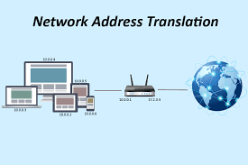

Slide 57
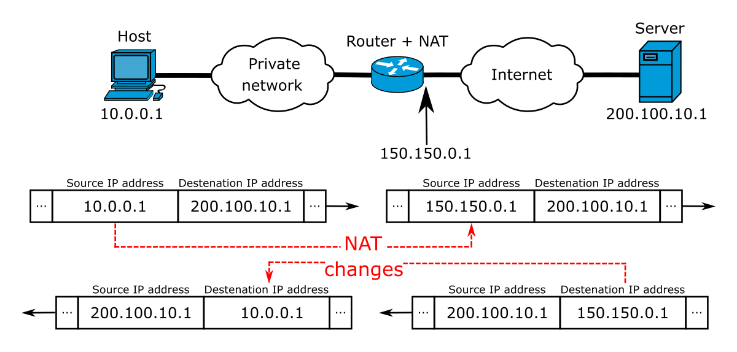

Slide 58
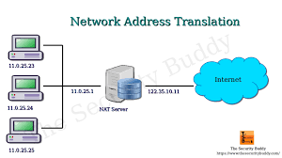

Slide 59
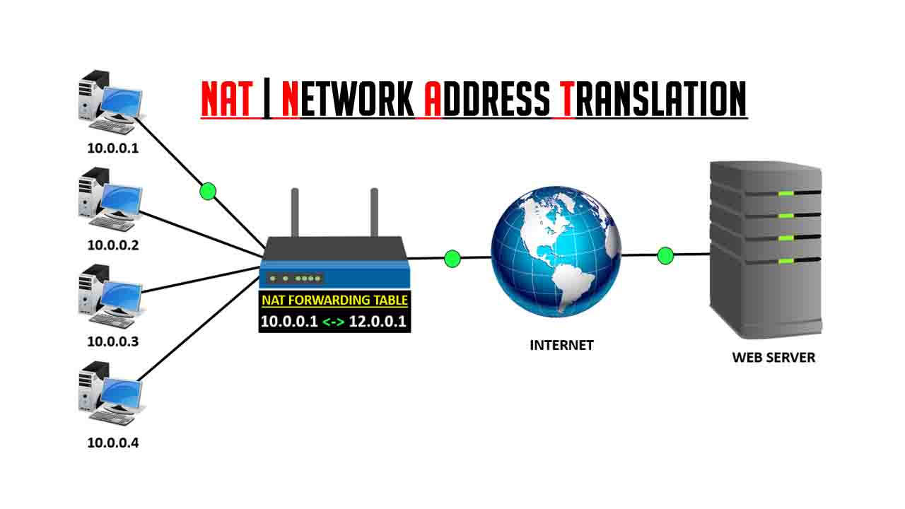

Slide 60
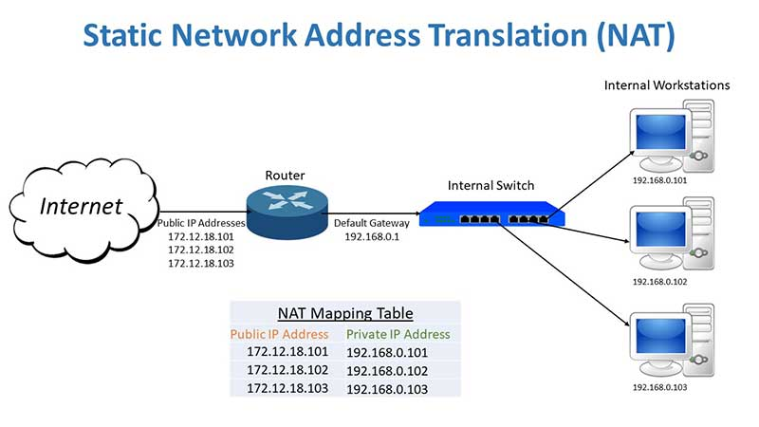

Slide 61
https://www.youtube.com/watch?v=FTUV0t6JaDA

Slide 62
Types of NAT
Static NAT
A pool of public IP addresses are assigned to the NAT device. A private IP address can then be statically mapped to anyone of these public addresses.
Dynamic NAT
Again the NAT device will consist of a pool of IP addresses. This time though the pool of IP addresses will be used when needed and then given back to the pool. So if computer A needed a public address, it would take one from the pool.
Port Address Translation (PAT)
In this type of setup, a company would only have one public IP address assigned to their network, and so everyone would share this one public address when using the internet, browsing the web for example.

