Slide 1
Agri – Input Marketing

Slide 2

































8/17/2019
Understanding Agri-Input Market
Classification
Nature of demand
Marketing environment
Marketing mix
Classification
Agri-Inputs
Consumables
Durables
Agri
Agri Implements
Product
Services
Machinary
Agri
Implements
Tractors
,
Threshers,
harveste
,
I

Slide 3
8/17/2019
Nature of Demand
Derived • Dynamic
Complementary • Recurring
Dependant • Seasonal
Relatively inelastic
Characteristics
Industrial goods
Consumer Goods

Slide 4
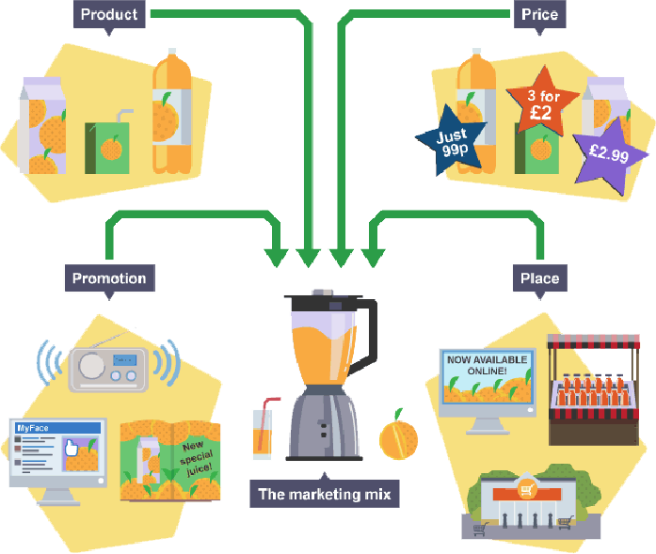
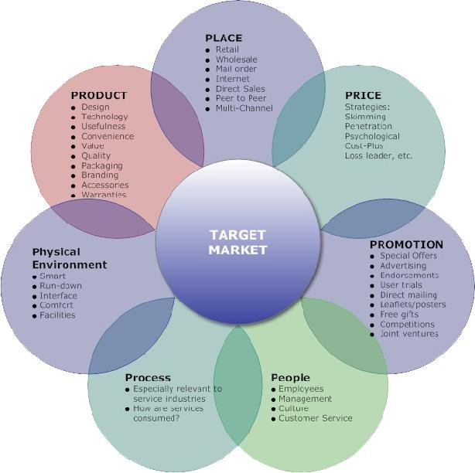
8/17/2019
Agri-Input Market
Derived & Joint Demand
Seasonal
Straight-Rebuy/Mod-Rebuy Little personal relationships Dispersed
Very Large Nos. Perfect Competition
Family involvement, influence
Longer/Indirect Low
Little personal relationships Medium
Standardised Professionally trained Mass/Ad
Little Info Exchange
Loyalty Cash/Credit
Type of Demand
Time of Demand Buy Situation Usage
Location
No. of buyers Mkt Str
Buying Influence
Distribution/Channel Cross Elasticity
B–S Relationship Price sensitivity Product
Seller Promotion
B–S Relationship
Buyer Behaviour Nature of Sales
Industrial
Consumer
Ps
4 Ps
7 Ps

Slide 5
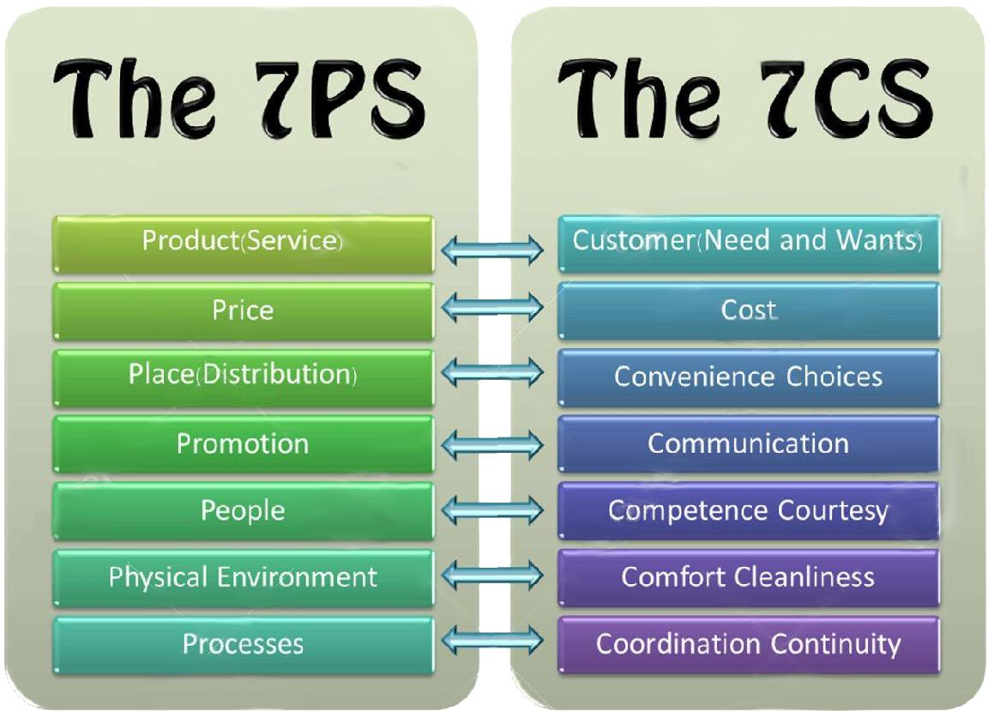


8/17/2019
4Ps - Marketing Mix
Price
  Both industrial and agri-inputs share similar response
  Both the users are concerned about quality and price. Balance
Product
  Both users are more concerned and interested to know the tech. aspects and performance
  Both seek product knowledge and advisory

Slide 6
8/17/2019
4Ps - Marketing Mix
Place
  No. of channel members
  Network intensity
  Role of channel members
  Demand creation/generation by channel
Promotion
  BTL Vs ATL
  Intensity
Characteristics
 | Consumer | Industrial | Agri-Inputs
Product |  | * | *
Place | * |  | *
Price | * |  | *
Promotion | * | * | *
People |  | * | *
Physical Env. |  | * | *
Process |  | * | *

Slide 7
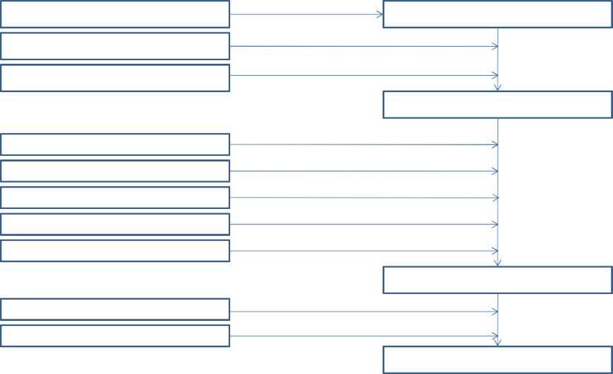
8/17/2019
Marketing Model for Agri-Inputs
R & D Agronomic potential
Output prices
Input costs
Agro-economic potential
Extension Infrastructure Transport Finance/credit Entrepreneurship
Demand Creation/Generation
Production Distribution
Consumption
Marketing Environment
Farmers perception
Demand creation
Consumption

Slide 8
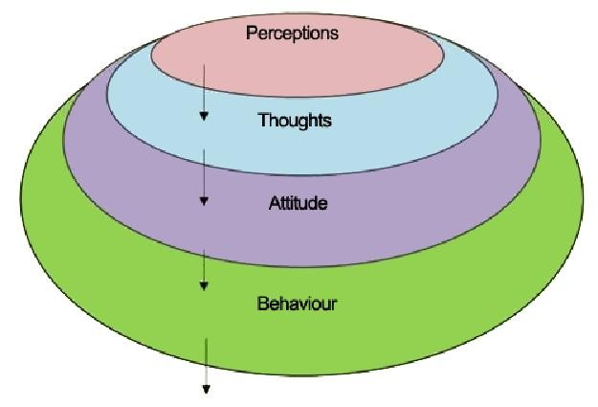
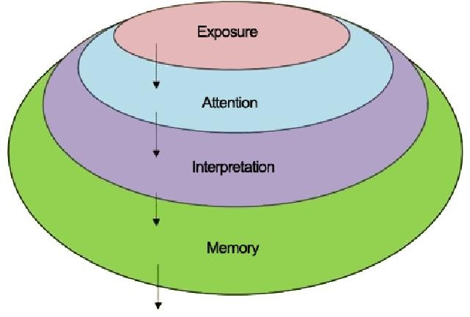
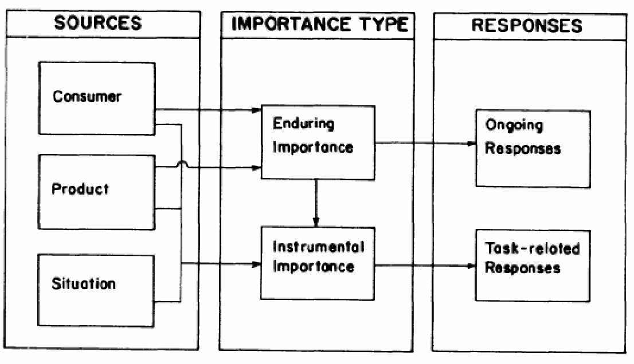
8/17/2019
Farmers Perception
Why does the farmer use inputs
  Usefulness
    Agronomic potential
      Derived
      Complimentary
      Package
» Demand?
A Model of Product Importance

Slide 9
8/17/2019
Demand Creation/Generation
Demand
  Input cost
    Input price
    Input cost
  Incremental output value
    cost
– Agro-economic potential of the Agro-input
Demand Creation/Generation
Strategies
– Pull or Push
•
•
•
– Consumer oriented or Trade oriented

Slide 10
8/17/2019
Distribution
Example
  No of products – 10
  Packs – 6
  Regions/states – 10
  Dealers – 17207
  Farmers - 9.87 million
  2 times a year
Fertilizer Sold in 2016-17
541.69 LMT
No. of Companies : 160 No. of Wholesalers : 22370 No. of Retailers : 263939
http://mfms.nic.in
Fertilisers

Slide 11
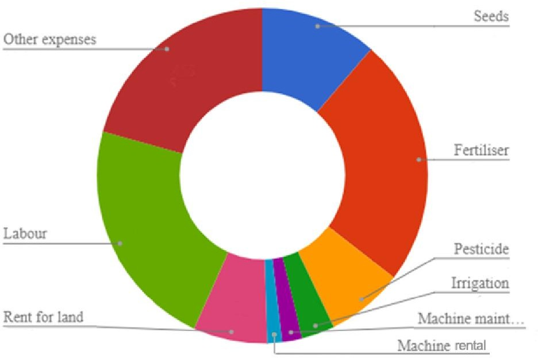
8/17/2019
Agribusiness
Input Business Output Business
Agrochemicals
  PPC
    Insecticides
    Fungicides
    Antibiotics
    Nematicide
  Herbicides
  PGR
Fertiliers
Seeds
Machinery
Finance
Cost Breakup

Slide 12
8/17/2019
Fertilisers
Synthetic or natural products applied to soil or to the foliage, supply certain essential nutrient to the plant for nutrition and growth are known as Fertilisers, Chemical Fertilisers or Commercial Fertilisers.
Salient Features
Contributes 40-50% of the agricultural productivity
3rd highest fertiliser production
Over 120 units
  57 - Large
  64 - Medium

Slide 13


8/17/2019
Industry Analysis
THREAT OF NEW ENTRANTS
BARGAINING POWER OF SUPPLIERS
INDUSTRY REVALRY
BARGAINING POWER OF BUYERS
THREAT OF SUBSTITUTES
Classification
Source
  Organic
  Inorganic
Ingredients
  Complete
  Incomplete
Physical property
  Solid
  Liquid
Packaging/Usage
  Bulk
  Specialty
Chemical Property
  Straight
  Mixed
  Complex

Slide 14
8/17/2019
What?
What is the need for fertilisers?
What is the need of the plant/crop?
What is supplied by the fertilisers?
Industry Makeup
Consumer/Customer
Channel
Importers
Manufacturers
State Governments
Government of India

Slide 15



8/17/2019
Industry Evolution
THE PAST 50 YEARS
New born independence
Famine of 50s
80% population dependent on agriculture
Contribution of agriculture to GDP-50%
National insult PL 480
Need to embark on crash programme on all fronts
Policy Requirements
Land reforms & consolidation
Development work on seeds
Irrigation
Fertilizers
Infrastructure

Slide 16
8/17/2019
THE PAST 50 YEARS
Land reforPms &OconLsoliIdaCtionY REQUIREMENT
Development work on seeds
Irrigation
Fertilizers
Infrastructure
HISTORY
1977 Introduction of RPS
1973 Rise in import prices after oil price hike
1972
1966
GoI specifies Area Quota for fertilisers under
ECA
Distribution control relaxed; focus on building good distribution system, PVT sector investment encouraged
1957 Fertiliser Control Order made effective
₁₉₅₆ Industrial policy recognises fertiliser as core sector. Fertiliser control pool created.

Slide 17
8/17/2019
HISTORY
January 2011
Nutrient Based Subsidy (NBS)
October, 2006 New Pricing Scheme (NPS)
January, 2011 Stage- III
March, 2004 New Pricing Scheme (NPS)
March, 2006 Stage- II
April 1, New Pricing Scheme (NPS)
2003 Stage - I
March 31, RPS
2003 dismantled
October Ammonium chloride, Ammonium sulphate and CAN were also
1994 removed
August Phospahtic and potassic fertilizers were removed from the RPS
1992 system
RETENTION PRICE SCHEME
Recommended by Marathe Committee
RPS Introduced in Nov. 1977
RPS covered N and P fertilizers.
Aimed at providing secured environment to attract investment

Slide 18
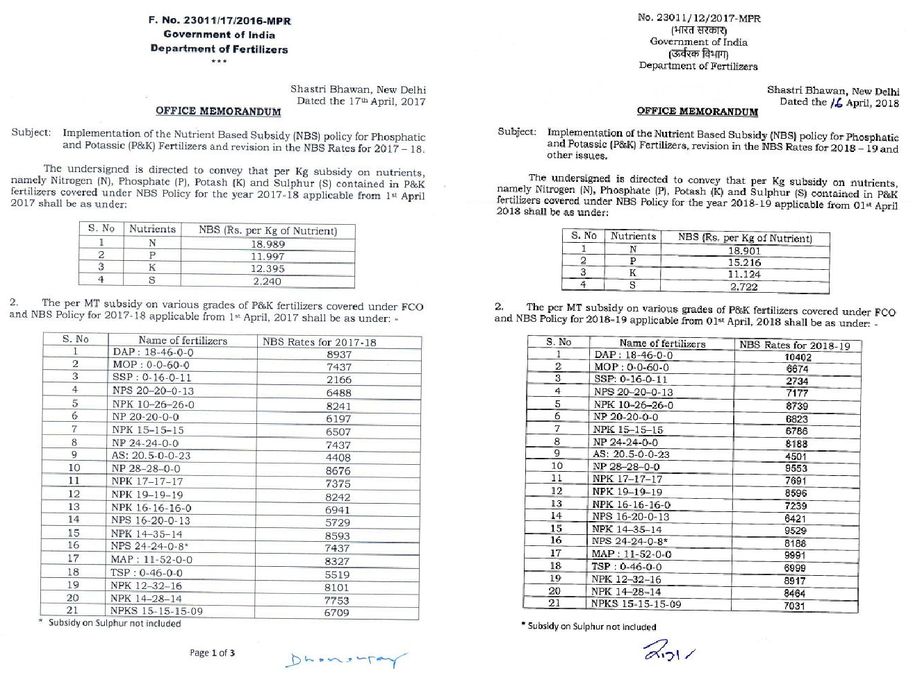
8/17/2019
RPS - Salient Features
Unit specific retention price fixed
Cost of raw material, utilities and conversion cost determined and fixed
Capital related charges included
Cost determination at normative level
Pricing period cycle – 3 Years
Escalation de escalation considered quarterly

Slide 19
8/17/2019
Grades of Fertilizers
DAP : 18-46-0-0 | 14–28–14-0
MAP : 11-52-0-0 | 14–35–14-0
TSP : 0-46-0-0 | 15–15–15-0
MOP : 0-0-60-0 | AS: 20.3-0-0-23
16-20-0-13 | 20-20-0-0
20–20–0-13 | 28–28–0-0
23–23–0-0 | 17–17–17-0
10–26–26-0 | 19–19–19-0
12–32–16-0 | SSP(0-16-0-11)
 |  | Grades of Fertilizers
 |  | DAP (18-46-0-0) |  | 15-15-15-0
 |  | MAP (11-52-0-0) |  | 17-17-17-0
 |  | TSP (0-46-0-0) |  | 19-19-19-0
 |  | MOP (0-0-60-0) |  | Ammonium Sulphate (20.6-0-0-23)
 |  | SSP (0-16-0-11) |  | 16-16-16-0 (w.e.f. 1.7.2010)
 |  | 16-20-0-13 |  | 15-15-15-9 (w.e.f. 1.10.2010)
 |  | 20-20-0-13 |  | 24-24-0-0 ( w.e.f. 22.6.2012)
 |  | 20-20-0-0 |  | DAP Lite(16-44-0-0) (w.e.f. 1.2.11)
 |  | 28-28-0-0 |  | 24-24-0-8 (wef 12.11.13 to 14.2.15) without subsidy on S
 |  | 10-26-26-0 |  | DAP 4S (w.e.f. 25.2.13 to 7.11.13) without subsidy on S
 |  | 12-32-16-0 |  | DAP Lite-II(14-46-0-0) (w.e.f. 30.8.2011 to 29.8.2012)
 |  | 14-28-14-0 |  | MAP Lite (11-44-0-0) (w.e.f. 30.8.2011 to 29.8.2012)
 |  | 14-35-14-0 |  | 13-33-0-6 (w.e.f. 30.8.2011 to 29.8.2012)
SOLUBLE FERTILIZERS
S.No | Particulars
1 | Krista – K (KNO₃)
2 | CaNO₃
3 | 19:19:19
4 | 20:20
5 | SOP (0-0-50-17)
MICRONUTRIENTS
S.No | Particulars
1 | Photosal Garden mix
2 | Rose mix
3 | Micronol
4 | Jayamin
5 | Coconut micronutrient
6 | Zinc Sulphate
7 | Copper Sulphate
8 | Magnesium Sulphate
9 | Manganese Sulphate
10 | Ferrous Sulphate
11 | Neem cake
12 | Borax (10 %)
13 | Borax (20 %)

Slide 20

8/17/2019
Global Consumption of Fertilizer by Nutrient
250
N
P2O5
K2O
Total
200
182.8
186.7
199.4
in million metric tons
150
100
111.3
113.7
119.5
50
41.8
29.7
42.2
30.8
45.9
34.0
0
2013
2014
2018
IFA
Global Fertilizer Consumption
(kg/ha of arable land)
200.0
180.0
160.0
140.0
120.0
100.0
80.0
World India
170.98
137.6
106.4
100.33
60.0
40.0
20.0
0.0
2002
2003
2004
2005
2006
2007
2008
2009
2010
2011
2012
2013
2014
2015
Worldbank

Slide 21
8/17/2019
Regional and Subregional share of World Increase/Decrease in Fertilizer Consumption & Supply, 2014-2018
 | N | N | P | P | K | K
Africa
North Africa | 2.5 | 19.7 | 2.1 | 37.4 | 0.5
Sub-Saharan Africa | 5.4 |  | 2.0 |  | 5.3
Americas
North America | 4.8 | 14.1 | 2.7 | -6.6 | 2.2 | 53.3
Latin America & Caribbean | 17.6 | 7.4 | 26.1 | 3.7 | 24.3
Asia
West Asia South Asia
57.7
42.1
4.1 8.1
24.5 3.4
57.6
62.8
7.3 24.9
31.3 2.6
56.3
1.2
_{12.0} 19.3
East Asia | 29.1 | 30.6 | 19.0 | 35.3 | 35.8 | 12.0
Europe
Central Europe | 3.3 | 0.9 | 2.9 |  | 2.8
West Europe | -1.5 |  | 0.3 |  | 2.0 | -0.5
East Europe & Central Asia | 9.0 | 16.0 | 5.9 | 3.0 | 6.0 | 34.8
Oceania http://www.fao.org | 1.3 | 0.4 | 0.5 |  | 0.4

Slide 22
8/17/2019
Production and Reserves of
Potash
in million tonnes
Country | Production | Reserves
Canada | 12.0 | 1,000
Russia | 7.2 | 500
Belarus | 6.4 | 750
China | 6.2 | 360
Germany | 2.9 | 150
Israel | 2.2 | 270
Jordan | 1.3 | 270
Chile | 1.2 | 150
Spain | 0.7 | 44
United States | 0.5 | 210
United Kingdom | 0.5 | 40
Brazil | 0.3 | 24
Other countries | 0.5 | 90
World total | 42.0 | 3,900
Industry Drivers
Government Policy
  EXIM
  Subsidy
  FCO
  Output Market
Production
  Raw Material
  Location
Marketing
  Distribution
    Primary
    Secondary
    Warehousing
  Seasonality

Slide 23
8/17/2019
Government Policy
EXIM Policy
  Import
  Export
Subsidy
  Production
  Transport
  Payment
ECA
  FCO
    Grades
    Quality
    MRP
    Movement
Output Market
  Policy
  Regulated markets
  Traders
  MSP
Government Policies
Essential Commodity Act - 1955
Fertiliser Control & Movement Order – 1985
  Production
  Packaging
  Movements
  Labeling
  Selling
  Reporting
The Legal Metrology Act, 2009 # No. 1 of 2010
  The Standards of Weights And Measures Act -1976
•

Slide 24
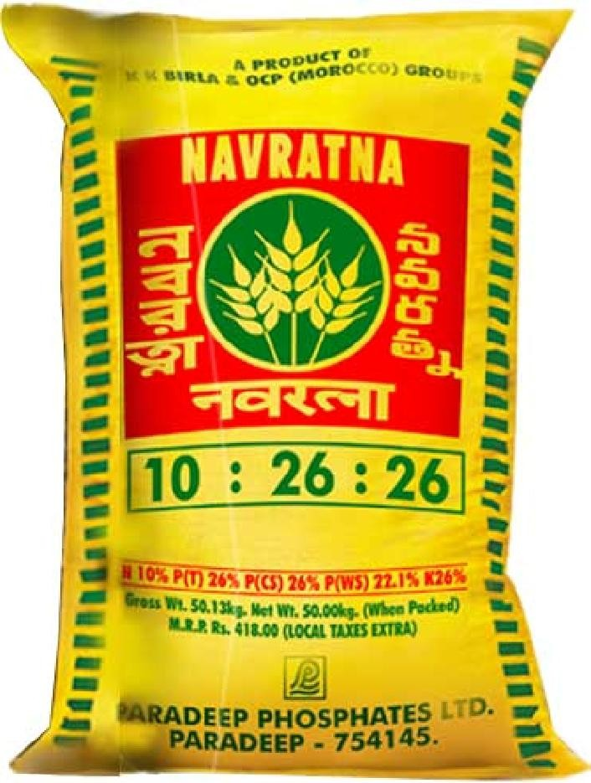

8/17/2019
Production
Raw Material
  Sourcing of Raw Material
    Imported – RP, S and MOP
    Quality, Cost, Time
  Production Efficiency
Use of cheap and efficient technology
The value addition very limited
Geographic
  Location of Plant
    Complex units limited to east & west coast
    Urea units in the East (3.15) North (79), West (95) and South India (30) – Lakh MT
  Markets – Across the country

Slide 25
8/17/2019
Inventory
Inventory Management
  Cost of warehousing
  Cost of capital
  Opportunity cost
  Deterioration of quality
    Physical Quality
    Chemical Quality
Channel
Questions
  How to reach the consumers
  How to control costs and save time
  How to build a competitive advantage
Decisions
  Types
    Indirect distribution
    Direct distribution
    Intensive distribution
    Selective distribution
    Exclusive distribution
  Development
  Management
    Service
    Motivation
    Conflict

Slide 26
8/17/2019
Credit
Channel Credit
  Assessment – no records available
    Geographic location
    Dealer
      Personal standing
      Period in business
      Type of firm – proprietor, partnership, etc
      Types of business – multiple business
      Infrastructure
» Warehouse – Nos. & capacity
» Vehicles
» Manpower – skilled, semi-skilled & unskilled
Credit contd…
Sales - Retail Vs Wholesale
– Financial
» Own investment
» No. of banks operating
» Banker opinion
– Past record - U and others
» Sales volume
» Payment schedule
» Relationship
Limit finalisation
Control
Indicators
  Delay in payment
  Cheque dishonour
  Under cutting
  Diversification – no synergy

Slide 27
8/17/2019
Market Scenario
Channel
  Investment is shrinking
  Number of players increasing
  Profit margins reducing
Farmer Purchasing power
Very poor growth rate
Customer spread
  593 Districts
  6.38 lakh villages
  1273 Lakh farmers
Changing requirements
  Dependant on crop
    Crop coverage – climate, price etc
    Soil status
  Season
  Government policy
    Restrictions
TRENDS
Focus is shifting from maximizing yield
to
maximizing value by meeting a specific quality standard with a minimum of reject.
Quantity
Quality

Slide 28
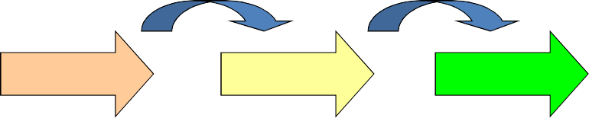
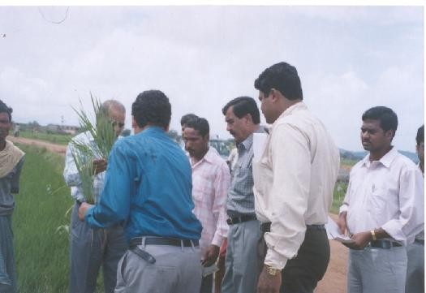
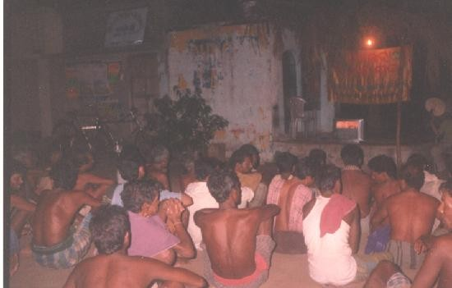
8/17/2019
2
Focus is shifting from single products to creating value through a balanced, crop specific plant nutrition concept
Product
Application
Quality Crop
3
Crop Competence will become more and more crucial, but even more so the capacity to transmit the superior knowledge to the end user (the farmer)

Slide 29
8/17/2019
4
Environmental and ecological factors gain importance
Will lead to continued growth in fertigation (5-6% p.a)
Could mean a clear growth in foliar application as means of optimal application
More attention to localised inputs such as placement
Continued focus on transparency in the value chain
Agrochemical & Crop Protection Industry

Slide 30




8/17/2019
CLASSIFICATION
Chemical Nature
  Organic
    Natural - Rotenone and pyrethrum
    Synthetic - permethrin, malathion, glyphosphate etc
  Inorganic
Target Pest
Chemistry
  Organochlorines – Chlordane, DDT
  Organophosphates - Malathion
  Carbamates - Propoxur
Mode of Action
  Stomach toxicants
  Contact toxicants
  Fumigants
  Systemic toxicants
  Chemical repellents
CLASSIFICATION - FORMULATION
Dry
Applied as Liquid sprays
(undiluted or with little dilution with
DP GR MG
organic substances)
Formulation for Baiting
ULV UL, OF
Fogging HN, KN
Seed Treatment
Fumigants and Smoke For Mixing and Spraying with water
Others
PO – Pour on GS – Grease
SL, SP WP EC SC WG

Slide 31
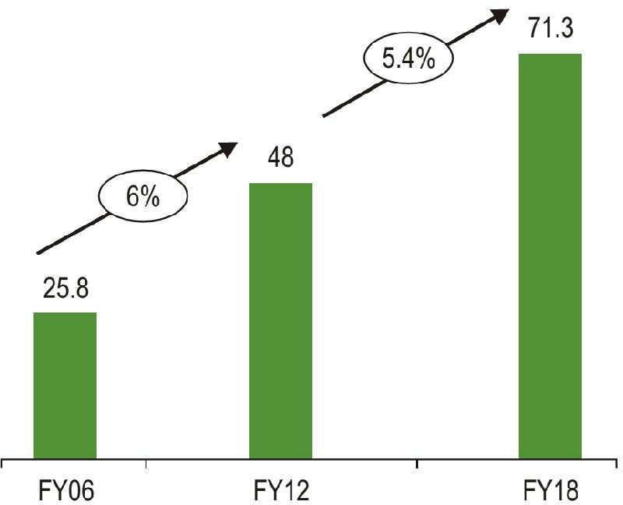
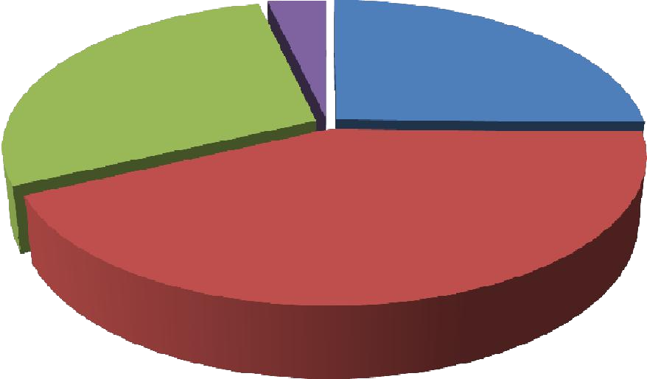
Global Agrochemical Market
8/17/2019
($ million)
(USD Bn)
Market segment | 2017 | % change | 2018
Crop protection | 54,319 | 5.6 | 57,561
Non-crop pesticides | 7,311 | 3.0 | 7,538
Total | 61,630 | 5.3 | 65,099
Crop Protection Market by Category
Others 4%
Fungicide 28%
Insecticide 25%
Herbicide 43%
Source: www.agrow.com

Slide 32

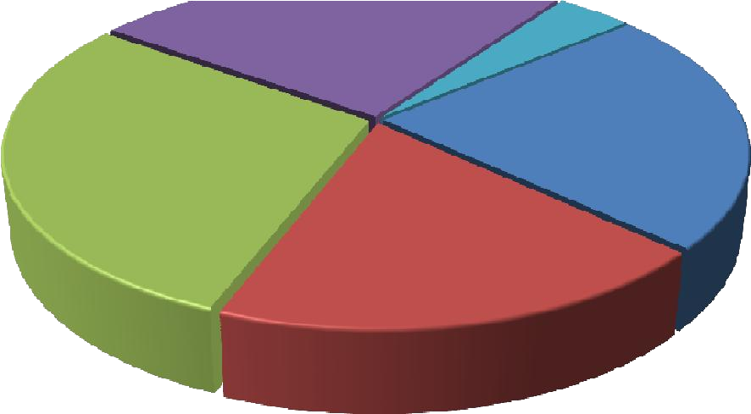



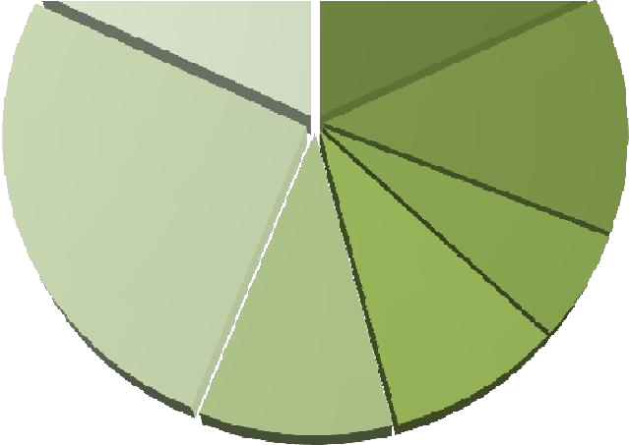
8/17/2019
Geographical share of Global Crop Protection Industry 2018
Middle East/Africa, 2267
($ million)
Asia, 25%
ROW, 4%
North America, 23%
Europe, 29%
Latin America, 19%
Asia/Pacific,
4% 17489
30%
North America, 11623
20%
Latin America 214181
25%
Europe, 12001
21%
Global PPC Market by Crops
Others, 18
Cereals, 18
Maize, 13
F & V, 26
Cotton, 6
Rice, 9
Soybean, 10

Slide 33
8/17/2019
Industry Structure
Agrochemicals
  Technical grade manufacturers - 125,
  Formulators - 800 and
  Distributors - 1,45,000
  4th Largest producer
  Major exporters of agrochemicals
India
About 20%-40% crop production is lost due to insects, weeds and diseases.
Crop protection chemicals usage is one of the lowest and erratic in the global scenario.
Consumption of pesticides in
  India is 0.6 Kg/ha as compared to
  World average is 3kg/ha.
  Highest is 17kg/ha.

Slide 34
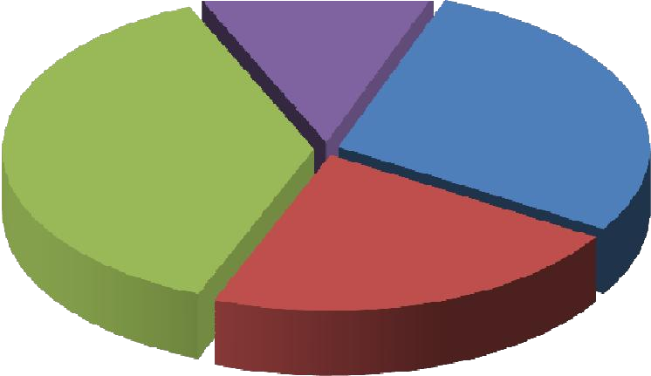

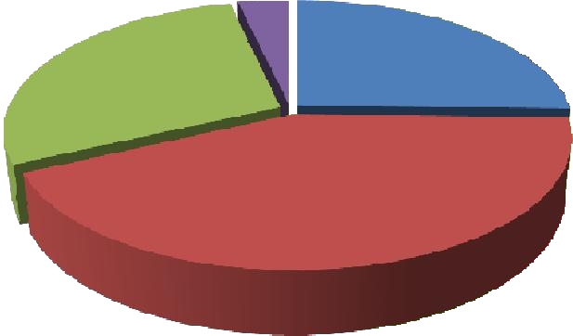
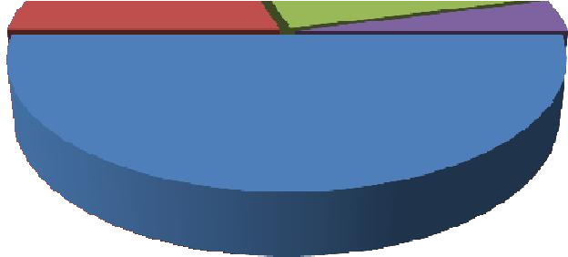


8/17/2019
Indian Crop Protection Industry
Crop Loss
World
Fungicide 28%
Others 4%
Others
India
Insecticide 25%
12%
Herbicide, 20
Insect 28%
Fungicide, 26
Weeds 38%
Others, 4
Herbicide 43%
Disease 22%
Insecticide, 50
Indian PPC Market by Crops
Cereals Millets & Oilseeds, 7
Others, 1
Paddy, 18
F & V, 14
Sugar cane, 2
Plantation Crops, 8
Cotton, 50

Slide 35
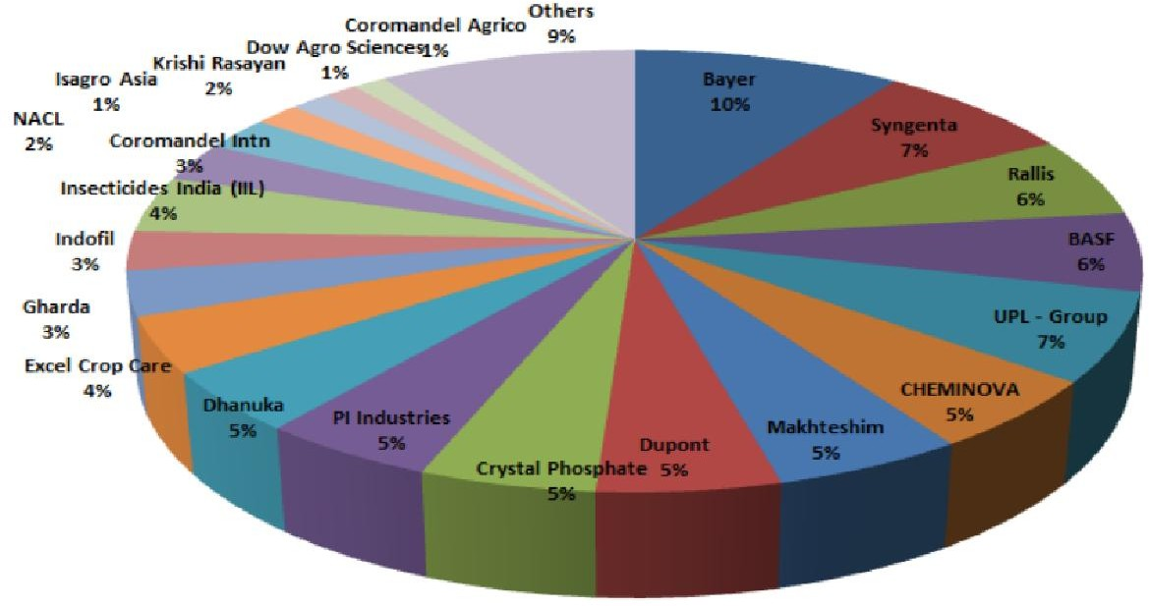











8/17/2019
Company wise Market Share
State wise PPC Consumption
30
%
25
24
20
15
13
11
13
10
8
7 7
5 5 5
5
2
0
AP Maharashtra Punjab Karnataka Gujarat MP & CG Tamil Nadu Haryana West Bengal Odisha Others

Slide 36
8/17/2019
It can take
  10 years and
  cost over € 200 million to turn an interesting molecule into a product that farmers can use.
What’s more, there are no guarantees. A potential product can fail at any point along the way - 1:1,00,000 rule .
Laws & Acts
The Insecticides Act, 1968 and
Insecticides Rules, 1971
  Regulate the import, registration
process, manufacture, sale, transport, distribute and use of insecticide in India.
Central Insecticides Board & Registration Committee (CIB & RC)
  All insecticides (pesticides) have to necessarily undergo the registration process before they can be made available for use or sale.

Slide 37
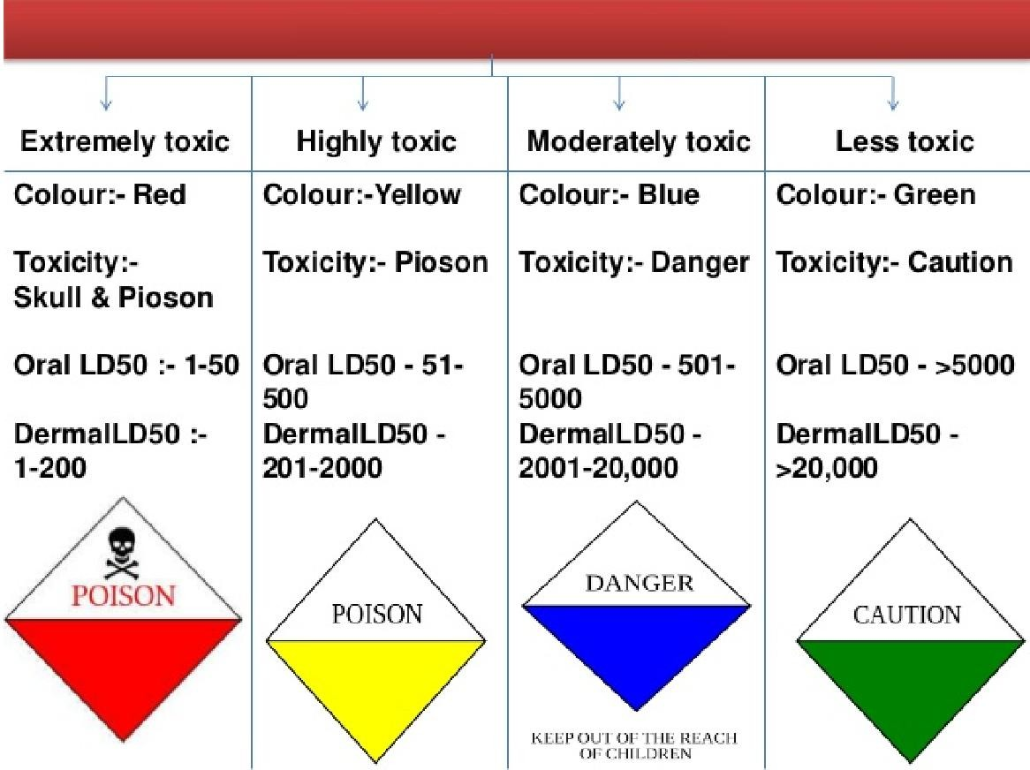
8/17/2019
Other Uses
Pest Control Services
  Household pest control
    Fly
    Rodents
    Mosquito
    Ant
Disinfestation of
  Ships
  Aircrafts
  Trains
  Buses
Stored grain pest control/management

Slide 38
8/17/2019
Indian Seed Industry
Definition
Any part of the plant used for crop
cultivation may agriculture.
Botanically
be defined as seed in
– A seed may be define as a mature ovule consisting of an embryonic plant (dormant) together with a store of food, all surrounded by a protective coat.

Slide 39
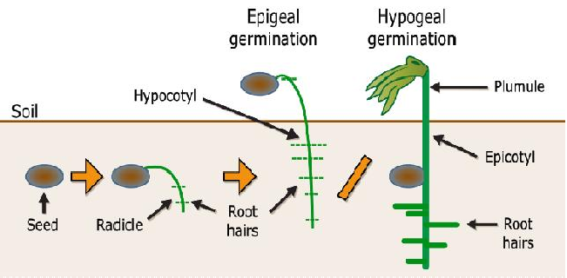
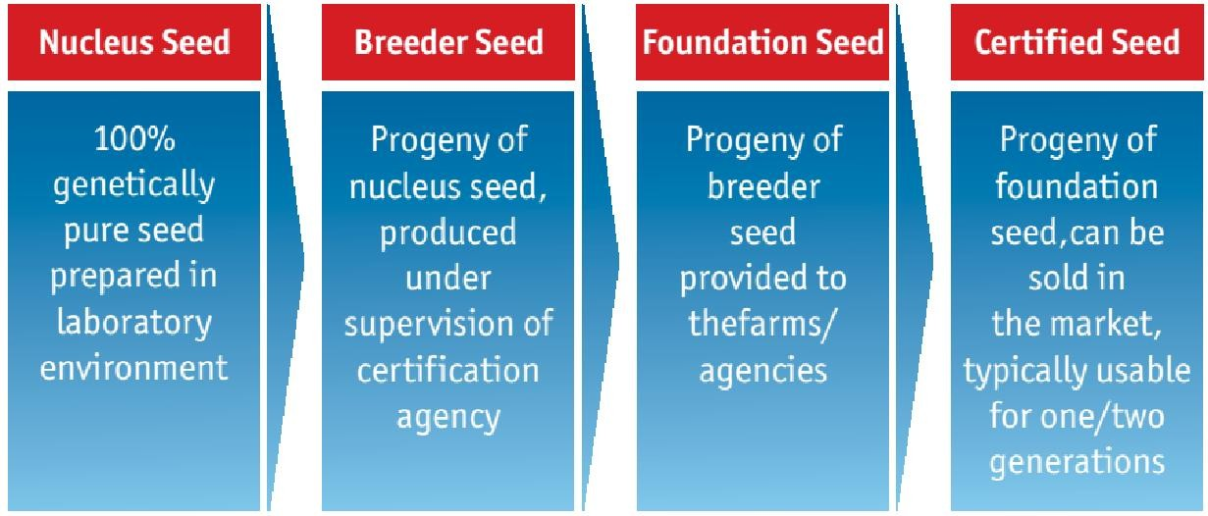
8/17/2019
Classification
Agriculture
  True seed
  Vegetative seed
Cotyledons
  Dicotyledonous
  Monocotyledonous
Germination
  Hypogeal
  Epigeal
Botanically
  Naked seed
  Covered seed
Classes of Seeds
There are 4 generally recognized classes of seeds
– Nuclear seed
– Breeder seed A pedigree certificate
– Foundation seed
– Registered seed
– Certified seed
– Truthful labeled seed
100% Genetic purity
99.5% Genetic purity
99% Genetic purity

Slide 40
8/17/2019
Certified & Truthful Labeled Seed
Certified seed | Truthfully Labeled Seed
It is the progeny of foundation seed. | Produced by cultivators, private seed companies.
Certification is voluntary. Quality guaranteed by certification agency. | Truthful labeling is compulsory for notified kind of varieties
Applicable to notified kinds only | Applicable to both notified and released varieties
It should satisfy both minimum field and seed standards | Tested for physical purity and germination
Seed certification officer, seed inspectors can take samples for inspection | Seed inspectors alone can take samples for checking the seed quality.
Global Scenario
Increasing global seed market
Growing use of hybrid seed
Growing international seed trade
Increasing number of regulations
Increasing number of multinational companies

Slide 41
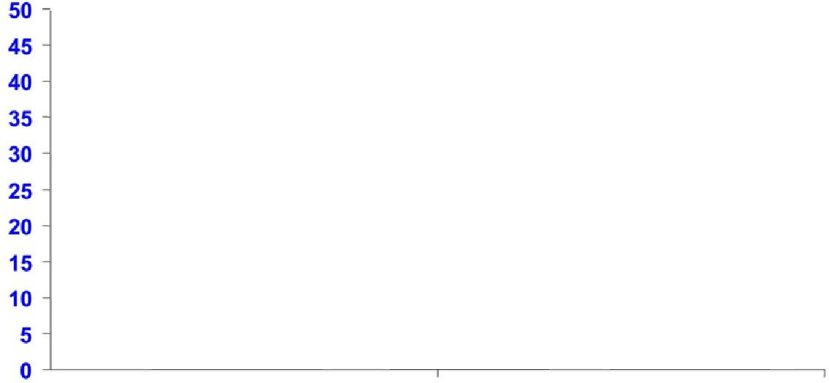
8/17/2019
The World Seed Market
67 Billion
38 Billion
Total Seed Field Crops Vegetable Flower
(Including Farmers Saved Seed)
Commercial seed market
6.8 b$ Veg. Seed
27.2 b $ Cereal Seed
(20.3 non GM
+6.9 GM)
20% Veg. seed
80% Field Crops & others
The World Seed Market
Market estimated to grow at same rate crossing USD 92 billion by 2020
USA, France, China, Brazil and India contributing to 70 % of total global market
International seed business grown three times over last decade

Slide 42
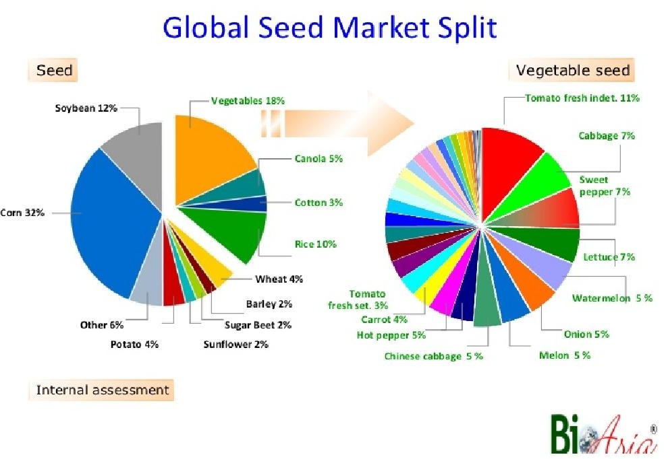
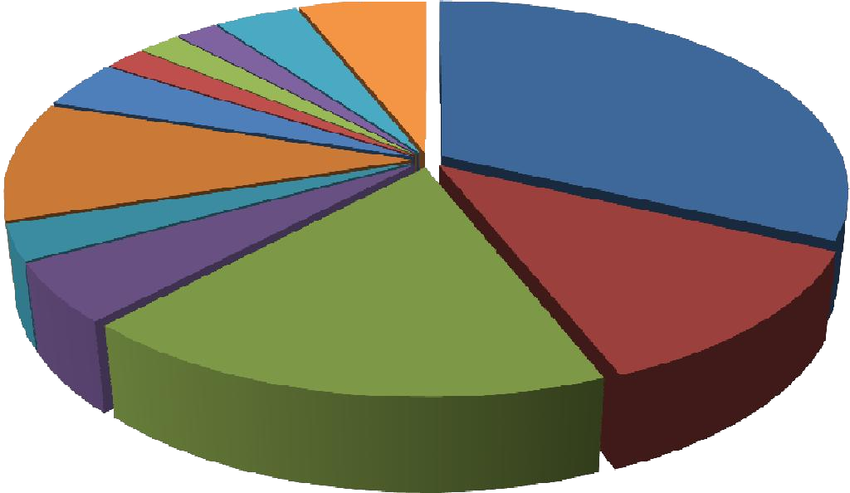
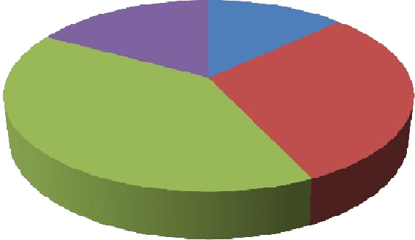
8/17/2019
Sunflower, 2
Others, 6
Sugar beet, 2
Barkey, 2
Potato, 4
Wheat, 4
Rice, 10
Cotton, 3
Canola, 5
Corn, 32
Soybean, 12
Vegetables, 18
Indian Scenario
Fifth largest seed market – 5% of global market
Growth rate of 12%
Dominated by open pollinated seeds
Approx. 200 Pvt Co & 14 Govt. organizations
Total Seed Industry is worth about 14000 cr
  Cereal - 6000 cr
  Cotton - 2000cr
Unorganised
Rice OP and hybrids - 1000 cr
Maize - 800 cr
Vegetable - 1500 cr
Medium Pvt Sector, 17%
Sector, 13%
Public Sector, 30%
Large Pvt Sector, 40%

Slide 43
8/17/2019
The Seed Industry - A Time Line
Pre independence
  No organized seed production
  Very few seed companies– Suttons and Sons in Kolkata
  Royal commission of Agriculture (1925) recommended spread of improved varieties and seed distribution
Post independence
  National Seed Corporation (NSC) in 1963
  The Seeds Act, 1963 (1966)
  New Seeds Policy, 1988
Public vs. Private
The Indian public sector seed industry used to dominate the private sector in the very beginning
The situation is quite reversed currently
Seeds of the private hybrids are forming a significant portion of the total vegetable seed market
Most of the public sector varieties and hybrids are replaced by private sector varieties and hybrids, seed production of which is solely done by the particular manufacturers

Slide 44

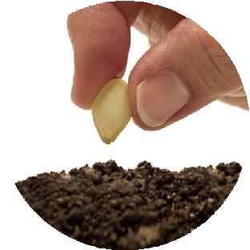
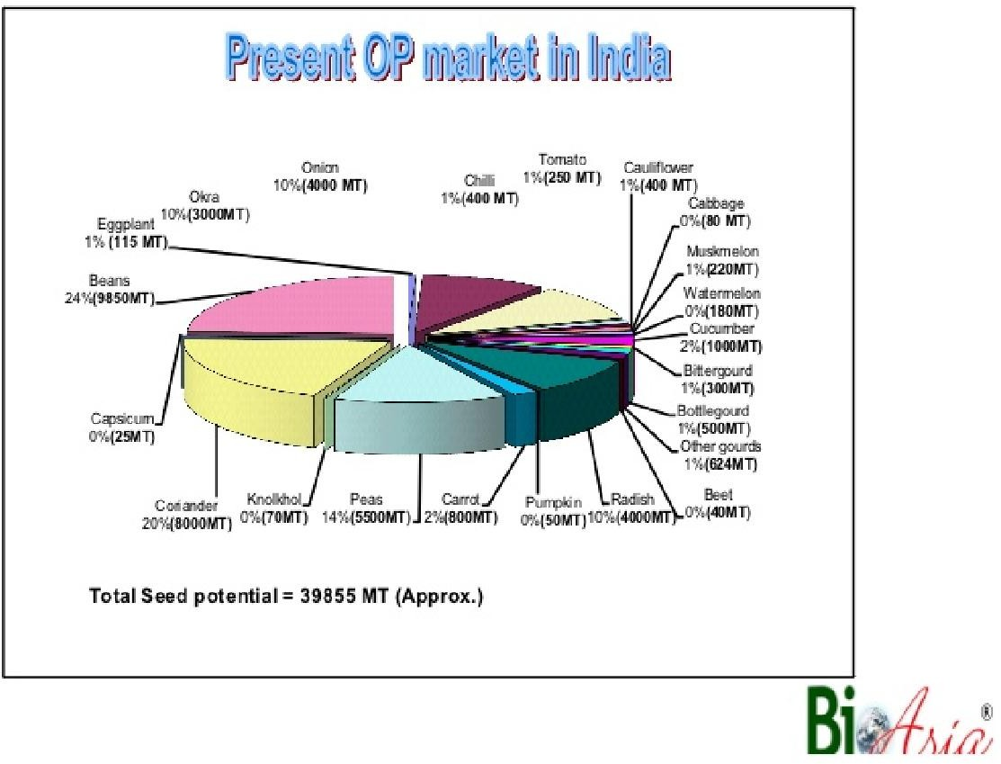
8/17/2019
70% Saved Seeds; 30% Marketed Seeds
75% Organised; 25% Unorganised
60% Public Sector; 40% Private Sector

Slide 45
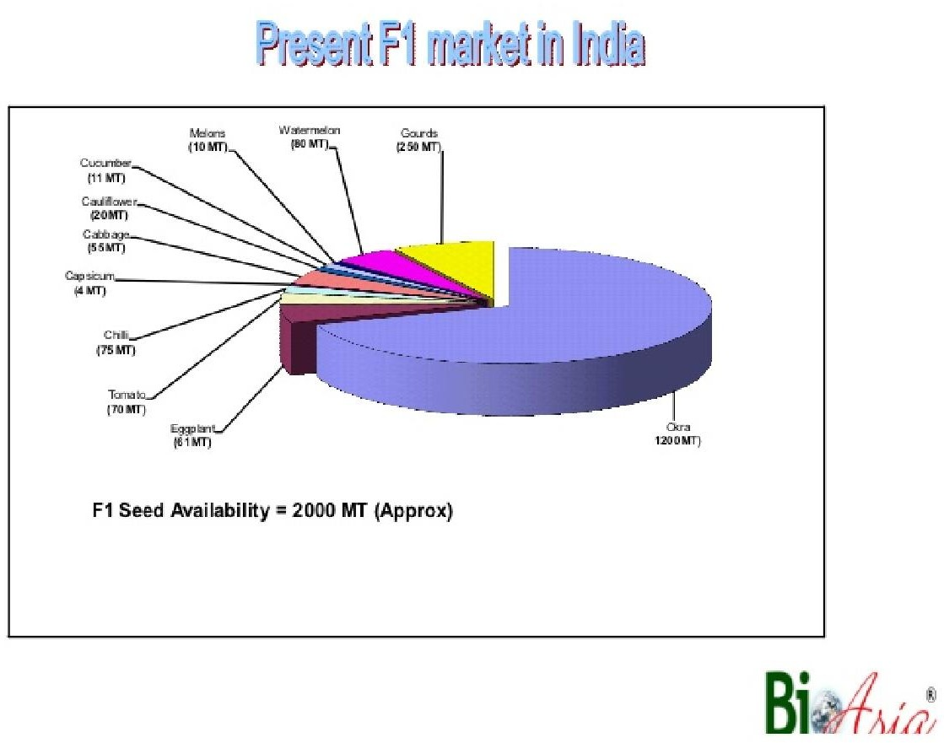
8/17/2019
Concerns
Long production time
Very wide range of requirement
Cumbersome registration process
Markets very competitive
Seasonal demand
Perishable product line
Vulnerable to environmental forces
Quality assurance
Cash flow – long
Inventory management
Unlike cereals, vegetable seeds are not the edible portions
Large area of land for seed production

Slide 46













8/17/2019
SRR in Different Crops and States
Crop | National Average SRR | Highest SRR |  | Lowest SRR
 |  | % | State | % | State
Paddy | 33 | 82 | AP | 9 | Uttarakhand
Wheat | 25 | 42 | Maharashtra | 11 | J&K
Maize | 50 | 100 | Karnataka | 5 | Orissa
Jowar | 26 | 65 | AP | 11 | Tamilnadu
Bajra | 63 | 100 | Gujarat | 29 | Karnataka
Sunflower | 43 | 100 | AP | 8 | MP
Reasons for Low SRR
Lack of Transfer of knowledge form R&D to farmers
Farmers are generally not aware of the correct package of practices and replacement schedule of seed
Fake & Spurious seeds
Need State policy implementation efforts for tech transfer
Farmers use crop produce as a seed resulted in low demand for quality seed
Low SRR
Companies are not in interested for neglected crop/orphan crop seeds.

Slide 47
8/17/2019
Terminator technology
Terminator technology is the genetic modification of plants to make them produce sterile seeds. They are also known as suicide seeds.
Patented in the US by subsidiary of Monsanto – Delta and Pine Land Company
  GURTs - Genetic Use Restriction Technologies
    V – GURTs – terminator technology
    T – GURTs – traitor technology
PPVR & FR
Act passed in 2001
  Right 1: Access to seed
  Right 2: Benefit sharing
  Right 3: Compensation
  Right 4: Reasonable seed price
  Right 5: Farmers’ recognition and reward for contributing to conservation
  Right 6: Registration of farmers’ varieties
  Right 7: Prior authorization for the commercialization of essentially derived varieties
  Right 8: Exemption from registration fees for farmers
  Right 9: Farmer protection from innocent infringement

Slide 48
8/17/2019
Seed Testing
Sampling
  Field
  Laboratory
Analysis of seed in the laboratory
  Purity analysis of seed lot is considered under two factors
    Testing the cleanliness of seed lot and
    Testing the geneuiness of the cultivar – genetic purity
      Morphological Tests – Grow out test
      Chemical Tests
      Biochemical Tests - Electrophoresis
      Molecular markers – Gene / DNA
  Test Wt.
  Moisture
  Viability - TZ test
  Germination and
  Vigour

Slide 49
8/17/2019
Industry Analysis
Buyer’s Power
New Entrants
Supplier’s Power
Rivalry
Substitutes
Seed Regulation in India
Seed Regulations & Seed related laws in India | Key Points
Seeds Act (1966) | Passed by the Indian Parliament in 1966 was designed to create a ‘Climate’ for making good quality seed available to cultivators. The major legislative measures involved under the Act are Seeds rules framed in 1968, Seeds (Control) order, formulated in 1983 after including seeds as an essential commodity. Seeds of food crops, oil crops, cotton seeds, seeds of cattle fodder and all types of vegetative propagating material are included under the act. A total of twenty five clauses have been mentioned in the act. The legislation could be broadly divided into two groups i.e. Sanctioning legislation and Regulatory legislation. Post the enactment of Seed Act in 1966 and framing of seeds rules in 1968 amendments were brought to the Seed Act in 1972, 1973, 1974 and 1981.
Seeds (Control) Order, 1983 | The inclusion of seeds as an essential commodity item under the Essential Commodity Act, 1955 brought the Seeds (Control) Order. The ministry of civil supplies earlier has declared the seed for sowing or planting materials of food crops, fruits, vegetables, cattle fodder and jute to be essential commodities in exercise of power conferred by Section 2(a) of Essential Commodities Act, 1955. The order confers power to the Central Govt. to control, and regulate production, supply and distribution of essential commodities.

Slide 50
8/17/2019
Seed Regulations & Seed related laws in India | Key Points
New Seed Development Policy (NSDP) 1988-89 | The New Seed Development Policy was formulated to provide Indian farmers with access to the best available seeds and planting materials of domestic as well as imported quality. The policy permits the import of selected seeds under Open General License (OGL), to make available to the farmers high quality seeds to maximize yield and productivity. The policy allows import under OGL of items such as seeds of oilseed crops, pulses, coarse grains, vegetables, flowers, ornamental plants, tubers, bulbs, cuttings and saplings of flowers.
Protection of Plant Varieties and Farmers Right Act, 2001 | The Protection of Plant Varieties and Farmers Rights Act, 2001 (and rules, which were released in 2003), provide for the protection of intellectual property rights of seed manufacturers, who are required to register /notify the seed which they want to be placed under protection. After due diligence, and establishment of the fact, protection is granted to the variety for a period of 15 years. This legislation ensures not only the protection on intellectual property rights of the company incurring the cost of research and development (in the market at large), but also those of the farmer whose land is being utilised for the production of the concerned seeds.
National Seed Policy, 2002 | National seeds policy was formulated in the year, 2002 to provide an appropriate climate for the seed industry to utilize available and prospective opportunities, safeguarding the interest of farmers and conservation of the biodiversity. The policy raised India’s share in the global seed trade by facilitating advanced scientific aspects such as biotechnology to farmers and as a result, in March 2002, the first transgenic Bt. cotton was approved for commercial cultivation in India.
Seed Regulations & Seed related laws in India | Key Points
Protection of Plant Varieties Rules, 2003 | The rules were enforced for the smooth implementation of the Act, 2001. The rules provide detailed procedures while applying for protection, ways of administering the national gene fund, procedure on application for compensation, procedure to alter the denomination of a registered variety, procedure for cancellation of certificate and all other procedures to be implemented as per the provisions given in the PPV & FR Act, 2001
Seed Bill 2004 | With a view to repealing and replacing the Seed Act 1966, the Seed Bill 2004 was introduced. Among others, one of the notable exemptions provided in the Bill with regard to farmers’ seed was: "Nothing in this Act shall restrict the right of the farmer to save, use, exchange, share or sell his farm seeds and planting material, except that he shall not sell such seed or planting material under a brand name or which does not conform to the minimum prescribed limit of germination, physical purity, genetic purity". An amended Seed Bill was introduced in 2008 has not been enacted thus far. Therefore, the Seed Act 1966 and its amendments are still in force.

Slide 51
8/17/2019
Bill 2004 and PPV & FR Act, 2001
Seed Bill 2004 | PPV & FR Act, 2001
Farmer has to claim compensation from a consumer court and redressal under the Consumer Protection Act, 1986 | Farmer get compensation from the PPV authority which is all the more simpler
Does not require the declaration of origin of variety along with pedigree details | Requires the declaration of origin of variety along with pedigree details
Does not grant any recognition to the contribution of farmers | Provides rewards for farmers contribution and also the benefit sharing
Seed dealers are not under any obligation to provide reasonable seed supply to farmers | Provides compulsory licensing which safeguards the interests of farming community to ensure adequate seed supply at reasonable price on the Government.
Grant of provisional registration is considered a major draw back | No such provisions have been given
Statutory bodies of Indian Seed Industry
Statutory Body | Function
State Seed Certification Agencies (SSCA) | Responsible for seed certification in the concerned states. Make field inspections and conduct seed tests required for seed certification.
Central Seed Certification Board (CSCB) | Advises the state governments and their SSCAs on the matters of seed certification.
State Seed Certification Board (SSCB) | Supervises the activities of its SSCA.
Protection of Plant Varieties and Farmers Rights Authority (PPV & FRA) | Central body that sets distinctiveness, uniformity and stability (DUS) test guidelines for the registration of 57 crop species covering cereals, pulses, millets, oilseeds, spices, vegetables, flowers, medicinal plants and fibre crops. The authority receives applications under three broad headers; new varieties, existing or extant varieties which existed prior to the existence of the Act, and farmer varieties.
National Seed Research and Training Centre (NSRTC) | Located at Varanasi and is the Central Seed Testing Laboratory (CSTL) under Seeds Act and also a Referral laboratory for courts in India.

Slide 52
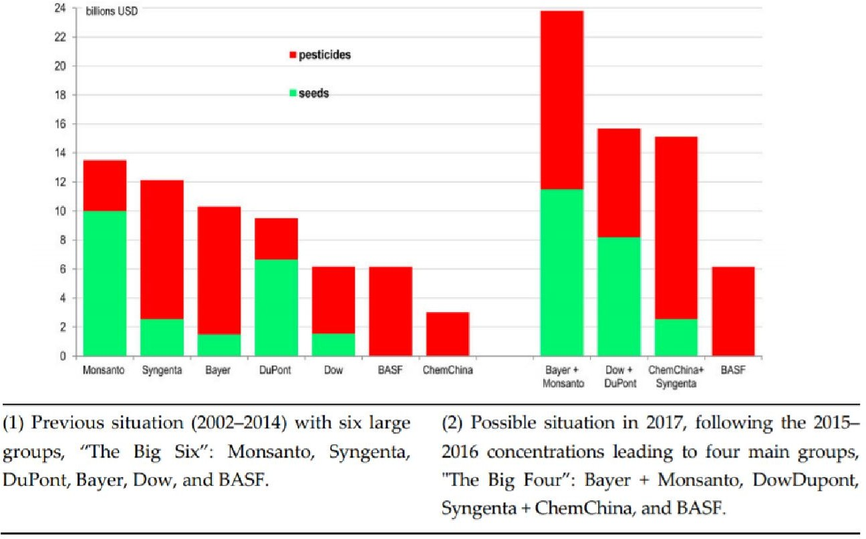
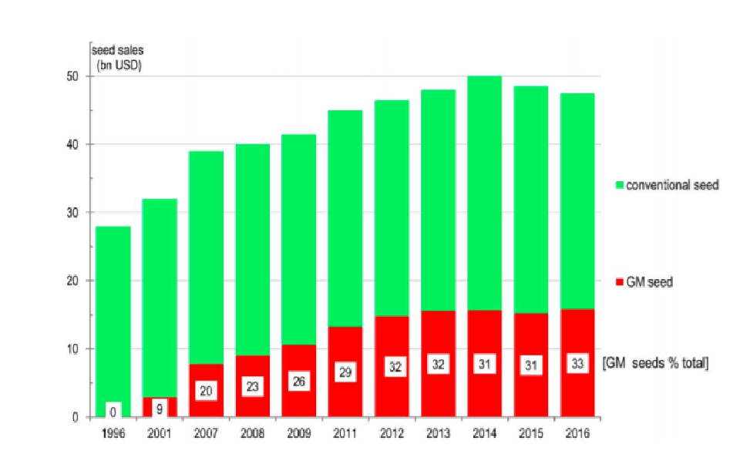

8/17/2019
Trends
Consolidation – M&A
Interest of Pvt players in OP crops
Technology
Seed Processing

Slide 53
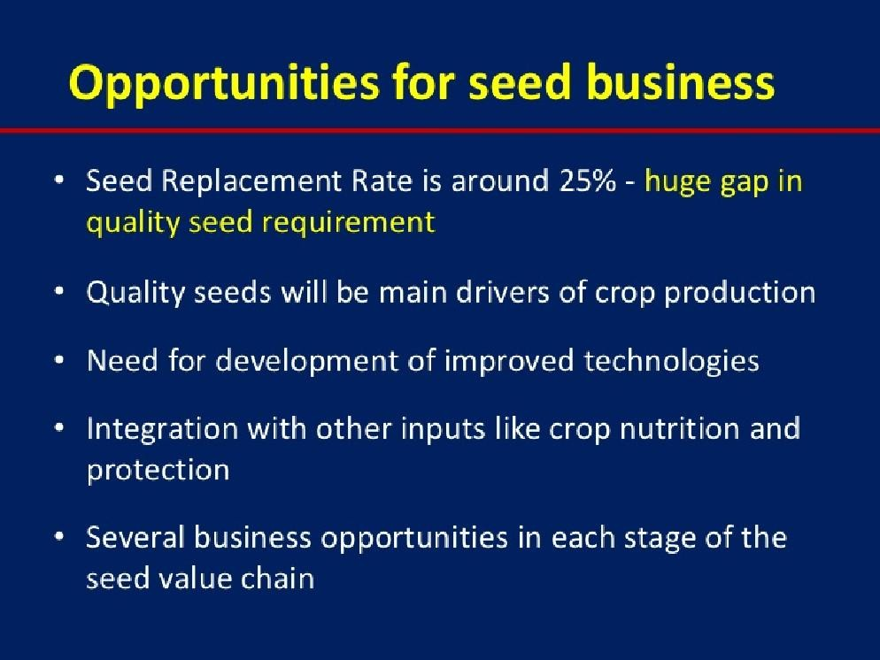
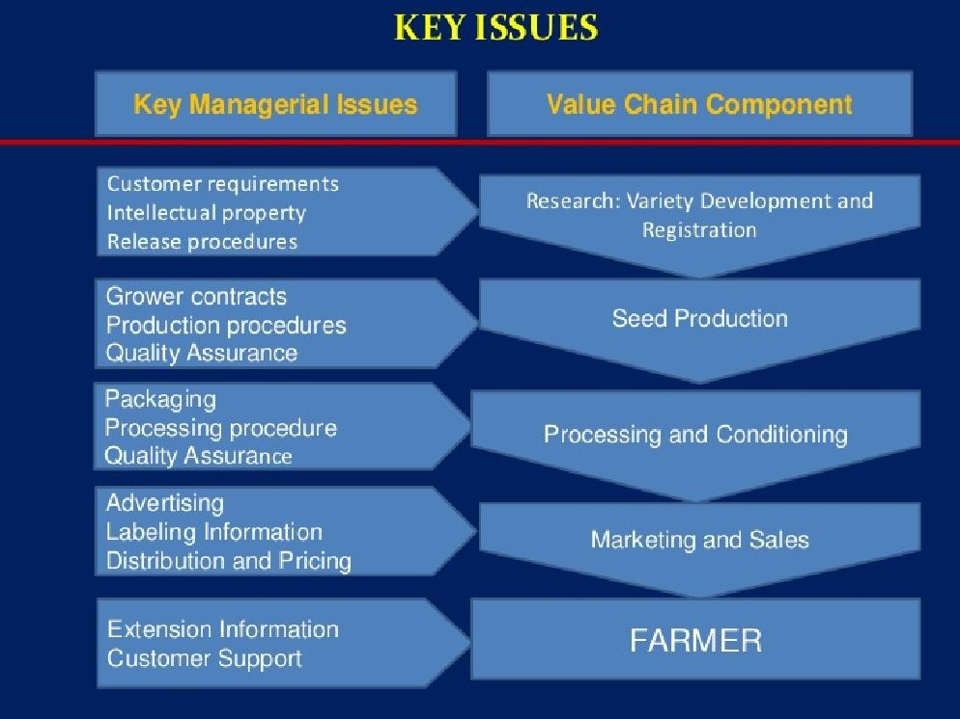
8/17/2019

Slide 54
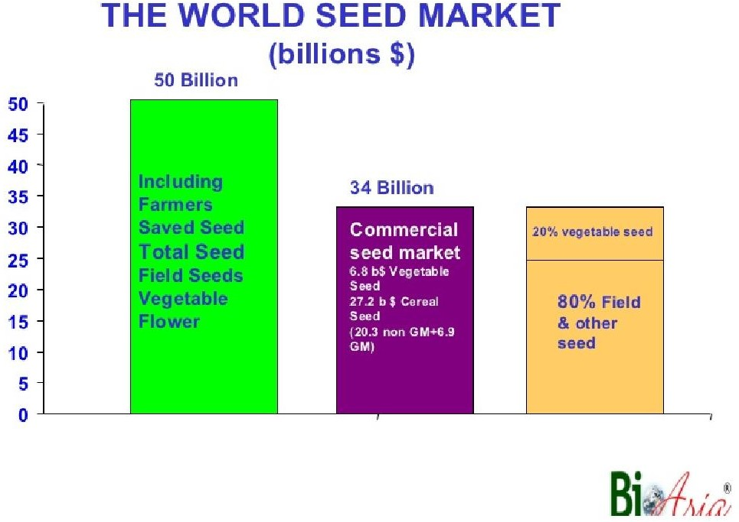
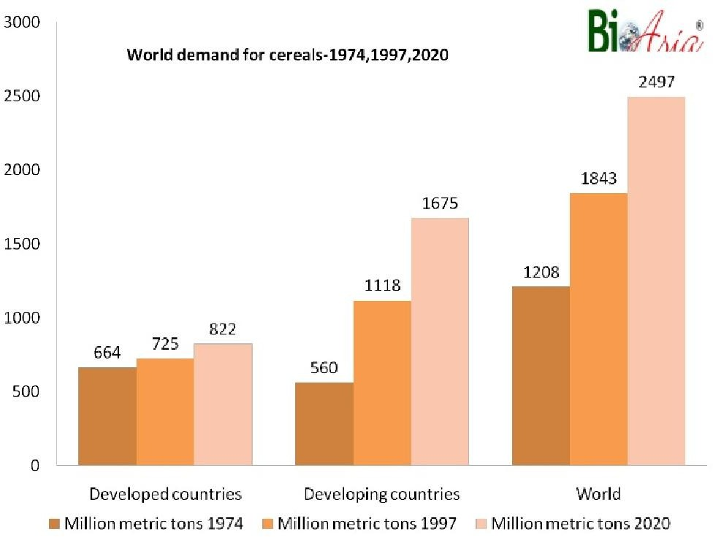
8/17/2019

Slide 55
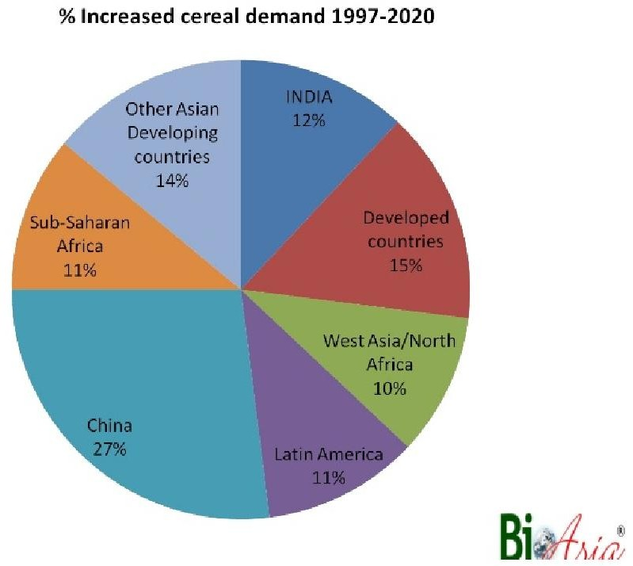
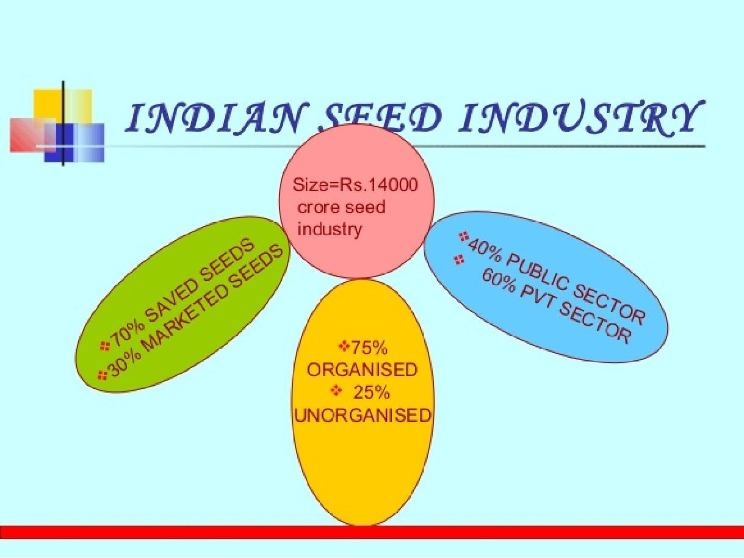
8/17/2019

Slide 56
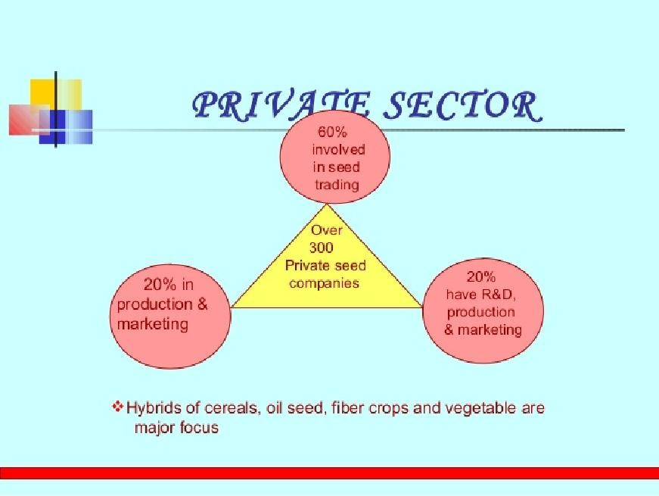
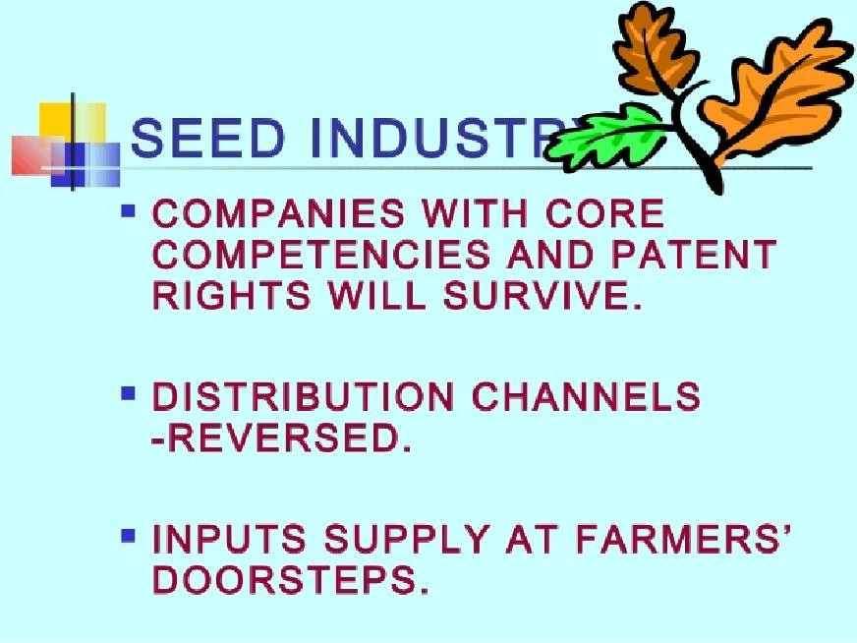
8/17/2019

Slide 57
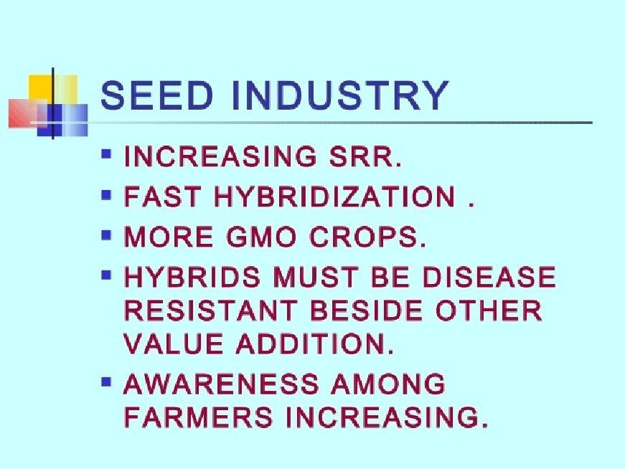
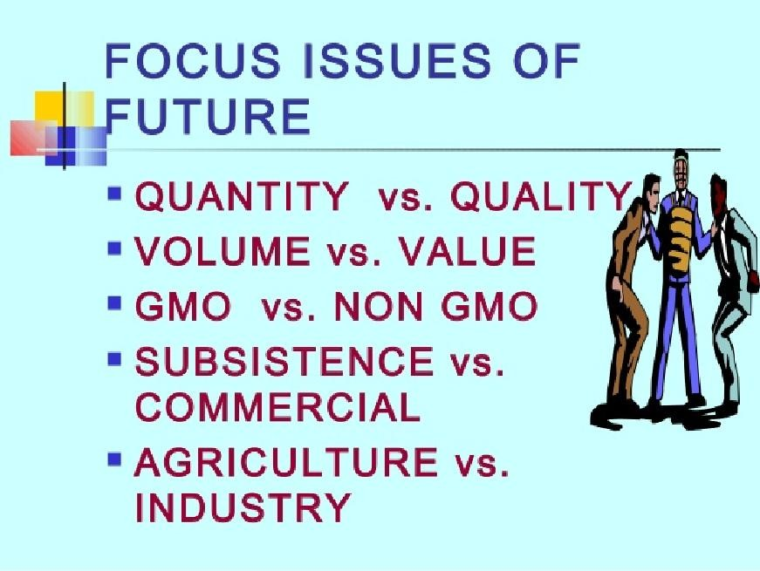
8/17/2019

Slide 58
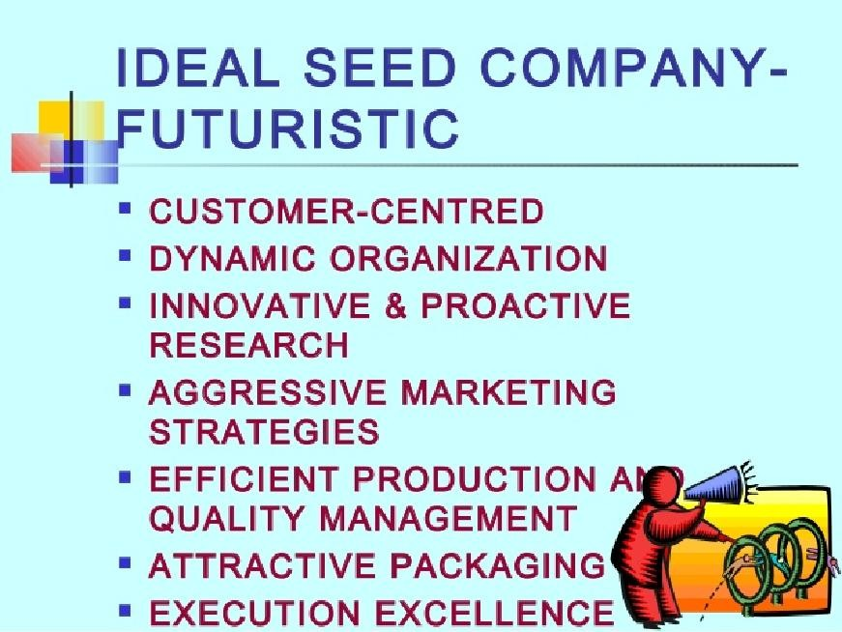
8/17/2019

Slide 59
8/17/2019
Buyer/User Behaviour
Market Segmentation
Product Management
Pricing Management
Brand Management
Channel Management
Rural Communication and Promotion
MIS
Logistics Management
Formulation of a Comprehensive Marketing Strategy

Slide 60
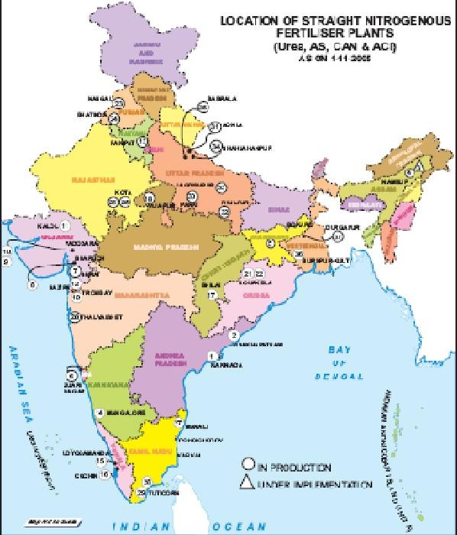

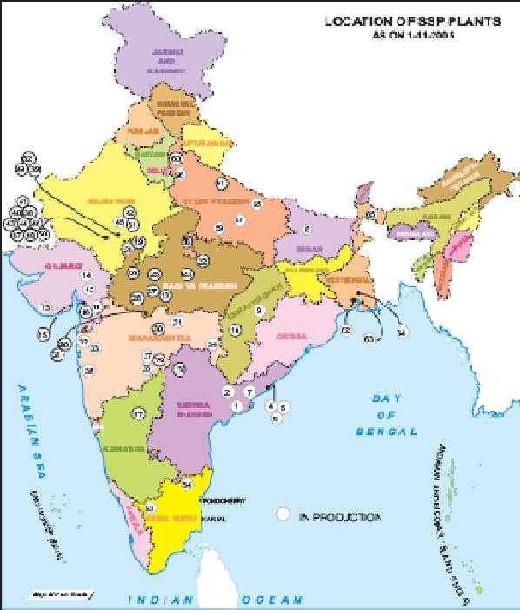

8/17/2019
Straight ‘N’ Fertiliser Plants
Straight ‘P’ Fertiliser Plants

Slide 61
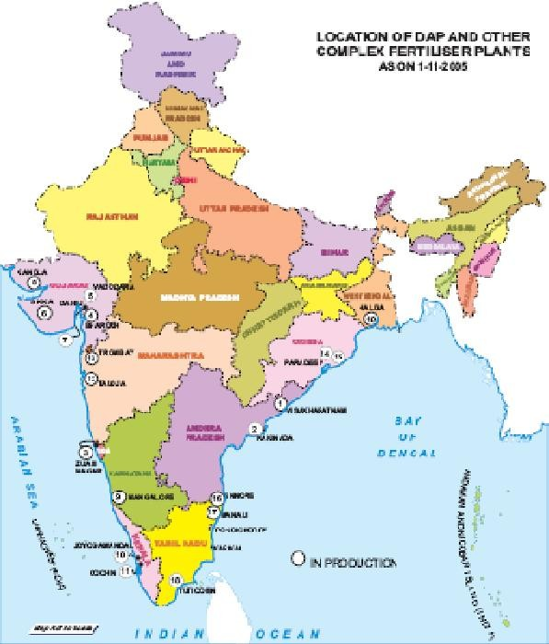


8/17/2019
Complex Fertiliser Plants
Cost of Cultivation- Methodology
Three stage stratified random sampling
  THESIL – First stage
  VILLAGE – Second stage
  HOLDING – Third stage

Slide 62
8/17/2019
Cost of Cultivation
COST A1 includes:
Value of hired human labour
Value of hired & owned bullock labour value of owned & hired machine labour Value of Seed (owned & purchased) Value of insecticides & pesticides
Value of fertilizers
Value of manure (owned & purchased) Irrigation charges
Land revenue & other taxes Interest on working capital
Depreciation on implements & farm buildings
Cost of Cultivation
COST A2 = COST A1 + Rent paid for leased-in- land
COST B1 = COST A1 + Interest on owned capital assets (excluding land)
COST B2 = COST B1 + Rental value of owned land + rent paid for Leased-in land

Slide 63

8/17/2019
Cost of Cultivation
COST C1 = COST B1 + Imputed value
of family labour
COST C2 = COST B2 + Imputed value
of family labour
COST C3 = COST C2 + 10 % of cost C2
Cost of Production
Cost of Cultivation v/s
Cost of Production

Slide 64
8/17/2019
Trends in Cost of Cultivation
Structure of cost of cultivation has changed for all crops in all the states over time
In case of paddy and wheat:
  share of purchased inputs particularly fertilizer and irrigation has increased significantly
  share of labour has decreased particularly in advanced states.
Trends in Cost of Cultivation
In case of Sugarcane, Jute and Cotton:
Human labour continues to be the most important item of cost about
  30 % in S. Cane and Cotton
  > 50 % in Jute

Slide 65
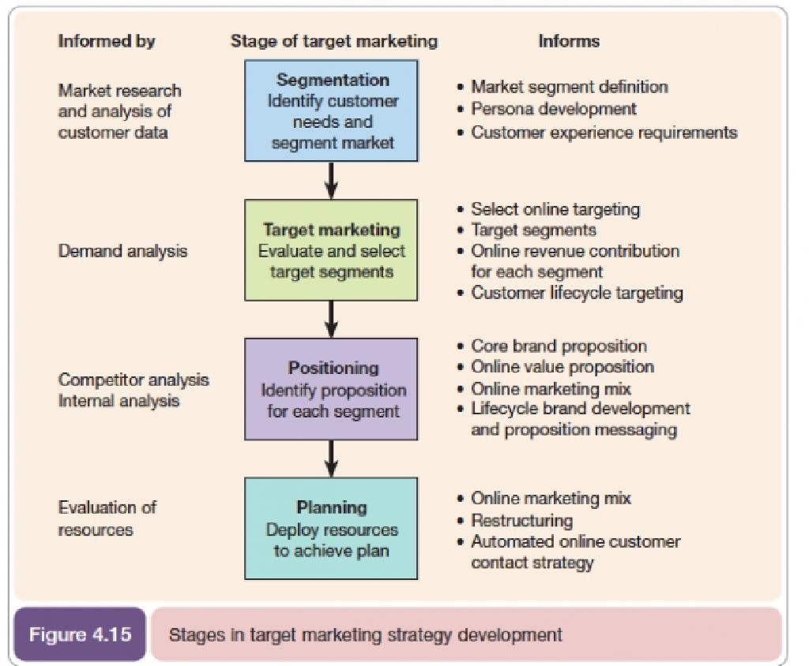
8/17/2019
Trends in Cost of Cultivation
The cost of cultivation (Rs/ha) also varies significantly across states for all crops.
For Paddy:
A.P – 22797, PUNJAB – 19126, ORISSA – 11646
For Wheat:
PUNJAB – 19479, U.P. – 13343, M.P. – 10260
For S.Cane:
A.P. – 45758, HARYANA – 24824, MAHARASHTRA – 40274, U.P. - 26148

Slide 66
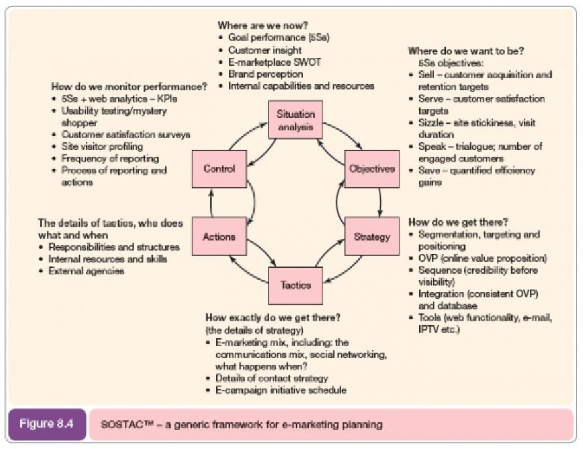
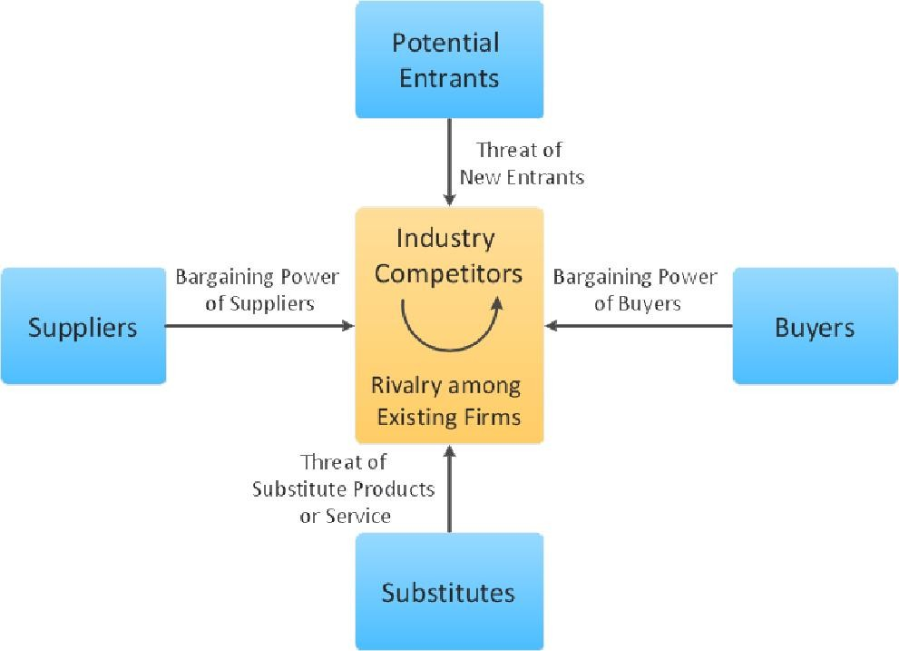
8/17/2019
PR Smith's SOSTAC® Model
This acronym stands for Situation, Objectives, Strategy, Tactics, Actions, Control and is a framework used when creating marketing plans.
Porter’s 5 Force Model

Slide 67


8/17/2019
Loyalty Ladder
As with continuums of behaviour such as UACCA – Unawareness, Awareness, Comprehension, Conviction, Action, or AIDA – Awareness, Interest, Desire, Action, the loyalty ladder begins from a point where the consumer has Not Yet Purchased, then he or she buys the product for the first time (Trialist), if the trial has been
a success he or she returns to buy again and again (Repeat Purchaser) and finally the consumer buys no other brand (Brand Insistent).
Turning a prospect into an advocate
Exercise – The Loyalty Ladder
Farley’s Irish Dream
Farley’s Irish Dream is a brandy-based liqueur (i.e. a sweet and creamy alcoholic drink) that is popular in most parts of Canada. It is associated with the sports of skiing, bobsleigh and snowboarding. It is most well liked during the months of winter when it is seen as a warming and relaxing treat that is shared with friends and family after participating in winter sports. Farley’s has decided to enter the European market, by targeting countries that have regions with a similar climate, and where the brand associations of winter sports can be exploited.
Farley’s Irish Dream is a brandy-based liqueur (i.e. a sweet and creamy alcoholic drink) that is popular in most parts of Canada. It is
associated with the sports of
skiing, bobsleigh and snowboarding. It is most well liked during the months of winter when it is seen as a warming and relaxing treat that is shared with friends and family after participating in winter sports. Farley’s has decided to enter the European market, by targeting countries that have regions with a similar climate, and where the brand associations of winter sports can be exploited.
Recommend an integrated marketing communications campaign that will turn Prospects into Advocates in the new European markets.

Slide 68

8/17/2019
Recommendations for Farley’s Irish Dream’s launch into European markets
Prospect
  Sponsor well-known professional skiers, snowboarders and bobsleigh teams in order to gain some early awareness amongst prospects.
  Employ a promotions agency that will visit top competitive events throughout Europe to hand out small trial bottles to prospects.
Customer
  Target bars, supermarkets and hotels in the winter sports regions. Here run sales promotions and distribute free merchandise such as ski hats, point-of-sale and drip trays carrying the Farley’s brand.
Client
  Sponsor websites that carry news and information about ski resorts and their current climate. Get clients to register their e-mail address and mobile phone numbers for e-mail and text information about skiing conditions.
  Begin a campaign that aligns the brand with aspiring, 25-40 year old professionals by advertising in targeted magazines.
Advocate
  This is the culmination of the previous three sections. Use text and e-mail to promote Farley’s to advocates, and reward them for forwarding e-mail and texts to their friends (using viral techniques). Record data on the success of campaigns by individual advocate, and continue to develop innovative and fresh ideas to keep your valuable advocates loyal.

Slide 69









8/17/2019
Losses caused by Different Pests, FY12
Rodents & others, 15%
Diseases, 26%
Weeds, 33%
Insects, 26%
Source: Industry Reports, Analysis by Tata Strategic
Per capita Consumption of PPC
kg/ha
18
16
14
12
10
17
12
13
8
6
4
2
0
6
7
7
5
5
India UK France Korea USA Japan China Taiwan
Source: Industry Reports, Analysis by Tata Strategic

Slide 70
8/17/2019
http://www.indiachem.in/brochure/Presen tation%20by%20Mr.%20Harsh%20Dhanuk a-%20Dhanuka%20Agritech.pdf
http://www.nuziveeduseeds.com/indian- seed-industry/

