Slide 1
CENTURION UNIVERSITY OF TECHNOLOGY AND MANAGEMENT
ASTIGMATISM AND ITS TYPES

Slide 2
EMETROPIA
Emetropia ( optically normal eye) can be defined as a refraction wherein the parallel ray of light coming from infinity are focused at the sensitive layer of retina with the accommodation being at rest

Slide 3
AMETROPIA
Ametropia is defined as a state of refraction wherein parallel rays of light coming from infinity ( with accommodation is at rest) are focused either infront or behind the sensitive layer of retina , in one or both the meridian.
Ametropia includes the following-
Myopia
Hypermetropia
Astigmatism

Slide 4
Components of ametropia
The overall refractive state of the eye is determined by four component:
Corneal power ( ranges from 40 to 45 D , mean 43.0 D )
Anterior chamber depth ( mean 3.4 mm )
Crystalline lens power ( ranges from 15 to 20D in its nonaccomodative state ) and
Axial length ( mean 24 mm )

Slide 5
ASTIGMATISM

Slide 6
DEFINITION
Astigmatism is a type of refractive error where in the refraction varies in the different meridian.
Astigmatism is a defect in which light entering the eye is unable to be brought to a single focus on retina resulting in blurred vision at all distance .

Slide 7
It simply means that there is a variation and disturbance in the shape of the cornea or lens . It is usually due to an –
Irregularly shaped cornea
Scarring of the cornea
Abnormalities in the crystalline lens

Slide 8
Some eyes condition are seen along with astigmatism as -
Nystagmus
Cataract
Ptosis
Retinis pigmentosa
Albinism
Inflammation
Degeneration

Slide 9
CLASSIFICATION

Slide 11
TYPES OF ASTIGMATISM
There are 2 types of astigmatism :-
Regular astigmatism
Irregular astigmatism

Slide 12
REGULAR ASTIGMATISM
The astigmatism is regular when the refractive power changes uniformly from one meridian to another.

Slide 13
ETIOLOGY
Corneal astigmatism
Lenticular astigmatism
Retinal astigmatism

Slide 14
Corneal astigmatism
It is the result of abnormality of the curvature of cornea.
It is usually congenital
Acquired corneal astigmatism is often irregular
Causes-
Congential curvature astigmatism
Keratoconus
Trauma to the cornea or lens
After cataract operation

Slide 15
Lenticular astigmatism
Mainly due to -
Congential abnormality of lens
Refrative index of lens
Congential or traumatic sublaxation of the lens

Slide 16
Retinal astigmatism
Due to oblique placement of macula
It can be corrected by visual aid

Slide 17
Types of regular astigmatism
It is subdivided into four types-
With-the-rule astigmatism
Against-the-rule astigmatism
Oblique astigmatism
Bi-oblique astigmatism

Slide 18
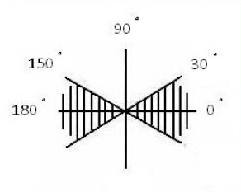
With-the-rule astigmatism
Refractive power of the vertical meridian is greatest
The vertical meridian is steepest than horizontal meridian
Eyes see vertical lines more sharply than horizontal lines
Requires concave cylinders at 180+/-20 degrees
Or convex cylinders at 90+/-20 degrees

Slide 19
Against-the-rule astigmatism
The Refractive power of the horizontal meridian is greatest than the vertical meridian
The horizontal meridian is steepest than vertical meridian
Eyes see horizontal lines more sharply than vertical lines
Requires concave cylinders at 90+/-20 degrees
Or convex cylinders at 180+/-20 degrees

Slide 20
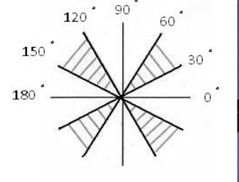
Oblique astigmatism
In which the two principal meridian lies somewhere between the axis defining either with-the-rule or against-the-rule astigmatism
Complementary ( 45 in one merdian, 135 in other meridian)

Slide 21
Bi-oblique astigmatism
Principal meridian are not at right angle
One at 30 , other at 100

Slide 22
Optics of regular astigmatism
Light entering the eye cannot converge to a point focus but form focal lines
Configuration of rays refracted from astigmatic surface-( strums conoid)
Lens with the cylinder produces as astigmatic focus contain vertical lines, corresponding to the focus of the horizontal principal meridian and horizontal focal line corresponding to the focus of the vertical principal meridian.

Slide 23
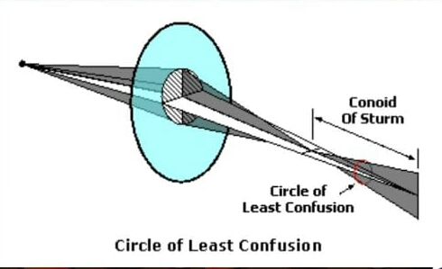
The region between these two lines in known as conoid of strums.
At the dioptric mid point between these two focal line , the astigmatism focus forms a circular patch known as circle of atleast confusion .

Slide 24
REFRACTIVE TYPES OF ASTIGMATISM

Slide 25
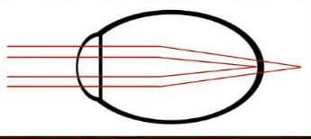
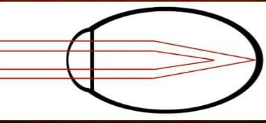
a) Simple hypermetropia astigmatism
When refracted rays from one meridian takes focus on the retina and the refracted rays from other meridian takes focus behind the retina.
b) Simple myopic astigmatism
When refracted rays from one meridian takes focus on the retina and refracted rays from one meridian takes focus in front of the retina

Slide 26
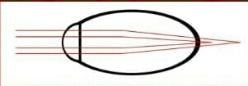
c) Compound hypermetropic astigmatism
In this condition of astigmatism refracted rays from both the meridians take focus behind the retina
d) Compound myopic astigmatism
In this condition of astigmatism refracted rays from both meridians take focus in front of retia

Slide 27
e) Mixed astigmatism-
When refracted rays from one meridian take focus in front of retina and the refracted rays from other meridian take focus behind the retina

Slide 28
IRREGULAR ASTIGMATISM
Irregular difference in curvature or refractive index of the optic components or misalignment of any optical component may lead to irregularity.
It is often the result of trauma, pterygium, corneal scars and complications of refractive surgery.
Another not uncommon condition is conical cornea ( keratoconus)

Slide 29
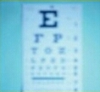
SYMPTOMS
Distorted vision at distance and near
Letter confusion
Asthenopia or ocular fatigue
Due to constantly squirting to clear up distorted vision
Tilting of head
Squinting
Burning and itching

Slide 30
SIGN
Decreased visual acuities at distance and near

Slide 31
CLINICAL TYPES
Visual acuity tests - distance and near
Autorefraction
Keratometry
Retinoscopy
Most reliable source of information for cylinder power and axis
Monocular subjective refraction , including Jackson cross cylinder

Slide 32
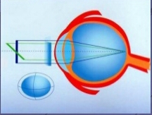
MANAGEMENT
Cylinderical lenses and spherocylindrical lenses in spectacles and contact lenses for simple astigmatism and compound astigmatism, respectively.
Refractive surgery
Photorefractive keratectomy (PRK)
Laser in-situ keratomileusis (LASIK)

Slide 33
THANKS FOR YOUR ATTENTION

