Slide 1
BASICS OF FINGERPRINTING
Biological basis of fingerprints
Formation of ridges

Slide 2
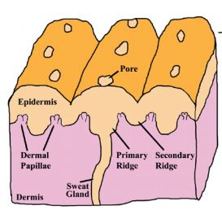
Biological basis of fingerprints
Proliferation of cells in the lower zone of epidermis resulted in projections in the dermis as regular spaced thickenings(PR).
The dermis also projects upwards into the epidermal hollows, known as dermal papillae. It results in elevations on the surface of the skin known as epidermal ridges.
As fingerprints patterns are due to dermal papillae, the pattern cannot be destroyed by superficial skin injuries.
Structure of friction ridge skin

Slide 3
Formation of Ridges
Ridge formation starts between 10th to 16th week of development.
Ridges are formed through volar pads that starts appearing on fingertips, palmar regions and soles between 7-8weeks.
At 10th week, embryonal volar skin consists of the layered epidermis
Periderm (outside)
Intermediate layer ( middle)
Basal layer (at the interface of dermis)

Slide 4
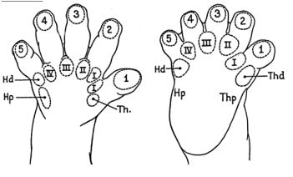
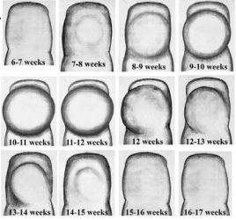
Distribution of volar pads
Appearance and regression of volar pads

Slide 5
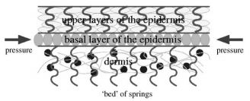
11th week : basal layer of epidermis becomes undulated, and form folds of the epidermis into dermis ( primary ridges) which establish the future surface patterns.
Become well pronounced at the 16th week.
The primary ridges experiences growth in two directions:
Downward penetration of the sweat glands
Upward push of new cell growth.
Secondary ridges (15-17 weeks) appear between the primary ridges. These are also cell proliferations of the basal epidermis and continue to mature from
It is mirrored on the surface of friction ridge skin as the furrows
Due to differential growth of intermediate layer and dermis, compressive stress acts on basal layer

Slide 6
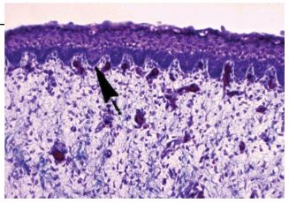
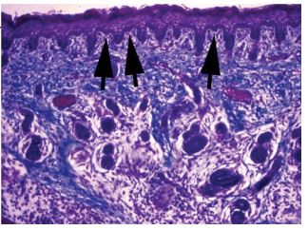
Undulations in basal layer results in the formation of primary ridges
Onset of secondary ridge formation between maturing PR (16wk)

Slide 7
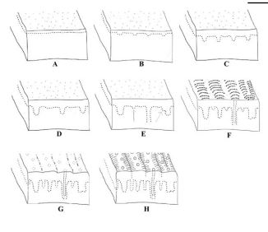
Diagram | Description
A | Undifferentiated friction ridge skin
B | Initiation of PR formation at epidermal and dermal border
C | PR increases in depth
D | Skin growth separating existing primary ridges
E | New PR growth between existing PR, sweat ducts are forming
F | initiation of SR in between PR
G | Maturation of SR along with surface ridge appearance
H | Entire system begins maturation process 24wks.

Slide 8
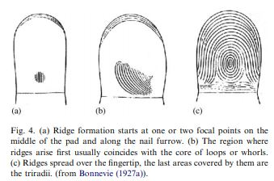
Primary ridge formation starts at
Middle of volar pad (which is called the ridge anlage) (coincides with center of whorl/loop)
Along nail furrow,
Along the interphalangeal flexion creases. (at later stages)
The location where these ridge systems meet, forms triradii/ delta.
This forms complete fingerprints pattern.

Slide 9
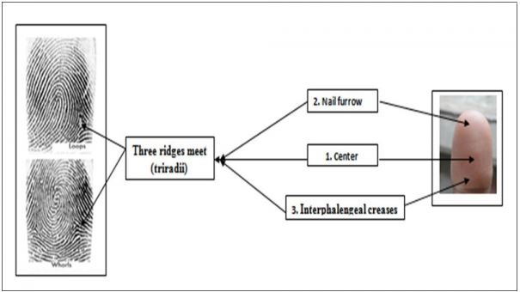
Stages in spread of epidermal ridges and formation of delta/triradii

Slide 10
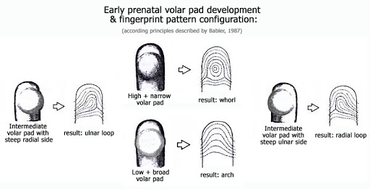
Different patterns

Slide 11
References:
https://www.lkouniv.ac.in/site/writereaddata/siteContent/202003241550009472kamyani_vajpayee_volar_pad_formation.pdf
https://openaccesspub.org/ijha/article/504
The fingerprint Sourcebook.

