Slide 1

Central and State Drug Regulatory Bodies

Slide 2

Drug Regulatory Authority
The drug regulatory authority (DRA) is the agency that develops and implements most of the legislation and regulations on pharmaceuticals.
Its main task is to ensure the quality, safety and efficacy of drugs, and the accuracy of product information.
This is done by making certain rules that the manufacture, procurement, import, export, distribution, supply and sale of drugs, product promotion and advertising, and clinical trials are carried out according to specified standards.

Slide 3
Functions of regulatory authority:
Product registration (drug evaluation and authorization, and monitoring of drug efficacy and safety);
  Regulation of drug manufacturing, importation, and distribution;
  Regulation & Control of drug promotion and information.
  Adverse drug reaction (ADR) monitoring.
  Licensing of premises, persons and practices.
  Main goal of drug regulation is to guarantee the safety, efficacy and quality of drugs available to public.

Slide 4



It is governed by both Centre and State Governments under the Drugs & Cosmetics Act, 1940.
MAIN BODIES:
Ministry Of Health & Family Welfare (MHFW)
Central Drug Standard Organization(CDSCO)
Indian Pharmacopoeia Commission (IPC)
Control
National Pharmaceutical Pricing Authority (NPPA)

Slide 5

The Ministry
of Health
is
and Family Welfare an Indian
(MHFW)
government ministry charged with health policy in India. It is also responsible for all government programs relating to family planning in India.
The ministry is composed of four departments: Health & Family Welfare; Health Research; AIDS Control; and Ayurveda, Yoga and Naturopathy, Unani, Siddha and Homoeopathy (AYUSH).
Current cabinet minister is Shri. Jagat Prakash Nadda.

Slide 6
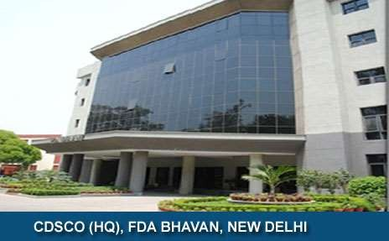
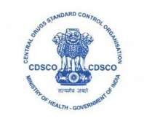
CDSCO (Central Drug Standard Control Organization)
National regulatory body for Indian Pharmaceuticals and medical devices.
Within CDSCO, DCGI (Drug Controller General of India) regulates pharmaceutical and medical devices under gamut of Ministry of Health and Family Welfare ( MHFW).

Slide 7
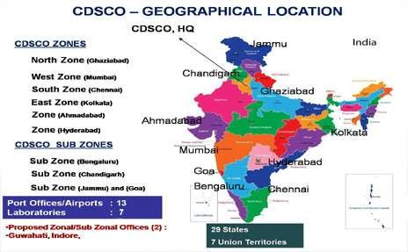
Locations(CDSCO) :

Slide 8
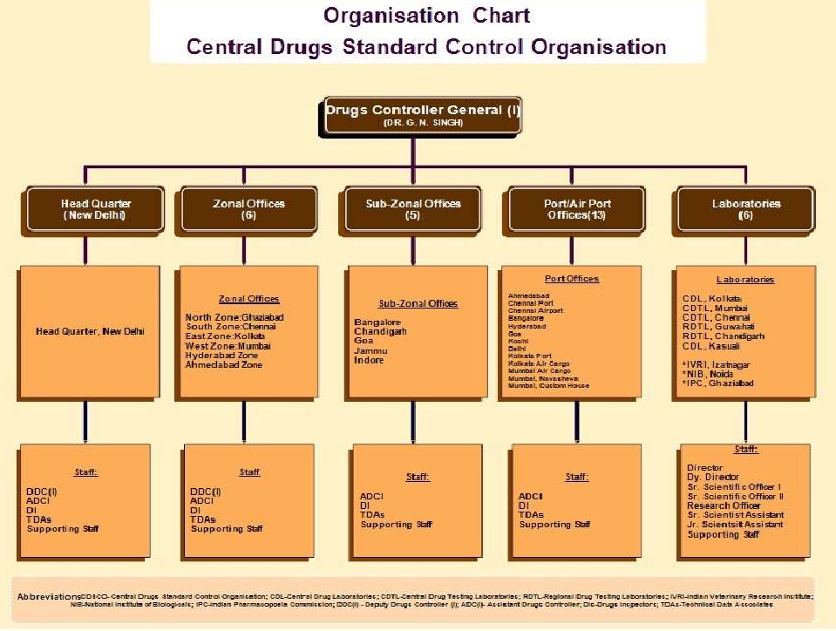

Slide 9
CDSCO (Vision)
To protect and promote public health CDSCO (Mission)
To safeguard and enhance the public health by assuring the safety, efficacy & quality of the drugs, cosmetics, medical devices.
FUNCTIONS:
Regulatory control over import, manufacturing, sale & distribution of drugs.
Approval of certain drugs & clinical trials
Meetings of DCC, DTAB
Approval for licenses as Central License Approving Authority
Co-ordination of activities of State Drug Control Organization

Slide 10
Central Drug Laboratory, Kolkata (CDL)
Statutory Lab. Of Gov. Of India over control of Drug & cosmetics act, 1940
Oldest QC lab. Statutory Functions:
analytical QC of majority of imported drugs available in Indian market.
QC of drugs & cosmetics manufactured in India.
Acting as appellate authority in matters relating to quality of drugs.

Slide 11
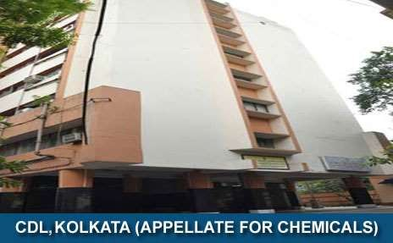
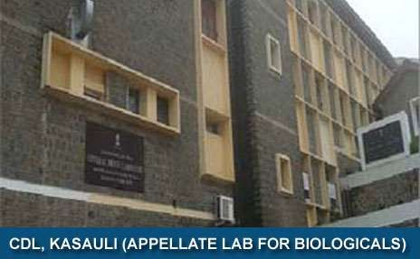
Other functions:
Collection, storage, distribution of International Standards, Int. reference preparation of drugs and p’ceutical substances.
Training to drug analyst.
Training to WHO fellows from abroad on modern methods of drug analysis.
Other laboratories:
CDTL, Mumbai
CDTL, Tamil nadu
CDTL, Hydrabad
RDTL, Guhawati
RDTL, Chandigarh
CDL, Kasauli

Slide 12
Indian Pharmacopoeial Commission(IPC)
Autonomous institute under MHFW, Gov. of India
Dedicated to settings of std. of drugs, p’ceuticals and healthcare devices besides providing Ref. Standards and Training.
To develop comprehensive monographs for drugs included in IP including API, Excipients and dosage forms.
To accord priority to monographs of drugs in the National Essential Drug List & their dosage forms.
To accelerate process of preparation, certification, distribution of IP reference sub.

Slide 13

DCGI (Drug Controller General of India)
Drug Controller General of India under the gamut of Central Drugs Standard Control Organization is responsible for approval of licenses of specified categories of drugs such as blood and blood products, IV fluids, vaccines and sera in India.
Present DCGI is Dr. G. N. Singh

Slide 14
Responsibilities of DCGI:
DCGI lay down the standard and quality of manufacturing, selling, import and distribution of drugs in India.
Acting as appellate authority in case of any dispute regarding the quality of drugs.
Preparation and maintenance of national reference standard.
To bring about the uniformity in the enforcement of the Drugs and Cosmetics Act.
Training of Drug Analysts deputed by State Drug Control Laboratories and other Institutions.
Analysis of Cosmetics received as survey samples from CDSCO (central drug standard control organization).

Slide 15
DCGI is advised by:
DTAB (Drug Technical •
DCC(Drug Consultative Committee)
Advisory committee
Advisory Board)
To advice Central technical arising
State & Gov. on
matters
out of
by Central Gov. to
advice State Gov. & DTAB
Under provision of Sec.(3)
administration of act.
Under Sec.(5)
provision of

Slide 16

Food & Drug Administration (FDA)
Maharashtra’s primary consumer.
An law enforcement agency.
Responsibility of enforcement of the
instrument of
prevention of Food Adulteration Act, 1954
The regulations are implemented by following independent sections:
Drug section
Food section
Food & drug control laboratories

Slide 17
Food & Drug Administration (FDA)
Drugs are used to elevate health of people & responsibility for implementation of various rules & regulation for getting safer drugs & cosmetics with good quality & purity to people of the state, is assigned to FDA.
For the drug section, following acts are implemented by administration ;
Drugs & Cosmetics Act 1940 & rules there of 1945
Drug & Magic Remedies (objectionable advertisements) Act 1954
Drug Price (Control) Order, 1995
Narcotic drugs & Psychotropic Substance Act,1985
Poison Act 1919

Slide 18
Object :
To ensure safety, purity, quality of drugs.
To prevent consumers from self-medication.
To ensure availability of drugs at authorized prices.
To create awareness about importance of proper storage of drugs.
To eliminate irrational combinations.
To prevent misuse of narcotic drugs.
To prepare policy regarding drug matter.

Slide 19
Regulate :
To grant and renew licenses for the following Categories of Drug Manufacturing Units .
  Allopathic Drugs
  Ayurvedic Drugs
  Homeopathic Drugs
  Unani ,Siddha Medicines
  Blood ,Blood Products
  Medical Devices
To approve Plan of manufacturing premises for Drugs.
To Grant Licenses for Repacking of Drugs
To Grant and Renew Licenses for Drug Selling Units.
To Grant Licenses for Public Testing Laboratory.

Slide 20
To issue various Certificates for Tenders, Exports as listed below:
  WHO GMP certificate
  No Conviction certificate
  Performance Certificate
  Free Sale Certificate
  Schedule M GMP Certificate
To issue
Quota of Narcotics Drugs under the
Narcotics Drugs and Psychotropic Substances Act.
To issue Transport Permits under NDPS Act.
To investigate complaints received regarding drugs
To carry out inspections of manufacturing and selling Units
To draw samples of Drugs
To conduct raids for those manufacturing spurious drugs /substandard drugs

Slide 21
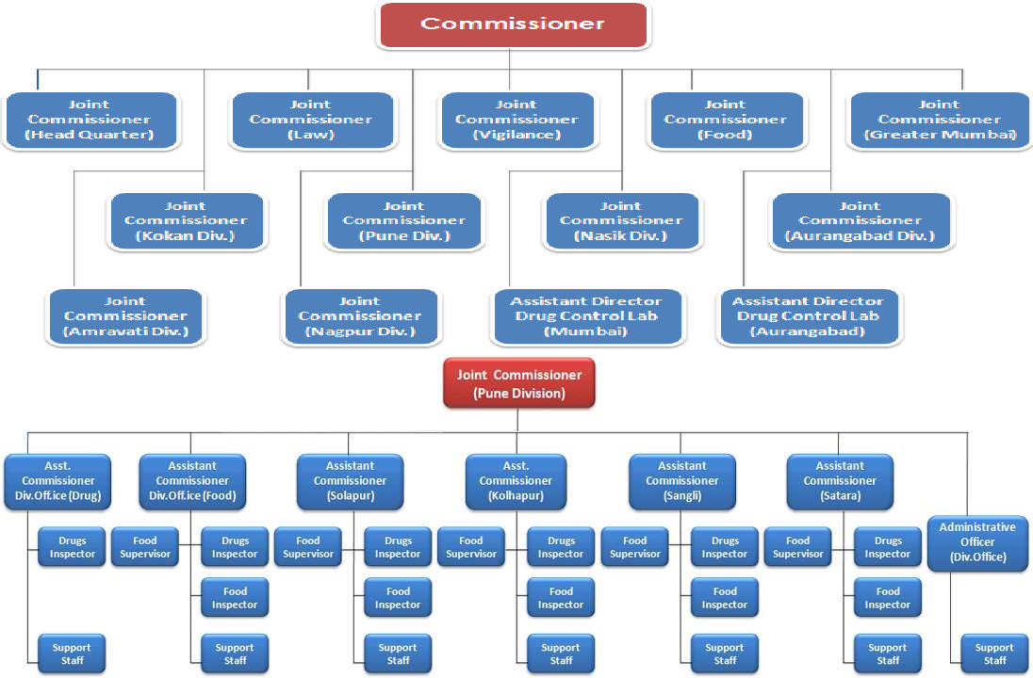

Slide 22
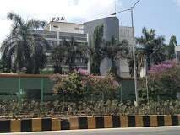
Headquarter is at Mumbai, and offices are at division & district place.
Commissioner is Head of Administration. The present commissioner is Dr. Harshadeep Kamble.
Divisional offices are headed by Joint commissioner.
District level offices are by Assistant commissioner.
Headquarter at Mumbai
Drug control laboratory
Under Section 20 & 33F of D
& C rule, 1940
DCL is at Mumbai and Aurangabad.

Slide 23
Drug Inspector(section 21):
The central Gov. & State Gov. by notification in official gazette appoints inspector prescribed in under section 21 of act.
Powers of Drug Inspection (Sec.22)
INSPECT
Premises; being manufactured; inspect (employees testing drugs)
Any premises wherein any drug or cosmetic is being sold/ stocked/ exhibited/ distributed.
Take samples of any drug/ cosmetic.
Enter & search at all reasonable times, any place, any premises.

Slide 24
Search any person in connection with offence.
Examine any record, register, document or any other material object found while exercising above powers.
Duties of Drug Inspector:
To inspect at least once in year all establishments licensed for sale of drugs in area assigned to him.
To investigate any complaint made to him.
To institute prosecution in case of breach of acts & rules.
To maintain records related to all inspections & actions taken by him.
To make inquires & inspections.

Slide 25
National Pharmaceutical Pricing Authority
NPPA is an organization of the Government of India which was established, inter alia, to fix/ revise the prices of controlled bulk drugs and formulations and to enforce prices and availability of the medicines in the country, under the Drugs (Prices Control) Order, 1995.
Responsibilities:
To implement and enforce the provisions of the Drugs (Prices Control) Order in accordance with the powers delegated to it.
to monitor the availability of drugs, identify shortages, if
any, and to take remedial steps.
to collect/ maintain data on production, exports and imports, market share of individual companies, profitability of companies etc, for bulk drugs and formulations.
to undertake and/ or sponsor relevant studies in respect of pricing of drugs/ pharmaceuticals.

Slide 26
References:
FDA Maharashtra(https://fda.maharashtra.gov.in
/Aboutus.aspx)
CDSCO (http://www.cdsco.nic.in/forms/Default.asp x)
https://en.wikipedia.org/wiki/Drug_Controll er_General_of_India
NPPA (http://www.nppaindia.nic.in/)

Slide 27
Thank you

