Slide 1
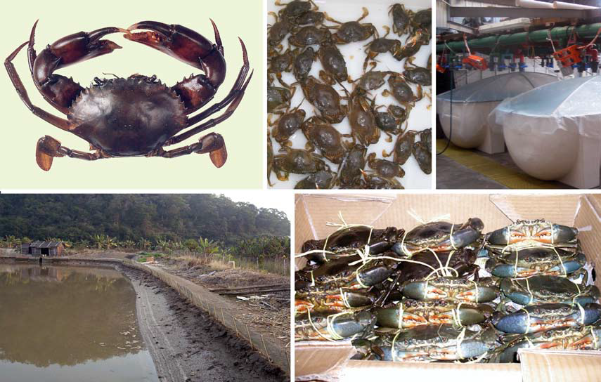
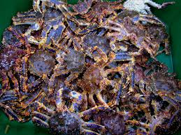
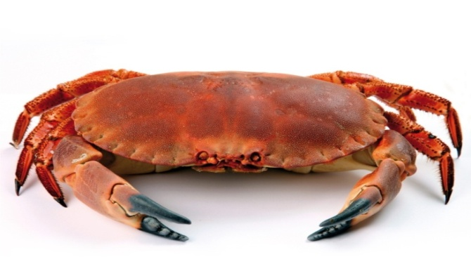
CRAB FARMING

Slide 2
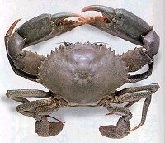
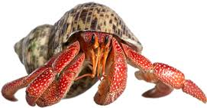
TAXONOMY
Kingdom : Animalia
Phylum : Arthropoda
Subphylum : Crustacea
Class : Malacostraca
Order : Decapoda
1. Infra order : Brachyura
True crabs.
5 visible pair of walking legs.
2. Infra order : Anomura
Hermit crab, king crab, etc
Last pair of walking legs hidden inside the carapace.

Slide 3
Why crabs farming?
Commercial significance as food organisms.
The crab meat is having high export value and highly relished by foreigners.
Resistance to diseases in culture.
Survival outside the water in case of emergency.
Tolerance to wide range of temperature & salinity.
Scylla serrata mainly cultured for its meat rich chelate legs.
Crab meat is sweet and tasty .
It also have medicinal value and used to cure various protein deficiency diseases.
Crab meat has 20% protein , 5%fat , 2% Minerals , vitamins A and D , glycogen and free amino acids so it has high demand as a table food all over the countries.

Slide 4
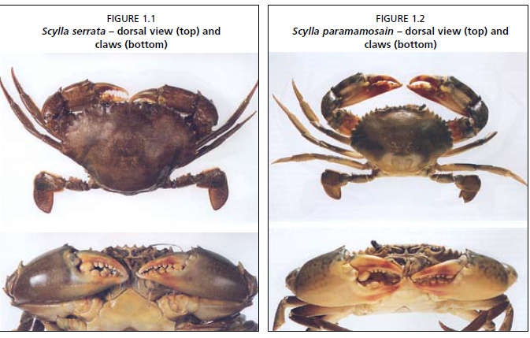

Slide 5
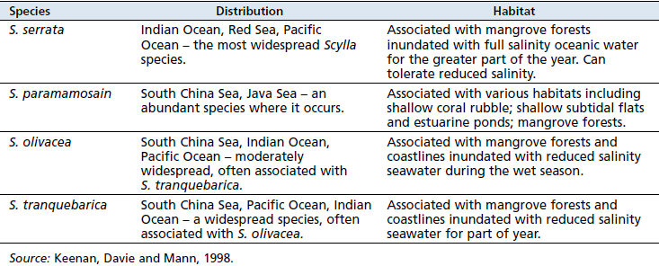
Distribution and habitat of Scylla species

Slide 6
A total of 11 species of crabs belonging to 7 genera of 04 families are found in India which are of commercial importance for culture process.
The most highly esteemed species suitable for coastal aquaculture is Scylla serrata commonly known as mud crab.
Reproduction season varies according to local water temperature.
In southern Asia, female crabs carrying eggs are few in winter, but in tropical regions, they can be found almost throughout the year.

Slide 7
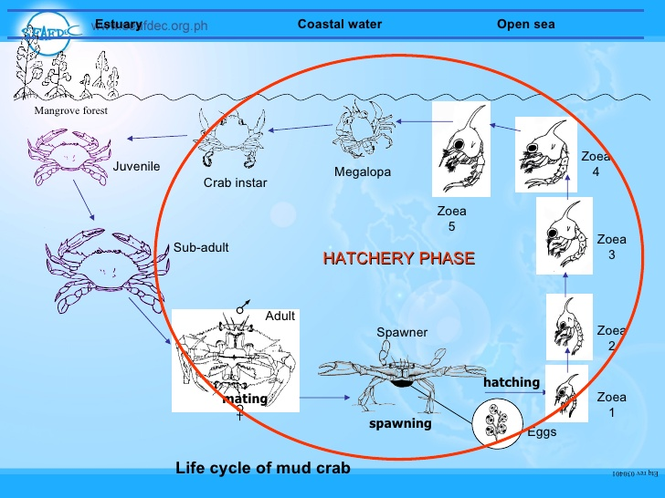
LIFE CYCLE OF MUD CRAB

Slide 8
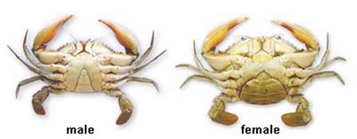
SEXUAL DIMORPHISM
Abdominal flap at the ventral side is slender and triangular.
2 pairs of abdominal appendages.
Gonopore- at base of fifth walking leg.
Abdominal flap at the ventral side is broad and semicircular.
4 pairs of abdominal appendages.
Gonopore- at the sterna of the sixth thoracic segment.

Slide 9
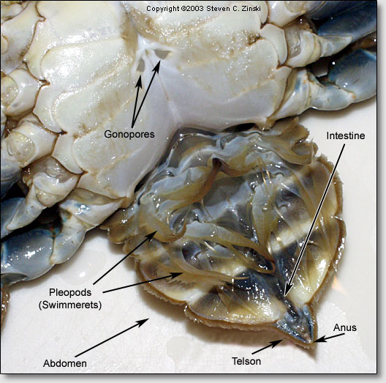
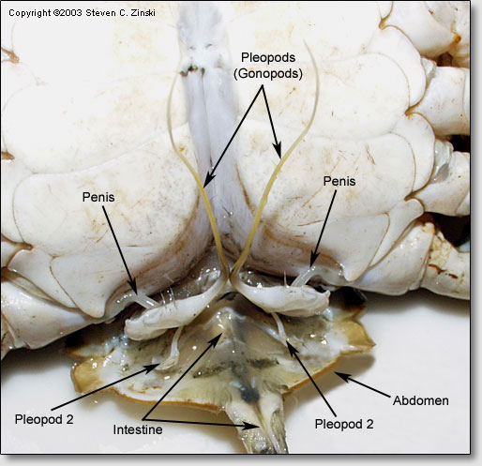
FEMALE
MALE

Slide 10
Moulting of Crab
It is the main method of growth and development in crabs.
The moulting process depends on body size and environmental factors. For example, moulting of big crabs takes longer than for small ones.
Newly moulted mud crabs lose their swimming ability and sink to the bottom of the pond.
It takes two to three hours for soft-shell individuals to regain this swimming ability.
The newly moulted crab are more prone to predation and diseases.

Slide 11
With each moult, shell width, shell length and body weight generally increase by about 28.4 percent, 30 percent and 41 percent respectively.
Strong stimuli or mechanical damages often result in the loss of appendages, a process called self-cutting.
New appendages can be regenerated several times.

Slide 12
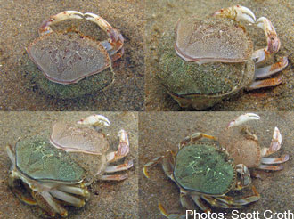

Slide 13
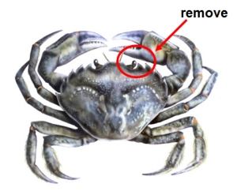
Eyestalk ablation
As the occurrence of berried crabs in nature is rare, it is essential to develop ovigerous crabs in captivity.
Eyestalks are the sites of gonad inhibiting hormones and therefore the removal of eyestalks accelerate the gonad development and spawning.
One of the eyestalk is removed.
Intact or ablated animals can also be used as broodstock, the time to get ovigerous crab extended according to the ovarian stages of the animal.
Reproductive performance of intact or ablated animals are significantly greater in wild animals.

Slide 14
Based on this principle, precocious or sudden maturation of ovaries and moulting are obtained through the removal of one of the eye stalks in larger females by electro-cauterisation.
In this method one of the eye stalk is cut at the base with a pair of scissors followed by sealing with a pencil type of soldering iron.
Eye stalk ablated female and un-ablated male brood stock are well maintained in laboratory with protein rich diets before allowing them to mate.

Slide 15
AGE AT FIRST MATURITY
Scylla serrata attains sexual maturity when about 11 months older under laboratory conditions , but in natural conditions sexual maturity attains early.
Males attains maturity when they are able to carry female and copulate successfully.
Females attains maturity when they are capable of copulating and extruding eggs.
Usually, the mud crab reaches the reproductive stage when:
shell width-greater than 7.8cm(males) and 8.5cm (female)
body weight over 100 g and 130 g respectively.

Slide 16
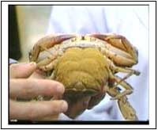
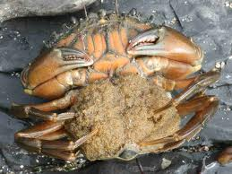
COLLECTION OF BROODSTOCK
Crab seed is procured through tidal water or procured from professional seed collectors in local markets.
Crab brood-stock can be collected either from the wild or from farm ponds.
The selected individuals should be healthy, with a body weight of over 300g and ovaries having reached development stage V.
Crab farmers depend on juveniles for seed stock rather than berried female.
Berried females are not selected as broodstock due to a lower fertilization rate and their contamination by parasites, such as ciliates, and by other disease pathogens.

Slide 18
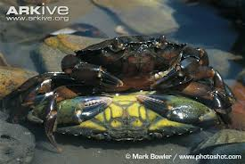
BREEDING
The mature female releases a chemical attractant (pheromone) in to the water, which attract males.
The successful male picks up the female and carries her around for several days until she molts.
Copulation can occur only when females are in soft shell condition.
Male deposits Spermatophore inside the female storage sac (spermatheca) by using its first pleopods.
The Spermatophore can remain viable, until fertilization takes place, for weeks or even one months.

Slide 19
The mud crab attains sexual maturity in the period of 5 months.
About 5 months after hatching pair formation occur between male crab and female crab.
After Few hours mating occur.
During mating male deposit sperm in the female.
Sperm fertilizes the different batches of egg released by the female.
After fertilization , fertilized egg attach to the abdomen of the female.

Slide 20
Berried female is transferred to the spawning pond.
After spawning the larva hatch out as first zoea stage and then metamorphoses into 2,3,4 & 5 zoea stages.
Then fifth larval stage of zoea metamorphoses into megalopa stage.
Megalopa metamorphoses into juvenile stage.
Phytoplankton , chlorella is commonly used for feeding the zoea where as brine shrimp nauplius is commonly used for feeding the megalopa stage.
Megalopa metamorphoses into juveniles which are then transferred into the nursery pond as a seed stock.

Slide 21
Mating of crabs
Generally, mating lasts for one or two days, a
period which may vary from nine hours to three days.
Mating occurs mostly at night, especially at the beginning of the high tide.
For mating to be successful, water temperature should preferably be higher than 18°C.
Both female and male crabs do not feed during the mating period.
After mating, females consume a large amount of food to support rapid ovarian development.
Under suitable conditions, ovulation may take place 30 to 40 days.

Slide 22
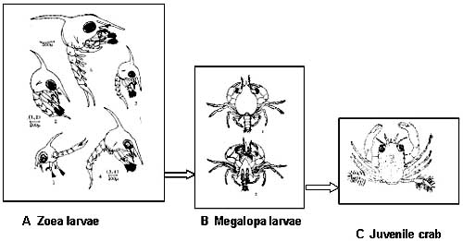
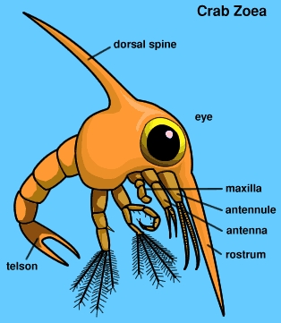
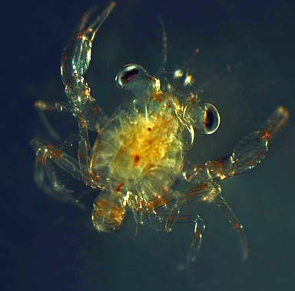
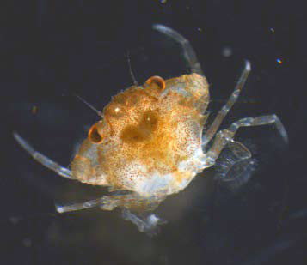
Larval stages
Megalopa larvae
An individual crablet

Slide 23
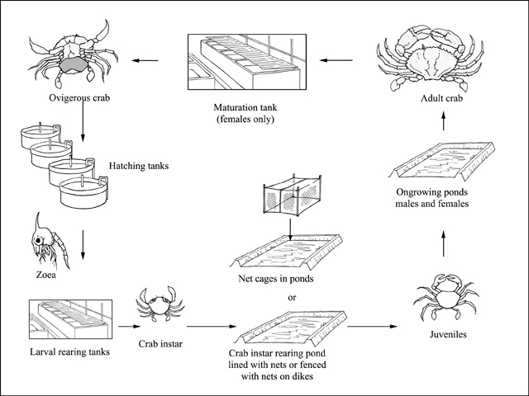
Captive rearing

Slide 24
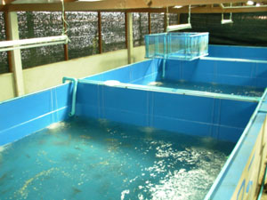
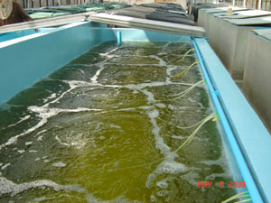
FACILITIES
Broodstock and larval rearing tanks:
Algal culture tanks:
Spawning tanks:
Artemia hatching tanks:
Reservoir:
Seawater system:
Other equipments and accessories:
such as weighing balances, Refractometer , pH meter and drainers etc are equally important in hatchery operations.

Slide 25
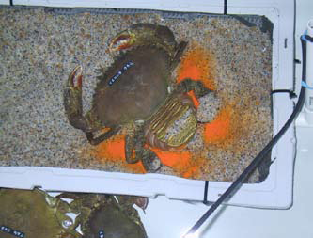
BREEDING TANK
A sandy substratum should be provided in the spawning tank.
Half of the broodstock tank can be provided with 10 cm sand layer and another half can be bare floor for feeding purpose.
Alternatively sand filled trays can be provided.
Crabs can be stocked at the rate of 1-2 animal per sq.metre.

Slide 26
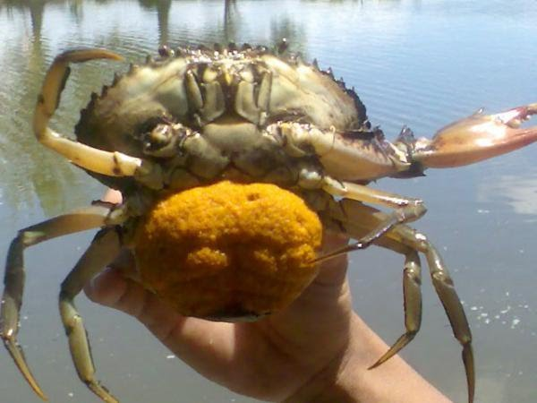
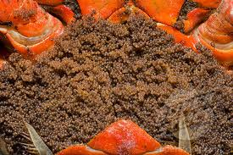
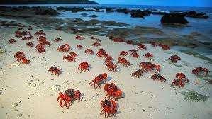
FERTILIZATION & SPAWNING
Eggs are released from the aperture genitals to meet the sperm released from the sperm theca.
Fertilization is internal.
Fertilized eggs stick to the bristles of the abdominal legs of the female which is then called a “berried” or “ovigerous” crab.
Fecundity of scylla tranquebarica is 2-3 million and of scylla serrata is 0.5 – 2.5 million.
Normally, spawning occurs early in the morning, between 5:00 -8:00 am.

Slide 27
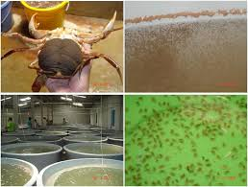

Slide 28
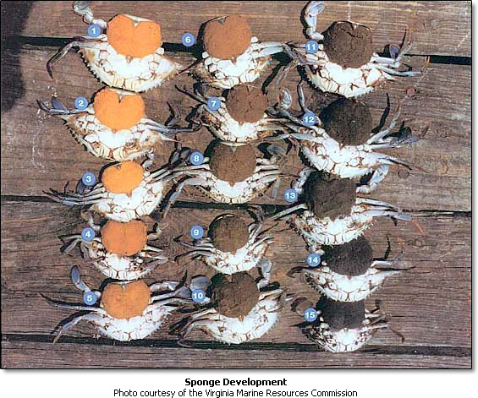
HATCHING
With the development of the embryos, the colour of eggs varies from bright orange to dark-grey.
When all the eggs get the dark grey colour , it indicates that the larvae will hatch soon.
The duration of the incubation period depends on water temperature.

Slide 29
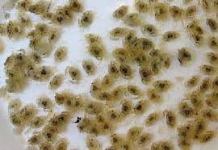
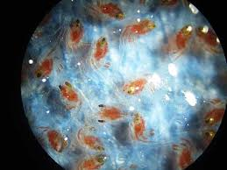
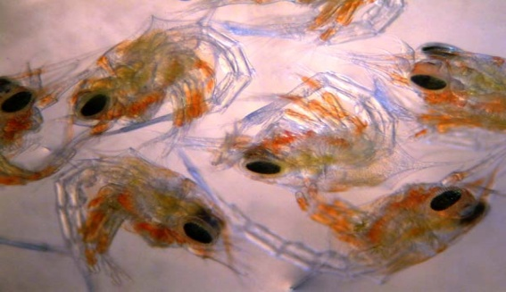
LARVAL DEVELOPMENT
The photo-taxic behavior of the zoea larvae is used to collect them.
In the rearing tanks, the stocking density varies from 20,000 to 50,000 per cubic meter.
There are five zoeal stages passing through five molts to reach the megalopa stage.
Zoea to megalopa 15 – 20 days (Each moult 3 - 4 days)
The megalopa takes 8 - 11 days before it molts into the first crab stage.
The megalopa larvae gradually adapt themselves to a benthic life.

Slide 31
POST HATCHERY PHASE
8-11 day

Slide 32
Culture techniques
Culture techniques have been developed for two species of mud crab Scylla serrata and Scylla oceanic ( available in mangrove and estuarine areas of Andhra Pradesh).
Crabs are cultured in ponds or mangrove pens.
As the crabs bore holes along the dykes and cause leakage so coastal ponds with numerous mounds and un-submerged regions are more suitable for crab culture.
The basic design of most earthen ponds used to culture mud crabs is the same as that used to culture marine shrimp.
In many parts of Asia, where the profitable culture of shrimp has been affected by disease or low prices, have been converted to mud crab ponds.

Slide 33
The abundance of mud crab is seasonal and localized in the brackish water.
Hence the female crabs are subjected to eyestalk ablation to get year- round production of berried crabs for hatchery production of larvae.
The seeds of crabs (2 to 10 cm carapace width) collected from the wild or produced in the hatchery.
The seeds are stocked at the rate of 10,000 to 30,000/ha.
Different sizes may be stocked and grown in smaller ponds until they reach suitable size for stocking

Slide 34
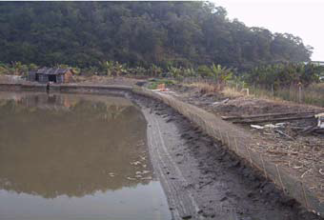
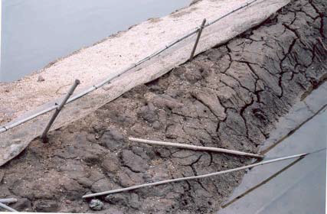
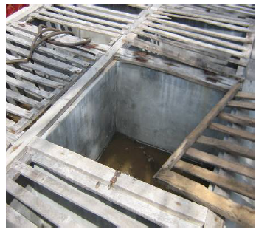
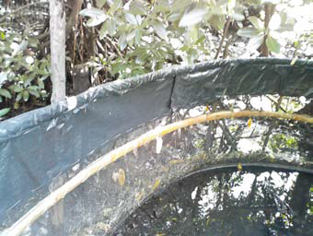
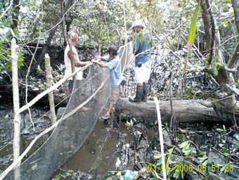
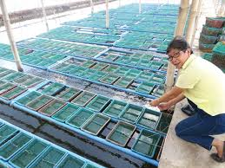

Slide 35
Three type of pond designs for crab culture in commercial scale, one pond for culture , second pond for fattening and a third one for breeding and nursery rearing have been developed.
In the nursery pond , the larval forms are grown up to the juvenile stage below 70 g size and then shifted into the culture pond for the further culture.
Culture pond – Stocking and growing young ones to the marketable size of 500g and above.
After attaining a size of 500 g and above crabs are to be transferred to the fattening pond for feeding for about 10 to 20 days before harvesting in the inter-moult and early pre-moult stage.
Crab ponds may be sandy bottom, the size of pond may be 400-800 m² and water depth of 30 cm is enough.

Slide 36
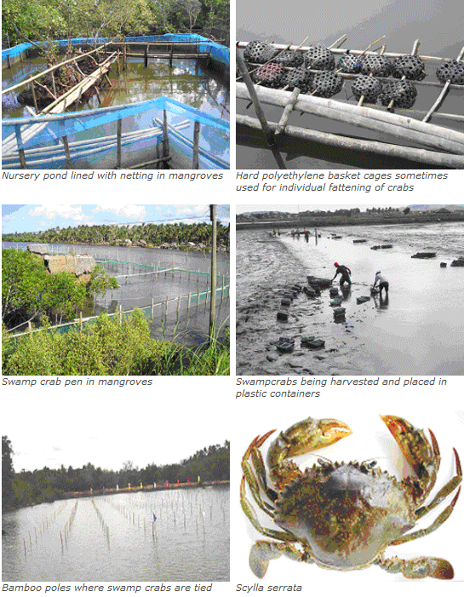

Slide 38
Poly culture of crab-prawn-fish
Milkfish nursery ponds of 2500 m² with earthen dykes could also be stocked with crab seeds at 1 seed/m² and grown to marketable size.
In brackish water ponds of 0.5-2 ha ponds, S. serrata can be stocked at 2000-5000 / ha along with prawns and milkfish, but ponds are to be modified with bamboo fences.
In poly-culture, crabs fed with supplementary diets for a period of 6 months, they attain carapace width of 12 cm and weight of 220g with 50% survival.

Slide 39
Feeding of growing crabs
Scylla serrata is a voracious feeder.
It prefers to crawl on bottom in search of food but it may also be seen swimming on the surface of the ponds
In ponds, the crabs feed on the naturally available algae, decaying animals, crustaceans etc.
To enhance the growth of crabs, they are fed with trash fish, fish offals, fish visceras, snails, chank meat etc.
The supplementary diet is given at the rate of 5-7% total body weight of growing crabs.
Feeding is given daily especially during late evening.
Under monoculture, survival rates of 70-90% is obtained.
Properly fed crab, reached a carapace length of 70 mm and with of 100 mm within six months.
Female crabs reared for 45 to 60 days have given on yield of 1000 kg/ha.

Slide 40
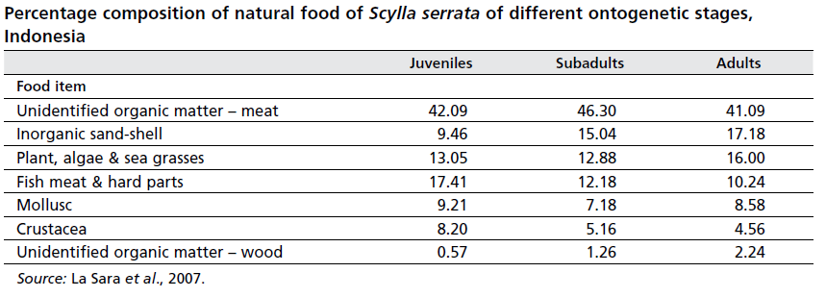

Slide 41
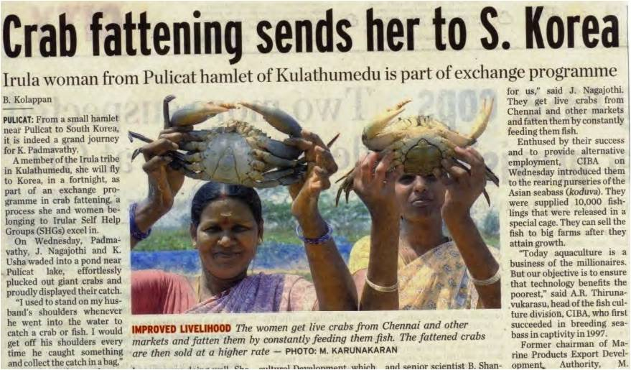

Slide 42
References
CIBA annual report 2013-14.
www.seafdec.com
www.fao.org/docrep/015/ba0110e/ba0110e.pdf
www.celkau.in/Fisheries/CultureFisheries/Crabs/crabculture.aspx
www.ciba.res.in/Books/ciba0186.pdf
www.shrimpnews.com/.../CrabFolder/FOAMudCrabFarmingManual.html
www.bar.gov.ph › Agfishtech Home › Fisheries › Brackishwater
vikaspedia.in/agriculture/fisheries/coastal-aquaculture/mud-crab-culture

