Slide 1
Height measurement of tree
Mrs. Sonia Panigrahi
Assistant Professor

Slide 2
Defination
Height is the linear distance of an object normal to the surface of the earth.
Tree height is the vertical distance measured from the ground surface.
Height of standing tree is measured to find out volume of the tree.

Slide 3
Methods of Height Measurement
Ocular Estimate: by using specific length of pole.
Non Instrumental methods: -
Shadow method: a pole of convenient length is fixed upright in the ground and its height above the ground is measured. The shadows of the pole and the tree are also measured.
Single pole method:

Slide 4
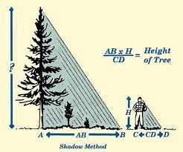
Shadow method

Slide 5
Shadow method
This method is applicable to only on sunny days and mostly in the morning or evening.
The shadow caused by pole and tree are measured.
Tree height = Shadow of the tree* Height of the pole
Shadow of the pole

Slide 6
Single pole method

Slide 7
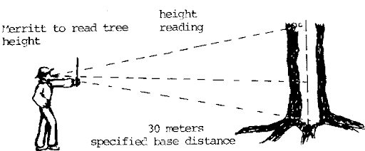
Tree height(AB)= EB*ab
Eb
AB=EB Since (ab=Eb)

Slide 8
Instrumental method
By using a instruments like hypsometer, clino meter, altimeters, abney’s level, calipers etc height of tree can be measured.
All these instruments are based either on geometric principle of similar triangles or on trigonometric principles.
Geometric principles of similar triangles:

