Slide 1
Artificial Regeneration
Mrs. Sonia Panigrahi
Assistant Professor

Slide 2
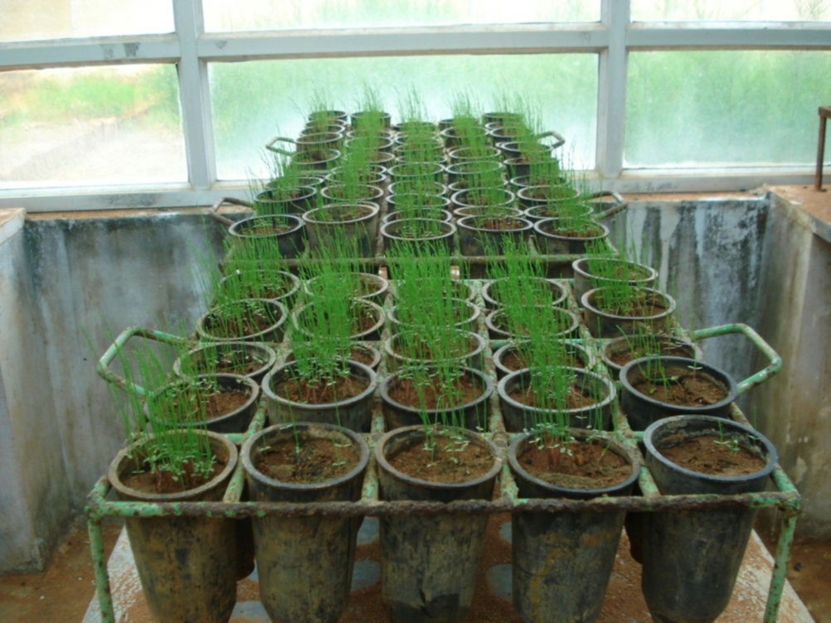
Artificial regeneration

Slide 3
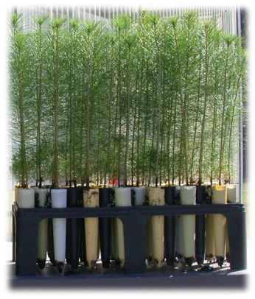
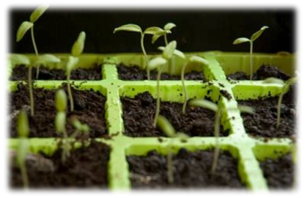
ARTIFICIAL
REGENERATION?
Artificial regeneration is defined as ‘ the renewal of a
forest crop by sowing, planting or other artificial
methods ’
29

Slide 4
Objectives of artificial Regeneration:
A) Reforestation, and B) Afforestation
Objectives of reforestation:
1. To supplement natural regeneration
2. To give up natural regeneration in favor of artificial regeneration
3. To restock forests destroyed by fire and other biotic factors
4. To change the crop composition
5. To introduce exotic.

Slide 5
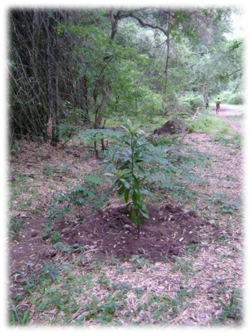
Objects
Objects
✓ Reforestation:
Restocking
of
a
felled
or
otherwise
cleared
woodland
by
Artificial means
✓ Afforestation:
Establishment of a forest by
Artificial means on an area from
which forest vegetation has always
long bean absent
30

Slide 6
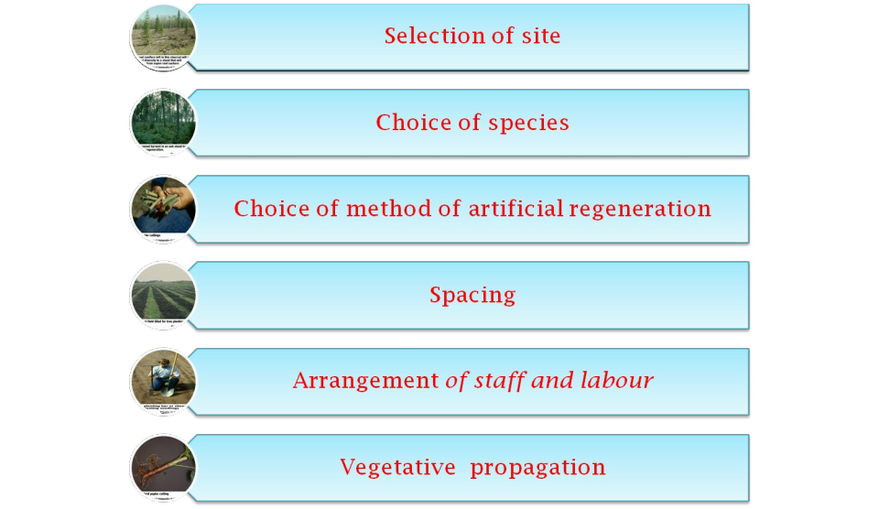
ESSENTIAL PRELIMINARY CONSIDERATION
ESSENTIAL PRELIMINARY CONSIDERATION
31

Slide 7
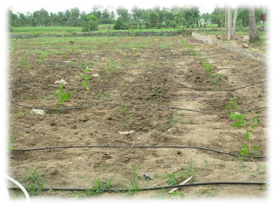
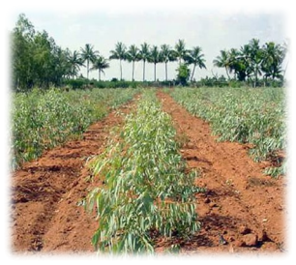
SITE SELECTION
SITE SELECTION
✓ Spp. to be raised are already known
✓ Spp. With particular use
✓ Local vegetation is the best indicator
32

Slide 8
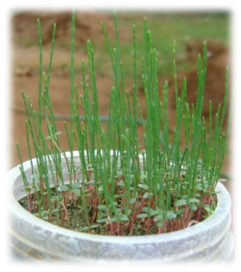
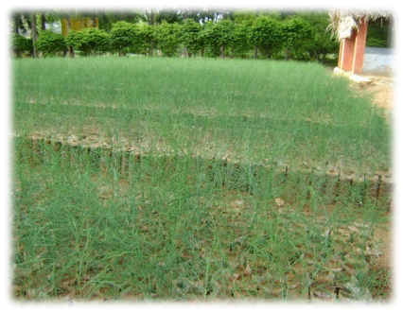
CHOICE OF SPECIES
CHOICE OF SPECIES
✓ Climate and micro – climate
✓ Soil conditions
✓ Object of management
✓ Consumers requirement
✓ Availability of suitable exotic
✓ Ease of establishment
✓ Cost
✓ Effect on site
33

Slide 9
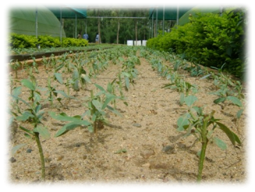
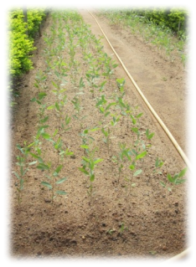
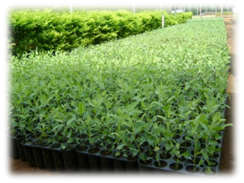
NURSERY PRACTICES USED TO INFLUENCE
NURSERY PRACTICES USED TO INFLUENCE
SEEDLING QUALITY
SEEDLING QUALITY
✓
✓
Seedbed density
✓
Control insects and disease
✓
Control competition
✓
Irrigate and fertilize
✓
Inoculate with mycorrhizae
✓
Top prune
34

Slide 10
CHOICE OF METHOD OF ARTIFICIAL REGENERATION
CHOICE OF METHOD OF ARTIFICIAL REGENERATION
✓
Sowing seeds (Broad-cast sowing, Line sowing, Stripe sowing,
Patch sowing, Dibbling)
✓ Seedlings
✓ Cutting
TYPE OF
ADVANTAGE
DISADVANTAGE
PLANTING
SOWING
Less cost, easy
Large quantity of
work
seed is required,
Seedling mortality
is high
PLANTING
Less material is
Planting is costlier,
required, less
requires more
damage by
labour
animals
39

Slide 11
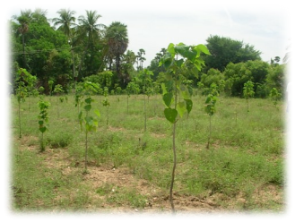
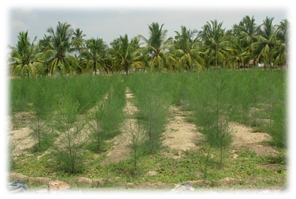
Spacing
✓ Spacing is varies with sp to sp
Factors governing spacing
✓Rate of growth
✓Habit of branching
✓Cost
✓Height of planting material
✓Site factors
✓Inter-cultivation
✓Market for small-sized timber
✓Fruit production as objective
40

Slide 12
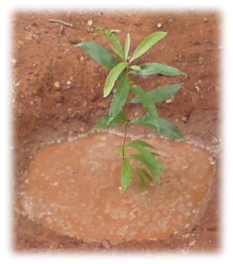
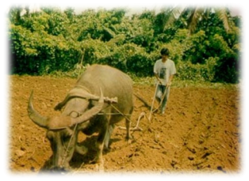
Arrangement of staff and labour
Mechanization
✓Soil preparation (Ploughing,
Harrowing,Ridging)
✓Digging pits for fence posts
✓Transport
✓Fire protection
41

Slide 13
Vegetative propagation
• CUTTINGS
Any portion removed from the parent plant
An art of joining parts of plants together in
such a way that they will readily unite and
continue to grow as one plant
• GRAFTING
• BUDDING
Budding is a variation of grafting in which
the scion is a dormant bud with a small
patch of attached bark
• LAYERING
Formation of roots on branches while they
are still attached to the tree
42

Slide 14
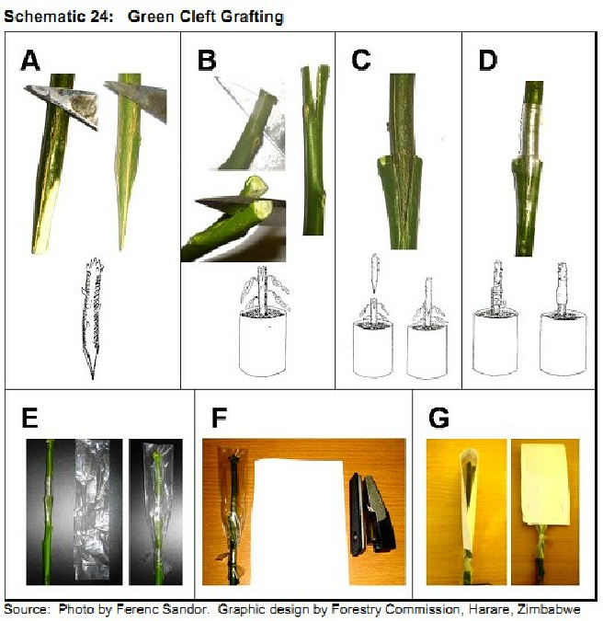
Grafting in oil
seed tree
species
43

Slide 15
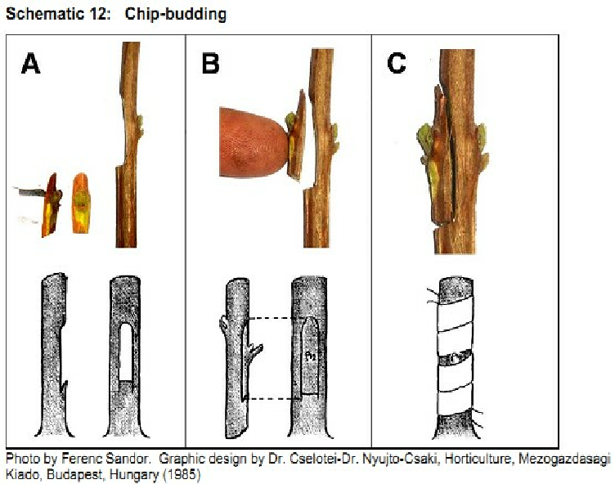
44

Slide 16
Factors affecting the choice between AR & NR
✓ Risk of loss and determination of soil
✓ Crop composition
✓ Genetic consideration
✓ Risk of damage by pests
✓ Flexibility of operation
✓ Density of stocking
✓ Yield
✓ Time factor
✓ Cost
46

Slide 17
Artificial Regeneration
Advantages
✓ Controlled plant density
✓ Predictable seedling production
✓ High flexibility
✓ Low management intensity
✓ Option of introducing improved seed or plant material
✓ Changing species and/or varieties
47

Slide 18
Artificial Regeneration
Disadvantages
✓ Labors-intensive
✓ Temporarily disturbed root development
✓ Less adapted to micro-sites
✓ Cost-intensive
48

Slide 19
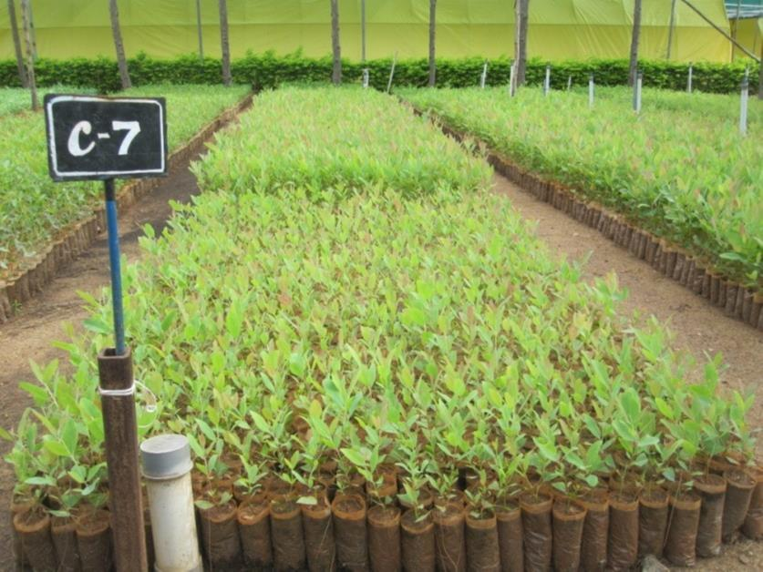
WHY WE GO TO NATURAL REGENERATION INTO ARTIFICIAL
REGENERATION
✓ Quality planting stock
✓ More production
✓ Meet the industrial demand
✓ silvicultural operation
✓ Resistant varieties
✓ Reduced rotation age
✓ Multiply suitable spp
✓ Clonal propagation
49

Slide 20
Questionnaires
Explain the natural regeneration from seed and the factors affecting natural regeneration?
What are the advantage of Natural regeneration and methods of regeneration from vegetative parts?
What are the advantage, disadvantages of Artificial regeneration and its objective?
What are the factors affecting the choice between artificial and natural regeneration.
Write short notes on
Coppicing
Pollarding
Root suckers

