Slide 1
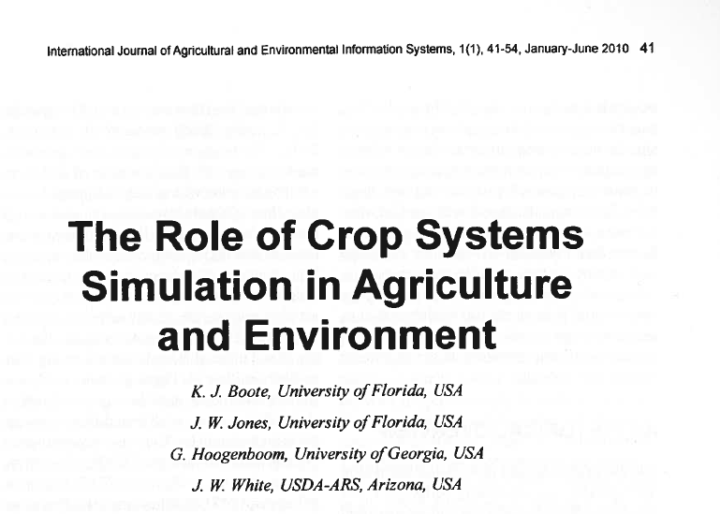
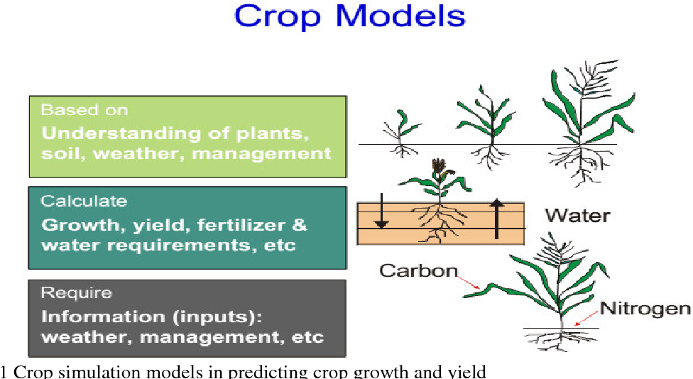
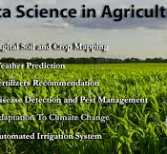
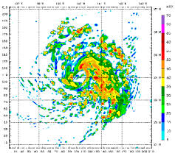
Computer models in Agriculture
Tufleuddin Biswas, Assistant Professor
Department of Agriculture Statistics

Slide 2
Models
To an extension personal a model describes the strategy for extending new idea to recipients
A plant growth model….
Thus…a model can be presented ..form of chart/ diagram/ portrait / mathematical equation and so on
A model can be described as a means or ways of presenting a process
A model can be either deterministic or statistical.
Ex. Y= f(x) deterministic while Y= f(x,ε) statistical which takes care of random component
A set of mathematical eqns describing behaviour of a system

Slide 3
Simulation vs model
mimics the operation of an existing (real world) system
Process of building models and analysing system
It represent the key behaviours and characteristics of the selected process (model)
While simulation represents how the model evolves under different conditions over time
Simulations are computer based, using a software- generated model helps in decision making
Aids in understanding and experimentation, as the models are both visuals and interactive

Slide 4
What is Crop Modelling?
Modeling is the use of equations or sets of equations to represent the behavior of a system. In effect crop models are computer programs that mimic the growth and development of crops (USDA, 2007).
Model simulates or imitates the behavior of a real crop by predicting the growth of its components, such as leaves, roots, stems and grains.
Thus, a crop growth simulation model not only predicts the final state of crop production or harvest able yield, but also contains quantitative information about major processes involved in the growth and development of the crop.
Reactions and interactions at the level of tissues and organs are combined to form a picture of the crop’s growth processes

Slide 5
Characteristics of Models
Written in popular computer language
Minimum time to solve problem
Data on weather, soil and genetic coefficient should be available
They must predict the chronological occurrence of phenological stages
Relatively simple
Use of Model
Act as a tool for research
Act a system of crop management (water and fertilizer input)
Act as tool for policy analyst (prediction and forecasting)
Limitations of modelling
Require large amount of data
Skilled manpower with good computer knowledge
Required multidisciplinary knowledge
Simulation results may error also
Model develop for specific region can not be used as such for other regions
Advantages of Crop model
Helps in prediction and forecasting
DM
Hypothesis formulation
Knowledge about the importance of systems

Slide 6
Crop simulation model (CSM)
Describes processes of crop growth and development as function of weather condition, soil, and crop management
Estimates times that specific growth stages are attained, biomass of crop component (e.g., leaves, stems, roots, and harvestable products) as they changed over times. Similarly changes in soil moisture and nutrient status.
Crop simulation software helps to find better crops
Classification
      Statistical models (yield prediction over time based on weather conditions)
      Mechanistic models (plant and soil process simulation for optimum outcome)
      Functional models (the Penman equation) usually runs using a daily time step and data is updated daily.

Slide 7

The steps of the APSIM modeling
1. Parameterisation: measure and collect data (soil, climate, and crop management) to adjust APSIM to local conditions.
2. Calibration: APSIM will be set up as for experimental trials: simulated and observed results will be compared. Empirical (estimated) model input parameters (phenology, soil) adjusted until observed and simulated results are similar.
3. Validation: APSIM will be run against independent data (second season data at same site): simulated and observed results compared.
4. Scenario analysis: APSIM as a research tool to gain insight into long term average production and risk under different management options.

Slide 8
Using APSIM
Rigorous process before scenario analysis
1. Parameterisation (Year 1)
Collect and, if necessary, measure data to inform APSIM of local conditions.
Data are required for:
    Soils (chemical and physical properties)
    Weather (daily temperature, rainfall, sunshine hours/radiation)
    Cropping systems management (tillage, fertiliser timing & amount, irrigation timing and amount, weed and pest controls)
    Any data which are used by the project will only be done so with the owners’ consent and they will be included on any publications arising

Slide 9
Calibration (Year 1)
APSIM set up as for field trials: simulated and observed results compared.
      Crop yields and biomass
      Crop phenology
      Soil dynamics (water, N, salinity)
Soil Salinity
(0-15cm)
adjust varietal phenology parameters as required
maturity
anthesis
PI
Rice crop yields
and
biomass
emergence
Adjustments made to coefficients and parameters until observed and simulated values match closely

Slide 10
3. Validation (Year 2)
APSIM run against independent data (new season at same site): simulated and observed results compared.
PARAMETERISATION & CALIBRATION
VALIDATION
soil salinity dynamics
EC in 0-15cm soil layer
Crop dynamics
Biomass and yield (kg/ha)

Slide 11
APSIM model calibration and validation
(in this case, over different irrigation salinity treatments….)
T1
T2
T3
T4
Soil EC
Production
Model is considered ‘validated’ when RMSE <= uncertainty in observed data
RMSE = 417kg/ha
Stdev (obs) = 530 kg/ha
In other words, the model error is within the bounds of experimental uncertainty

Slide 12
Scenario analysis (Years 2+)
Once the rigorous parameterisation, calibration and validation process has been completed adequately, use validated APSIM as a research tool to gain insight into long term average production and risk under different management options

Slide 13
APSIM Plug and Play Modules generally used for simulation of rice based cropping system
Module | Purpose | Reference
Crop Modules
Rice (Oryza)** | Basic rice module written based on the ORYZA 2000 crop module. Used to simulate the crop growth, phenology, yield, stress etc. of rice | Bouman et al. (2006); Gaydon et al. (2012b)
Weed | Used to simulate the growth of various weed under different rice growing ecology | Deen et al. (2003)
Soil Modules
SoilN | To simulate the nitrogen dynamics, uptake, removal etc. from different soil layers | Provert et al. (1998)
Phosphorous | To simulate the phosphorus dynamics, uptake, removal etc. from different soil layers | Delve et al. (2009)
Pond | To simulate the algal growth under flooded rice system | Gaydon et al. (2012a)
Water Supply | APSIM Water Supply module is an instantiable module, capable of performing the role of water-source for the APSIM Irrigate module. | Gaydon and Lission (2005)
Solute | Used to a simulate the solute balance within different soil layers for five different solutes. | Poulton et al. (2005)
SWIM3 | The SWIM3 (module is the latest release under SWIM family Soil Water Infiltration and Movement) to simulate the water and solute movement within soil profile | Connolly et al. (2002); Huth et al. (2012)

Slide 14
APSIM model for assessing the complexities of rice-based cropping systems
APSIM has recently been enhanced to simulate different research questions and management practices of rice-based cropping systems and environmental dynamics (Amarasingha et al., 2015; Balwinder-Singh et al., 2015a; Gaydon et al., 2017).
APSIM’s capability for assessing different complexities of rice-based cropping systems under South Asian Countries are well docuemted.

Slide 15
Abiotic stress
APSIM can successfully simulate the crop growth, yield, nutrient transformation, and loss for different rice-based cropping systems under nutrient, moisture and temperature stress condition (Gaydon et al., 2017).
Li et al. (2017) further improved the APSIM-Oryza to simulate the growth and yield of rice under non-stressed, water-stressed, and nitrogen-stressed environments.
In practical field, it is expensive to assess the effects of daily dynamics soil water and salinity and their responses to the associated crops. In some investigations, APSIM-Oryza model were used in more simplistic way to simulate the effect of salinity on crop (focussing on water-availability effects only) (Hochman et al., 2007).

Slide 16
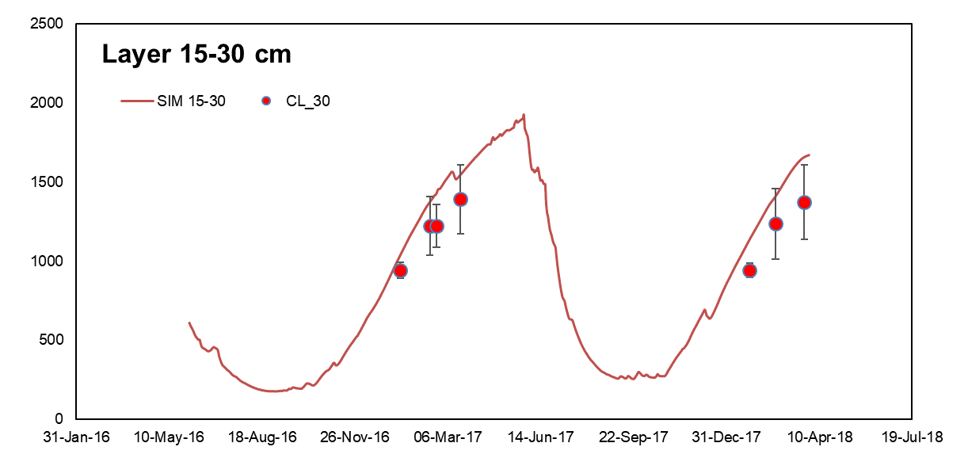
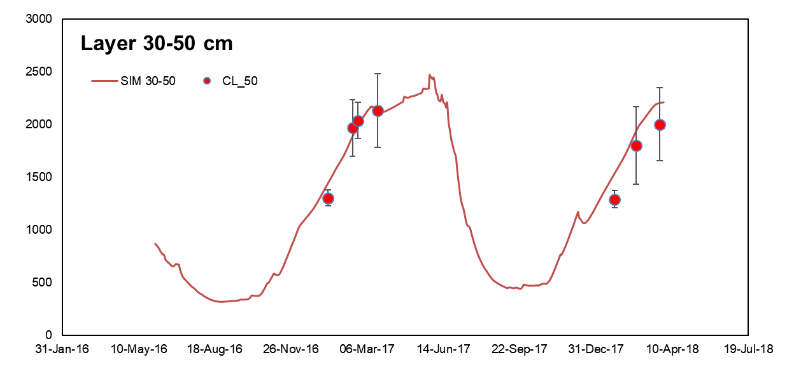
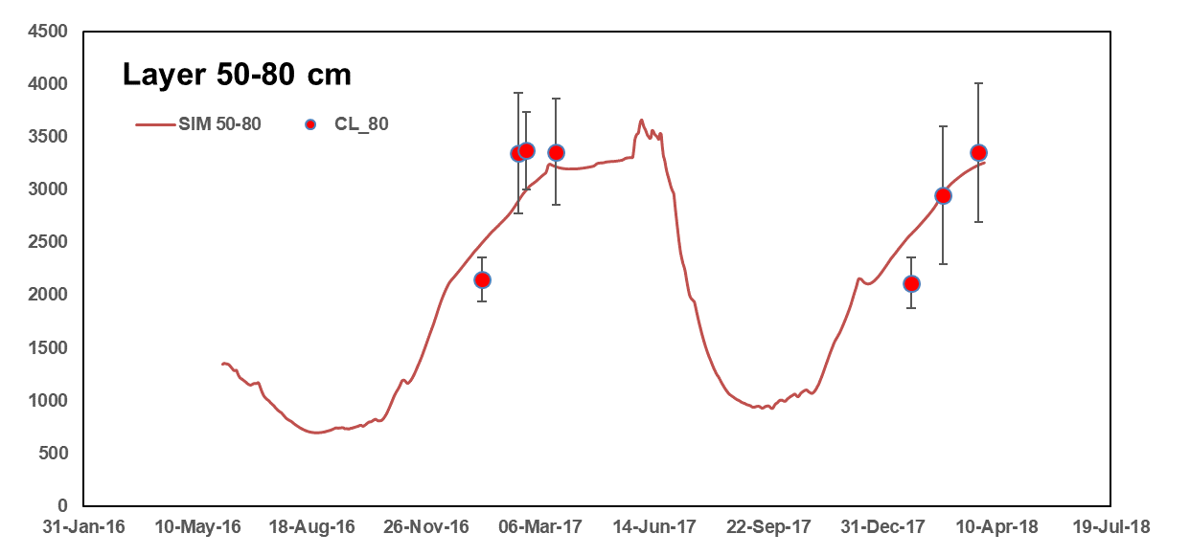
Seasonal Dynamics of Chloride deposition (simulated and observed) in different soil layer of the experimental site

Slide 17
Calibration
Validation
Simulated Chloride Deposition (kg ha⁻¹) versus Observed Chloride Deposition (kg ha⁻¹) across the 0-120 cm soil layer of the experimental site (Lines present the linear relationship between simulated and observed values with intercept at 0)

Slide 18

Increasing CO₂ concentration and climate change
Climate change followed by increasing CO₂ concentration in atmosphere significantly influenced the growth and yield of rice under different growing ecologies
ASPIM cropping system model provides an insight to mitigate the negative impact of climate change by selection of sowing window, cultivars, and management practices like supplementary irrigation and improved agronomic practice etc. (Dalgliesh et al., 2016).
This Photo by Unknown Author is licensed under CC BY-NC

Slide 19
Climate Change studies
Adaptation options are being examined that have the potential to help farmers better manage current climate variability and risk, as well as providing immediate livelihood benefits to them (in each country). Overlaid on top of these are three climate scenarios:
Historical climate
Project future climate 2021-2040 (Echam5) (milder future climate changes)
Project future climate 2021-2040 (GFDLCM2.1) (more extreme, harsher future climate)
Figure 3.12: Annual rainfall distributions in Khulna, Bangladesh, predicted for a present day climate and for 2030 climates described by the ECHAM5 and GFDLCM2.1 GCMs
Figure 3.13: Annual temperature distributions in Khulna, Bangladesh

Slide 20
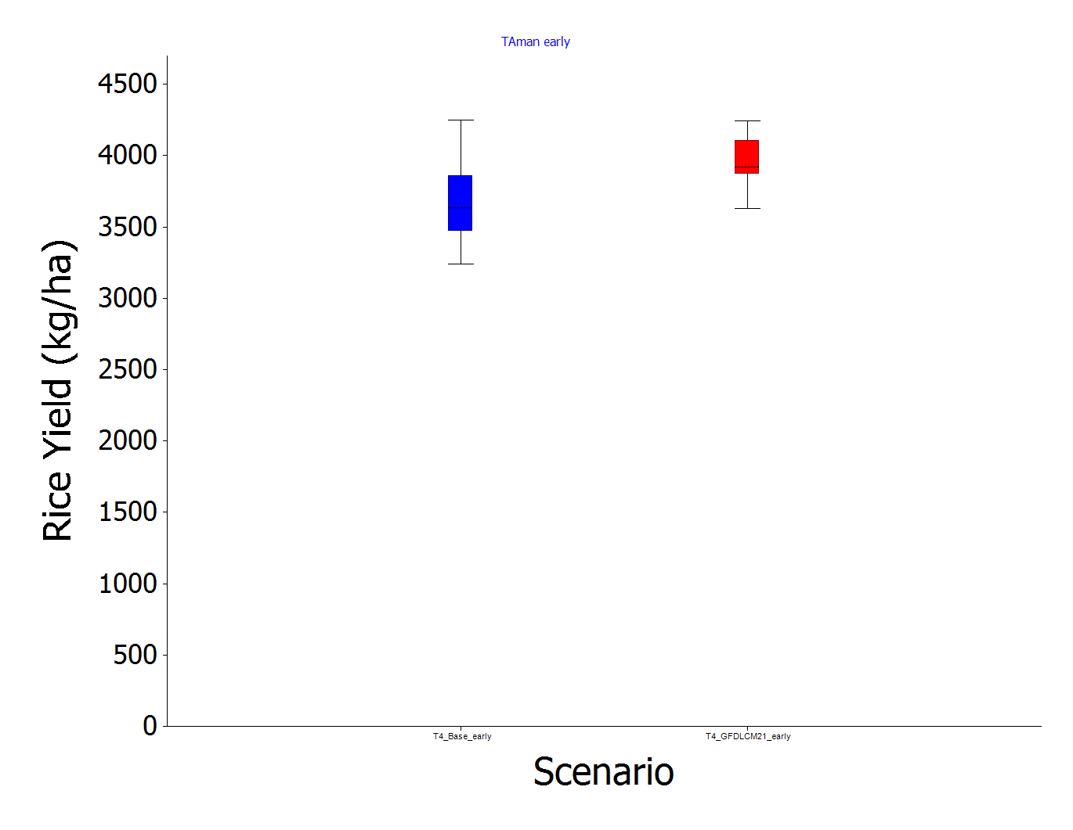
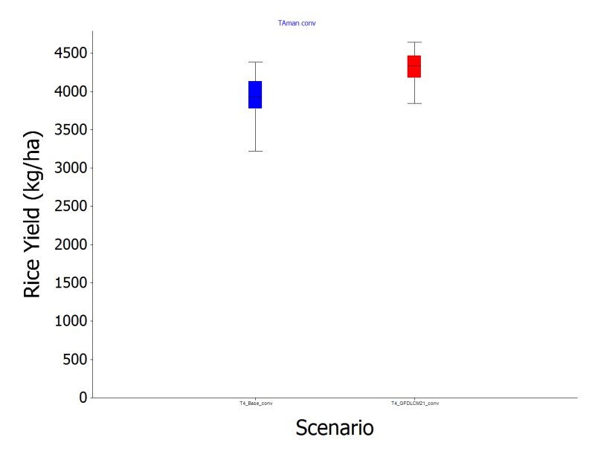
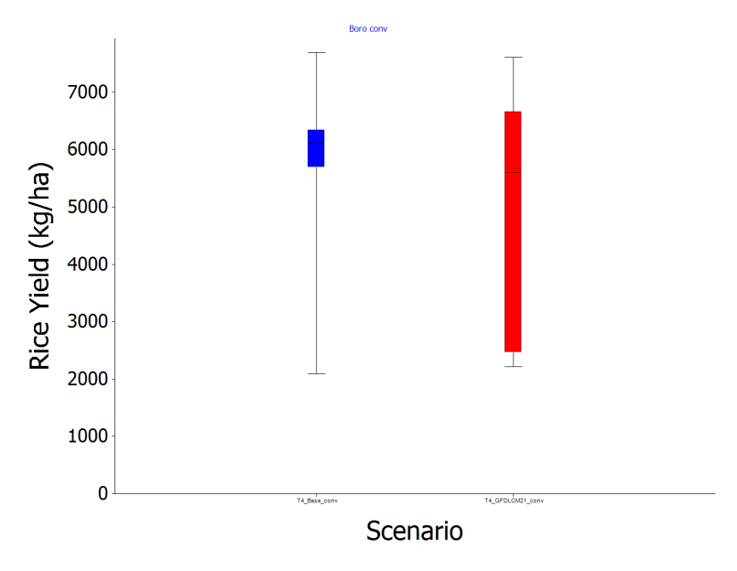
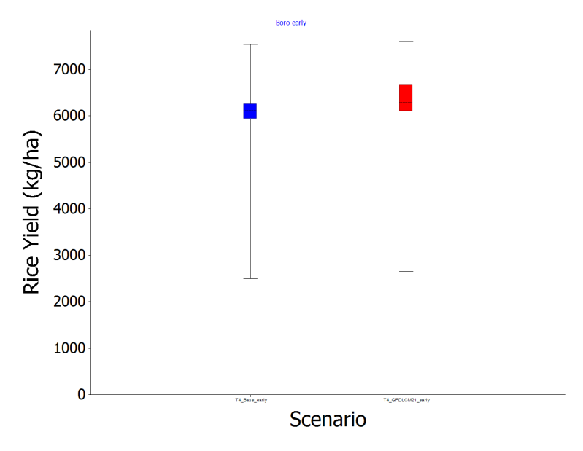
EXAMPLE 1 – Dacope, Khulna, Bangladesh (20 years of simulated data
TAman – conventional sowing
TAman – early sowing
T.Aman not greatly affected by earlier sowing
Historical
2030
Historical
2030
Boro – conventional sowing
Boro – early sowing
But, earlier sowing of the T.Aman crop is an effective future adaptation for the following Boro Rice crop
Historical
2030
Historical
2030

Slide 21
Example 2: Dacope, Khulna, Bangladesh – boro rice
Historical
Future Climate (2030)
Key Points:
Penalty for sowing boro rice earlier is removed (warmer conditions now overcome the low temperature sterility problems associated with earlier historical sowings)
The optimum boro rice sowing date is clearly changed in future, with earlier sowings likely to give advantages. The high variability in yields of later sowings are due to increase high temperature floret sterility.

Slide 22
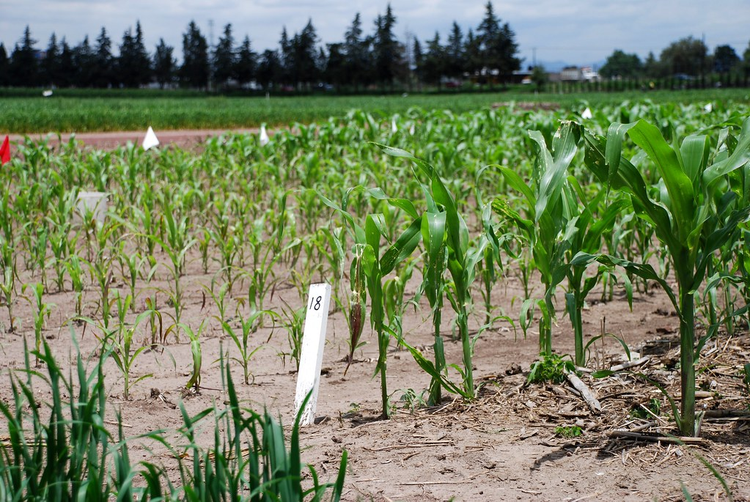
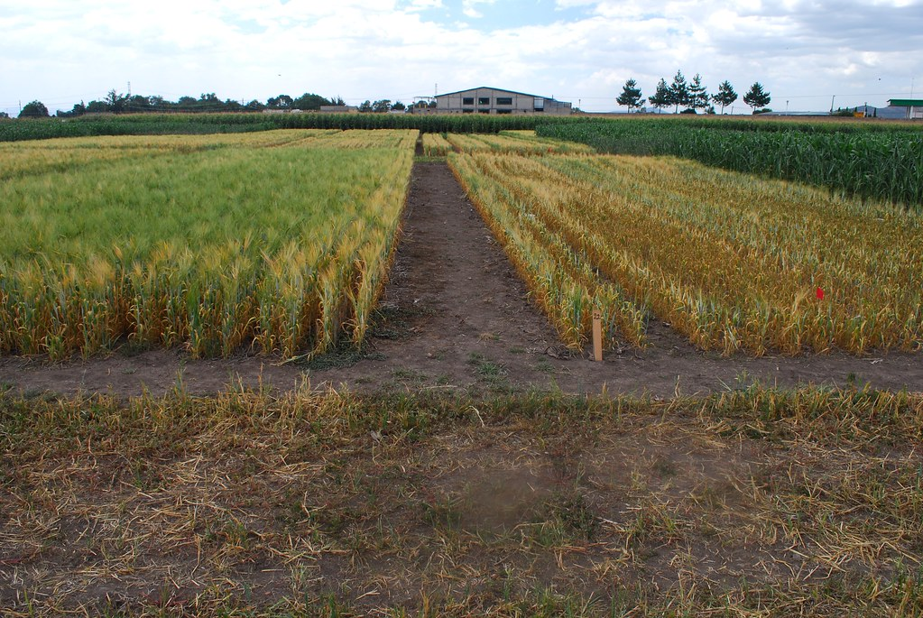
Adaptation of Conservation agriculture
Conservation agriculture (CA) includes stable soil cover, low disturbance of soil and crop diversification are following the principal of sustainable agriculture.
CA is one of the potential solutions for rice -wheat cropping system like adoption of dry seeding rice, (DSR), zero tillage (ZT) of wheat with surface residue retention of rice etc.
The benefit of the CA can further explore with successful application of APSIM model by understanding different complex research questions like: application mulching, residue amount of residue retention, best tillage methods finally impact of climate changes (Naveen-Gupta et al., 2016; Chaki et al., 2021).
This Photo by Unknown Author is licensed under CC BY-SA-NC
This Photo by Unknown Author is licensed under CC BY-SA-NC

Slide 23
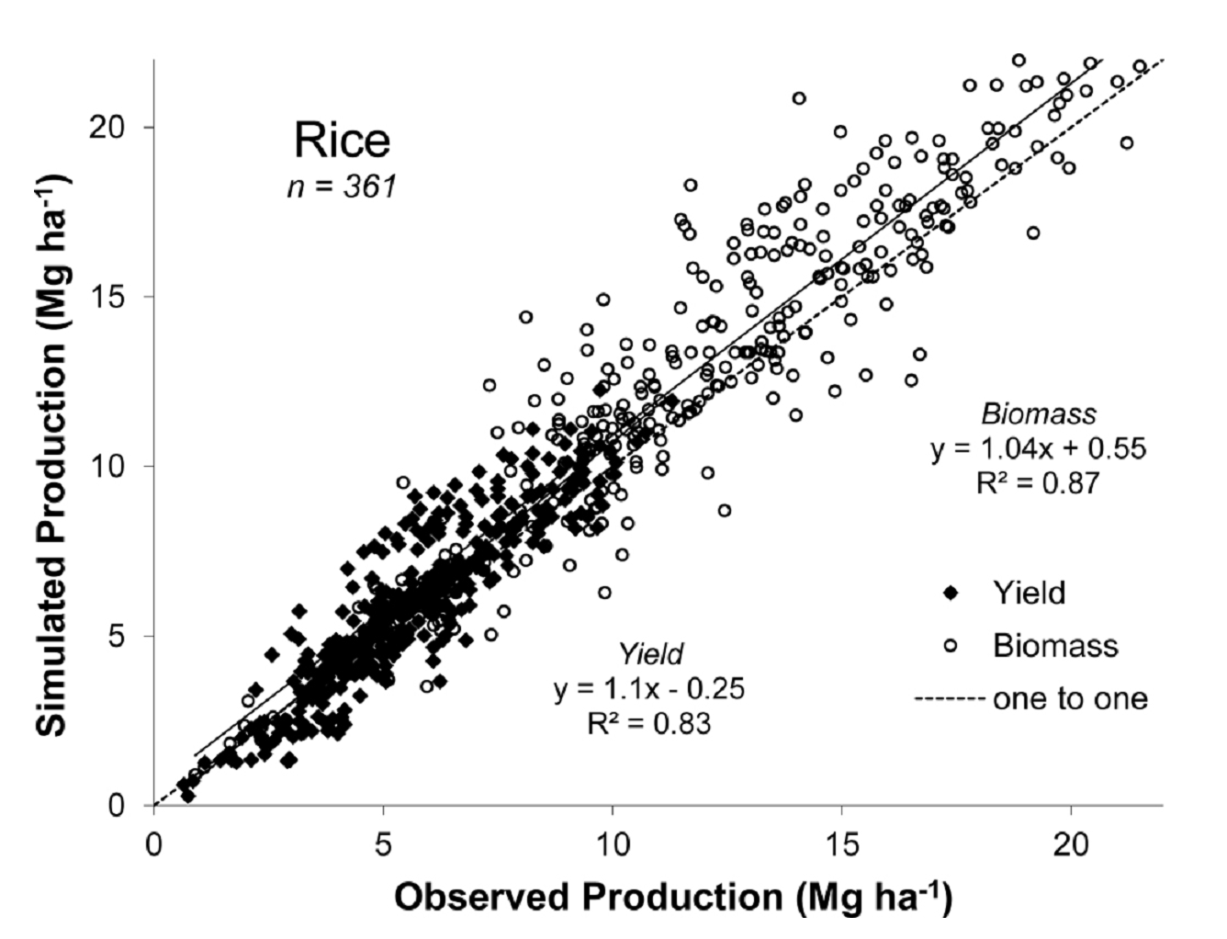
Selection of suitable rice-based cropping system
Selection of location specific cropping system is very essential for intensification of different rice-based cropping system is utmost important.
APSIM can be efficiently utilized for selection of suitable sowing window, rice cultivar, irrigation methods and inclusion of grain legumes in rice based cropping systems (Balwinder-Singh et al., 2015a).
APSIM could be an potential supoort tool for the development of higher-yielding, short duration rice cultivars to reduce groundwater depletion for rice-wheat cropping system of Indo-Gangetic Plains.
Comparison between observed and simulated grain yields and above-ground biomass (Mg ha⁻¹) for 43 rice based field experiment (Gaydon et al., 2017)

Slide 24
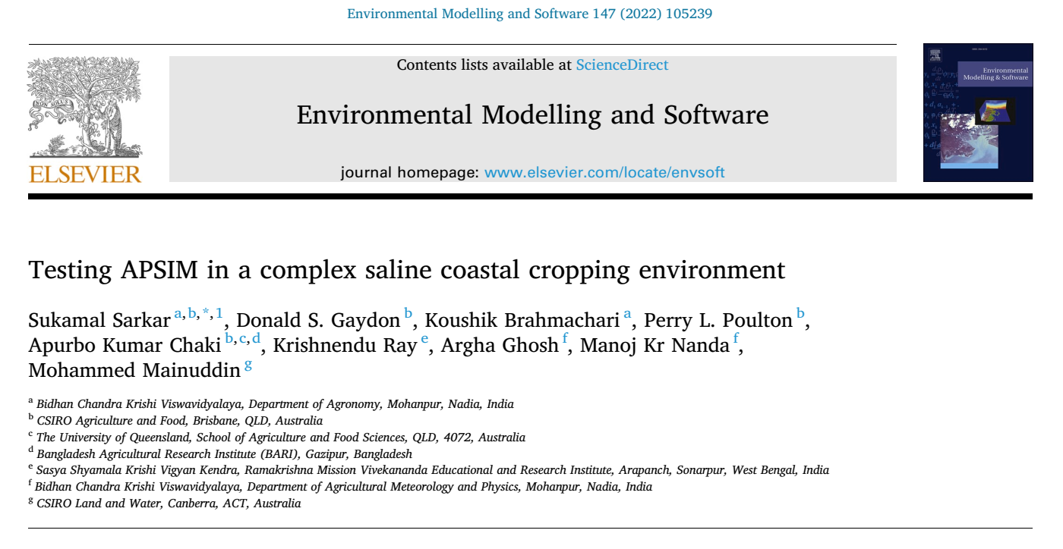
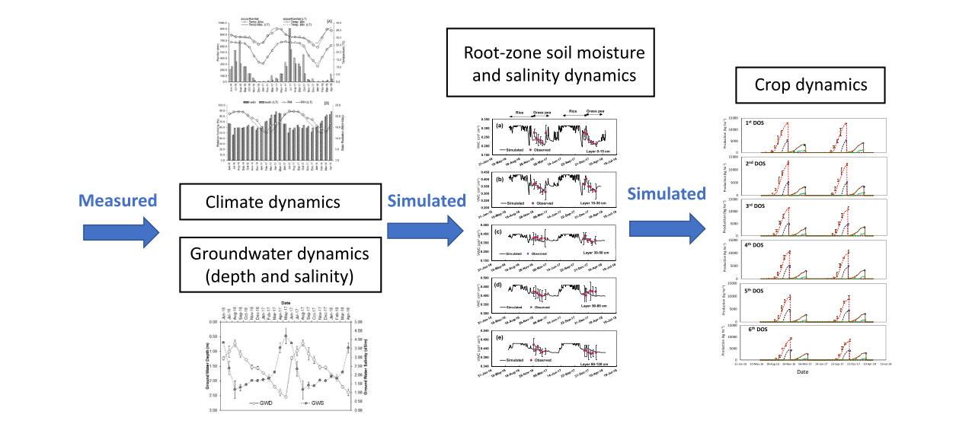
The innovation presented in this paper represented as a flow diagram.
Measured inputs of climate and complex groundwater dynamics were used to simulate
root-zone soil dynamics (moisture and salinity) and this was then used to inform simulation of crop dynamics (biomass and grain yield production).

Slide 25
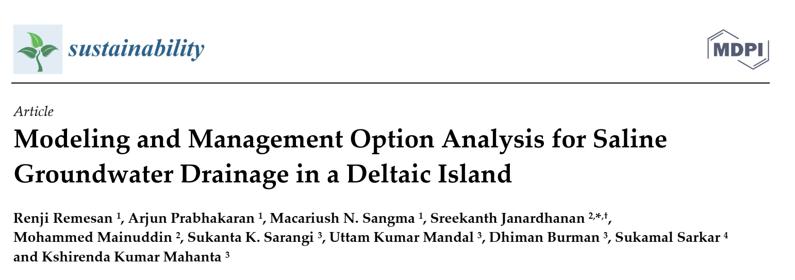
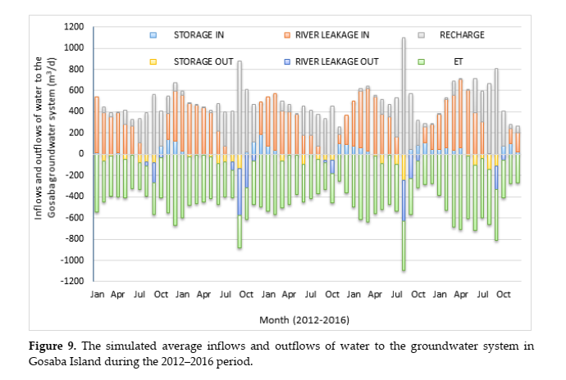
This preliminary modeling study shows encouraging results to consider drainage management as to solve the increasing challenge of water logging and salinity management in the deltaic region.
The insights will be useful for farmers and policymakers in the region for planning various sustainable saline groundwater management.

Slide 26
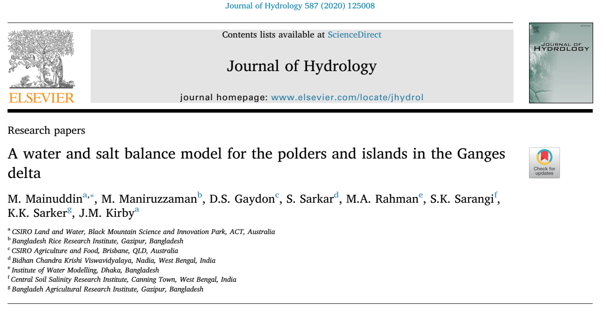
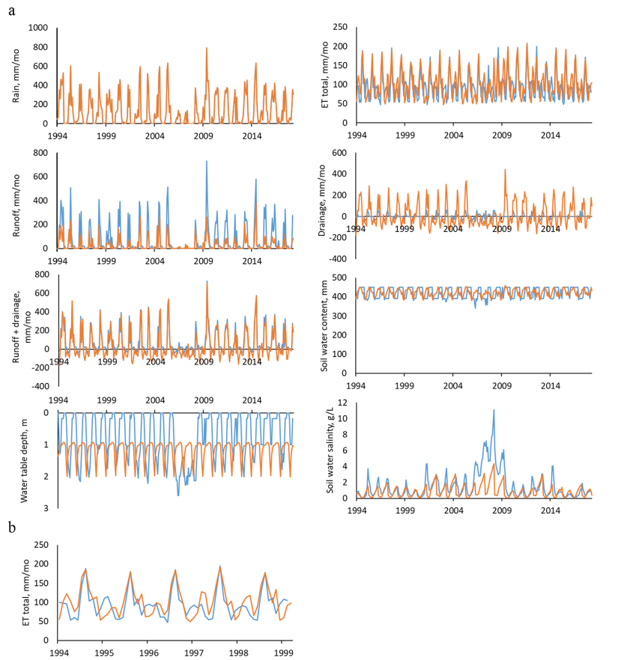
Comparison of polder salt and water balance model results (blue lines) with those of the APSIM model (orange lines) for Amtali. (a) shows the full 24 year simulation with the input rain (top left), actual evapotranspiration (top right), runoff (2nd row, left), vertical drainage from the soil (2nd row, right), combined runoff and drainage (3rd row, left), soil moisture content (3rd row, right), water table (4th row left) and soil salt concentration (4th row right). (b) Shows the actual evapotranspiration for the first five years, repeated from the top right of (a)

Slide 27
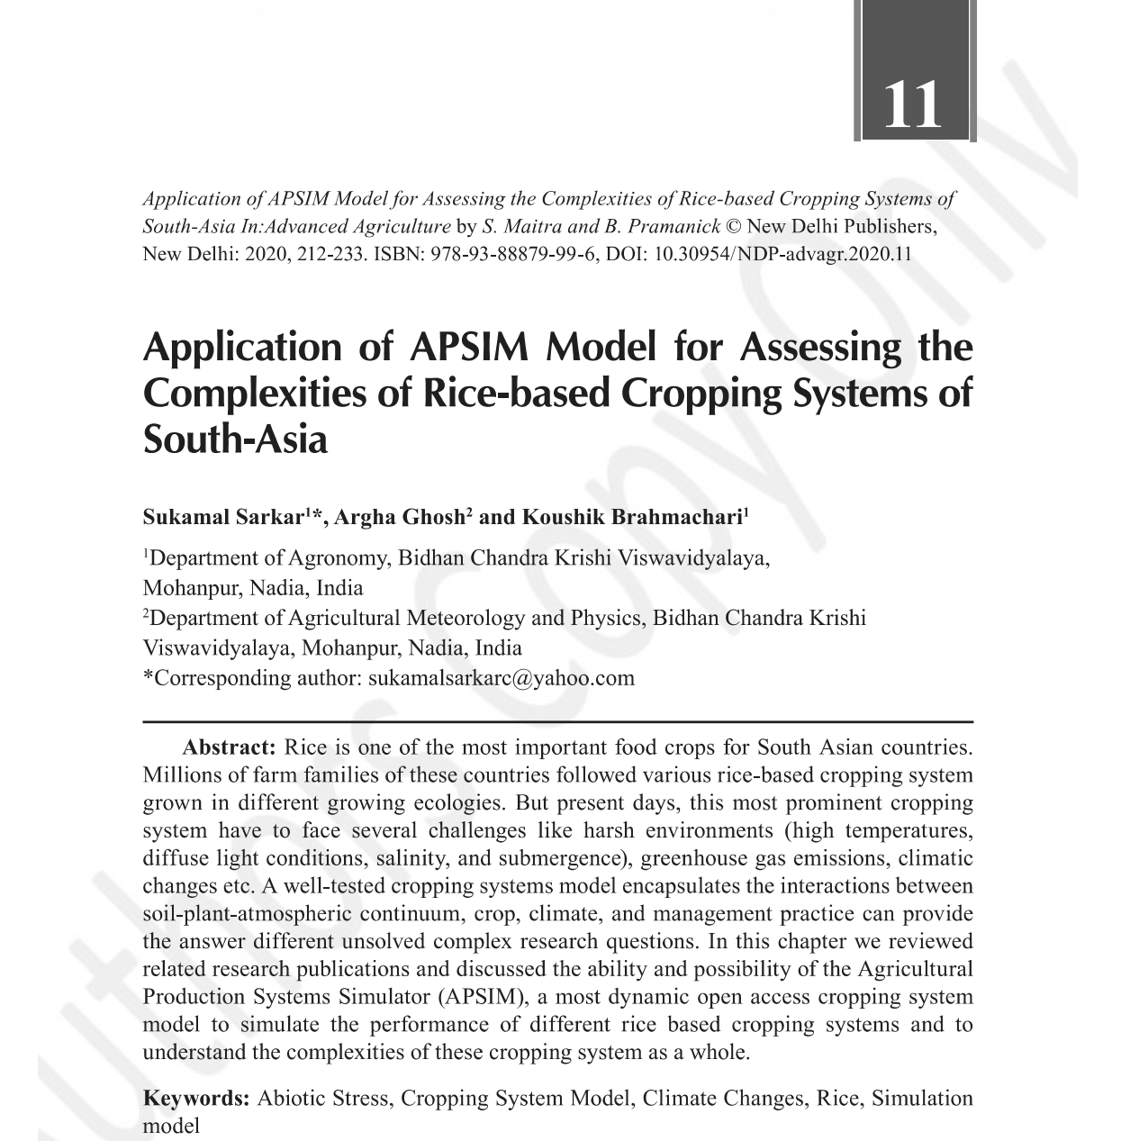
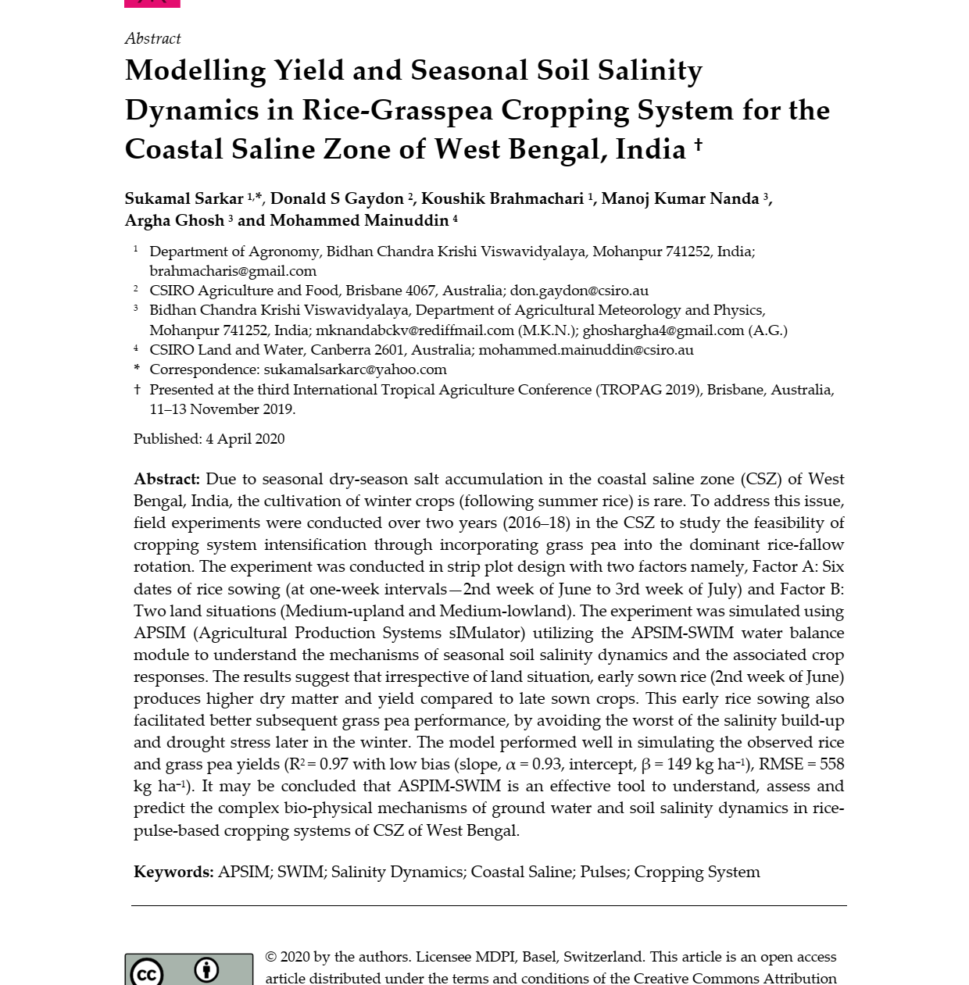

Slide 28
Future thrust
A well tested APSIM cropping system model was calibrated and validated under diverse agro-climatic zones of South Asian Countries performed satisfactorily
The modelling study also may be successfully used to understand and predict the dynamic behaviour of the soil moisture and salinity as well as assist the farmers to select the suitable crops, cultivars, cropping systems and suitable management practices
APSIM model that capture interactions between soil-plant-atmospheric continuum, crop, climate, and farmer management may provide the answers different unsolved complex research questions

Slide 29
Decision Support system for Agro Technology Transfer (DSSAT)
The major product of IBSNAT was the Decision Support System for Agro-Technology Transfer (DSSAT) which is currently being used as a research and teaching tool. As a research tool its role is to derive recommendations concerning crop management and to investigate environmental and sustainability issues.
The DSSAT products enable users to match the biological requirements of crops to the physical characteristics of land to provide them with management options for improved land use planning.
DSSAT is used extensively in addition to the other models such as WOFOST, Info Crop etc. Location and crop specific models are validated using data generated at respective places.

Slide 30
The package consists of data base management system for soil, weather, genetic coefficients, and management inputs, Crop simulation models, series of utility and weather generation programs and strategy evaluation program to evaluate options including choice of variety, planting date, plant population density, row spacing, soil type, irrigation, fertilizer application, initial conditions on yields, water stress in the vegetative or reproductive stages of development, and net returns.
In effect, DSSAT has the potential to reduce substantially the time and cost of field experimentation necessary for adequate evaluation of new cultivars and new management systems.
The DSSAT is a collection of independent programs that operate together; crop simulation models are at its center (Fig. 1). Databases describe weather, soil, experiment conditions and measurements, and genotype information for applying the models to different situations. Software helps users prepare these databases and compare simulated results with observations to give them confidence in the models or to determine if modifications are needed to improve accuracy (Uehara, 1989; Jones et al., 1998).

Slide 31
In addition, programs contained in DSSAT allow users to simulate options for crop management over a number of years to assess the risks associated with each option. DSSAT was first released (v2.1) in 1989; additional releases were made in 1994 (v3.0) (Tsuji et al., 1994) and 1998 (v3.5) (Hoogenboom et al., 1999).
Reasonably precise estimate of yield before the actual harvest of the crop is vital in policy planning. The relatively small cost and speed of assessment makes crop growth stimulation models promising for areas where significant daily weather data are readily available. In this approach, the model is run using actual weather data during the cropping season for the geographical reason of interest. Weather data for typical years viz., normal, deficient,
excess rainfall etc. are used to continue stimulation until harvest. For example crop growth simulation models, regional weather data bases and historical yield data are used to forecast rice yield for different regions of Japan. There is an urgent need to develop such model for early assessment of yield to help in strategic planning and decision-making. It is especially useful in countries where the economy depends on crop harvest.

Slide 32
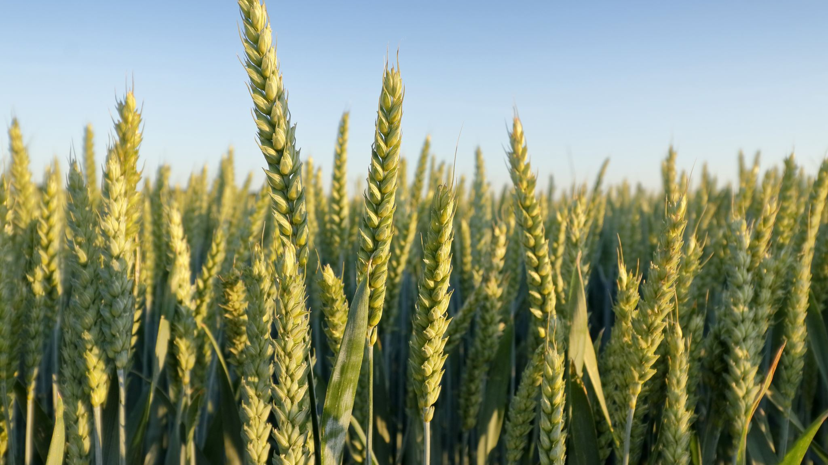
Decision Support system for Agro Technology Transfer (DSSAT)
DSSAT is used extensively in addition to the other models such as WOFOST, Info Crop etc. Location and crop specific models are validated using data generated at respective places.
DSSAT is a decision support system that is designed to aid farmers in developing long term crop rotational strategies. Fifteen crop stimulation models (CERES: wheat, maize, rice, sorghum, millet, barley, sunflower, sugarcane, chickpea, tomato and pasture;mSOYGRO, PNUTGRO, BEANGRO, SUBSTOR-potato) are accessible in DSSAT.
The crop models are developed to assess the influence of weather and management practices (cultivar selection, sowing time, plant population, initial condition, irrigation water, nitrogen schedule, mulching etc.) on crop growth and development on daily basis.
Significant feature of DSSAT is the development of standards for data collection and formats for data acquisition and exchange. This allows any crop model of the family to share and access common soils and weather data.

Slide 33
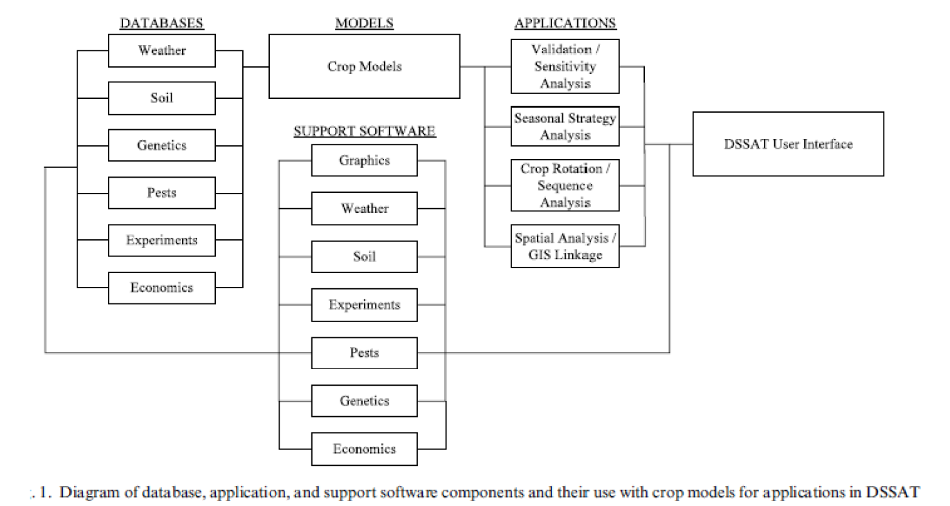

Slide 34
Database
Applications of system approach using comprehensive models like DSSAT to represent the total agricultural production systems require datasets on the different components, namely: (a) crop; (b) weather; (c) soil; and (d) management.
Crop data
Crop data refers to the cultivar’s information or genetic coefficients that characterize the physiological and morphological processes determining crop growth, development and yield.

Slide 35
Database
Weather data
Weather data requirement for crop models differ depending on the level of crop production being simulated. When simulating crop growth and development under optimum conditions weather data needed are daily values of solar radiation, maximum temperature, and minimum temperature since light and temperature are the driving variables of plant processes. Rainfall is an important weather variable since it supplies the soil moisture needed by the crop particularly in rainfed areas.
Good quality weather data (without missing data) are needed for crop simulation models to calculate dry matter accumulation and to determine the physiological development of the crop. They will be obtained from historical records of agrometeorological stations. When meteorological data are inadequate or missing, statistical techniques are used to augment or generate weather data for crop simulation.

Slide 36
Database
Soil data
Crop models require soil data which characterize the soil texture, structure, depth, profile, level of soil nutrients, and other related variables that describe the soil-water balance and nutrient dynamics during crop growth and development. Soil physical characteristics such as hydraulic conductivity determine the movement of water in the soil. Besides, field capacity, wilting point, thickness of root zone, bulk density, and water table depth are also required.
Management data
Management Parameters required in the crop models include data on date of sowing or transplanting, spacing or planting density, timing and dosage of fertilization as well as schedule of irrigation. Data for management inputs to simulation models should consider the prevailing or existing management practices for which crop response is simulated.

Slide 37
Calibration
Calibration means derivation of genetic coefficients of the crop cultivar and soil parameters.
This requires the crop and management data set, at least from, 6 field experiments in order to capture the genotype and environmental interaction. This may contain experiments with different dates of sowing (2 or 3) in different years (3 or 2).
Genetic coefficients are variety specific for a crop. Hence major ruling varieties of a crop in a district need to be selected.
The models will be run separately for the individual variety and finally composite yield forecast for the district will be developed based on the ruling varieties.
Genetic coefficients are nothing but cumulative heat unit and photoperiod requirement of a variety so that the crop will progress to next stage once cumulative heat unit requirement prior to that stage is met out. e.g. if genetic coefficient is 390, that means as soon as the maize crop acquires 390 heat units after silking, the crop will go to maturity.

Slide 38
Cont..
Hence estimation of precise requirements of heat units and photoperiod would require accurate observations from the field experiments with a condition that crop should not have faced any stress due to weather and input resources. Estimation of genetic coefficients hence is highly sophisticated, which also requires laboratory setup to fix photoperiod requirements.
Alternatively, and practically genetic coefficients for a given variety of a crop in a region may be developed if genetic coefficient of a known cultivar of similar duration of the crop are available in the DSSAT software or available with the institute.

Slide 39
Soil: To create file in DSSAT format it requires the various types of soil data (depth wise) of our experiment field. Like lower limit moisture (cm³ cm¬³.), Upper limit moisture, drained (cm³ cm¬³.), Upper limit moisture, saturated hydraulic conductivity, Bulk density (g cm¬³), Clay percentage, Silt percentage, Sand percentage, Soil texture, Soil depth, pH, EC and slope of soil etc.
Crop Management Data: In addition to year wise weather and Soil file the crop management data like, Latitude, Longitude, Year of experiment, Location, Crop, Names of variety, Dates of transplanting, Date of emergence, Thermal time requirement to complete physiological stages of crops like: Anthesis, physiological maturity, Harvest stage, yield attributes, Nutrient requirement (N,) and time of application and Irrigation and simulation control information requires.
Genotype of the crop: The crop, the genetic characteristics of local varieties, information of existing genotypes of specific crop are required to run the model.

Slide 40

Cont..
P1 Thermal time from seedling emergence to the end of the juvenile phase (expressed in degree days above a base temperature of 8°C) during which the plant is not responsive to changes in photoperiod.
P2 P2 extent to which development (expressed as days) is delayed for each hour increase in photoperiod above the longest photoperiod at which development proceeds at a maximum rate (which is considered to be 12.5 hours).
P5 Thermal time from silking to physiological maturity (expressed in degree days above a base temperature of 8°C).
G2 Maximum possible number of kernels per plant. G3 Kernel filling rate during the linear grain filling stage and under optimum conditions (mg/day).
PHINT Phylochron interval; the interval in thermal time (degree days) between successive leaf tip appearances.
The above genetic coefficient are derived for a variety based on the known variety of similar duration by fine tuning genetic coefficients so that phenology of observed and 17 predicted days would match perfectly. Similarly, by adjusting growth parameters (G), we may set the model for yield and yield attributes.

Slide 41
Validation
(i) Validation of model needs above type of data from another 2 experiments for the
same cultivar.
(ii) Crop yield data only for around 10 years for long term simulation and validation.
(iii) Time series data required for detailed comparison of model simulations.
Models require cultivar specific genetic coefficients for better prediction. These coefficients vary among the crop varieties in response to weather, soil and management practices. Estimation of genetic coefficients, hence, is vital in crop yield forecasting models. Field experiments will be conducted for different cultivars and observations will be made to estimate genetic coefficients.

Slide 42
Check list
DSSAT; Minimum Data set for crop model required are- Soil, Weather, Crop Genotype and Crop Management as described below.
Weather: Long term (25 years) daily meteorology data of major weather parameters viz, Year in Julian data format, Tmax, Tmin, Rainfall and BSSH or Solar radiation etc.

