Slide 1
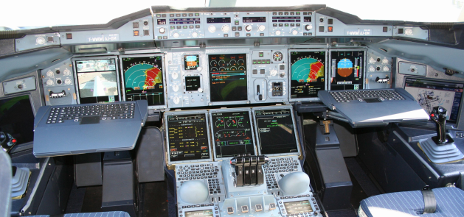
EMI and EMC
By
Dr P A Sunny Dayal
Associate Professor, Dept of ECE,
Centurion University of Technology and Management

Slide 2
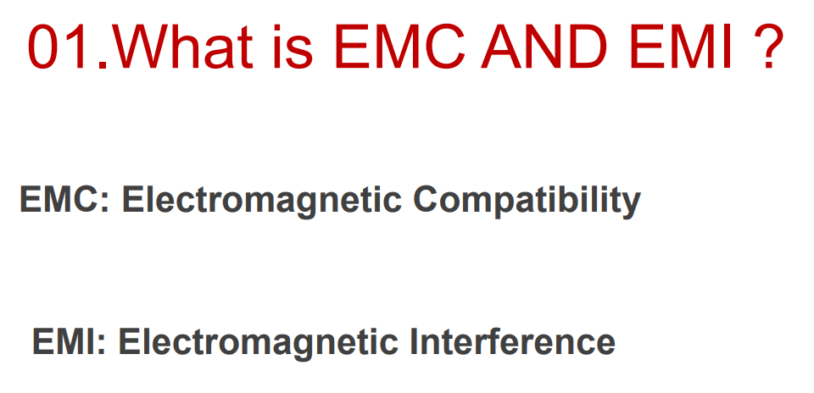

Slide 3
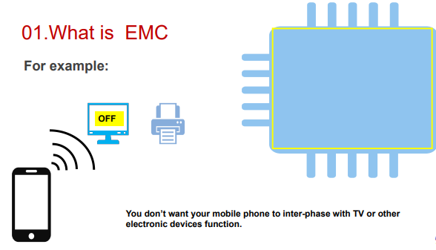

Slide 4
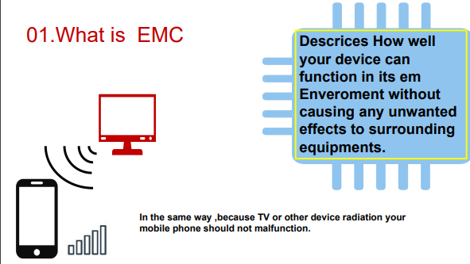

Slide 5
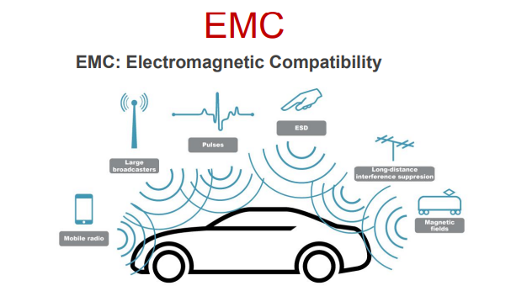

Slide 6
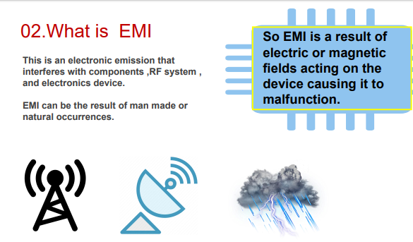

Slide 7
