Slide 1
Drug toxicity and toxicity caused by agrochemicals

Slide 2
DRUG TOXICITY
Drug toxicity may occur when the dose is given is too high or the liver or kidneys are unable to remove the drug from the bloodstream, allowing it to accumulate in the body.
DRUGS
Supratherapeutic doses
Genetic predispositions
Inappropriate use
Non-selective actions
Used correctly
Therapeutic
Toxic

Slide 3
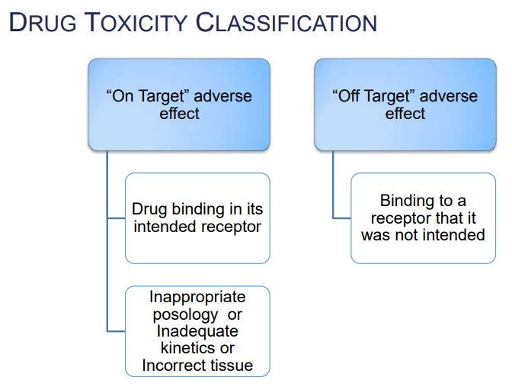
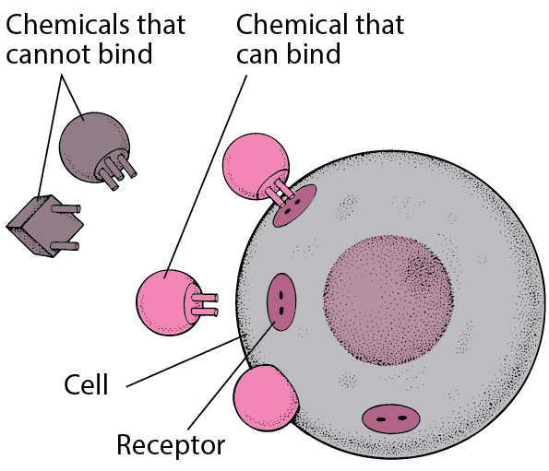

Slide 4
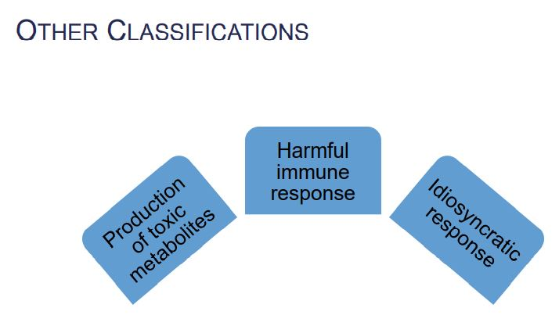
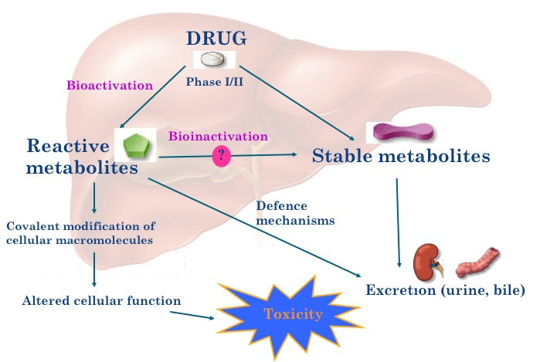

Slide 5
Examples of Metabolic Conversions Leading to Toxic Metabolites
A. Acetaminophen. The analgesic acetaminophen (4-hydroxyacetanilide, paracetamol) exhibits lethal hepatotoxicity.
B. Tienilic Acid. Tienilic acid is a uricosuric diuretic drug that may cause immunoallergic hepatitis.

Slide 6
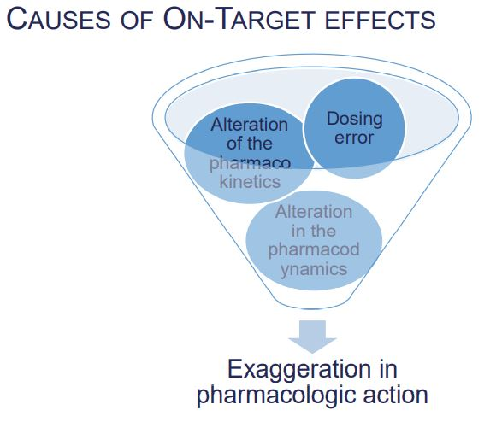
On-target effects refers to exaggerated and adverse pharmacologic effects at the target of interest in the test system.

Slide 7
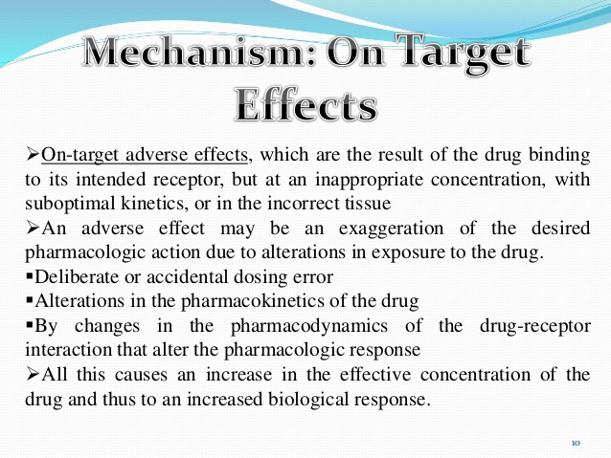

Slide 8
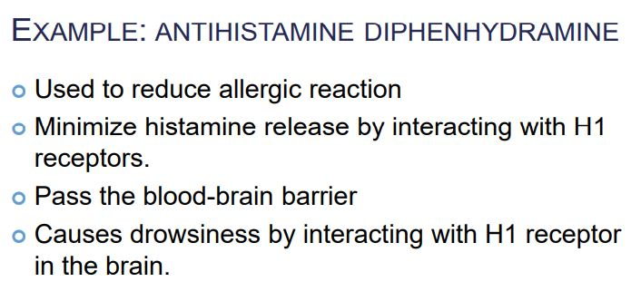

Slide 9
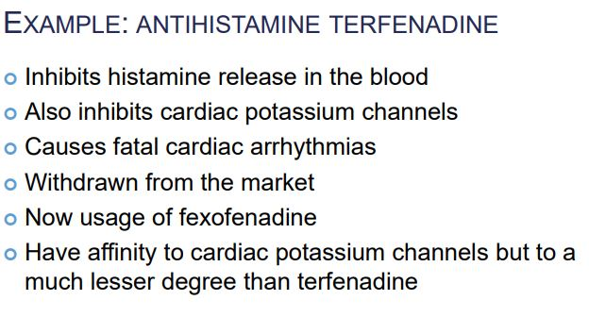
MECHANISM OF DRUG TOXICITY: Off-Target adverse effect
Off-target refers to adverse effects as a result of modulation of other targets; these may be related biologically or totally unrelated to the target of interest.

Slide 10
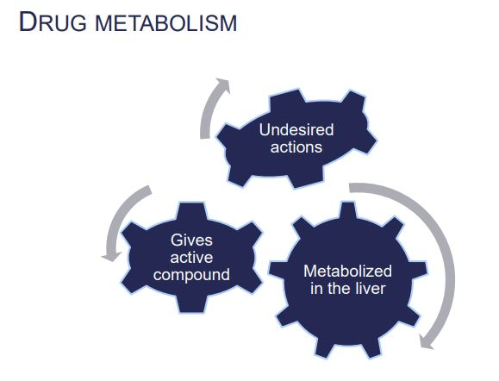
MECHANISM OF DRUG TOXICITY: Production of toxic metabolites

Slide 11
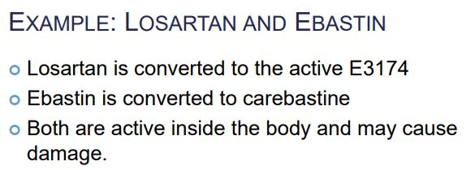
Losartan, sold under the trade name Cozaar among others, is a medication mainly used to treat high blood pressure. It is also used for diabetic kidney disease, heart failure, and left ventricular enlargement.
Ebastine is a H₁ antihistamine with low potential for causing drowsiness

Slide 12
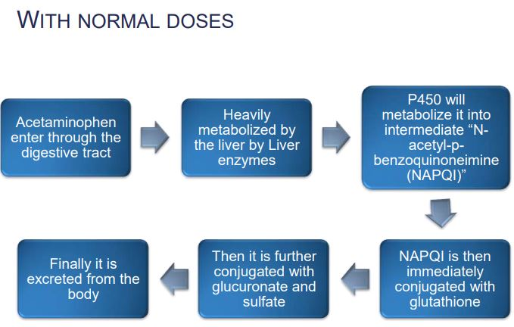
ACETAMINOPHEN: Mechanism of Acetaminophen toxicity

Slide 13
