Slide 1

Toxicity caused by Agrochemicals

Slide 2
Introduction
Various pests, fungi, weeds and rodents cause much harm to the production and storage of food grains.
A large number of pesticides including insecticides, rodenticides, herbicides and fungicides are available in the market.
They enable the farmers to control their crops, from being destroyed by insects, diseases and weeds.
As a result, though the yields of food crops have reached new high levels.
Extensive use by the agriculturists has resulted in poisoning of human beings, Animal, birds, plant and aquatic living things.

Slide 3
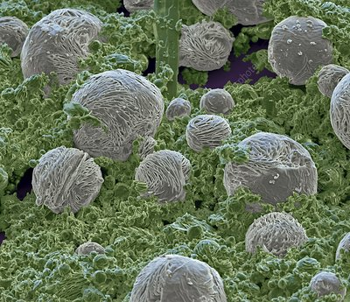
Fungicidal
Fungicides preserve the seeds for seedling purposes.
These are mainly mercurial compounds

Slide 4
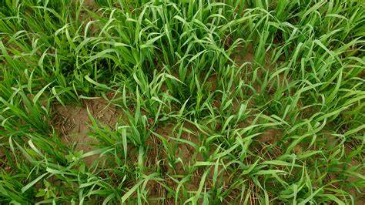
Herbicidal or Weed Killers
Since the growth of undesirable herbs and weeds in the field yields low production, the herbicides or weed killers are used to protect the field.
These are:
Sulphuric acid (1%); is a corrosive acid.
Sodium chlorate; is irritant.
Potassium cyanide; causes tissue anoxia
Paraquat.
Weed

Slide 5
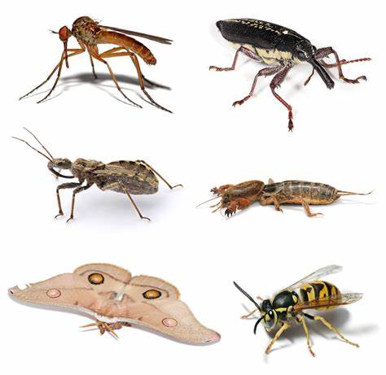
Insecticides
Insecticides are the compounds that are employed for killing insects, are classified as:
Organophosphorus compounds
(i) Alkyl phosphates
(ii) Aryl phosphates
2. Halogenated hydrocarbons
Aldrine
Endrine
DDT

Slide 6
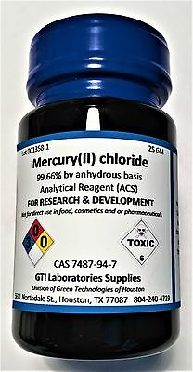
3. Miscellaneous compounds:
Mercurial salts
Arsenic salts

Slide 7
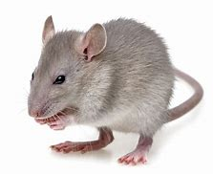
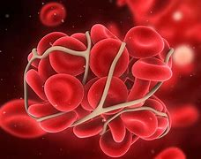
Rodenticidal
Inorganic compounds
Aluminium phosphide
Zinc phosphide
Thallium
Phosphorus
(ii) Organic compounds- Fluoro-acetate
(iii) Convulsants-Strychnine
(iv) Anticoagulant-Warfarin

Slide 8
Insecticides or herbicides are further classified according to their toxicity as:
Virtually Harmless
(i) Pheno-oxalic acid
(ii) Copper oxide—fungicide
(iii) Lime sulphur—orchard fungicide
(iv) Petroleum washes— orchard insecticide

Slide 9
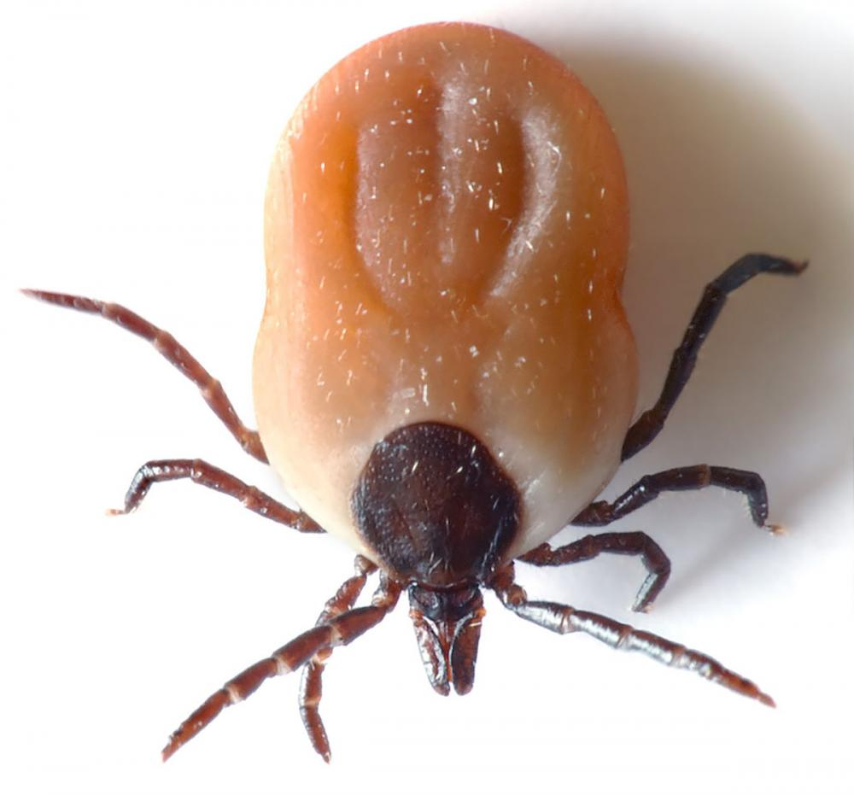
2. Comparatively Harmless
(i) Sulphuric acid 20%—weed killer
(ii) Sodium chlorate—mass herbicide
3. Mildly toxic (25-60 gm)
(i) Chlorinated hydrocarbons
(ii) DDT
(iii) Gammaxene
(iv) Aldrin, dieldrin: used to control flies, louse, tick and as an agricultural insecticide.
Tick

Slide 10
4. Moderately toxic (10-25 gm)
(i) Diazinon
5. Highly toxic
Sodium arsenite
Lead and calcium arsenate
Organic polyphosphates
Organophosphorus compounds which include
HETP (Hexa Ethyl tetra phosphate)
TEPP (Tetra Ethyl pyro phosphate)
Parathion

Slide 11
Toxicity mechanism of Action of Organophosphates
Organophosphates inactivate Acetylcholinesterase (AChE) by phosphorylating (addition of a phosphate group) the serine hydroxyl group located at the active site of acetylcholinesterase.
Once AChE has been inactivated.
Acetylcholine accumulates throughout the nervous system.
Resulting in excessive stimulation of cholinergic receptors (muscarinic and nicotinic receptors) at various organs.
Resulting in acute cholinergic crisis.

Slide 12
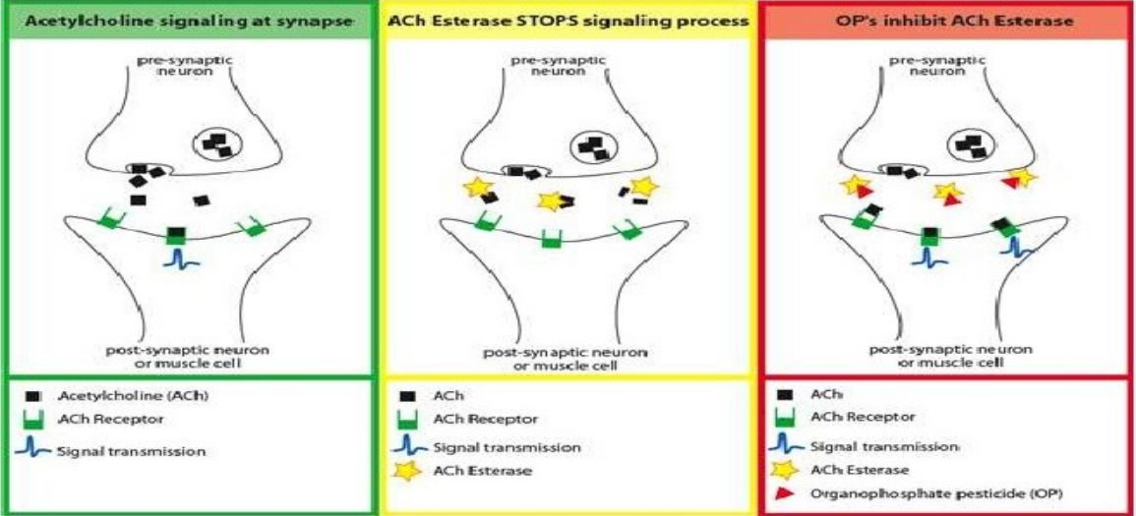

Slide 13
Toxicity Effects of organophosphate (OP)
The effects of organophosphate (OP) toxicity can be divided into 3 categories, including :
Muscarinic effects
Nicotinic effects and
CNS effects

Slide 14
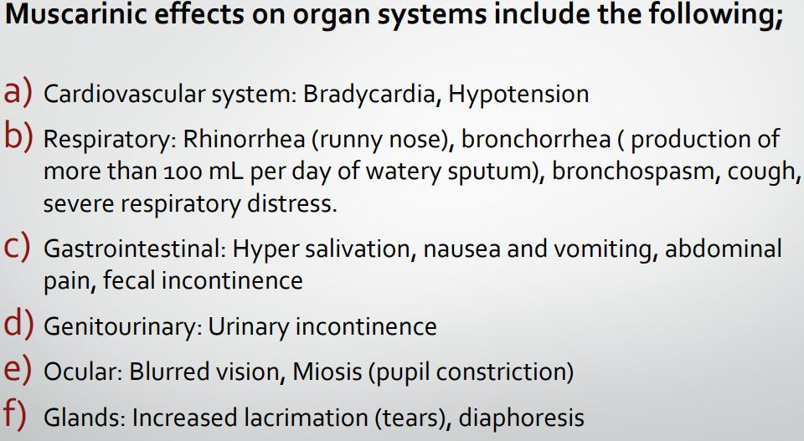
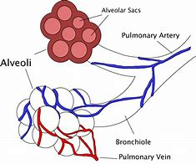

Slide 15
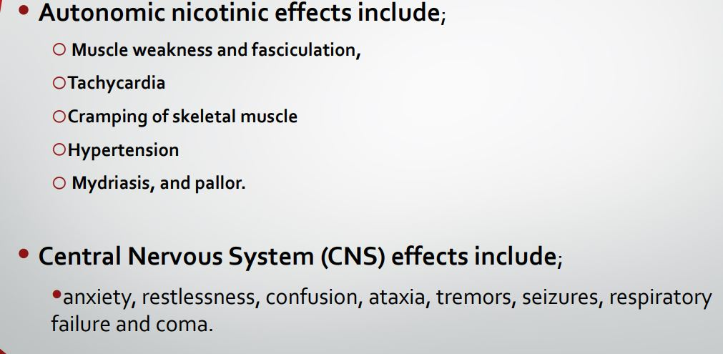

Slide 16
Management
In History taking: You have to find out;(Direct Answer Questions) What, When, How much, and Why?
Protect yourself using protective clothes and gloves and decontaminate the patient by removing contaminated clothes and washing the skin thoroughly with soap and water.
Look for and Recognize signs and symptoms of organophosphate poisoning-
DIAPHORESIS
POOR AIR ENTRY or in severe cases, respiratory failure
BRADYCARDIA
HYPOTENSION

Slide 17
Obtain IV access and give atrophine intravenously as soon as possible for a symptomatic patient.
Perform gastric decontamination with gastric lavage once the patient is stabilized and within two hours of ingestion.
Give activated charcoal while maintaining atrophine infusion
Administer pralidoxime.

Slide 18
ATROPINE
Used as an antidote to counter the muscarinic effects of acetylcholine; only life saving antidote.
PRALIDOXIME
Oximes used as rejuvenators.
The beneficial effect of oximes is exerted through the
Reactivation of enzyme cholinesterase by cleavage of the phosphorylated site.
Detoxifying effect on the unbounded organophosphorous compound.

Slide 19
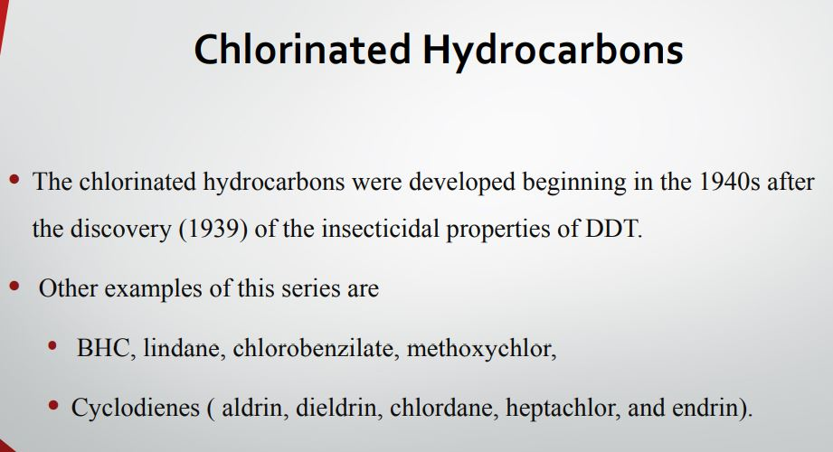

Slide 20
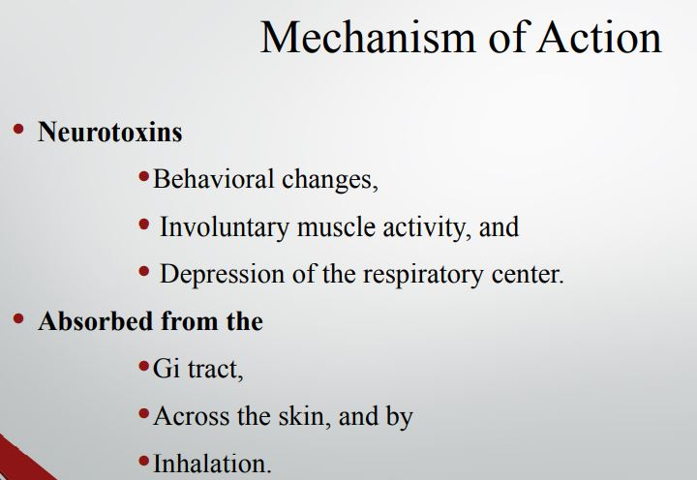

Slide 21
