Slide 1
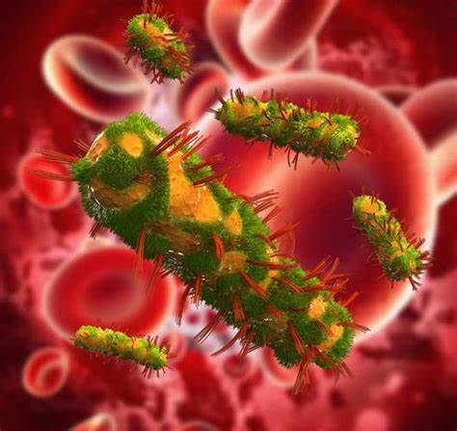
Bacterial toxins

Slide 2
Introduction
Usually virulent strains of the bacterium produce the toxin while non virulent stains do not.
Toxigenesis: The ability to produce toxins, is an underlying mechanism by which many bacterial pathogens produce disease.
Bacterial toxins are the soluble antigens, secreted by a number of pathogenic bacteria.
Toxins can modulate the cellular functions by selectively targeting a number of signaling pathways within the host cell in order to tilt the balance in bacteria favor.

Slide 3
Classification of bacterial toxin
There are two types of bacterial toxins.
ENDOTOXINS
EXOTOXINS
ENDOTOXINS: LIPOPOLYSACCHARIDES - Are associated with the cell walls of gram –ve bacteria
EXOTOXINS : PROTEINS - Released into the extracellular environment of pathogenic bacteria.

Slide 4
Endotoxins
Endotoxins are the integral part of the cell walls of Gram-negative bacteria, and are liberated when bacteria are disintegrated (lysed).
Cell wall of Gram negative bacteria contain lipopolysaccharides (LPS, endotoxin) which consists of
(1) Lipid A. This is the endotoxin and is the core, and
(2) Polysaccharide form coat. This is the O antigen which can induce specific immunity.

Slide 5
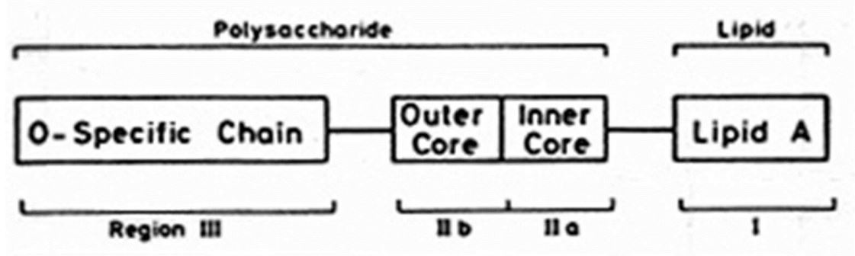
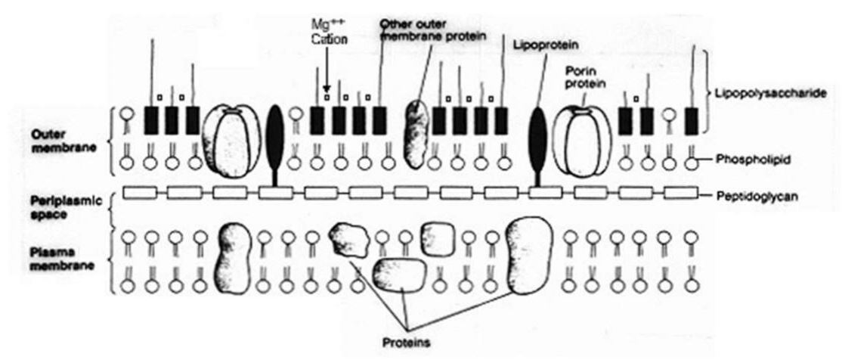

Slide 6
Features of Endotoxins
Endotoxin is an integral part of the cell wall of Gram-negative bacteria.
Released on bacterial death and in part during growth.
Formed only by Gram-negative bacteria
Lipopolysaccharides. Lipid A portion is responsible for toxicity
No specific receptor.
Moderately toxic. Fatal to animals in large doses.
Relatively heat stable.
Toxicity is not destroyed above 60°C for hours.
Weakly antigenic.

Slide 7
Not converted to toxoid.
Synthesis directed by chromosomal genes.
Usually produce fever in the host by release of interleukin-1 and other mediators.
The biological activity is associated with the lipopolysaccharide(LPS).
The toxicity is associated with the lipid component (lipid A) and the immunogenicity is associated with the polysaccharide components.
Endotoxins are heat stable.
Certain powerful oxidizing agents such as super oxides, peroxide and hypochlorite are neutralize them.

Slide 8
Mechanism of endotoxins
Begins with CD14 binding of receptors on Macrophages that:
Induces cytokine production: IL-1, IL-6, IL-8, TNF, PAF
Activation of complement cascade (C3a, C5a or alternate pathway).
Activation of coagulation cascade.

Slide 9
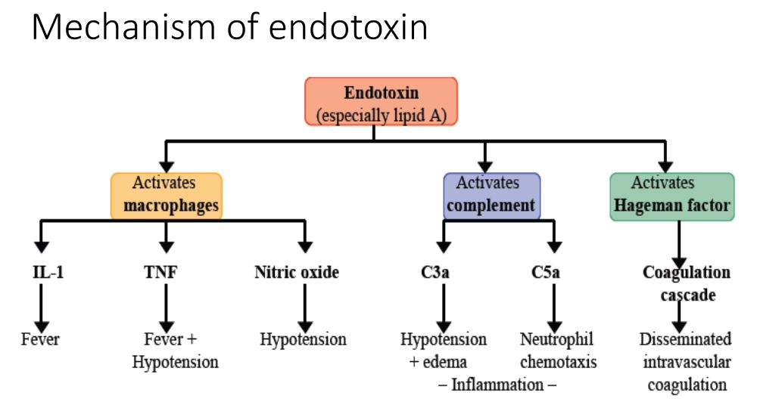

Slide 10
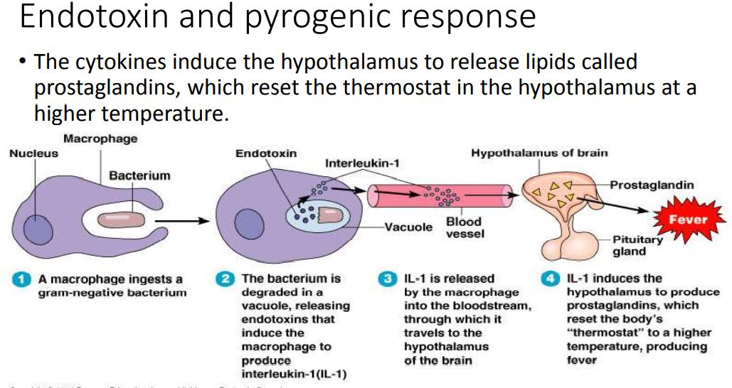

Slide 11
Organisms that produce endotoxins include:
Salmonella typhi
Proteus spp.
Pseudomonas spp.
Neisseria spp.

Slide 12
Complications of endotoxins
Fever. The endotoxin acts on mononuclear phagocytes (monocytes /macrophages), with liberation of interleukin-1.
Interleukin-1 acts on thermoregulatory center.
2. Leucopenia occurs early with onset of fever. It may be followed by leukocytosis.
3. Hypoglycemia. LPS enhances glycolysis in many cell types and can lead to hypoglycemia.
4. Hypotension occurs early in Gram-negative bacteremia.

Slide 13
5. Activation of complement.
Endotoxin activates complement system by alternative pathway.
6. Disseminated Intravascular Coagulation (DIC).
DIC may occur in Gram negative bacteremia.
It is initiated on activation of factor XII (Hageman factor)
7. Death may occur due to DIC.

