Slide 1
EXOTOXINS
Bacterial protein toxins are the most potent poisons may show activity at very high dilutions.
Protein toxins are resemble enzymes.
bacterial exotoxins are:
Proteins.
Denatured by heat, acid, proteolytic enzymes.
Have a high biological activity (most act catalytically).
Exhibit specificity of action.
Bacterial exotoxins have enterotoxic, cytotoxic, hemolytic and neurotoxic effect.

Slide 2
Features of Exotoxins
Exotoxins:
Excreted by living cells
Produced by Gram-positive and Gram-negative bacteria
Polypeptides
Usually bind to specific receptors on cells
Highly toxic. Fatal to animals in very small doses

Slide 3
Relatively heat labile. Toxicity destroyed over 60°C
Highly antigenic. Stimulate formation of antitoxin. Antitoxin neutralizes the toxin Converted to toxoid by formalin. Toxoid is nontoxic but antigenic used to immunize, e.g. tetanus toxoid
Usually controlled by extra-chromosomal genes, e.g. plasmids, phage gene
do not produce fever in the host

Slide 4
A+B subunit arrangement
Many protein toxins, notably those act intracellularly (with regard to host cells), consist of two components:
One component (subunit A) is responsible for the enzymatic activity of the toxin;
The other component (subunit B) is concerned with binding to a specific receptor on the host cell membrane and transferring the enzyme across the membrane.
The enzymatic component is not active until it is released from the native (a+b) toxin.

Slide 5
Attachment and Entry of Toxins
There are at least two mechanisms of toxin entry into target cells.
Direct entry, the b subunit of the native (a+b) toxin binds to a specific receptor on the target cell and induces the formation of a pore in the membrane through which the a subunit is transferred into the cell cytoplasm.
Alternative mechanism : receptor-mediated endocytosis (rme).

Slide 6
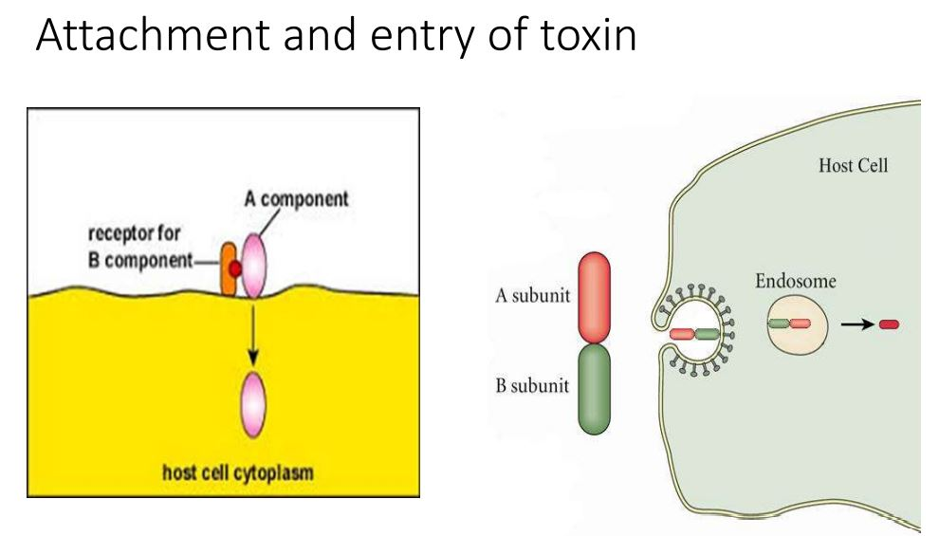

Slide 7
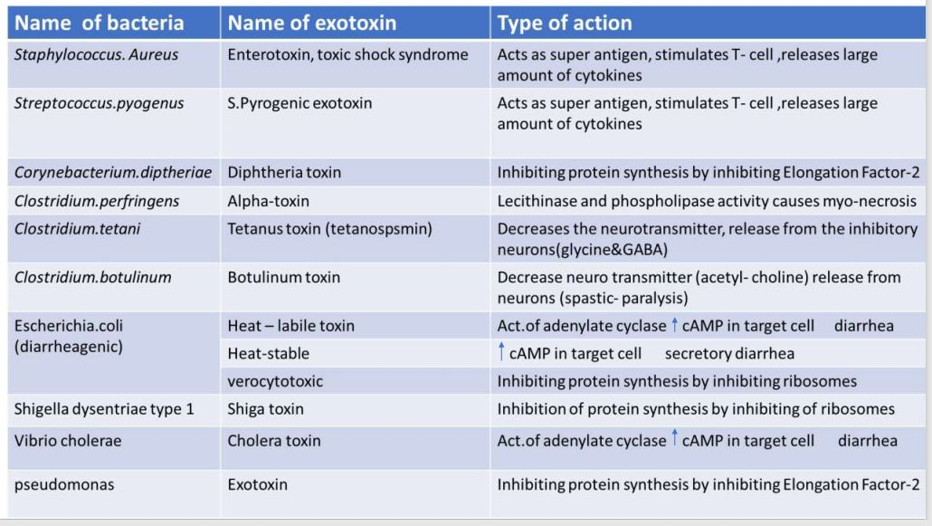
Bacteria produced exotoxin

Slide 8
Staphylococcal enterotoxin
It is responsible for the manifestations of staphylococcal food poisoningnausea, vomiting and diarrhoea 2-6 hrs after consuming food contaminated by toxin.
Toxin is relatively heat stable, resisting 100°c for 10-40 mins depending on the concentration of the toxin and the nature of the medium.
About 2/3rd of S. aureus strains, growing in carbohydrate and protein foods, secret the toxin.
Milk and milk products is also contaminated.
The source of infection is usually a food handler, become a carriers.

Slide 9
8 antigenic types of enterotoxins are currently known, named A,B,C1- 3, D,E and H. they are formed by toxigenic strains either by singly or in combination.
The toxin acts directly on autonomic nervous system to cause illness.
The toxin is very potent.
The toxin also exhibit pyrogenic, mitogenic, hypotensive, thrombocytopenic and cytotoxic effect.
Sensitive serological tests such as latex agglutination and ELISA are available for detection of toxin.

Slide 10
Toxic shock syndrome
It is potentially fatal multisystem disease presenting with fever, hypotension, myalgia, vomiting, diarrhea, mucosal hyperaemia and an erythromatous rash.
TSST type 1 is often more responsible, through enterotoxin B or C may also cause the syndrome.
TSST 1 antibody seen in convalescents.
Staphylococcal enterotoxins and TSST-1 are super antigens which are potent activators of T lymphocytes.
This leads to an excessive and dysregulated immune response, with release of cytokines interlukin1-2,TNF and interferon gamma.
This explain the multisystem involvement and florid manifestations in staphylococcal food poisoning and TSS.

Slide 11
Clostridium perfringens Toxin
Perfringolysin O:
Cholesterol-dependent cytolysins (CDCs) constitute a family of pore forming toxins secreted by Gram positive bacteria.
These toxins form transmembrane pores by inserting a large β-barrel into cholesterol-containing membrane bilayers.
Binding of water-soluble CDCs to the membrane triggers, formation of oligomers containing 35-50 monomers.
The coordinated insertion of more than seventy β-hairpins into the membrane requires multiple structural conformational changes and leads to pore formation.
Perfringolysin O(PFO), secreted by Clostridium perfringens, has become the prototype for the CDCs.

Slide 12
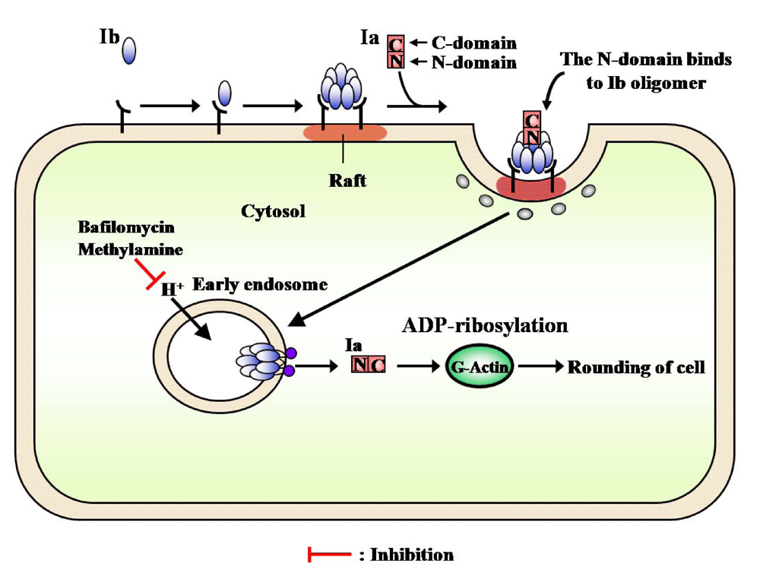
Clostridium perfringens iota-toxin is composed of the enzyme component (Ia) and the binding component (Ib).
Ib binds to receptor on targeted cells and translocates Ia into the cytosol of the cells.
Ia ADP-ribosylates actin, resulting in cell rounding and death

