Slide 1
Foreign Exchange Market
Dr. Madhumita Das

Slide 2
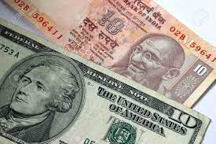
Exchange Rate
A (foreign) exchange rate is the rate at which one currency is exchanged for another.
An exchange rate is a ratio between two currencies.
If 5 UK pounds or 5 US dollars buy Indian goods worth Rs. 400 and Rs. 250 then pound- rupee or dollar-rupee exchange rate becomes Rs. 80 = £1 or Rs. 50 = $1, respectively.

Slide 3
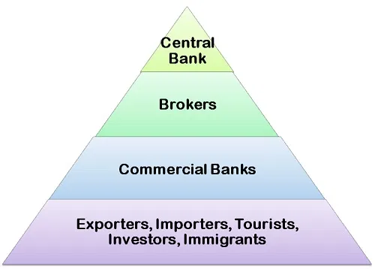
Foreign Exchange Market
Organizational setup under which foreign currencies are bought and sold by the buyers and sellers
Foreign exchange market is a system
The key players are:

Slide 4
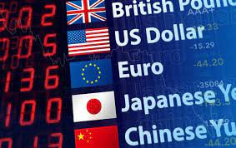
Kinds of Foreign Exchange Market
Spot Market: Spot sale and purchase of foreign exchange
Forward Market: Deals for sale and purchase of a foreign currency at some future date at a presettled exchange rate

Slide 5
Nature of foreign exchange transactions
Hedging
Arbitrage
Speculation

Slide 6
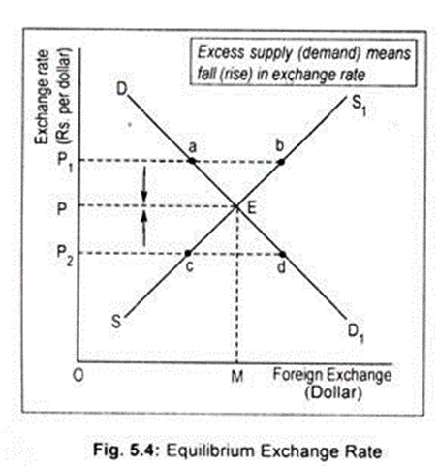
Determination of Exchange rate
The market theory of exchange rate

Slide 7
Change in Equilibrium
Change in domestic prices
Change in real income
Change in rate of interest
Structural change
Speculative demand and supply

Slide 8
Purchasing Power Parity Theory
The relative value of different currencies correspond to the relation between the real purchasing power of each currency in its own country

Slide 9
Fixed vs Flexible Exchange Rate

Slide 10
THANK YOU

