Slide 1
HEAT TRANSFER
Dr. Gurudutta Pattnaik

Slide 2


CONTENTS
Mechanisms of heat transfer
Fourier’s law
Single and compound wall resistance in series
Film coefficient
Stephan-Boltzmman law
Tubular heaters or heat exchangers
References

Slide 3
Mechanisms of heat transfer
Heat transfer from one place to another takes place by three different mechanisms and all three may occur simultaneously.
Convection
Conduction
Radiation

Slide 4
Mechanisms of heat transfer
Convection is the transfer of thermal energy by the actual motion of the medium itself. The medium in motion is usually a gas or a liquid. Convection is the most important heat transfer process for liquids and gases.
Conduction is the transfer of thermal energy by molecular action, without any motion of the medium. Conduction can occur in solids, liquids, and gases, but it is usually most important in solids.
Radiation is a transfer of thermal energy by electromagnetic waves.

Slide 5
Heat transfer applications
Evaporation: heat is supplied in order to convert a liquid into a vapor.
Distillation: heat is supplied to the liquid mixture for separation of individual vapor component.
Drying: for drying the wet granules.
Crystallization: saturated solution is heated to bring out super saturation, which promotes crystallization of drugs.
Sterilization: Autoclaves are used with stream as a heating medium.
Heat transfer is required for refrigeration.

Slide 6
Fourier’s law

Slide 7


Single and compound wall resistance in series
Up to now a wall has been treated as if it consisted of only one material.
Walls are made up of many different materials of different thicknesses.
We solve this more general problem by considering the compound wall.

Slide 8
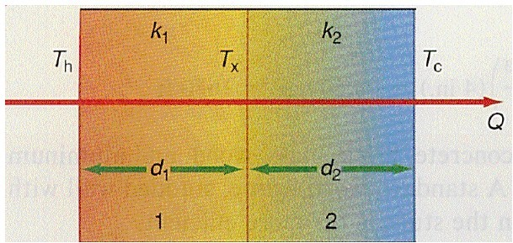
Single and compound wall resistance in series
Let us assume that the inside wall is the hot wall and it is at a temperature
Th, whereas the outside wall is the cold wall and it is at a temperature Tc. The temperature at the interface of the two materials is unknown at this time and will be designated by Tx. The first wall has a thickness d1, and a thermal conductivity k1, whereas wall 2 has a thickness d2, and a thermal conductivity k2.

Slide 9

Film coefficient
•
Film coefficient, in thermodynamics and in mechanics is the proportionality coefficient between the heat flux and the thermodynamic driving force for the flow of heat (i.e., the temperature difference, ΔT):
Where
q" : heat flux, W/m² i.e., thermal power per
unit area, q = dQ/dAh : heat transfer coefficient, W/(m²•K)ΔT : difference in temperature between the solid surface and surrounding fluid area, K

Slide 10

Stephan-Boltzmman law
The thermal energy radiated by a blackbody radiator per second per unit area is proportional to the fourth power of the absolute temperature and is given by

Slide 11
Tubular heaters or heat exchangers
It is the simplest form of heater. It is single pass tubular heater.
Construction: It consists of bundle of parallel tubes relatively thin walled. Ends of tubes are expanded into
two sheets. Bundles of tubes are
enclosed in a chambers are
cylindrical shell. Two distribution
provided at each end. Fluid inlet is provided to left distribution chamber. Heated fluid outlet is provided to
right distribution connections, non
chamber. Steam is provided by condensate vapor escape
through
vent. Condensate vapor drains at the bottom.

Slide 12
Tubular heaters or heat exchangers
Working:
Steam is introduced and it flows down the tubes
In this process tubes get heated, the condensate vapor drained.
Non condensate gases escape through vent
The fluid to be heated is pumped into the left distribution chamber
The fluid flows through the tube and steam and fluid are separated physically.
The total heat transfer is affected by the single pass of the fluid
Thus the fluid reaches the right distribution chamber and leaves through the exit point.

Slide 13
Tubular heaters or heat exchangers
Advantages:
Large heating surface can be packed into volume.
small
Disadvantages:
Velocity of fluid is low because of large cross section area.
Due to high temperature loosening and leakage take place.

Slide 14
THANK YOU
E-mail: nanjwadebk@gmail.com

