Slide 1
INTERNET OF THINGS(IOT)
Mr. Rajesh ku Mishra
Asst.Professor(E.C.E)
07008268738
rkmishra@cutm.ac.in

Slide 2
What is IoT
The internet of things is a platform where regular devices are connected to the internet, so they can interact, collaborate and exchange data with each other.
Internet of Things (IoT) comprises things that have unique identities and are connected to the Internet.

Slide 3
While many existing devices, such as networked computers or 4G enabled mobile phones, already have some form of unique identities and are also connected to the internet, the focus on IOT is in the configuration ,control and networking via the internet of devices or things that are traditionally not associated with the internet.
These includes devices such as utility meter, thermostats, irrigation pumps,control circuit for an electronic car ,blue tooth connected head set.

Slide 4
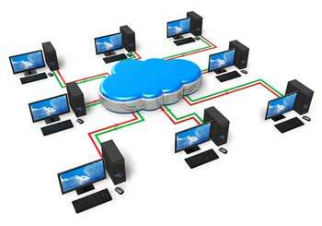
Computer Network

Slide 5
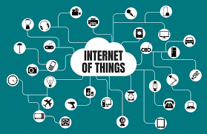

Slide 6
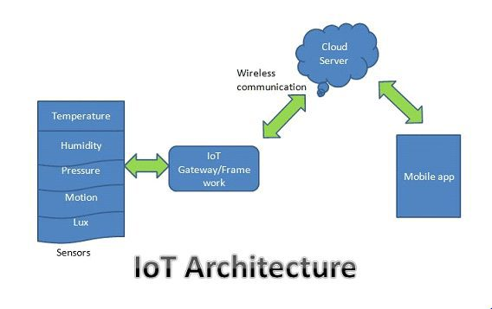

Slide 8
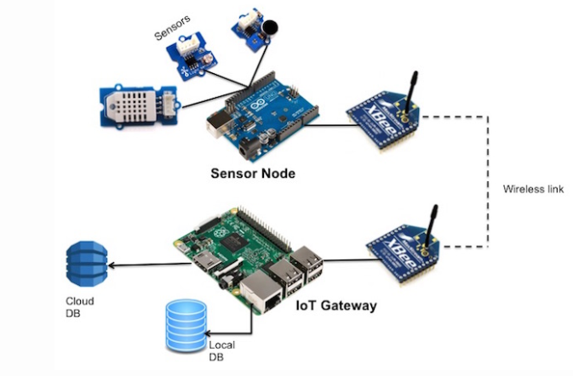

Slide 9
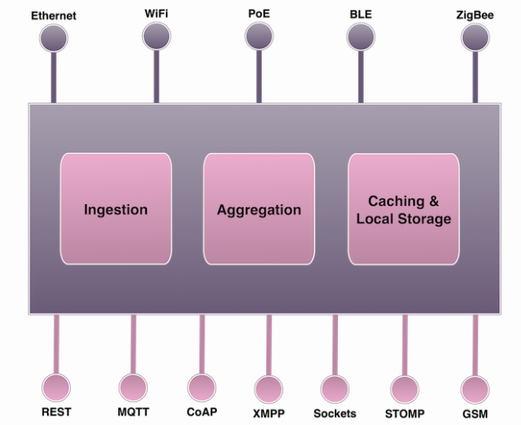

Slide 10
An IoT gateway has multiple roles to play. One of the first jobs of the gateway is to transform and normalize the data. The datasets generated by the sensor nodes will be in disparate formats. Some of the legacy nodes use proprietary protocols, while the contemporary ones may rely on JSON or CSV. The gateway acquires heterogenous datasets from multiple sensor nodes and converts them to a standard format that is understood by the next stage of the data processing pipeline.
The second role of an IoT gateway is protocol transformation. Since the sensor nodes cannot use power hungry Wi-Fi or ethernet, they use low-powered communication networks. A gateway supports multiple communication protocols for accepting the inbound data sent by the sensor nodes.

Slide 11
In some scenarios, the gateway may also process the data and raise alerts in real time. But this is best left to the powerful stream processing pipelines running in the cloud.

Slide 12
Sensors:
Sensor is the instrument which sense the change and make it readable.
Sensors are everywhere, sensors sense data from the atmosphere or place. the eg. temperture sensor senses temperature from the room and shares it through IoT gateway.
Sensors will sniff a wide variety of information ranging from Location, Weather/Environment conditions, running machine, from the human body, engine maintenance data to health essentials of a vehicle.

Slide 14
IoT Gateways & frameworks:
As the name rightly explains, it is a gateway to the internet for all the things/devices that we want to interact with. Gateways act as a carrier between the internal network of sensor nodes with the external Internet or World Wide Web.
They do this by collecting the data from sensor nodes and transmitting them to the internet infrastructure
An IoT gateway performs several critical functions from translating protocols to encrypting, processing, managing and filtering data.

Slide 15
Cloud server:
The data transmitted through the gateway is stored & processed securely within the cloud server i.e. in data centers.
This processed data is then used to perform intelligent actions that make all our devices Smart Devices.
In the cloud, all analytics and decision making happen considering user comfort.

Slide 16
User Interface
The intuitive mobile apps will help end-users to control & monitor their devices (ranging from the room thermostat to vehicle engines) from remote locations.
These apps push important information from the cloud on your smartphones, tablets.
After analytics, Information is in the form of graphs, bars and in pi-diagram and display to the user in a user-friendly manner.
From mobile application, we can send a command to sensors to change default values, like changing default temperature of air conditioner and many more.

Slide 17
Actuator
An actuator operates in the reverse direction of a sensor.
It takes an electrical input and turns it into physical action.
For instance, an electric motor, a hydraulic system, and a pneumatic system are all different types of actuators.

Slide 18
Actuator

Slide 19
Where is IoT?
It’s everywhere!

Slide 20
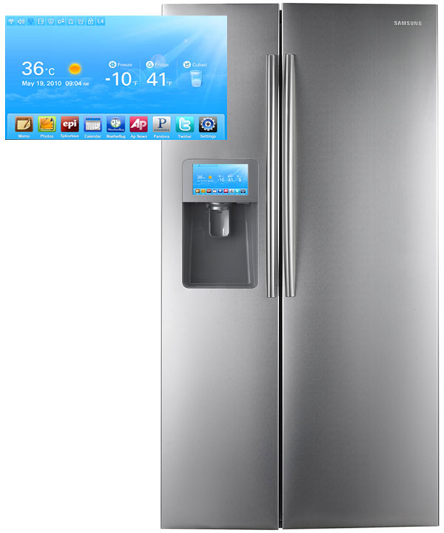
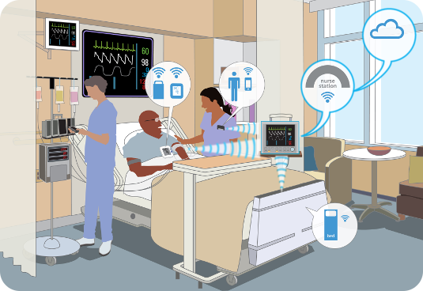
Smart Appliances
Wearable Tech
Healthcare

Slide 21
Iot application
The application of Internet of things span a wide range of domains including homes,cities, environment,energy systems,health care,retails
For home, Iot has several applications such as smart lighting that adapt the lighting to suit the ambient conditions, smart appliances that can be remotely monitored and controlled ,intrusion detection system, smart smoke detector etc
For cities ,IoT has applications such as smart parking systems that provides status update on available slots, smart lighting that helps in saving energy, smart roads that provides information on driving conditions and structural health monitoring system

Slide 22
For agriculture domain, IoT has application such as smart irrigation system that help in saving water while enhancing productivity and green house control system.
Industrial application of IoT includes machine diagnosis and prognosis systems help in predicting faults and determine the cause of faults and indoor air quality system.
For health and life style, Iot has application such as health monitoring systems and wearable's electronics.

Slide 23
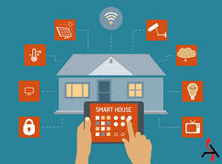
IOT HOME AUTOMATION

Slide 24
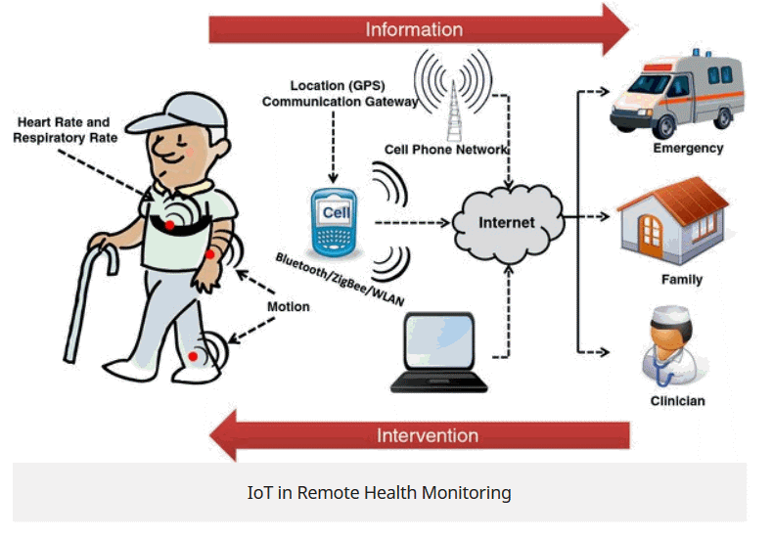
IOT FOR HEALTH MONITORING

Slide 25
Body Temperature Heart Beat
Glucose Level Blod Pressure Diabetic GPS position

Slide 26
The Birth of IoT
The actual term “Internet of Things” was coined by Kevin Ashton in 1999 during his work at Procter&Gamble. Ashton who was working in supply chain optimization, wanted to attract senior management’s attention to a new exciting technology called RFID. Because the internet was the hottest new trend in 1999 and because it somehow made sense, he called his presentation “Internet of Thing”
The concept of IoT started to gain some popularity in the summer of 2010.
In 1982 Coca-Cola vending machine at Carnegie Mellon University(CMU) becoming the first internet connected appliance.
People get to know whether the newly loaded drink is cold or not.

Slide 27
Benefits of IoT
Allows IOT devices to remotely control over the Internet, thus it creates opportunities to connect directly and integrate the physical world to the computer-based systems using internet and sensors. The major benefits for IoT are:
Improved customer engagement: IoT improves customer experience by automating the action. E.g. Any issue in the car will be automatically detected by sensors. The driver, as well as the manufacturer, will be notified about it.
Technical optimization: IOT has helped in improving technologies and improving them.
Reduced waste: Our current insights are superficial, but IoT provides real-time information leading to effective decision making and management of resources.

Slide 28
Communication
IoT encourages the communication between devices, also famously known as Machine-to-Machine (M2M) communication. Because of this, the physical devices are able to stay connected and hence the total transparency is available with lesser inefficiencies and greater quality.
Automation and Control
Due to physical objects getting connected and controlled digitally and centrally with wireless infrastructure, there is a large amount of automation and control in the workings. Without human intervention, the machines are able to communicate with each other leading to faster and timely output.
Information
It is obvious that having more information helps making better decisions. Whether it is mundane decisions as needing to know what to buy at the grocery store or if your company has enough widgets and supplies, knowledge is power and more knowledge is better.
Time
As hinted in the previous examples, the amount of time saved because of IoT could be quite large. And in today’s modern life, we all could use more time.

Slide 29
Monitor
The second most obvious advantage of IoT is monitoring. Knowing the exact quantity of supplies or the air quality in your home, can further provide more information that could not have previously been collected easily. For instance, knowing that you are low on milk or printer ink could save you another trip to the store in the near future. Furthermore, monitoring the expiration of products can and will improve safety.
Money
The biggest advantage of IoT is saving money. If the price of the tagging and monitoring equipment is less than the amount of money saved, then the Internet of Things will be very widely adopted. IoT fundamentally proves to be very helpful to people in their daily routines by making the appliances communicate to each other in an effective manner thereby saving and conserving energy and cost. Allowing the data to be communicated and shared between devices and then translating it into our required way, it makes our systems efficient.

Slide 30
Automation of daily tasks leads to better monitoring of devices
The IoT allows you to automate and control the tasks that are done on a daily basis, avoiding human intervention. Machine-to-machine communication helps to maintain transparency in the processes. It also leads to uniformity in the tasks. It can also maintain the quality of service. We can also take necessary action in case of emergencies.

Slide 31
Disadvantages of IoT:
Compatibility: Currently, there is no international standard of compatibility for the tagging and monitoring equipment. I believe this disadvantage is the most easy to overcome. The manufacturing companies of these equipment just need to agree to a standard, such as Bluetooth, USB, etc. This is nothing new or innovative needed.
Lesser Employment of Menial Staff
The unskilled workers and helpers may end up losing their jobs in the effect of automation of daily activities. This can lead to unemployment issues in the society. This is a problem with the advent of any technology and can be overcome with education. With daily activities getting automated, naturally, there will be fewer requirements of human resources, primarily, workers and less educated staff. This may create Unemployment issue in the society.

Slide 32
Complexity
The IoT is a diverse and complex network. Any failure or bugs in the software or hardware will have serious consequences. Even power failure can cause a lot of inconvenience.
Technology Takes Control of Life
Our lives will be increasingly controlled by technology, and will be dependent on it. The younger generation is already addicted to technology for every little thing. We have to decide how much of our daily lives are we willing to mechanize and be controlled by technology.

Slide 33
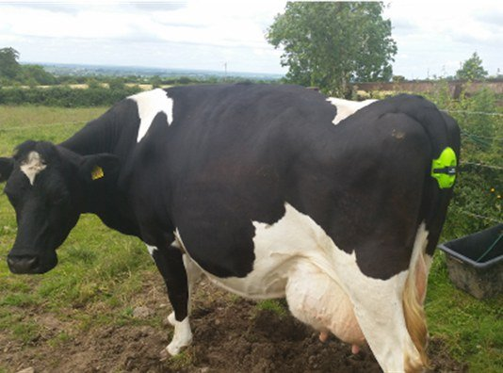
Calving Alert Systems: Know Exactly When Your Cow is Calving

Slide 34
Observation during calving can be beneficial to both the dam and the calf; however, it is difficult to predict time of calving on the basis of visual signs alone. Using technology to identify cows in active labor can help minimize prolonged calving and improve the overall health and profitability of your operation.
Researchers have found that almost 50% of all calf deaths within the first 24 hours after birth are a result of calving difficulty. While monitoring heifers and cows due to calve is vital in improving calf survival, it can be difficult to carry out as calvings can occur at any time of the day and night.

Slide 35
Generic block diagram of iot device
The "Things" in IoT usually refers to IoT devices which have unique identities and can perform remote sensing, actuating and monitoring capabilities.
• IoT devices can:
• Exchange data with other connected devices and applications (directly or indirectly), or Collect data from other devices and process the data locally or Send the data to centralized servers or cloud-based application back-ends for processing the data, or Perform some tasks locally and other tasks within the IoT infrastructure,based on temporal and space constraints

Slide 36
Iot device

Slide 37
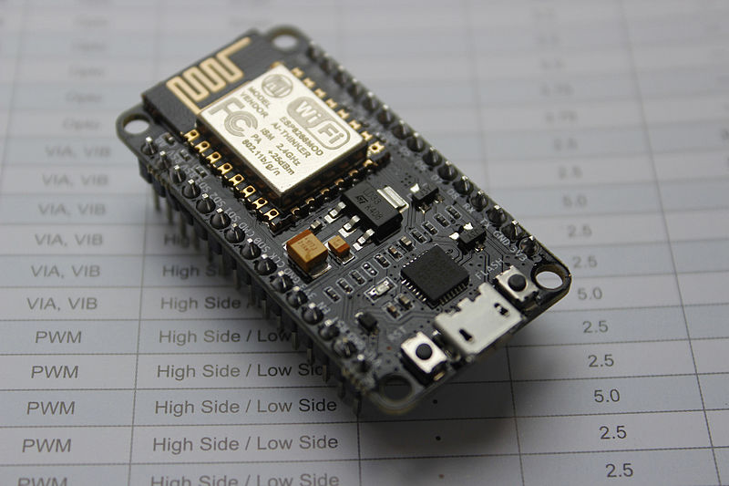
NODE MCU

Slide 38
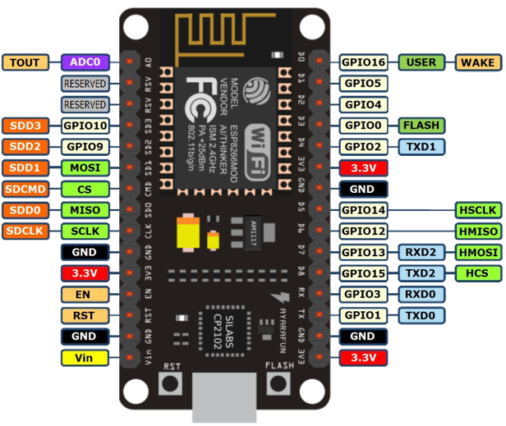

Slide 39
Ultrasonic sensor
Ultrasonic sensors emit short, high-frequency sound pulses at regular intervals. These propagate in the air at the velocity of sound. If they strike an object, then they are reflected back as echo signals to the sensor, which itself computes the distance to the target based on the time-span between emitting the signal and receiving the echo.

Slide 40
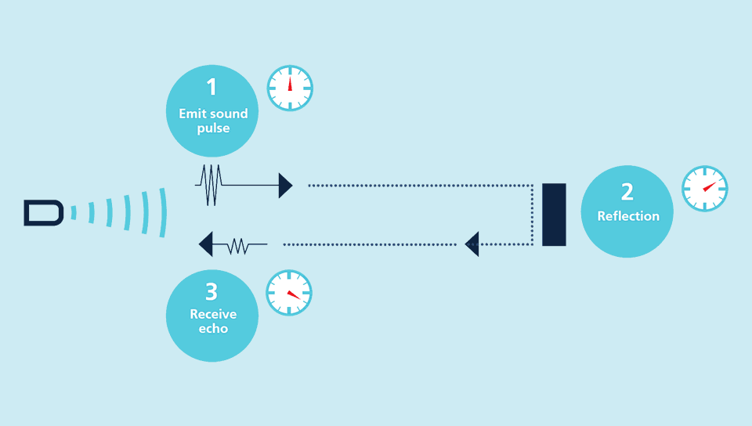

Slide 41
Sensor – it is the instrument which senses the change and makes it readable.

Slide 42
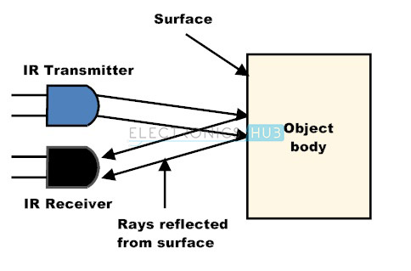
IR sensor

Slide 44
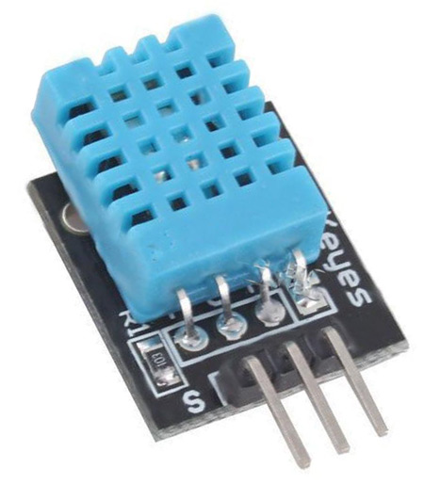
DHT11 (temperture and humidity sensor)

Slide 46
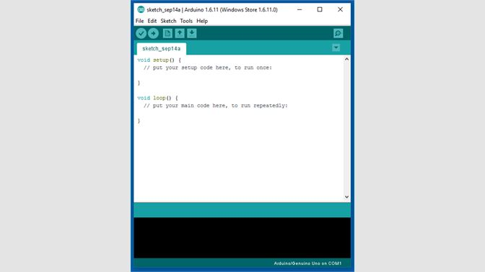
Arduino IDE

Slide 47
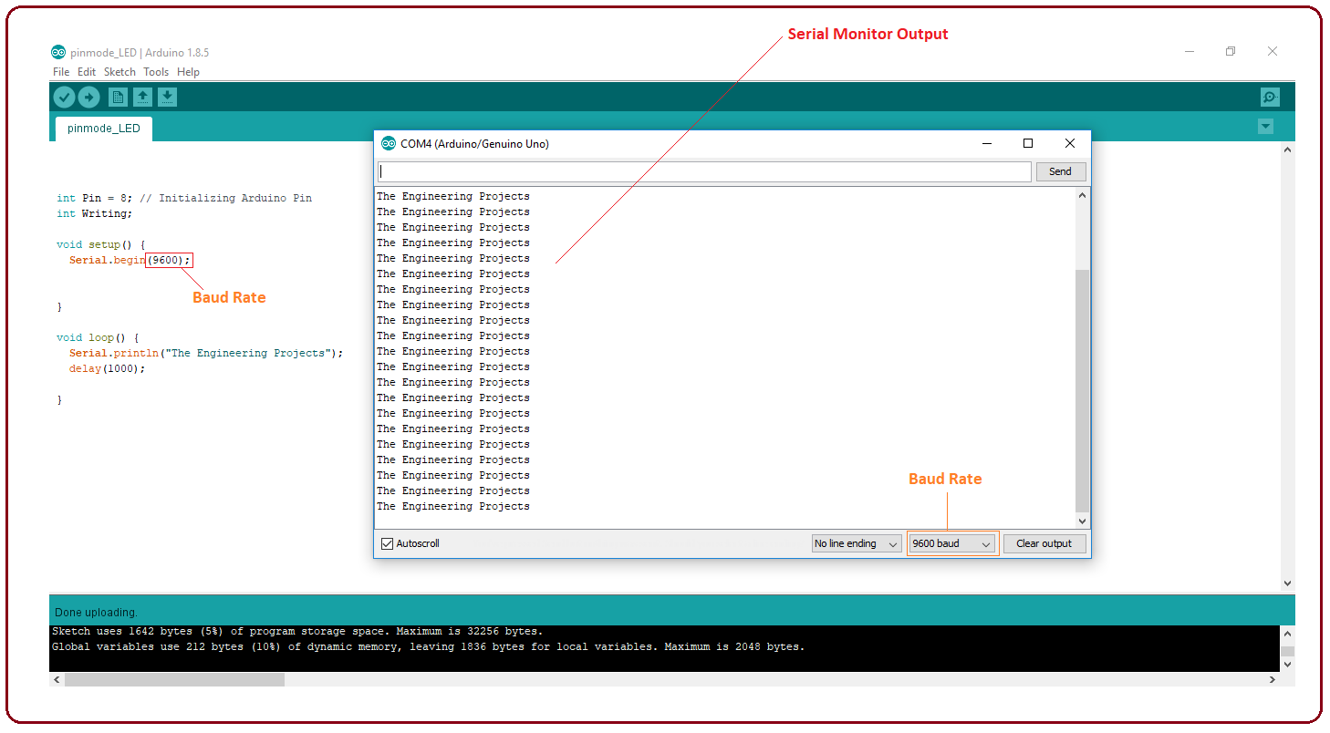
Serial monitor

Slide 48
ThingSpeak
According to its developers, "ThingSpeak is an open-source Internet of Things application and API to store and retrieve data from things using the HTTP protocol over the Internet or via a Local Area Network. Wikipedia

Slide 49
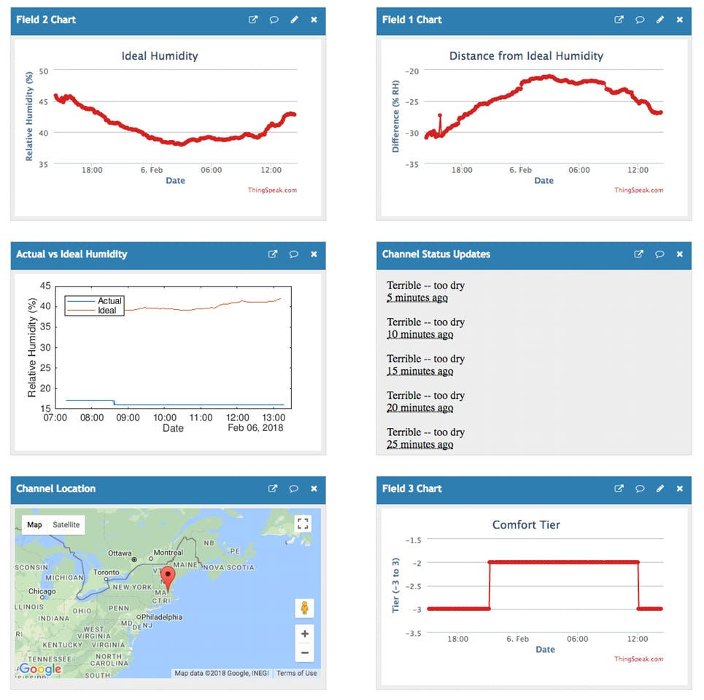

Slide 50
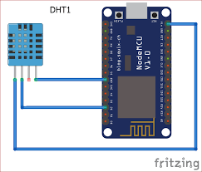

Slide 51
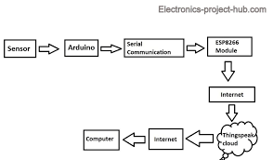

Slide 52
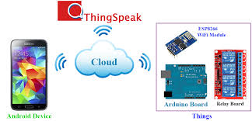
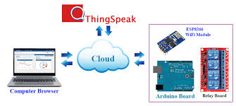
IOT control devices

Slide 53
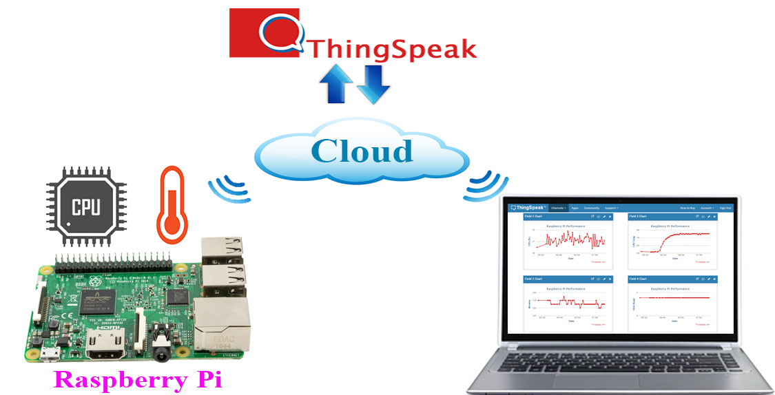

Slide 55
led blinking code
/*
Note that this sketch uses BUILTIN_LED to find the pin with the internal LED
*/
#define BUILTIN_LED D0 //D0 OR D4 for lolin board
void setup() {
pinMode(BUILTIN_LED, OUTPUT); // Initialize the BUILTIN_LED pin as an output
}
// the loop function runs over and over again forever
void loop() {
digitalWrite(BUILTIN_LED, LOW); // Turn the LED on (Note that LOW is the voltage level
// but actually the LED is on; this is because
// it is acive low on the ESP-01)
delay(1000); // Wait for a second
digitalWrite(BUILTIN_LED, HIGH); // Turn the LED off by making the voltage HIGH
delay(1000); // Wait for two seconds (to demonstrate the active low LE)
}

Slide 56
int LED = 5; // Assign LED pin i.e: D1 on NodeMCU
void setup() {
// initialize digital pin LED_BUILTIN as an output.
pinMode(LED , OUTPUT);
}
// the loop function runs over and over again forever
void loop() {
digitalWrite(LED, HIGH); // turn the LED on (HIGH is the voltage level)
delay(1000); // wait for a second
digitalWrite(LED, LOW); // turn the LED off by making the voltage LOW
delay(1000); // wait for a second
}

Slide 57
Interfacing of switch
int led = 5; // LED pin int button = 16; // push button is connected
int temp = 0; // temporary variable for reading the button pin status
void setup()
{ pinMode(led, OUTPUT); // declare LED as output
pinMode(button, INPUT); // declare push button as input
}
void loop()
{ temp = digitalRead(button);
if (temp == HIGH)
{
digitalWrite(led, HIGH);

Slide 58
Serial.println("LED Turned ON");
delay(1000);
}
else {
digitalWrite(led, LOW);
Serial.println("LED Turned OFF");
delay(1000);
}
}

Slide 59
Characteristics of Iot
Dynamic and self -adapting : iot device and systems may have the capability to dynamically adapt with the changing contexts and take actions based on their operating conditions or sensed environment.
Unique Identity: each iot device has unique identity and a unique identifier such as IP .this identity is helpful in tracking the equipment and at times to quarry the status .
Interoperable communication protocols: iot device may support a number of interoperable communication protocols and can communicate with other devices and also with the infrastructure

Slide 60
Internet of things - Wikipedia
en.wikipedia.org › wiki › Internet_of_things
The Internet of things (IoT) describes the network of physical objects—“things”—that are embedded with sensors, software, and other technologies for the purpose of connecting and exchanging data with other devices and systems over the Internet.

Slide 61
Interfacing of temperture sensor
# include "DHT.h“
DHT dht;
void setup()
{
// declare the enable and ledPin as an OUTPUT:
Serial.begin(115200);
delay(10);
dht.setup(14); // data pin 14 mens D5
void loop()
{
//--------------------------DHT22/DHT11-------------------------
float h = dht.getHumidity();
float t = dht.getTemperature();
if (isnan(h) || isnan(t)) {
Serial.println("Failed to read from DHT sensor!");
return;
//}

Slide 62
Interfacing of temperture sensor
Serial.print("Temperature: ");
Serial.print(t);
Serial.print(" degrees Celcius ");
Serial.println();
Serial.print("Humidity: ");
Serial.print(h);
Serial.print("%");
Serial.println();
//--- extra---- you can measure dew point with the temperature and the humidity
double gamma = log(h/100) + ((17.62*t) / (243.5+t));
double dp = 243.5*gamma / (17.62-gamma);
Serial.print("Dew point: ");
Serial.print(dp);
Serial.print(" degrees Celcius ");
Serial.println();
delay(2000);
}

Slide 63
Cloud refers to remote computation, storage, and communication systems.

