Slide 1
Insulation Resistance TEST OF Transformer

Slide 2
purpose
Insulation resistance transformers are specialized transformers used for testing the insulation properties of electrical equipment
They are designed to measure the resistance between various components of the electrical system and the ground
The primary purpose of insulation resistance testing is to ensure the safety and reliability of electrical installations

Slide 3
Ir tEST
Insulation resistance transformers consist of a high-voltage winding, a low-voltage winding, and a high-resistance load connected to the secondary winding
The high-voltage winding is energized, creating an AC voltage across the low-voltage winding and the high-resistance load
The high-resistance load limits the current flow, allowing only a small current to pass through the winding under test
The insulation resistance is determined by measuring the voltage drop across the winding under test and calculating the current using Ohm's law

Slide 4
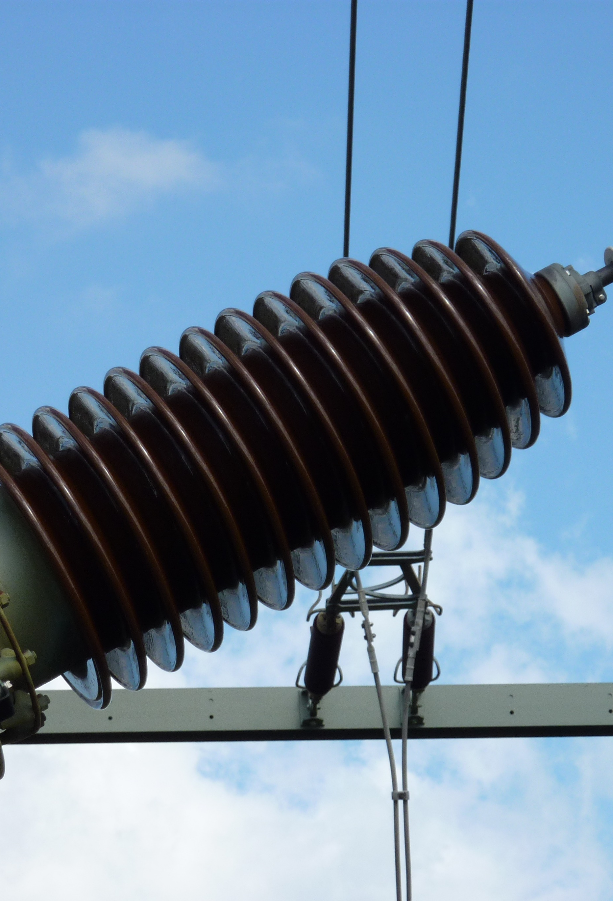
Procedure
Insulation resistance testing is performed by connecting the winding under test to the high-voltage winding of the insulation resistance transformer
The high-resistance load limits the current flow, preventing excessive current from damaging the winding or causing an electric shock hazard
By measuring the voltage drop and the current, the insulation resistance can be calculated using the formula: Insulation Resistance = Voltage Drop / Current
Insulation resistance transformers find applications in various industries, including
Power generation and distribution: Testing insulation of transformers, generators, and power cables
Manufacturing: Assessing the insulation of motors, transformers, and other electrical equipment

Slide 5
Outcomes
Maintenance and troubleshooting: Detecting insulation degradation and potential faults in electrical systems
Electrical safety: Ensuring compliance with safety standards and regulations
Insulation resistance transformers offer several benefits, including
Safety: They provide a safe method for testing insulation resistance without exposing personnel to high voltages
Reliability: Insulation resistance testing helps identify potential issues before they lead to equipment failure or accidents
Cost savings: By identifying insulation problems early, maintenance can be performed proactively, reducing downtime and costly repairs
Compliance: Insulation resistance testing ensures compliance with safety regulations and standards

Slide 6
Conclusion
Insulation resistance transformers are crucial tools for testing the insulation properties of electrical equipment
They provide a safe and reliable method for assessing insulation resistance, ensuring the safety and efficiency of electrical installations
By using insulation resistance transformers, industries can prevent equipment failure, reduce downtime, and maintain compliance with safety standards

