Slide 1
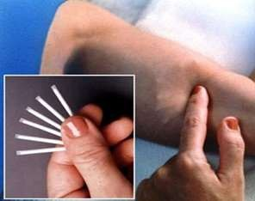
Implants
Definition
Implants are small sterile solid masses consisting of a highly purified drug made by compression or molding or extrusion.
Implants are drug delivery systems which provide controlled delivery of drug over a period of time at the site of implantation.

Slide 2
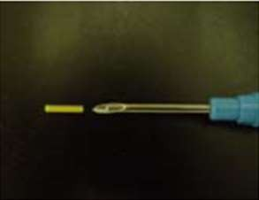
Introduction
Implants are intended for implantation in the body subcutaneous or intramuscular tissue by a minor surgical incision or injected through a large bore needle.
Implants are developed with a view to provide continuous release of the drug into the blood stream over long periods of time without the repeated insertion of needles.

Slide 3
Advantages and disadvantages of implants
Advantages
Controlled drug delivery for over a long time.
Improve patient compliance.
Targeted drug delivery.
Bypass first pass metabolism.
Decrease side effects.
Improved stability of drugs.
Improve availability of drugs.
Disadvantages
Mini-surgery is needed (Painful).
Uneasy to simply discontinue the therapy.
Local reactions.
Inadequate release.

Slide 4
Ideal properties of implants
1-Biostable.
3 -Easily removable.
2-Biocompatible.
4-Nontoxic & non carcinogenic.
4-Minimum surface area & smooth texture. 6-rate controlled release of the drug.
Type of Implants
Non Biodegradable
Implants
Biodegradable

Slide 5
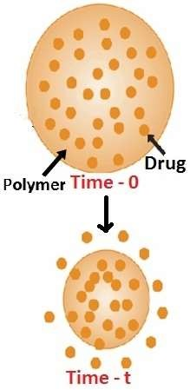
Non Biodegradable implants
The drug is dispersed homogeneously, inside the polymeric matrix through which the drug diffuses slowly providing sustained release .
This type of system has several disadvantages, the outer membrane is nondegradable.
Thus minor surgery is necessary for the removal of the delivery system from the body.
There is also a possibility that membrane rupture will potentially lead to “drug dumping” during therapy.

Slide 6
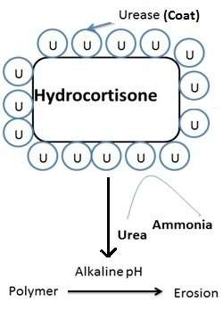
Biodegradable implants
The inert polymers, used are eventually absorbed
or excreted by the body.
No need for surgical removal of the implant after the conclusion of therapy.
Drug is dispersed in to a biodegradable polymer matrix like poly vinyl methyl ether and is coated with immobilized urease in a neutral PH.
In the presence of urea, ammonia is released causing increase in PH at which polymer degrades leading to drug release.

Slide 7
Classification
Activation modulating drug delivery
Feed back regulated process
Rate programmed drug delivery
Bioerosion.
Bioresponsive.
Membrane permeation.
Matrix diffusion.
Membrane matrix hybrid type
Physical activation
Osmotic pressure.
Vapor pressure.
Phonophoresis
Hydration.
Magnetically activated.
Chemical activation
Hydrolysis.

Slide 8
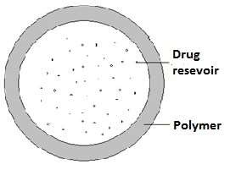
A) Rate programed drug delivery system
1- Polymer membrane permeation controlled drug delivery
Drug reservoir is encapsulated within a spherical compartment that is enclosed by a rate controlling polymeric membrane.
Drug reservoir : solid particle/dispersion of solid particles in a liquid or solid dispersion medium.
Polymer membrane: nonporous/microporous/semipermeable
Example
Norplant subdermal implant.
Progestasert IUD.
Ocusert system.

Slide 9
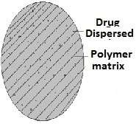
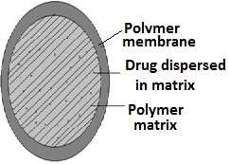
A) Rate programed drug delivery system
2- Matrix diffusion controlled drug delivery systems
- Drug reservoir is prepared by homogeneously dispersing drug particles at a rate controlling polymeric matrix fabricated from either a lipophilic or hydrophilic polymer.
3- Matrix Hybrid Type Drug Delivery System
It is a hybrid of Membrane permeation controlled DDS and Matrix diffusion controlled DDS.
It minimizes the risk of dose dumping associated with membrane permeation controlled DDS.

Slide 10
B) Activation modulated DDS
The release of drug molecules from the delivery system is activated by some physical, chemical or biochemical process facilitated by an external energy supplier.
1- Hydration Activated Drug Delivery System
Drug reservoir is homogeneously dispersed in a swellable hydrophilic polymeric matrix.
After hydration drug molecules are released by diffusing through the microscopic water saturated pore channels in the swollen polymeric matrix.
Ex: Norgestomet releasing HYDRON implant.

Slide 11
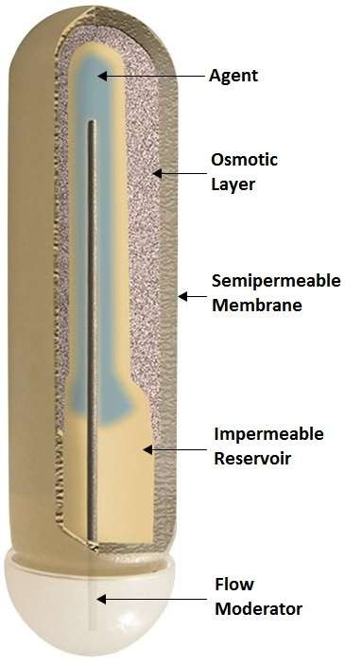
B) Activation modulated DDS
2- Osmotic Pressure Activated Drug Delivery Device
In this type of DDS, the drug in solution is released through a specialized laser drilled delivery orifice at a constant rate under a controlled gradient of osmotic pressure.
External component: Rigid semipermeable housing made up of substituted cellulosic polymers containing an osmotically active salt.
Internal compartment: Drug reservoir enclosed by a flexible partition layer and osmotic agent impermeable polyester bag.
Ex: Alzet Osmotic Pump

Slide 12
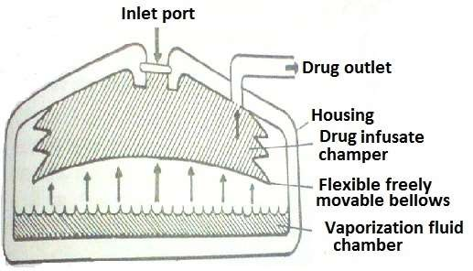
B) Activation modulated DDS
3- Vapor Pressure Activated Drug
In this system, the drug reservoir in a solution formulation, is contained inside an infusate chamber.
It is physically separated from the vapor pressure chamber by a freely movable bellows.
The vapor chamber contains a vaporizable fluid, which vaporizes at body temp. & creates a vapor pressure.
Under the vapor pressure created, the bellows move upward & forces the drug solution in the infusate chamber to release, through a series of flow regulators & the delivery cannula into the blood circulation at a constant flow rate.

Slide 13
B) Activation modulated DDS
4- Hydrolysis Activated Drug Delivery
These systems are prepared from a bio-erodible or bio-degradable polymer such as polylactide or poly(lactide-glycolide) copolymer.
This device is activated to release the drug upon hydrolysis of polymer base
by tissue fluid at the implantation site.
Ex: ZOLADEX system

Slide 14
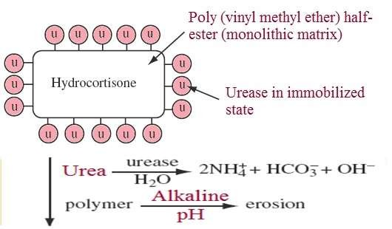
C) Feed back regulated process
The release of drug molecules is activated by a triggering system , such as a biochemical substance in the body, through some feedback mechanisms.
The rate of drug release is regulated by the concentration of the triggering agent detected by a sensor built in the system.
1- Bioerosion Regulated
- This consists of bio-erodible drug dispersed polymer matrix fabricated from poly (vinyl methyl ether) half ester , which was coated with a layer of immobilized urease.

Slide 15
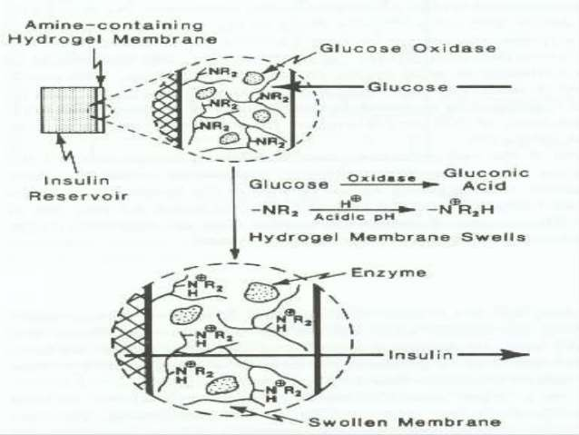
C) Feed back regulated process
2- Bioresponsive Drug Delivery
The drug reservoir is contained in a device enclosed by a
bioresponsive polymer membrane whose permeability to drug molecules is controlled by concentration of biochemical agent in the tissue.
Ex: Glucose Triggered Insulin Delivery System

Slide 16
Is this all what it’s about ?
Of course NOT, There are many types of implants: - 1- Implant drug delivery.
Implant devices.
Implant support.
Dental implants.

Slide 17
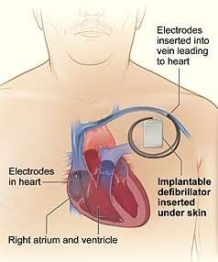
Implant devices
1- Implantable Cardioverter Defibrillators
- ICDs are devices that monitor and treat rhythms when they are detected by sending a large jolt of electricity to the heart, and basically pressing the reset button.
2- Pacemakers
Pacemakers are used when the heart’s internal clock is not maintaining a fast enough pace.
Pacemakers override the aberrant signals in the heart by passing small jolts of electricity to multiple parts of the heart muscle, providing its own rhythm.

Slide 18
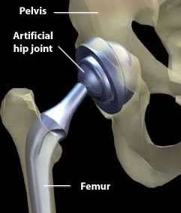
Implant Support
1- Artificial Hips
As people age and gain weight the wearing down of cartilage and the painful friction of bone rubbing against bone.
Hip replacement can lead to a decrease in pain and an increase in mobility in over 90% of recipients.
2- Spine Screws, Rods, and Artificial Discs
Spinal fusion surgeries are performed for a variety of back problems.
The surgery essentially fuses two or more vertebrae with the help of hardware such as screws and rods.

Slide 19
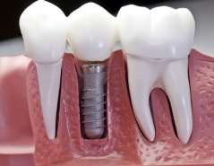
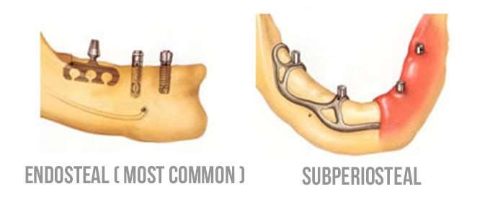
Dental Implants
A dental implant is an artificial tooth root that is placed into your jaw to hold a replacement tooth or bridge.
Dental implants may be an option for people who have lost a tooth or teeth due to periodontal disease, an injury, or some other reason.
Types of DENTAL Implants
Endosteal ► in the bone.
Subperiosteal ► on the bone.

Slide 20
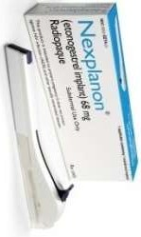
Implant drug delivery
1- Contraceptive implants “Nexplanon®”
- The contraceptive implant is a small flexible tube about 40mm long that's inserted under the skin of your upper arm.
How the implant works?
- The implant steadily releases the hormone progestogen into your bloodstream which leads to: -
Stops a woman releasing an egg every month (ovulation).
Thickens the mucus from the cervix (entrance to the womb).
makes the lining of the womb thinner so that it is unable to support a fertilized egg.

Slide 21
Implant drug delivery
Contraceptive implants “Nexplanon®”
Advantages
It works for three years.
It is an option if you cannot use oestrogen-based contraception. 3- you do not have to remember to take a pill every day.
The implant is safe to use while you are breastfeeding.
your fertility should return to normal as soon as the implant is removed.
It may reduce heavy periods or painful periods after the first year of use. 7- Implants offer some protection against pelvic inflammatory disease.
8- Implants give some protection against cancer of the womb.

Slide 22
Implant drug delivery
1- Contraceptive implants “Nexplanon®”
Disadvantages
1- Bleeding patterns are likely to remain irregular.
2- headaches, acne, nausea. 4- changes in mood.
3- breast tenderness. 5- loss of sex drive.
Implants interactions
Some medicines can reduce the implant's effectiveness, These are called
enzyme-inducing drugs
Ex:-
Medication for HIV, epilepsy.
Antibiotics as rifabutin, rifampicin.

Slide 23
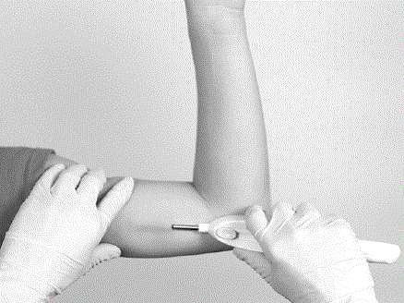
Implant drug delivery
2- Histrelin implants
Histrelin implant is a small, thin, flexible tube containing medication that is inserted by a doctor on the inside of the upper arm.
Histrelin is a man-made form of a hormone that regulates many processes in the body. Histrelin overstimulates the body's own production of certain hormones, which causes that production to shut down temporarily.
Uses
The Vantas ® ► Treat symptoms of prostate cancer in men.
The Supprelin LA® ► Treat precocious puberty in both male and female children.

Slide 24
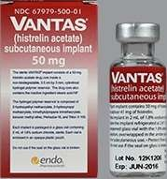
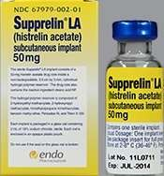
Implant drug delivery
2- Histrelin implants
Usual Adult Dose for Prostate Cancer:
Vantas®: One 50 mg implant inserted subcutaneously in the inner aspect of the upper arm.
Duration of therapy: The implant should be removed after 12 months.
Palliative treatment of advanced prostate cancer
Usual Pediatric Dose for Precocious Puberty:
Supprelin LA®: One 50 mg implant inserted subcutaneously in the inner aspect of the upper arm.
Duration of therapy: The implant should be removed after 12 months.
Discontinuation of therapy at the appropriate time point for the onset of puberty.

Slide 25
Implant drug delivery
Histrelin implants
Side effects
Bloody urine.
Increased thirst.
Nausea, vomiting .
lower back or side pain.
Swelling of the face.
Trouble breathing.
Unusual tiredness or weakness.
Contraindications
Histrelin Pregnancy Warnings:-
Spontaneous abortions may occur.
US FDA pregnancy category X.
Teratogenic and fetotoxic effects.
Major fetal abnormalities,
Increased fetal mortality.
Decreased fetal weights.
Reduced fertility.

Slide 26
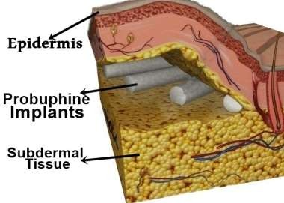
Implant drug delivery
3- Buprenorphine implants “Probuphine®”
It consists of a small, solid implant made from a mixture of ethylene-vinyl acetate (EVA) and a drug substance.
It is placed subcutaneously, normally in the upper arm.
Each implant contains the equivalent of 80 mg of buprenorphine.
Uses
It is indicated for the maintenance treatment of opioid dependence in patients who have achieved and sustained prolonged clinical stability on
low-to-moderate doses of a transmucosal buprenorphine-containing product.

Slide 27
Implant drug delivery
3- Buprenorphine implants “Probuphine®” Warnings and Precautions
Addiction, Abuse and Misuse: Buprenorphine can be abused in a manner similar to other opioids.
Respiratory and CNS Depression and death have occurred in association with buprenorphine particularly when taken by the intravenous (IV) route.
Neonatal Opioid Withdrawal Syndrome (NOWS) is an expected and treatable outcome of prolonged use of opioids during pregnancy.
Risk of Opioid Withdrawal with Abrupt Discontinuation.
Most common side effects : headache, insomnia, rhinorrhea,, nausea, anxiety, back pain, depression, constipation, and vomiting.

Slide 28
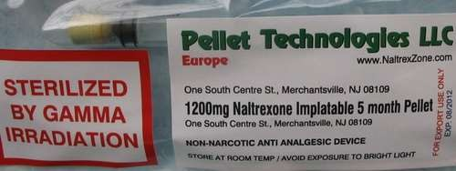
Implant drug delivery
4- Naltrexone implants
Naltrexone implants are small medication pellets that get inserted under the skin and slowly release the medication over varying lengths of time.
Naltrexone is a drug belonging to a class of drugs called opioid antagonists.
Naltrexone can help reduce the desire for drugs such as: Heroin, Morphine, Dilaudid, Fentanyl, Oxycontin.
But naltrexone doesn’t treat the withdrawal symptoms that opioid users may experience, including: Anxiety, Agitation, Sleep disturbances, Sweating, Abdominal pain

Slide 29
Implant drug delivery
4- Naltrexone implants Why Choose an Implant?
Patient has a history of relapsing.
Life circumstances make it difficult to stay consistent with oral medication.
Implants Last a Long Time ► effective for 2-6 months.
Warnings and precautions
Implantation site complications ► Infection, Inflammation, Irritation.
Withdrawal symptoms, if you haven’t completely detoxed at the time you started treatment.
Women who are pregnant or nursing are advised not to take naltrexone.

Slide 30
References
https://www.mdtmag.com/article/2013/07/implantable-drug-delivery- devices%E2%80%94-overview
http://www.slideshare.net/biniyapatel/implant-37632814 http://www.sciencedirect.com/science/article/pii/S1056871998000276
https://www.fpnsw.org.au/health-information/contraception/contraceptive- implant
https://braeburnpharmaceuticals.com/braeburn-pharmaceuticals-announces- fda-approves-probuphine-buprenorphine-implant-the-first-implant-for- treatment-of-opioid-dependence/
Cochlear Implant Patient Assessment Evaluation of Candidacy, Performance, and Outcomes
Biointegration of Medical Implant Materials

