Slide 1
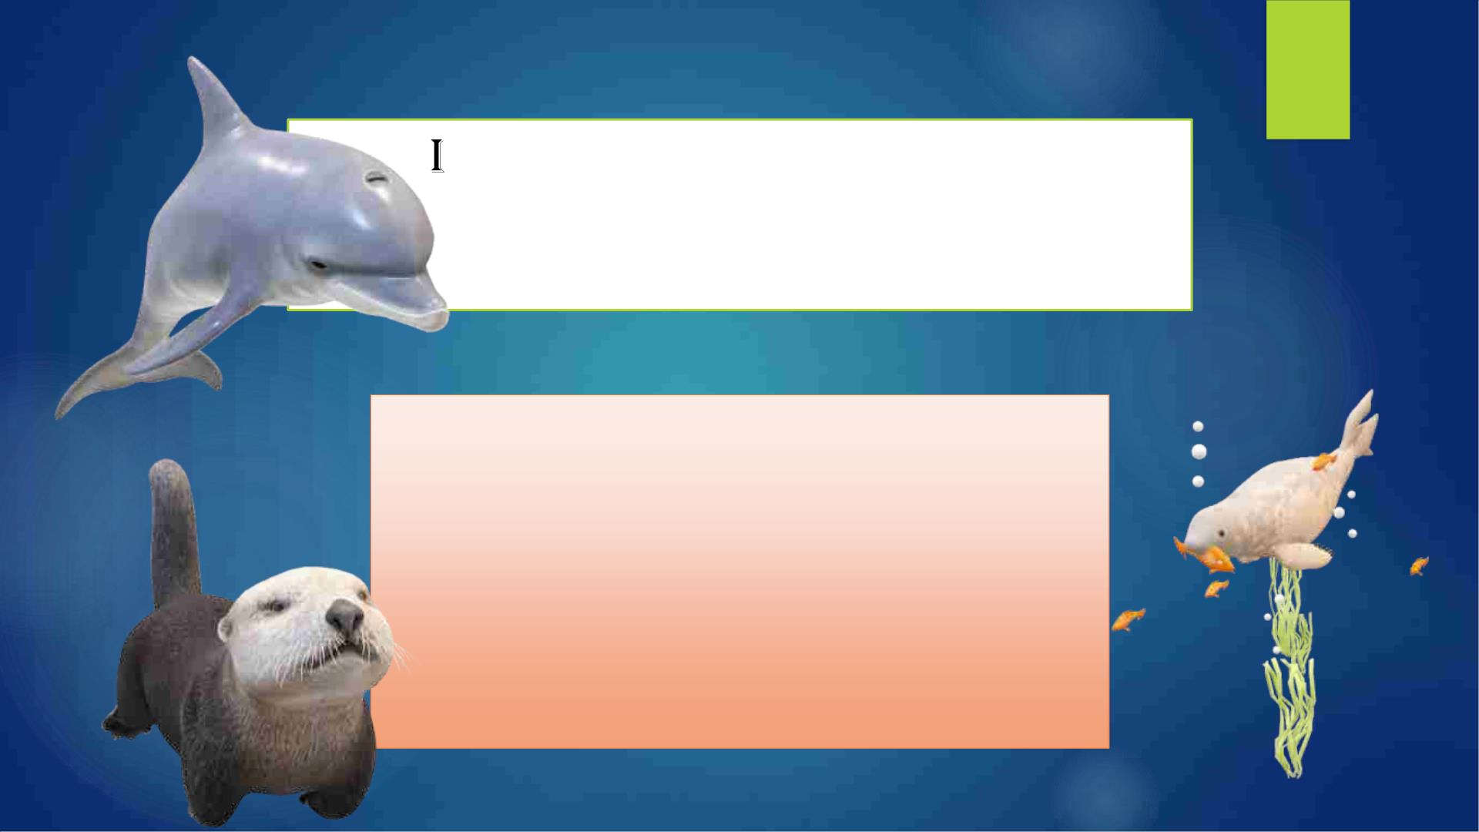
ntroduction to aquatic
mammals, reptiles and
amphibians
Course Name
Aquatic mammals, reptiles and amphibians
Course Code (Credit)
FSRM 2109 (1-0-0)
Course teacher
Mr. Chinmaya Nanda

Slide 2

◆ UNIT 1:
Selected Aquatic Mammal, Reptile, Amphibian And Birds Species of India
relevant to Fisheries: Taxonomic Status, Identification Characters, Distribution,
Abundance, Habitat, Exploitation, Threats And Conservation.
◆ Unit 2:
Biology Of Aquatic Animals: Cetaceans (Whales. Dolphins, Porpoises And
Narwal), Sirenia (Manatees And Dugongs), Carnivora (Seals, Sea Lions,
Walruses, Polar Bear And Otter), Sea Turtles, Tortoise, Crocodiles,
Sea/Freshwater Snakes And Amphibians.
◆ Unit 3:
◆ IUCN Criteria – Red List, Wild Life (Protection) Act.

Slide 3

ARMA
Course Credit= 1+0+0
*1 Credit= 50 Marks
INTERNAL THEORY EXAM
(40%)
END SEMESTER/EXTERNAL THEORY EXAM
(60%)
Internal-1
(10 Marks)
Internal-2
(Continuous Assessment)
Final Theory Exam
(30 Marks)
Presentation or
Class Attendance
(2.5 Marks)
Assignments
(7.5 Marks)

Slide 4

Class Planning
• Each Class= 1hrs
• First 10 Min= Presentations by two students
and discussion
• Next 30-40 Min= Usual Class Progression
• Last 5 Minutes= MCQ related to previous class

Slide 5


Slide 6

Session
/Class
Topic/Chapter
Class Break-up/Sub-Topics
• Course Outline
Introduction to
1
Aquatic Mammals, • General Introduction
Reptiles and
Amphibians
• Current Trends of Aquatic mammals, reptiles
and amphibians
• Classification & Identification characters
• Evolutionary Trends
Aquatic Mammals • Geographical Distribution & Habitat
• Current Status (Exploitation, Threats and
Conservation)
2
• Classification & Identification characters
• Evolutionary Trends
• Geographical Distribution & Habitat
• Current Status (Exploitation, Threats and
Conservation)
3
4
Aquatic Reptiles
Amphibians
• Classification & Identification characters
• Evolutionary Trends
• Geographical Distribution & Habitat
• Current Status (Exploitation, Threats and
Conservation)
• Classification & Identification characters
• Evolutionary Trends

Slide 7

Sessio
n/Clas
s
Topic/Chapter
Class Break-up/Sub-Topics
Biology of Aquatic
Mammals
• Habitat, Food and Feeding and Reproductive
Biology of Cetaceans (Whales, Dolphins and
Porpoise)
6
7
8
Biology of Aquatic
Mammals
•
Habitat, Food and Feeding and Reproductive
Biology of Sirenians (Manatees and Dugongs)
Biology of Aquatic
Mammals
•
Habitat, Food and Feeding and Reproductive
Biology of Pinnipeds (seals, sea lions, walruses).
• Habitat, Food and Feeding and Reproductive
Biology of Other Marine Mammals of the order
Carnivora like Chungungo, Sea Otters & Polar
Bear
9
Biology of Aquatic
Mammals
Biology of Aquatic
Reptiles
• Habitat, Food and Feeding and Reproductive
10
11
12
Biology of Marine Turtles and Tortoise
Biology of Aquatic
Reptiles
• Habitat, Food and Feeding and Reproductive
Biology of Crocodiles and Snakes
Biology of
• Habitat, Food and Feeding and Reproductive
Biology of Important Amphibians

Slide 8

Sessio
n/Clas
s
Topic/Chapter
Class Break-up/Sub-Topics
International Laws,
Rules, Conventions
and Treaties for
Conservation of wild
fauna
• Different Worldwide Protection Acts, Rules &
Conventions for wildlife
• Instruments for Implementing
13
14
Conservation/Protection acts and rules like
CITES, IUCN, Red Data Book, etc.
• Wildlife Protection Act and its schedules
• Environment Act
• Biodiversity Act
Legal Framework for
Wildlife Conservation
in India
• Other Acts/Rules/Treaties etc.
• What is IUCN criteria red list
• History
15
16
IUCN criteria – Red
list
• IUCN criteria red list categories (Extinct, Extinct
in wild, critically endangered, endangered,
vulnerable, near threatened, least concern,
data deficient and not evaluated)
• Versions
• Criticism
• Conservation status
• Red list index
• Regional red list
IUCN criteria – Red
list

Slide 9


Slide 10
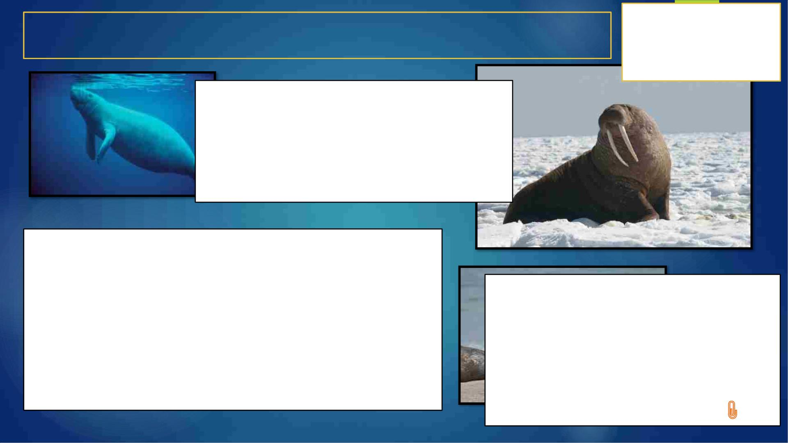
Aquatic Mammal/Marine Mammals
Kingdom: Animalia
Phylum:
Clade:
Clade:
Clade:
Class:
Chordata
Amniota
Synapsida
Mammaliaformes
Mammalia
• “Marine Mammal/Aquatic Mammals”=
Not a single taxonomic unit, but all
mammals that spend most/all-time in
marine habitats (except a few freshwaters)
• Four orders-
• three exclusively aquatic- The Cetaceans, The
Mammals are characterized by the
presence of milk-producing mammary
glands for feeding their young, a
neocortex region of the brain , fur or
hair, and three middle ear bones.
Sirenians, The Pinnipeds
• One, Mainly terrestrial, includes a smaller number of
true marine mammals, such as the sea otter
(Enhydralutris) and the polar bear (Ursus maritimus).

Slide 11

Aquatic Reptiles
Aquatic reptiles=vertebrates= not a single group=several types=live in
different habits (exclusively aquatic/semi-aquatic)
Certain commonalities:
• Dependence on fresh or saltwater
• Least diversity of aquatic reptiles (approx. 1 %)
• Some can withstand the great pressure of deep-sea
• Limbs modified for swimming
Four reptile groups have
species found in aquatic
habitats:
1. Turtles (e.g. Sea Turtles)
2. Lizards (e.g. Iguanas)
3. Snakes
• Marine reptiles have mechanisms of salt excretion through
specialized glands via mouth, eyes or nose
• Valve nostrils cease water entering when submerged
• Some strictly carnivorous predators, others omnivores and some
herbivores.
4. Crocodilians

Slide 12
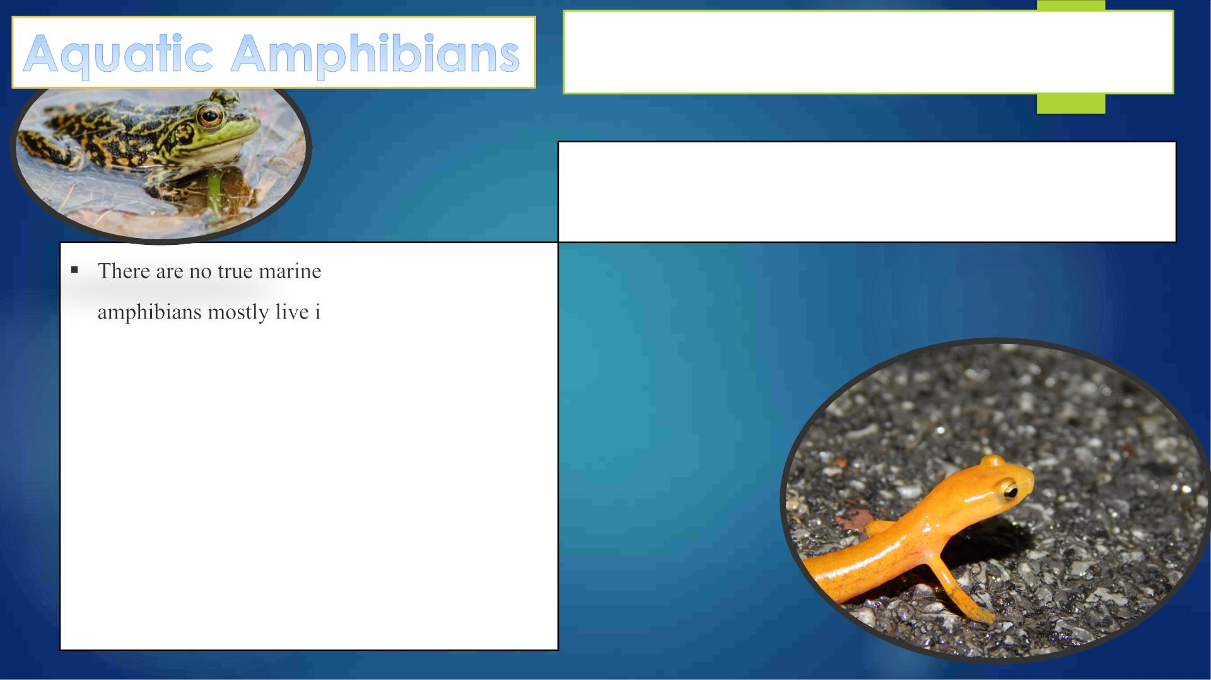
Amphibians are four-limbed and ectothermic
vertebrates of the class Amphibia.
They inhabit various habitats, with most species living
within terrestrial, fossorial, arboreal or freshwater aquatic
ecosystems.
amphibians because
n freshwater, and their
body composition makes them unable to tolerate
pure salt.
§ Amphibians typically start as larvae living in
water, but some species have developed
behavioural adaptations to bypass this.
§ Amphibians are the type of animal which are not
found in the sea.

Slide 13
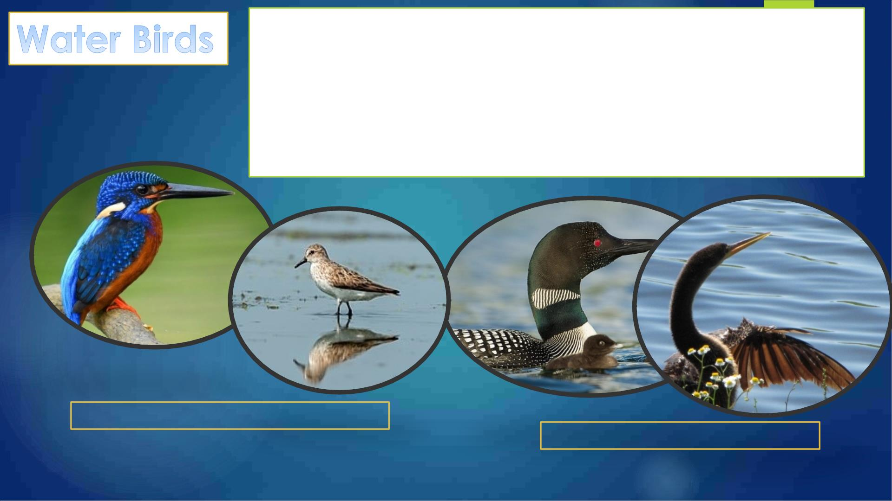
A water bird, alternatively a waterbird or aquatic bird, is a bird that
lives on or around water.
In some definitions, the term water bird is mainly applied to birds
in freshwater ecosystems, although others make no distinction
from seabirds that inhabit marine environments.
Some More Terrestrial- wading birds
Some more Aquatic- waterfowls

Slide 14

1. Divide the class into groups
2. Each group will visit Library and collect the list of available
books directly/indirectly related to the course.
3. Each group should search online for the related
books/reference suitable for this subject

Slide 15


Slide 16
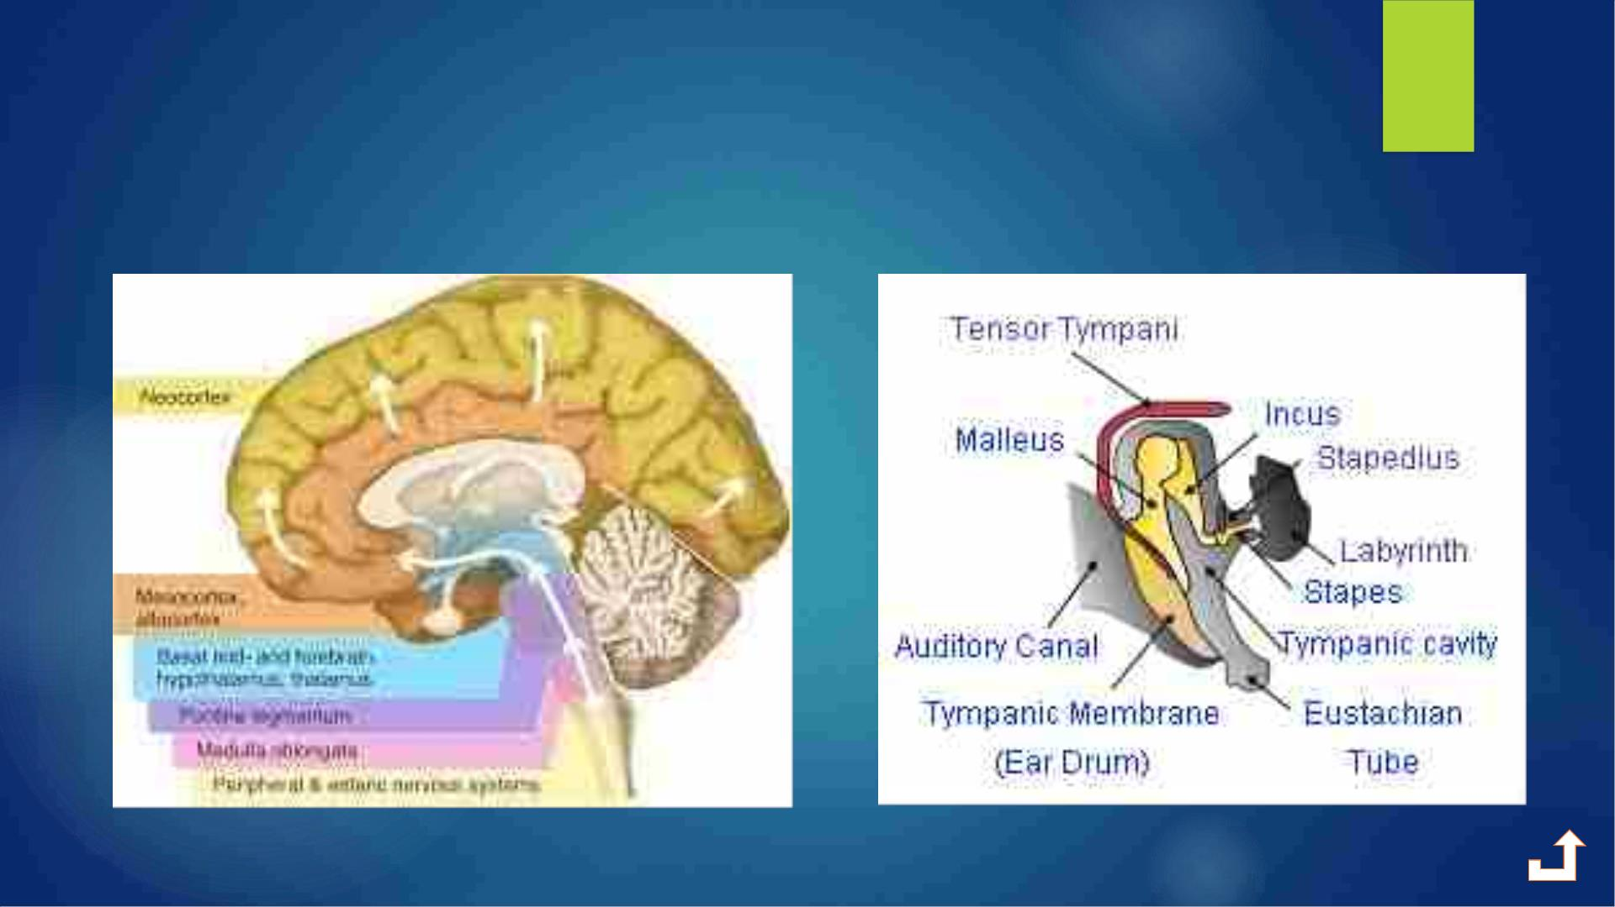
Mammalian Neocortex and Middle
Ear Ossicles

