Slide 1
SCOPE OF VEGETABLE SEED PRODUCTION AND CURRENT STATUS OF SEED INDUSTRY IN INDIA
COURSE TITLE: Seed production of vegetable and cereal crops
COURSE NO: CUSP2261

Slide 2
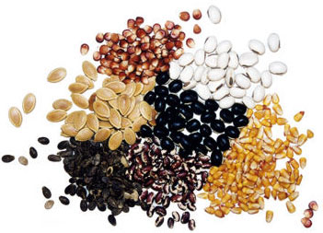
BASIC INPUT OF VEGETABLE INDUSTRY
Seed is first & foremost commodity for successful vegetable cultivation
Quality of seed accounts for 20-25% of productivity
Policies of GOI since independence liberalized & encouraged seed trade
Vegetable trade was started during 1917.
India’s seed industry has grown in size and level of performance over the past four decades at a CAGR of 12% compared to global growth of 6-7%.

Slide 3
HISTORICAL PERSPECTIVE
Vegetable seed production programme started at vegetable breeding station at Kattrain and Kulu valley by GOI (1949)
National Seed Corporation was established in 1963
GOI enacted the Seeds Act in 1966 to regulate the growing seed industry.
In order to meet requirements of the country, National Seed Project was launched in 1977
The first ICAR project on Hybrid seed in vegetables is over 15 centers and covering 9 vegetable crops
First Indian vegetable hybrid - Pusa Meghadoot in Bottle gourd
AICRP on production of breeder seed in vegetable crops is started under NSP in 1994
Notes:
NSP 2002- to provide appropriate climate for seed industry, safeguarding the interest of Indian farmers and conservation of agro biodiversity.

Slide 4
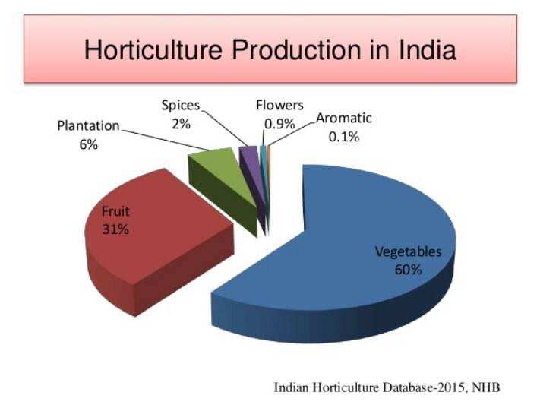
Horticulture production in India

Slide 5
The Global Vegetable Seeds Market is estimated to be valued at USD 8.77 billion in 2018 and is projected to reach USD 14.00 billion by 2025, at a CAGR of +8.10% from 2019.
Fig. India’s vegetable and fruits seed export to other countries
Notes:
1. Total Horticulture production in 2019-20 (1st Advance Estimates) is expected to be 0.84% higher than 2018-19.
2. Increase of 2.64 % in production of vegetables in 2019-20 over 2018-19.

Slide 6
Notes:
Globally, North America accounts for the largest market share of Solanaceae Vegetable Seeds Industry and is estimated to lead the overall market in the years to come. The reason being, maximum species are found in this region. The United States is the major consumer of the market in this region. Europe and Asia Pacific follow the suit. On the other hand, Asia Pacific is estimated to grow at fastest pace in the years to come.

Slide 8
Major reasons for low productivity of vegetables
Limited availability of high quality seeds of released hybrids
High cost of hybrid seed of vegetables
Requires application of improved cultivation technologies and government policies
Global production (in million MT) of vegetables
Source: Statista, 2019
Notes:
However, lack of quality seed continues to be one of the greatest impediments to bridging the vast yield gap. Therefore, to approach the potentially realizable yield of a cultivar, production and distribution of quality seed is essential. The good quality seed should have the following characters:
Genetic purity, and uniformity and should conform to the standards of the particular cultivar.
Disease free, viable seeds.
Free from admixtures of other crop seeds, weeds and inert matter.
Acceptable uniformity with respect to size, shape and color.

Slide 9
S.No | SEED PRODUCTION | CROP PRODUCTION
1. | Basic seed should be from an authentic source | Any seed material can be used
2. | Seed plot should be selected carefully for better performance, | Can be grown in any area
3. | Needs isolation from other varieties | Isolation is not necessary
4. | Maintenance of genetic purity is important | Genetic purity is not required
5. | Rouging is compulsorily practiced | Rouging is not practiced
6. | Harvesting should be done at physiological/ harvestable maturity | Harvested at field maturity
7. | Resultant seed should be vigorous and viable | Importance is given more to yield
Notes:
2. as per edaphic and environmental requirement
7. Importance is given to seed quality rather than the yield

Slide 10
CURRENT STATUS
Public and private sector companies are involved in quality seed production
The Indian seed industry is the eighth largest in the world with an estimated value of INR 49 billion (USD 1.06 Billion) and with an annual growth rate of 12% to 13 %.
Export of Vegetable Seeds from India is 11.99 Th MT, valuing Rs. Crores 745.95 / US$ Mill 107.76 during 2018-19.
Indian seed industry is the fifth largest seed market in the world and valued at more than Rs 2500 crores

Slide 11
Estimation for export of Vegetable Seeds from India

Slide 14
PUBLIC SECTOR COMPONENTS
NATIONAL SEEDS CORPORATION
STATE FARM CORPORATION OF INDIA
15 STATE SEED CORPORATIONS
ICAR and STATE AGRICULTURAL UNIVERSITIES
22 STATE SEED CERTIFICATION AGENCIES
104 STATE SEED TESTING LABORATORIES

Slide 15
Total seed production by public and private sectors

Slide 16
SCOPE OF VEGETABLE SEED INDUSTRY
1
2
3
Income and Employment generation
Ever Increasing Demand
Varied Agro Climatic Conditions
Vast Domestic and International market
4

Slide 18
VEGETABLE SEED MARKET
India is 2nd largest producer of vegetables (17.3 t/ha) after China (22.5 t/ha).
In the past two decades, the vegetable production in India has been increased 2.5 times from 58.5 Mt in 1991-92 to 146.5 million tons in 2010-11.
India imported 1525.38 t vegetables seed valuing 1503.1 m INR in (2007-08)
Fruit and vegetable seed exports increased from 12302 mt in 2001-02 to 17174 mt in 2012-13

Slide 19
Influence of vegetable seed industry on economy
Income Generation
Employment Generation
Foreign Exchange Earning

Slide 20
ADVANTAGES OF VEGETABLE SEED PRODUCTION
High seed yield under diverse climatic conditions
Problem of synchronization of flowering in parental lines can be minimized
Number of seed crops and varieties can be grown together
Grafting technology in seedling can be applied.
Best opportunity for organic seed production
Field standards can be well enforced
Notes:
High cost inputs
Perishable nature
Pest & disease incidence

Slide 22
CONSTRAINTS
Vegetable seed production in the country has been vulnerable to vagaries of weather resulting in production of poor quality seeds.
Availability of realistic data on actual area under vegetable and requirements of vegetable seeds is inappropriate.
Maintenance of isolation distance
Very low or no indents for new improved varieties
Non-availability of adequate nucleus and breeder seeds in the seed production chain.
Declining arable land, technology-driven agriculture, and changing weather patterns in developing countries
Notes:
3. . Since in our system there is no restriction for planting any particular vegetable crops in any particular area, it becomes difficult many times to maintain the recommended isolation distance.
4. due to ignorance about the performance of newly developed improved varieties.

Slide 23
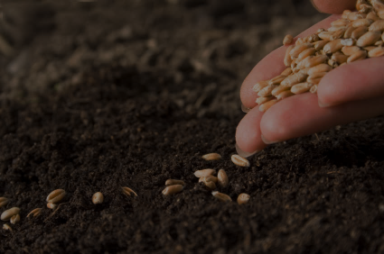
CONCLUSION
Availability of quality seeds to the farmers
Policy making and implementations
Strengthening of public sector in R&D
Exchange of germplasm and other inputs between public and private sectors
Government has to reduce precincts on import and export of quality seeds and planting materials
To protect the farmers from spurious seeds and ensure supply of quality seeds

Slide 24
REFERENCES
Koundinya, A.V.V. and Kumar, P.P. (2014). Indian vegetable seeds industry: status and challenges. International Journal of Plant, Animal and Environmental Sciences, 4(4): 62-69.
Gadwal, V. R. (2003). The Indian seed industry: Its history, current status and future. Current Science, 84(3): 399-406.
Seed Times. (2016). Vegetable seed industry: India & World. The National Seed Association of India Magazine, 9(4): 13-23.

Slide 25
THANK YOU

