Slide 1
SEED POLICIES
Different Seed policies
Objectives
Thrust areas of National Seed Policy, 2002
Seed marketing and Distribution
Export and Import of Seeds
Seed productioin

Slide 2
INTRODUCTION
Indian Agriculture has made enormous strides in the past 50 years, raising foodgrain production from 50 million tonnes to over 200 million tonnes
Globalization and economic liberalization have opened up new opportunities as well as challenges
The seed sector has made impressive progress over the last three decades.

Slide 3
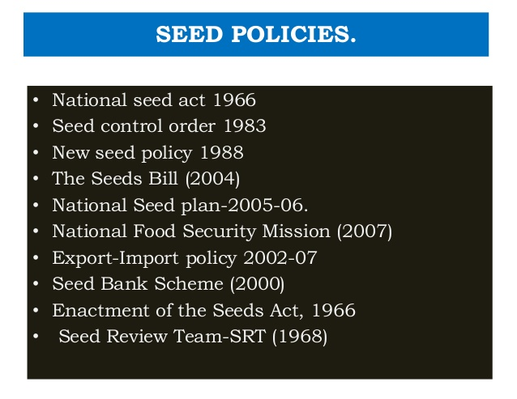
Notes:
The Seed Act, 1966, seed control order 1983 and New Policy on Seeds Development, 1988, from the basis of promotion and regulation of the Indian Seed Industry

Slide 4
How National Seed Policy, 2002 has evolved
The important constraints were:
Non existence of National Seed Policy
IPR laws
Restrictions and licenses on seed exports and imports
Lack of incentives for the public and private seed sectors of the country
Notes:
New seed policy 1988 ushered in a new area of growth and phenomenal development. Because, it allowed limited import of commercial seed, remove curbs on imports of seeds of vegetables, flowers and ornamental plants and even allowed import of seed of course cereals, pulses and oilseeds for a period of two years.

Slide 5
OBJECTIVES OF National Seed Policy
The provision of an appropriate climate for the seed industry to utilize available and prospective opportunities
Safeguarding of the interests of Indian farmers and the conservation of agro-biodiversity
Ensure quality assurance mechanisms coupled with facilitation of a vibrant and responsible seed industry
To raise India’s share in the global seed trade by facilitating advanced scientific aspects
Notes:
in March 2002, first transgenic Bt cotton was approved for commercial cultivation in India

Slide 6
Features of National Seed Policy
1. Development of new and improved varieties of
plants
2. Timely availability of quality seeds
3. Compulsory registration of seeds
4. Creation of infrastructure facilities
5. Quality assurance, promotion of seed industry
6. Abolition of licensing for seed dealers
7. Facility for import of best quality seeds
8. Encouragement to export of seeds
9. Creation of Seed Banks and National Seed Grid
Notes:
National Seed Grid will be established as a data base on seed requirement, production, distribution and farmers preference. 3. Access to finance from commercial banks will be facilitated. 4. Availability of high quality seed will be ensured through improved distribution system and efficient marketing set up.

Slide 7
The policy encourages private sector participation in research and development of new plant varieties
The rights empowered to various bodies for regulating the quality of seeds produced, distributed and for providing variety protection as per the Seeds Act, 1966 and PPV & FR Act, 2001 have been retained in the policy
Promotion of seed village scheme to increase the production and make available the seeds in time as well as upgrading the quality of farmers' saved seeds
Establishment of seed banks for ensuring supply in times of calamity and storage facility at village level
Establishment of a National Seed Board in place of Central Seed Committee and Central Seed Certification Board to undertake seed certification and advising Government on all matters related to seed planning and development. NSB will serve as the apex body in the seed sector
Setting up of National Seed Research and Training Centre to impart training in seed technology
Development of a National Seed Grid to provide information on availability of different varieties of seeds with production details.
Both public and private sector will be encouraged to join the grid for a clear assessment of demand and supply of seeds

Slide 8
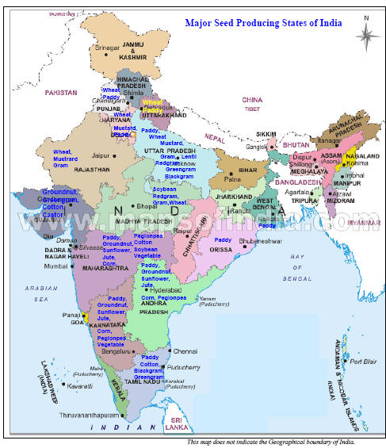

Slide 9
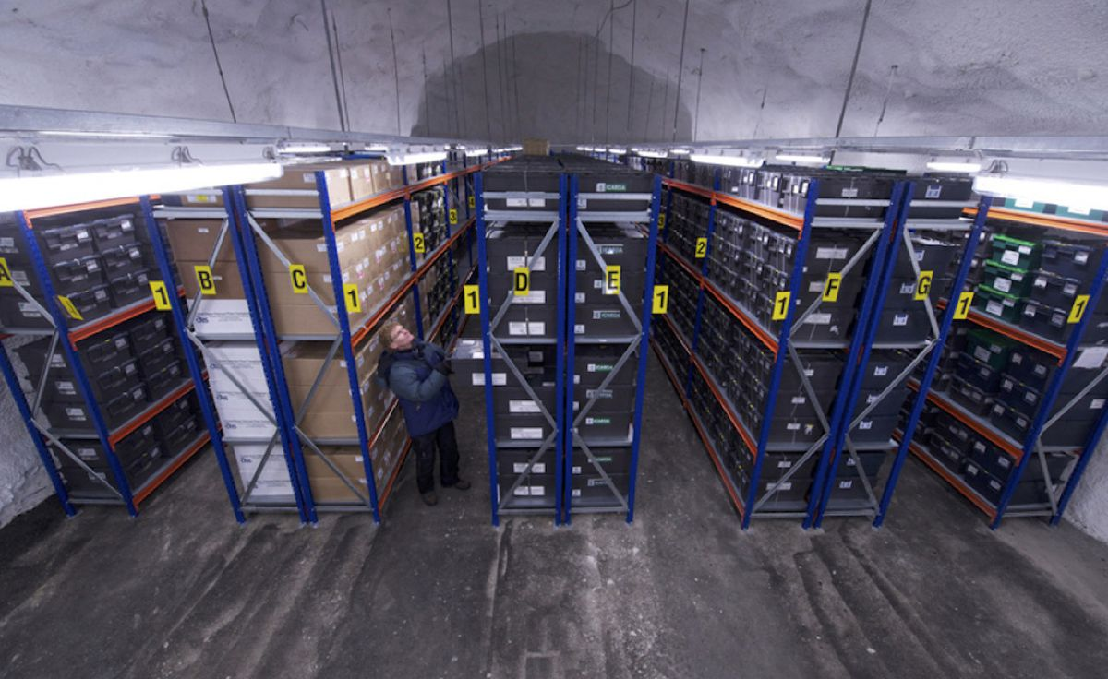
Seed Bank Scheme has been implementing by Seed Division from 1999- 2000 with the objective to meet requirement of seeds during natural calamities and unforeseen conditions
Svalbard Global seed vault, Norway

Slide 10
THRUST AREAS
• VARIETAL DEVELOPMENT AND PLANT VARIETY PROTECTION
• SEED PRODUCTION
• QUALITY ASSURANCE
• SEED DISTRIBUTION AND MARKETING
• INFRASTRUCTURE FACILITIES
• TRANSGENIC PLANT VARIETIES
• IMPORT OF SEEDS AND PLANTING MATERIAL
• EXPORT OF SEEDS
• PROMOTION OF DOMESTIC SEED INDUSTRY
• STRENGTHENING OF MONITORING SYSTEM

Slide 11
VARIETAL DEVELOPMENT AND PLANT VARIETY PROTECTION
• Registration of new plant varieties, EDV and extant varieties
• Developing DUS test guidelines for new plant species
•Developing characterization and documentation of registered
varieties
• Cataloging facilities for all variety of plants particularly tribal and rural community
• Maintenance of the National Register of Plant Varieties
• Maintenance of National Gene Fund

Slide 12
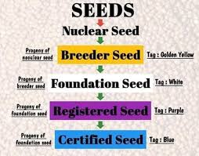
THRUST AREAS
SEED PRODUCTION

Slide 13
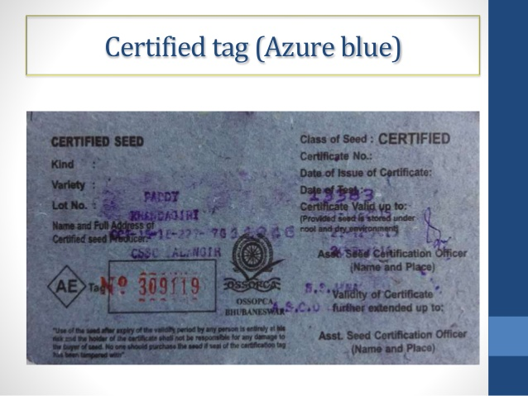

Slide 14
QUALITY ASSURANCE
Novel: variety was not sold or disposed by the breeder for commercial exploitation in India earlier than one year or outside India, earlier than four years before the date of filing of application for registration.
Distinct: variety is clearly distinguishable by at least one essential characteristic from any other variety whose existence is known in any country at the time of filing of application
Uniformity: variety is sufficiently uniform for essential characteristics other than the variation that may be expected within the variety due to its mode of reproduction
Stability: remain unchanged for its essential characteristics even after repeated propagation
Notes:
National Seed Board will be established as apex body in place of existing Central Seed Committee to implement New Seed Act

Slide 15
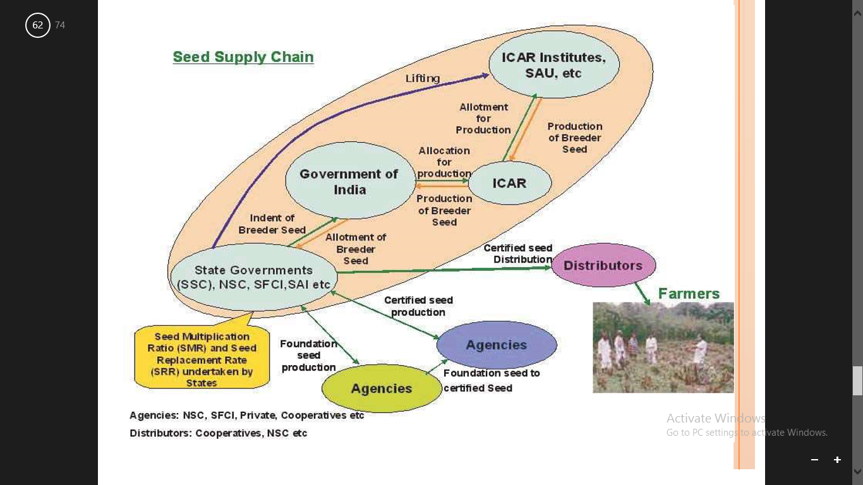
SEED DISTRIBUTION AND MARKETING

Slide 17
TYPES OF SEED DISTRIBUTION
(a) Farmer to farmer distribution: This is the traditional method, where by farmers obtain their requirements from neighbours either on cash payment or on an exchange basis. No formal marketing organization is required for this type of distribution.
(b) Distribution by co-operatives: This involves procurement of seeds by cooperatives and its subsequent distribution. The distribution of seeds through cooperatives has often been encouraged by the government through subsidies and guarantees.
(c) Distribution by Departments of Agriculture: Seeds are purchased by the government, out of the government funds, and are distributed through district Agricultural Officers and Block Development Officers.
(d) Distribution of seeds by non-government or quasi-government agencies: In this system, the seeds are distributed through a network of seed distributors and seed dealers.

Slide 18
TRANSGENIC PLANT VARIETIES
The Genetic Engineering Appraisal Committee (GEAC) of India was reconstituted on March 11, 2013
Department of Environment, Forest and Wildlife for approval of activities involving large scale use of hazardous microorganisms and recombinants in research and industrial production from the environmental angle

Slide 19
TRANSGENIC PLANT VARIETIES
To permit the use of GMOs and products thereof for commercial applications.
To adopt producers for restriction or prohibition, production, sale, import & use of GMOs both for research and applications under EPA.
To authorize large scale production and release of GMOs and products there of into the environment.
To authorize agencies or persons to have powers to take punitive actions under the EPA.

Slide 20
IMPORT and EXPORT OF SEEDS AND PLANTING MATERIAL
The export/import of seeds and planting material is governed by the Export and Import(EXIM) Policy 2002-07
(i) breeder or foundation or wild varieties;
(ii) onion, berseem, cashew, nux vomica, rubber, pepper cuttings, sandalwood, saffron, neem, forestry species and wild ornamental plants;
(iii) export of niger which is canalized through TRIFED, NAFED, etc.
(iv) groundnuts, exports of which is subject to compulsory registration of contract with APEDA;
The export of these seeds is restricted and is only allowed on case-to-case basis under license issued by Director General Foreign Trade on the basis of the recommendations of Department of Agriculture and Cooperation

Slide 21
Requirements for IMPORT and EXPORT OF SEEDS
Importer Exporter Code(IEC) from Director General of Foreign Trade(DGFT)
Registration with National Seed Corporation
Seed Dealer’s License from state govt.
Import permit form from Plant Quarantine Dept.
Appointing Clearing and Forwarding Agent (C and F agent)
Filling bill – Bill of Lading
Payment of customer’s Duty
Phytosanitary Certificate issued by exporting country

Slide 22
NBPGR
•Earlier NBPGR was known as “Division of Plant Introduction” was upgraded to an independent institute ‘National Bureau of Plant Introduction’ in August 1976 which was rechristened as ‘National Bureau of Plant Genetic Resources’ (NBPGR)
in January 1977.
• Improvement of various crop plants and development of agriculture in India through germplasm introduction from various institutes located in foreign countries.

Slide 23
PROMOTION OF DOMESTIC SEED INDUSTRY
It will be facilitated by providing incentives to domestic seed industry, financial support through NABARD, commercial and co-operative banks, considering tax rebate / concessions for R&D, reduction of import duty on machines and equipment used for seed production and encouragement of membership in National and International organization related to seed

Slide 24
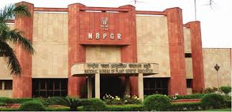

Slide 25
THANK YOU

