Slide 1
SEED PROCESSING AND SEED CLEANING
Prepared by: Dr. Aninda Chakraborty Assistant Professor Ph.D. Seed Science and Technology

Slide 2
SEED PROCESSING
Seed processing is necessary in order to dry the seeds to safe moisture level;
remove or reduce to the extent possible the various undesirable material, weed seeds, other crop seeds, deteriorated or damaged seeds;
uniform size grading and seed treatment to upgrade the over all seed quality.
Seed processing refers to all the steps necessary for preparation of harvested seed for marketing, namely, handling, drying, shelling, preconditioning cleaning, size grading, treating and packaging

Slide 3
Factors to be considered in planning and designing a seed processing plant
1. Kinds of crop seeds to be handled
2. Size of operation
3. Whether drying facilities should be required;
4. Selection of suitable equipment;
5. Location of the plant;
6. Source of power for running machinery;
7. System of seed delivery to processing plant; and
8. Availability of labour

Slide 4
Type of Layouts
a) Multistorey: In this system, seed is carried by elevators to the top floor and emptied into large bins. Cleaning machines are then arranged in a vertical series on the lower floors.
b) Single level: In the single storey plant, seed is moved from one machine to the next by elevators placed between the machines.
c) Combined designs: A compromise between the single and multistorey system could also be adapted.
Notes:
A great advantage of the single level system is that one man can supervise the processing line without running up and downstairs. He can thus maintain closer supervision of all operations.

Slide 5
SEED CLEANING
Pre-cleaning & Pre -conditioning: It refers to the operations such as shelling, debearding etc. that prepares the seed lots for basic cleaning and also for the removal of particles such as trash, stones, clods etc. larger than crop seed.
1. Scalper or Rough Cleaner
2. Huller Scarifier
3. Debearder
4. Maize Sheller

Slide 6
SEED CLEANING
1. Scalper or Rough Cleaner: The single sieve pre-cleaners are called as scalpers and the multiple sieve units are referred as rough cleaners
2. Huller Scarifier: Hulling (removal of an outer coat or husk) and scarification (scratching of the seed coat) can be done separately or jointly with a huller scarifier
3. Debearder: Debearder removes the hair like structures present on the seeds
4. Maize Sheller

Slide 7
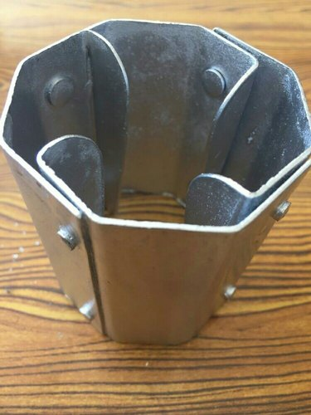
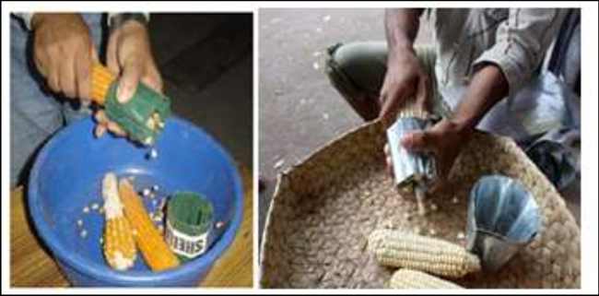
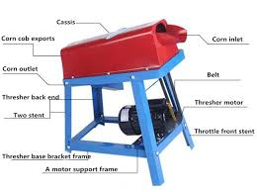

Slide 8
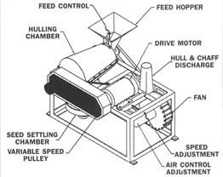
HULLER/ SCARIFIER

Slide 9
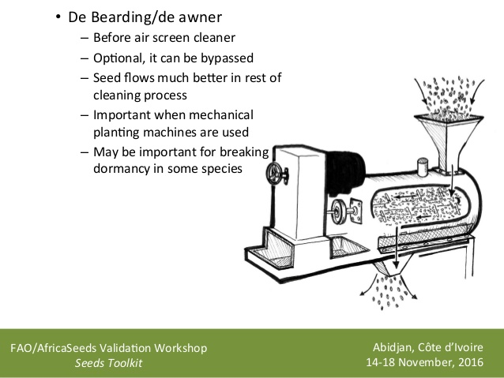

Slide 10
BASIC SEED CLEANING
It refers to actual cleaning and grading of seeds and is essential process in seed cleaning operation.
The basic seed cleaning is done over an air screen machine commonly referred to as an air screen cleaner
1. Aspiration: the light seed and chaffy material is removed from the seed mass through aspiration.
2. Scalping: Good seed are dropped through screen openings but large material (trash, clods etc.) are scalped off over the screen into a separate spout.
3. Grading: The good seed ride over the screen openings, while smaller particles (undersized, weed seeds, shriveled) drop through the screen perforations.

Slide 11
PARTS OF AIR SCREEN CLEANER
1.Feed hopper
2. Screens
3. Clay crushing rolls
4. Brushes
5. Tappers or screen knockers
6. Shoes
7. Eccentrics
8. Fans
9. Air Chest

Slide 12
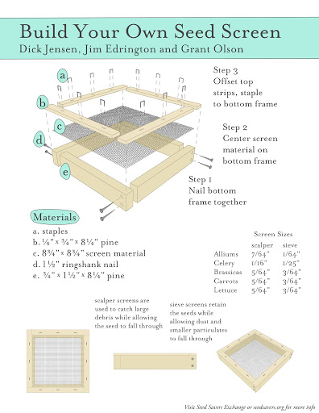

Slide 13
DIFFERENT SCREENS/ SIEVES

Slide 14
DIFFERENT SCREENS/ SIEVES

Slide 15
Principle of Operation of air screen machine
1. The air blast removes lightweight seed and chaffy seed. 2. Scalping screen removes material larger than the crop seed.
3. Grading screen drop out material smaller than crop seed.
4. Eccentrics do the shaking motions of the screens.
5. The two shoes in 4 screen cleaner move in opposite direction to balance each other also to reduce machine vibrations to minimum.
First screen does scalping
Second screen does grading
Third screen does close scalping
Fourth screen does close grading

Slide 16
UPGRADING MACHINES

Slide 19
SPECIFIC GRAVITY SEPERATOR

Slide 20
ELECTRICAL COLOUR SORTER

Slide 21
SPIRAL SEPERATOR

