Slide 1
A Presentation on the Topic:- “Seed Health Tests for Seed borne Disease.”

Slide 2
CONTENTS:-
Seed Health Test(brief definition)
Requirements for Seed health test
Types of Seed borne pathogen
Seed Health tests for Fungi
Seed health tests for Bacteria and Viruses
Seed Health tests for Nematode
Division of different Seed health tests for different pathogen.
References

Slide 3
Seed health Test:-
Seed health is a science of determining the presence or absence of seed-borne pathogens can be confirmed through the use of seed health testing. Seed borne pathogens can be present in 3-forms:-
Accompanying mixture/Contaminants- Like smuts , scelerotia, nematode, gall, fruiting bodies. Through which the disease can be contaminanted.
Seed Infestation:- When the pathogen affect on the surface of the seeds then it is known as Seed Infestation or External Seed Borne pathogen.
Seed Infection:- The particular seed will be affected from its living tissue is known as Seed Infection or Internal Seed Borne Pathogen.

Slide 4
There are six main requirements for selection of seed health tests methods:-
Specificity: The ability to distinguish the target or specific pathogen from all the pathogens likely to occur on seeds from field or store, i.e. to avoid false positives.
Sensitivity: The ability to detect target organisms, which are potentially significant in field crops at a low incidence in seed stocks.
Speed: In some cases, small concession to accuracy may be necessary to ensure rapid results, but such results should be followed by more definite testing.
Simplicity: The methodology should minimize the number of stages to reduce room for error and to enable tests to be performed by not necessarily highly qualified staff.
Cost effectiveness: Test costs should form part of acceptable production margins for each crop.
Reliability: Test methods must be sufficiently robust so that results are repeatable within and between samples of the same stock regardless of who performs the test (within the bounds of statistical probability and sample variation).

Slide 5
Seed Health Tests for Fungi:-
Visual Examination:- It can be observed through Naked eye. First we will take the Seed Sample, then we will separate the smuts , gall, fungal spore mixed in seed or not. If present then it should be separated and the % of spores are calculated.
Embryo Examination:- Examination of dry seeds with the naked eye and at magnifications of 10 to 30 times reveals a number of plant pathogens that occur mixed with the seeds as fungus bodies. For example:- Fungus Claviceps purpurea , the cause of Ergot of Grasses.
Blotter Paper Method:- Given by Limonard ,1966. Blotter tests are similar to germination tests in that seeds are placed on moistened layers of blotter paper and incubated under conditions that promote fungal growth.The seed may then be allowed to germinate and fungal seed-borne infections may manifest themselves by any pertinent signs or symptoms.
Agar Plate Method:- Sowing the seeds on the Agar media. Then, on the Agar media we will place the seeds and observe the germination. If any fungal infection or mycelia is observed then it is found to be unhealthy and if it grow wisely then it is healthy.

Slide 6
5. Examination of Imbibed Seeds:- Firstly we will take the seed sample then soak it overnight in water . After that Imbibition starts, and whatever the smuts, sclerotia will float on the top and they will drain out. After that we will go for germination and if it germinate then it is healthy.
6. Examination by washing of Seeds:- After taking the seed sample in a bottle ,we will wetting agent on that we will soak the seeds. Then the infested portion will be removed out.
7. Growing of Plants:- In this method the seeds are grown into plants and then observe the plant symptoms. And based on that we can decide whether it is infected or not.

Slide 7
Example of Seed health test for Fungi:-
Karnal Bunt of wheat(Neovossia indica)
The wheat seeds are soaked in a flask/beaker containing 500ml of 0.2% Sodium hydroxide(NaOH) for 24hours at 20-30degree celcius.
Then the seeds are taken out and washed in tap water.
Seeds are spread over a blotter paper so that excess water on the surface of seed is absorbed.
Seeds which are exhibiting black shiny appearance with hollow or without hollowness are separated.
Then the seeds are observed visually to observe the release of fungal spores.
The number of seeds releasing stream of fungal spores are counted as infected seeds.

Slide 8
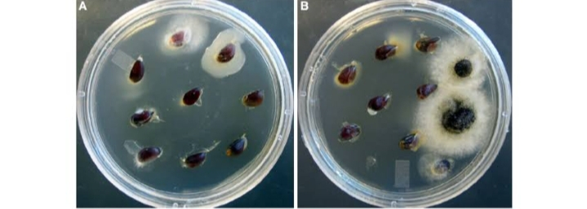
ELISA
Agar plate method:-

Slide 9
Different Seed Borne/ Seed Health Tests for Bacteria, Virus:-
Visual Examination:- Just by looking after the Seed lot.
Direct Examination:- Based on the symptoms observed like yellowing, wilting, curling of leaves through this the seed borne diseases can be observed.
Serological Tests(Immunoassays):- It consists of 3 tests which helps for Seed health tests- A. Double Diffusion B. Radial Diffusion C. Latex Flocculation Test
A. Double Diffusion:- After taking the Seed sample, along with that we will take Antiserum sample from that suspected virus. Based on the charges, the antigen and antibody will move in different direction. When the antigen and antibody will meet at a particular point due to the reaction taken place. If White precipitate will comes out then there is no antigen or pathogen and if there is no precipitation will be there then the seeds are found to be healthy.

Slide 10
B. Radial Diffusion:- Firstly Seed sample should be taken with antiserum sample. Then, the Antigen sample starts moving radially, towards the periphery. Antibodies and antigen will come in contact in the Locule. Then, when White precipitation forms then there is the observation of antigen or pathogen.
c. Latex Flocculation Test:- The seed sample should be taken in powder form then we will mix the seed sample with 10-15ml of latex and if Agglumatation occurs then it is infested. When virus is present in the sample the latex suspection becomes flocculated or aggregated.
4. Indicator Test:- Working seed sample is sterilized with (2.6%) Sodium hypochlorite for 15min and rinsed with sterile water.
The seed sample is incubated for 18-24hrs in sterile water.
The water suspension is inoculated by infiltration into the primary leaf node of 10day old bean seedlings.
The appearance of lesions followed systemic necrosis positive reaction.

Slide 11
5. ELISA:-
As a first step, sap extract from the plant is added to the wells of the microtiter plate; after incubation, antibodies are added followed by washing.
If the virus of interest is present in the plant, it will bind to the antibodies. Any unbound extract is washed off before a secondary antibody that recognizes the first antibody is added.
The secondary antibody allows for indirect detection of the virus because it has a reporter molecule attached to it, usually an enzyme (alkaline phosphatase [ALP] or horse-radish peroxidase [HRP]) that acts on a substrate that changes color, which is detected visually by a microtiter plate spectrophotometer.
The enzyme alkaline phosphates is conjugated to the antibody molecules specific for the virus under examination.
Notes:
ELISA is a biochemical and serological method using enzymatic reactions to detect and quantify the amount of a specific substance, such as viral proteins/particles in a solution.
ELISAs are sensitive, specific, and inexpensive. This serological technique was first introduced to the study of plant viruses in the 1970
ELISA is apparently a rapid and economic detection method for plant viruses

Slide 12
The enzyme alkaline phosphates is conjugated to the antibody molecules specific for the virus under examination.
Finally enzyme substrate is added to the plate.
Hydrolyzed substrate is determined by measuring the extinction spectrophotometrically or by Visual observation.

Slide 13
Example of Seed health test for Bacteria/Virus:-
Common Scab of Potato(Streptomyces Scabies)-Bacteria
Through the visual observation of symptoms like Superficial roughed area.
The lesions consists of corky tissues.
Deep pitted scab consists of lesions.
Internal Cork of Sweet Potato- A virus disease
Dark brown to blackish, hard corky spots which vary in sizes. These corky areas increase in size and number, the longer the root held in storage.

Slide 14
Seed health test for Nematode:-
Detection of External Insect Injury:- The working sample is examined under Magnification or Stereomicroscopic Microscope.
Alkali or Glycerine Method:- Seeds are boiled in 10% NaOH solution for 10mins. Wash with water and then examine it under magnification . Seeds with visible internal infestation are separated , cut opened to confirm the presence of insect or its stage and counted.

Slide 15
Example of Seed health test for Nematode:-
Ear Cockle Galls
Hard,small,dark purplish black colour structures, the galls are separated
And Soaked in water for 30mins and cut in water in petridish for observing the release of nematode larvae, galls releasing nematode are counted and result is reported in %.

Slide 16
Nucleic Acid based detection method:-
Polymerase chain reaction (PCR) is the in-vitro, primer-directed, enzymatic amplification of nucleic acids.
It is a kind of Molecular Method.
Specific primers are used in this method.
PCR is a promising tool for distinguishing specific sequences from a complex mixture of DNA and therefore is useful for determining the presence and quantity of pathogen-specific or other unique sequences within a sample.
Based on the banding patterns , it can be determined whether there is any foreign organism or not.
If the taken samples DNA bands making banding pattern with the markers we have taken, then it is clear that the seed sample is infected.

Slide 17
Fungi
Bacteria
Virus
Nematode
Visual Examination
Blotter Method
Agar Plate Method
Wash Method
Examination of Imbibed seeds.
PCR
Example:-
- Karnal Bunt of wheat(Neovossia indica)
1.Bioassay
2. Indicator test
3. Serological Test
4. PCR
Example:-
-Common scab of potato Streptomyces Scabies.
By growing seeds
Direct seed test
Serological Tests
ELISA
Example:- Internal cork of sweet potato.
Detection of External Insect Injury.
Alkali or Glycerine Method
Example:- Ear Cockle of wheat(Anguina tritici)

Slide 18
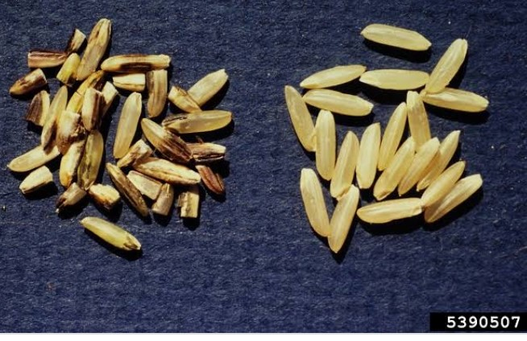
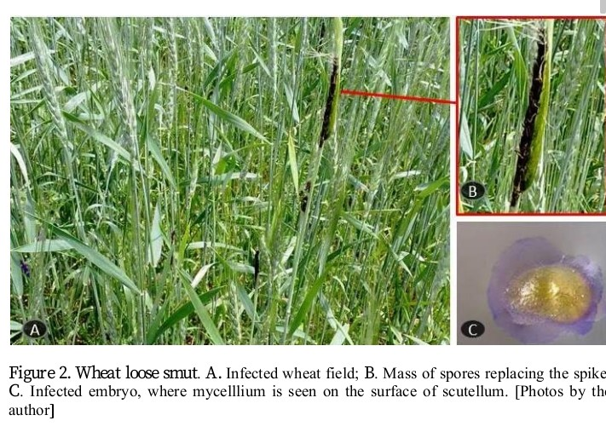
Karnal bunt in rice
Bunt in Rice

