Slide 1
SEED QUALITY
Seed is a basic input in agriculture
It is a fertilized matured ovule containing embryo embedded in the food storage tissue surrounded by a protective coat
Any part (or) organ of plant which has the capability to regenerate into a new plant
Any propagative material

Slide 2
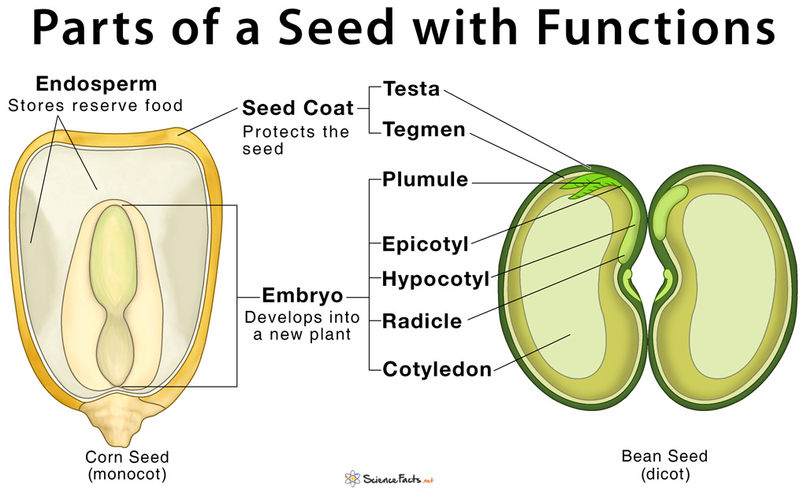

Slide 3
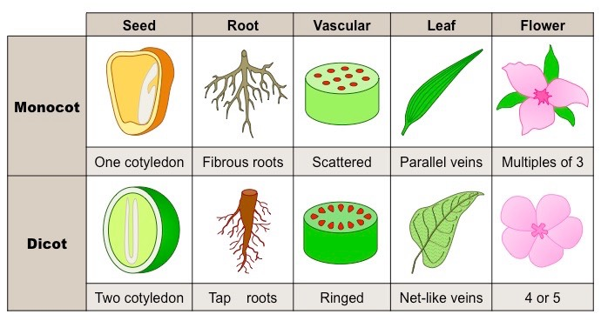

Slide 4
ROLE OF SEED TECHNOLOGY
A carrier of new technologies
A basic tool for secured food supply
The principal means to secure crop yields in less favorable production areas
A medium for rapid rehabilitation of agriculture in cases of natural disaster:
The establishment of National Seed Reserve Stocks should receive high priority for meeting natural calamities for rapid production of food grains
Notes:
cultivation of high yielding varieties have helped to increase food production
High Yielding Varieties Programme (HYVP) in India has led to a remarkable increase in production
The supply of good quality seeds of improved varieties suitable to these areas

Slide 5
GOALS OF SEED TECHNOLOGY

