Slide 1
SEED PRODUCTION IN PADDY

Slide 3
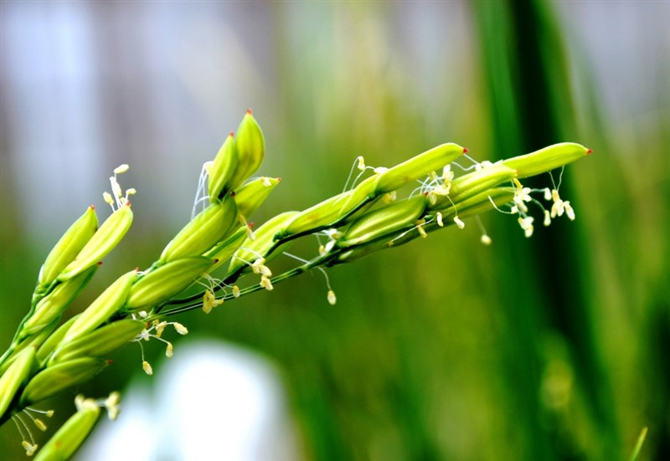
BOTANICAL INFORMATION
Botanical Name : Oryza sativa
Chromosome number :24
Family : Poaceae
Inflorescence : Panicle
Pollination : Self-Pollination
Panicle Emergence : 4-5 days APE
Flower Opening : Tip of primary & secondary branches open and proceeds downward
Duration of Flowering : 6-8 days
Time of Anthesis : 7.00 –10.00 A.M
Temperature : 24 -28˚C
Favourable RH for flowering : 70-80%
Stigma receptivity : 3 days
Pollen viability : 10 minutes

Slide 4
FLORAL BIOLOGY
ANTHERS: 6 stamens
GYNOECIUM: bifid feathery stigma
FLORAL PARTS: Lodicules, Lemma, Palea, Pedicel
Notes:
loral parts mature, the lodicules will swell and open the spikelet to expose the mature floral parts hardened, modified stems that protect the floral organs.
The lemma is relatively larger than the palea.
When the spikelet is closed, the lemma partly encloses the palea
pedicel branches from every node on the secondary rachis and a flower is produced

Slide 6
INFLORESCENCE

Slide 7
CRITICAL GROWTH STAGES

Slide 8
SEED PRODUCTION
Land requirement: The land should be free of volunteer plants and the same crop or the other varieties of the same crop should not have been grown for the previous season
Isolation: 3 meters
Selection of seed: Seed should be from an authenticated source

Slide 10
Notes:
one hectare of paddy, 20 cent (800m2 ) nursery is needed

Slide 12
Nutrient management: Apply 25% of N and K as basal and remaining 75% in 3 split doses at tillering, panicle initiation, and at heading stages
Foliar spray:
FeSO₄ 0.5% to prevent yellowing of plants in calcareous soils.
DAP 2% to enhance seed set in paddy cultivars
GA₃ three times at panicle initiation stage for complete exertion of panicle
Water, Weed and Pest management done as per recommendations
Rouging should be done

Slide 13
First inspection : At flowering stage after panicle emergence
Second inspection : At maturity stage after grain development

Slide 15
PHYSIOLOGICAL MATURITY
Seeds attain maturity with the visual symptom of turning of ear heads to golden yellow colour
When 80% of the plants are exhibiting the symptom the crop is ready for harvest
The moisture content of the seed will be 18-20-%
Harvesting and Threshing
Seed Processing and Seed Treatment

Slide 18
HYBRID SEED PRODUCTION
Cytoplasmic genetic male sterility system
Three line method (ABR line)
Two line method or environmental genetic male sterility (EGMS) system that involve PGMS (photosensitive genetic male sterility) and TGMS (Thermosensitive male sterility system)
Land requirements same followed
Isolation: FS: 200 m CS: 100 m
Time isolation : 20 days either earlier or later for other varieties compared with MS line
Seed rate: Female- 20 kg /ha; Male- 10 kg /ha
Planting ratio: 2:8
Notes:
Maintainer lines are not involved Choice of parents are more. No negative effect on sterile cytoplasm

Slide 19
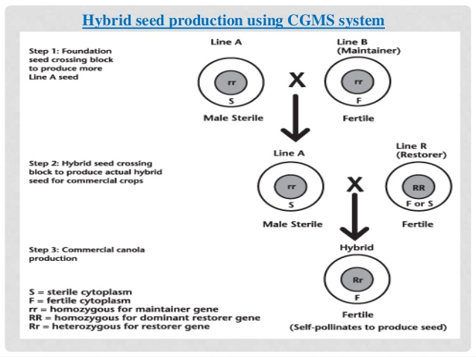

Slide 21
TRANSPLANTING
Transplant `A’ line seedlings in blocks of 8 rows in between the paired rows of `R’ lines
Transplant with 1-2 seedlings/hill at a spacing of 15 x 15 cm
Always keep 20 cm wide space between A line rows and nearest R line row
Notes:
Maintainer lines are not involved Choice of parents are more. No negative effect on sterile cytoplasm

Slide 23
Flag leaf clipping:
The clipping of flag leaf helps in free movement and wide dispersal of pollen grains to give higher seed production.
Only half or two-third portion of flag leaf should be clipped at booting stage.

Slide 24
ROUGING

Slide 25
SUPPLEMENTARY POLLINATION
Technique of shaking the pollen parent so that the pollen is shed and effectively dispersed over the A line plants.
Rope pulling or by shaking the pollen parent with the help of two bamboo sticks.
The first supplementary pollination should be done at peak anthesis time i.e. 8.30AM to 10.30AM when 30-40 % of the spikelets are opened.
Process is repeated 3- 4 times during the day at an interval of 30 minutes
It is done for 7-10 days during the flowering period.
Notes:
Maintainer lines are not involved Choice of parents are more. No negative effect on sterile cytoplasm

Slide 27
SEED STANDARDS

