Slide 1
M.S SWAMINATHAN SCHOOL OF AGRICULTURE
Course Name :Seed production of vegetable and cereal crops
Topic: Floral biology and hybrid seed production of maize
Dr. Aninda Chakraborty
(Asst. Prof- Dept. of GPB & SST)

Slide 2
INTRODUCTION
Maize or corn (Zea mays) is a plant belonging to the family of grasses (Poaceae). It has high yield potential among the cereals that is why called queen of cereals.
It is cultivated globally being one of the most important cereal crops after wheat and rice worldwide grown over an area of 132 Mha with a production of 570m.t.
Maize is not only an important food crop for human consumption, but also a basic element of animal feed and raw material for manufacturing of many industrial products.
The products include corn starch, maltodextrins, corn oil, corn syrup and products of fermentation and distallaries. It is also being recently used in the production of biofuel.

Slide 3
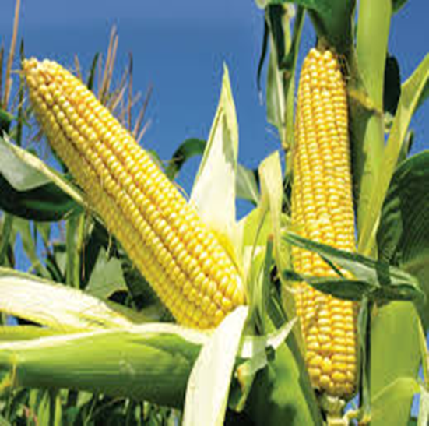
General description
Scientific name: Zea mays
Family: Poaceae
Chromosome no.:2n=2x=20
Centre of origin: South america and central mexico
WILD PROGENATORS
It has two close relatives,
Gama grass tripsacum;(2n=36;72) and teosinte ( 2n=20 ).
Teosinte is the closest relative of maize and crosses readily with it

Slide 4
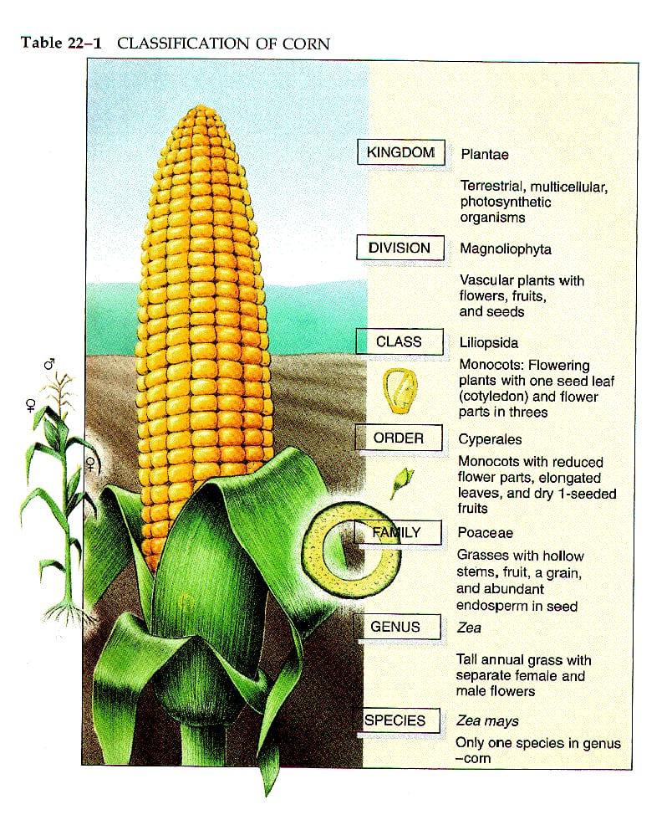
Scientific classification
Kingdom:-plantae
Division:-magnoliophyta
Class:-liliopsida
Order:-cyperales
Family:-poacece
Genus :-zea
Species:-zea mays
Chromosome no:-20

Slide 5
Cultivated Species
Maize belongs to the tribe Maydeae of the grass family Poaceae. “Zea” (zela) was derived from an old Greek name for a food grass.
There are five species of the genus Zea viz. Zea maxicana, Z. perennis, Z, luxurian, Z diploperenis and Z mays.
The first four species are wild and commonly called Teosinte. The last species i.e. Z mays is the only cultivated species) The teosinte species are easily crossed with maize.
. The wild species, diploperennis is tetraploid (4n = 40); rest are diploids. The other genus which is close to maize is Tripsacum. However, special techniques are required to cross maize and Tripsacum. There are 16 species of Tripsacum in which the somatic chromosome number varies from 36 to 108

Slide 6
Floral biology
Maize is a monoecious plant, i.e. the sexes are partitioned into separate pistillate (ear), the female flower and staminate (tassel), the male flower.
The main shoot terminates in a staminate tassel. Maize is generally protandrous, i.e. the male flower matures earlier than the female flower.

Slide 7
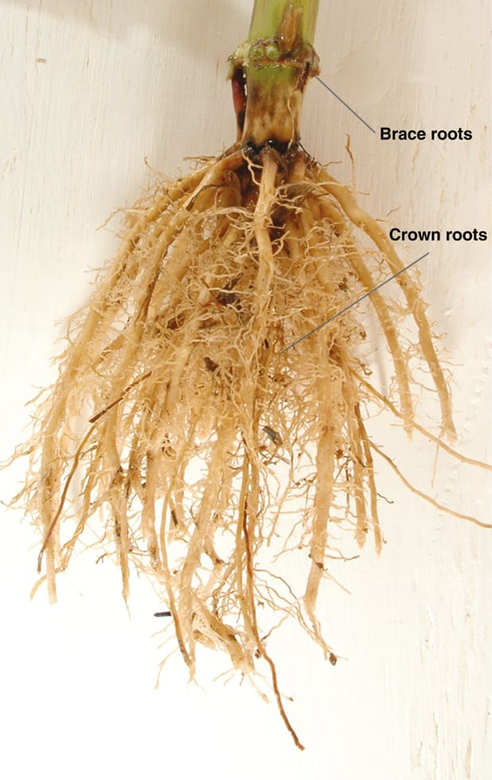
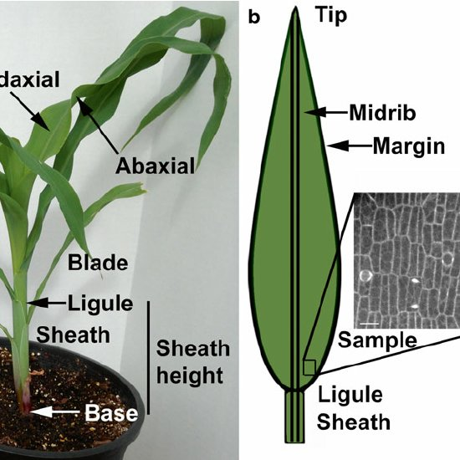
ROOT SYSTEM
Seminal or temporary root
Crown or coronal roots
Brace, Prop or Aerial roots
STEM AND LEAVES
Stems are stout, solid with distinct nodes and internodes.
Leaves are simple with entire margin, quite large, linear in shape and arranged alternately. They have sheathing leaf-base surrounding a part of internode above.
Membranous ligule is present at the junction of base and blade. Venation is parallel. All the organs have rough surface due to impregnation of silica.
Inflorescences are of two types, viz. terminal staminate compound raceme or panicle and axillary pistillate spadix

Slide 8
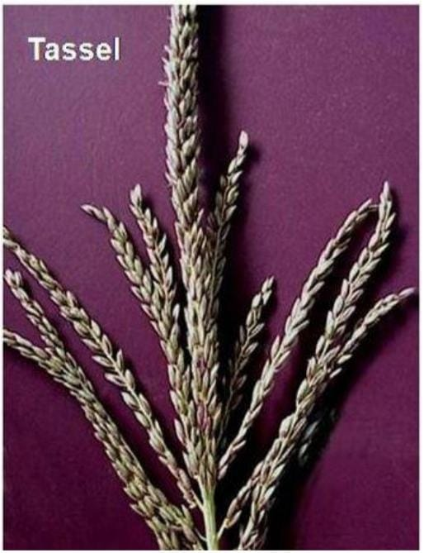
Male inflorescence-Tassel
Male inflorescence consists of many spikelets. The spikelets occur in pairs—the lower one is sessile and the upper one is stalked.
Each spikelet is two-floret. Each floret contains a pair of thin scales i.e. lemma and palea, three anthers, two lodicules and rudimentary pistil
Flowers are obviously unisexual. Perianth is represented by a pair of fleshy scale-like bodies called lodicules.
Androecium is composed of three free stamens with long prominent linear anthers.
Anthers starts from top to bottom in main axis and lateral branches.
Spikelets consists of two florets sessile and pedicellate, pollen shedding, 2-3 days often complete emergence of tassel.
Pedicellate flowers shed pollen first followed by sessile flowers (double wave of falling pollen in maize).

Slide 9
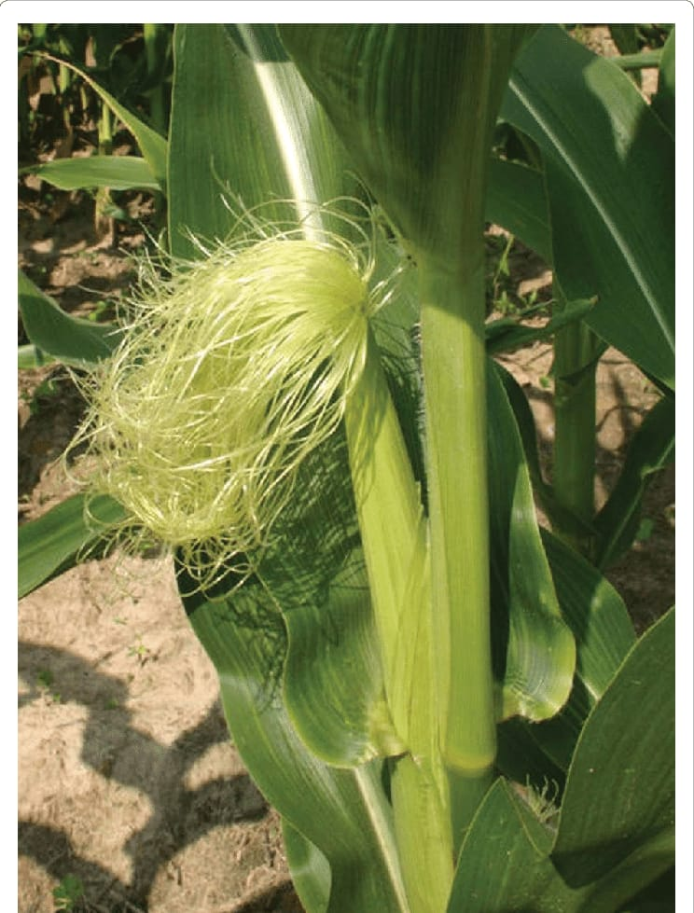
Female inflorescence-cob
Female flower consists of florets in pairs in longitudinal rows.
One is sterile and other is fertile.
Each female flower is represented by thread like structure called style (800-1000) depending on cob size with bifid stigma.
All the styles together constitute silk of the cob.
Emergence of silk will be around 8-10 days later than complete emergence of tassel. Stigma remain receptive for 1-2 days

Slide 11
Anthesis and Pollination
Maize is an example for protandry.
Pollen shedding begins 1-3days before the silks emerge from the cob.
It is estimated that a normal tassel produces 2,50,00,000 pollen grains.
Pollen is viable for 12-18 hours.
Silk remains receptive for 8-10 days.
Anthesis continues up to 2 weeks

Slide 12
KERNEL OR CARYOPSIS
Maize kernel is a one-seeded fruit or caryopsis.
The seed enclosed within the pericarp,consists of the embryo,endosperm,and remnants of the seed coats and nucellus.
The pericarp is the mature ovary wall.
The endosperm, beneath the pericarp consists of cells filled with starch granules. It is surrounded by a layer of aleurone cells. The embryo consists of the plumule,radicle and scutellum.

Slide 13
HYBRID SEED PRODUCTION IN MAIZE
Crossing technique: Manual emasculation by detasseling
Detasseling: Removal of male inflorescence from the monoecious crop.
Time for detasseling :The time taken for shedding of pollen from the tassel in 1-2 days after emergence. Hence the tassel should be removed before the shedding of pollen.

Slide 14
Detasseling [manual creation of male sterility]
Detasseling is the removal of tassel from female parent. Detasseling is done when the tassel emerged out of the boot leaf, but before anthesis have shed pollen. Detasseling is done every day from the emergence of tassel upto 14 days.
Method
Hold the stem below the boot leaf in left hand and the base of the basal in right hand and pull it out in a single pull. • Grasp entire tassel so that all the pollen parts are fully removed. • Do not break or remove leaves as removal will reduce yields and will result in lower quality of seed.

Slide 15
Detasseling

Slide 16
Precautions to be adopted during detasseling
No part should be left on the plant as it causes contamination.
It should be uniform process done daily in the morning in a particular direction.
Donot break the top leaves as the field may be reduced due to the earning of source material to accumulate in sink [seed ] as removal of 1 leaf course 1.5% loss 2 leaves 5.9% loss and 3 leaves 14% loss in yield.
Detassel only after the entire tassel has come out and immature detasseling may lead to reduced yield and contamination.
Mark the male rows with marker to avoid mistake in detasseling
Look out for shedders [shedding tassel] in female rows as the may cause contamination.
After pulling out the tassel drop it there itself and bury in soil. Otherwise late emerging pollen from detasseled tassel may cause contamination.
Do not carry the tassel through the field as any fall of pollen may lead to contamination.
Donot practice, improper, immature and incomplete detasseling

Slide 17
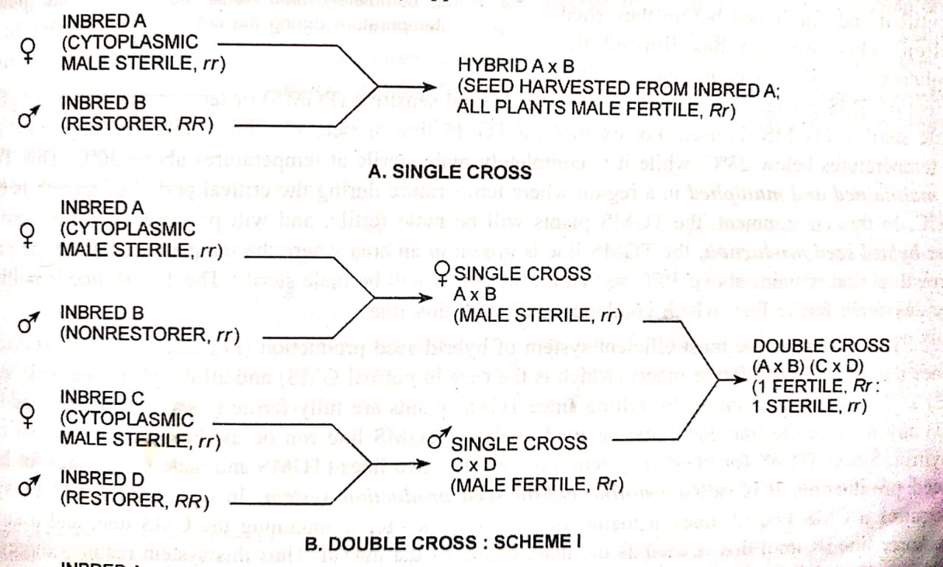
Cytoplasmic genetic male sterility
Production of single cross hybrid seed and Production of double cross hybrid seed

Slide 18
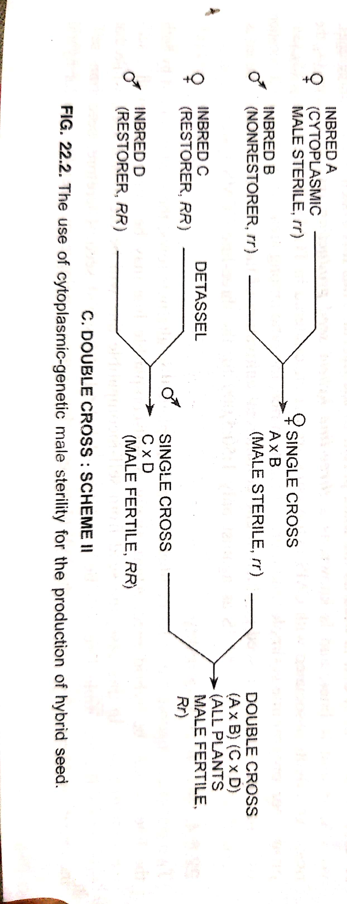
.

Slide 19
Conventional Hybrids:
Single cross hybrid -It is a cross between 2 inbreds(A x B).
A genotype will be detasseled and crossed with B genotypes.
Example-COH 1- UMI 29 x UMI 51
COH 2- UMI 810 x UMI 90
CoH(M) 5-UMI 285 X UMI 61
Double cross
It is a cross between two single crosses. It is a cross between 2 hybrids (A x B) x (C x D) (A x B)
Example Ganga 2 : (CM 109 x CM 110) x (CM 202 x CM 111)
Ganga 101 : (CM 103 x CM 104) x (CM 201 x CM 206)
COH3 : ( UMI 101 x UMI 130 ) x (UMI 90 x UMI 285
Three way cross: (AXB) X C [single cross and inbred line]
e.g. Ganga -5 (CM 202 x CM 111) x CM 500

Slide 20
Non-conventional Hybrids
I) Inter-varietal hybrids:formed by inter-crossing of two varieties approximately equivalent to synthetics/composites.
Ii) Top cross hybrids: are inbred x variety hybrids.
It may also, a. Inbred line x variety
b. Inbred line x synthetic variety
c. Inbred line x family
Iii) Inter-family hybrids: the progeny resulting from the crosses of two families originating from the same population or two different populations.
Iv) Double top cross hybrids: progeny of a single cross and a variety.
Example:-(AXB) X Composite e.g. Ganga safed, Histarch, Ganga 4
Single, double and three-way cross hybrids have mostly been commercialized world over.

Slide 21
Production of Synthetic and composite cultivars
The possibility of commercial utilisation of synthetic varieties in maize was first suggested by Hayes and garber in 1922.
Operations in production of synthetic varieties
Evaluation of lines for GCA
Production of synthetic variety
Multiplication of synthetic varieties.
Operations in production of composite varieties
Selection of base material
Intermating selected genotypes
Evaluation of crosses
Mixing parental seed of superior class

Slide 22
 | Synthetic cultivars | Composite cultivars
Base material | Inbreds or clones | Open pollinated varieties
Evaluation for | GCA | SCA
Seed replacement | After 4 to 5 years | After 3 to 4 years
Exact reconstitution | Possible | Not possible
Component genotypes | Two to eight | Two to many

Slide 23
Important considerations of hybrid seed production.
Planting ratio:
Maize hybrids vary considerably in respect of plant height, Panicle size, the amount of pollen produced and duration of pollen availability.
Single cross hybrid : 4:2
Double cross : 6:2
Three way cross: 6:2
Non-synchronization of flowering:
Good seed set in seed parent can be achieved by chronological adjustment of pollen shedding and silking respectively.
Prolongation of effective flowering period, planting design, efficient alteration of rows planting ratio, staggered planting are some of measures which are effectively used to ensure maximum synchronization and good seed set.

Slide 24
Genetic drift: It is recognised as a important factor affecting quality of seed.
The danger of genetic change in respect of cross pollinated crops like maize is prominent.
Detasselling: Removal of male inflorescence from the monoecious crop. The time taken for shedding of pollen from the tassel in 1-2 days after emergence. Hence the tassel should be removed before the shedding of pollen.

Slide 25
Technology for hybrid seed production
Well drained seed production site
Disease, weed, pest free
Preferably the field where preceding crop was not maize to maintain the genetic purity
Time of sowing
For most part of India First week of July (kharif) to avoid flowering during heavy rains (washing off the pollens)
First week of November for Rabi to avoid low temperature during flowering (killing anthers)

Slide 26
Seed rate
Depends on
Seed size/test weight of male and female seed.
Plant type: In case of erect plant-higher seed rate.
Male: female ratio- Optimum rate is 15 kg/ha for female and 10 kg/ha for male.
Minimum germination per cent recommended-80 %.
Seed treatment:
Necessary to protect the seeds from soil borne diseases and some insect pests.
Bavistin +Captan in 1:1 ratio @ 2g/kg seed for TLB,BLSB (Banded leaf and sheath blight, Maydis leaf blight etc.
Apran 35SD @4g/kg for brown strip downey mildew
Captan 205g/kg for Pythium stalk rot
Imidachlorpit@4g/kg or Fipronil @4ml/kg seed for termite and shoot fly.

Slide 27
Nutrient management
Inbreds requires high fertility as compared to hybrids FYM@15t/ha 15 days prior to seeding.
Fertilizer: 180-200 kg-N 80 kg P2O5 80 kg K2O 25 kg/ha ZnSo4 Full dose of phosphorus, potash, Zinc and 10 % N applied as a basal dose.
Remaining fertilizers given in the split doses: 1. 20 % N ,at 4 leaf stage 2. 30 % N at 8 leaf stage ,3. 30 % N at flowering stage, 4. 10 % N at grain filling stage.

Slide 28
Major weeds: Cynodon Dactyloctenium Echinocloa Cyperus Amaranthus Chenopodium Parthenium Trianthema
Control measures:
Atrazin and simazine: Broad spectrum pre-emergent herbicide. @1-1.5kg a.i/ha
Manual weeding
Major pest: Stem borer
Control measures:
1-2 spray of Carboryl or Endosulphan after 10 days and 20 days of germination First spray: 500 gm Carbotyl or 625 ml of Endosulfan (35 EC) Second spray: 750 gm Carboryl or 900 ml Endosulfan (35 EC

Slide 29
Estimated loss due to major diseases of maize in India : 13.2 % out of which foliar Diseases (5 %), stalk rots, root rots, ear rots (5 %).
Major diseases:
Turcicum leaf blight : Zineb/Maneb @ 2.5-4 gm/l at 8-10 days interval.
Maydis leaf blight: Dithane M-45/Zineb @2gm/l of water (2-4 application)
Polysora rust: 3 sprays of Dithane M-45 @2-2.5 gm/l
Banded leaf and sheath blight: Seed treatment of peat based formulation of Pseudomonas fliorescence @16g/kg.
Earthing up
During earthing up 3rd split of N should be applied followed by hoing. ➢ It should be done before tasseling stage to save crop from lodging.

Slide 30
Rouging: Removing unwanted and off plants.
Should be conducted before genetic or physical contamination.
Rogue volunteer plants.
Roguing on male plants must be complete before pollen shedding begins.
Roguing on female plants should be complete soon after silk-emergence.
Mechanical admixtures: These can be avoided taking due precaution at harvesting, seed setting, bagging and storing operations etc.
Stages of crop inspection:-At the time of sowing 2. During pre flowering/ vegetative stage. 3. During flowering 4. During post flowering and pre-harvest stage 5. Harvesting time.

Slide 31
Field standard for synthetic,composite and open pollinated variety

Slide 32
Seed standard

Slide 33
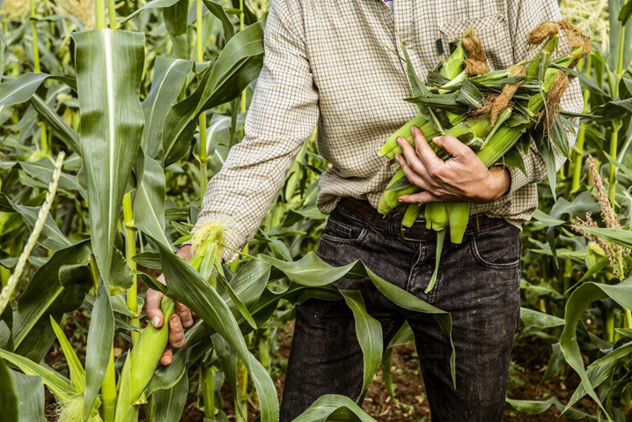
Physiological maturity of the crop: The crop should be harvested at proper stage of maturity to minimize qualitative &quantitative losses. The symptoms of physiological maturity are the degeneration, formation of dunken layer, moisture content of seed 35% and cob sheath turn straw yellow colour.
Harvesting
Male lines harvested first then female.
Optimum moisture for grain harvesting should be 20 %.
Harvested crops should be spread evenly instead of pooling.
Threshing
a. Dehusking - The husks are removed manually.
b. Cob sorting - Remove ill filled, diseased cobs and cobs having kernel colour variation.
Zenia :-The direct/visible effects of pollen on endosperm and related tissues in the formation of a seed colour. e.g. seed colour. In maize, the gene present in sperm cell contributes in the expression of colour of hybrid seeds.
Matazenia:- is the effect of pollen on the maternal tissues of fruit.

Slide 34
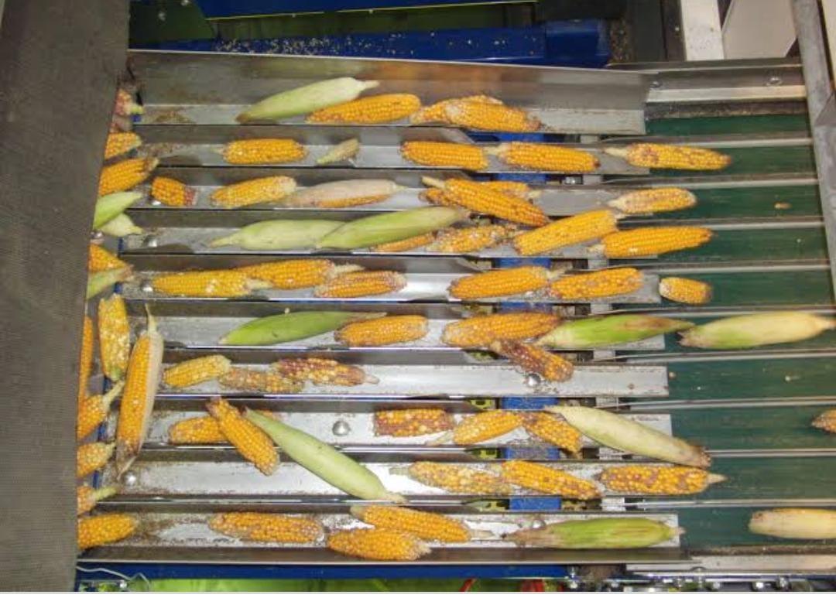
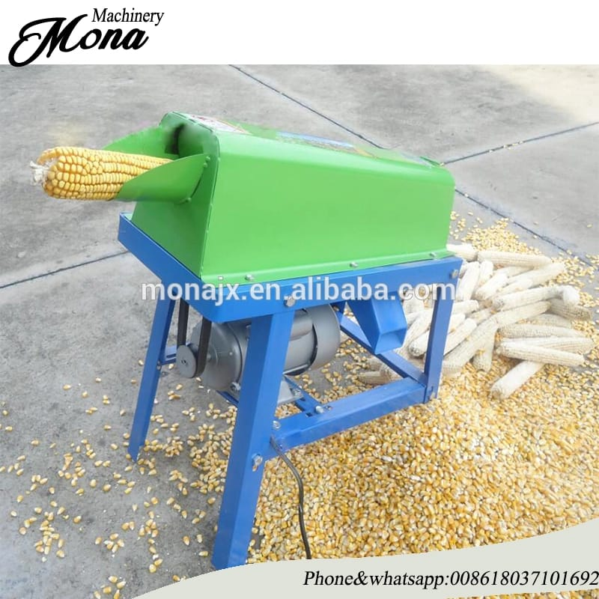

Slide 35
Post harvest management
Drying and sorting of seed parent cobs: Sun drying is the best.
Spread on Tarpoline sheets to avoid seed injury.
13-14 % moisture should be retained.
Shelling: Shelling should be avoided during high moisture to avoid embryonic damage.
It can be done manually or power operated maize sheller.

Slide 36
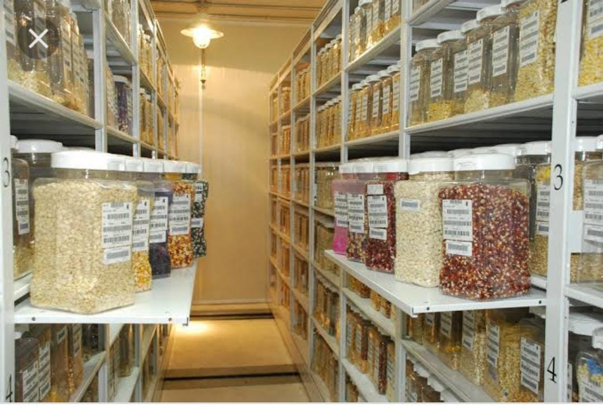
Seed processing
➢ Should be undertaken when seeds dry completely.
➢ To maintain quality remove all under sized, broken, damaged and malformed seeds.
➢ Should be done in seed processing plant.
Seed storage and marketing
➢ Seed drying should be done to bring moisture up to 8 % and should be kept in aerated jute bag.
➢ Store in dry and cool place to avoid germination and vigor loss during storage.

Slide 37
Important varieties
Double cross hybrids-Ganga 1,ganga 101,deccan,and ranjeet.
Top cross varieties-Ganga 2 and hi-starch
Composite varieties-Vikram,vijay,amber,kisan,jawahar,sona
Varieties of qpm(opaque 2 gene)-Shaktiman 1,shaktiman 2,HQPM 1

Slide 38
References:
https://www.oecd.org
https://en.m.Wikipedia.org
https://www.Investopedia.com
https://www.slideshare.net

Slide 39
Acknowledgement:
I owe a deep sense of gratitude to Dr. Pusarla Susmitha Assistant professor in Department of Genetics and Plant breeding for her keen interest on us ,her prompt inspirations, guidance and for timely suggestions.

