Slide 1
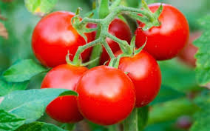
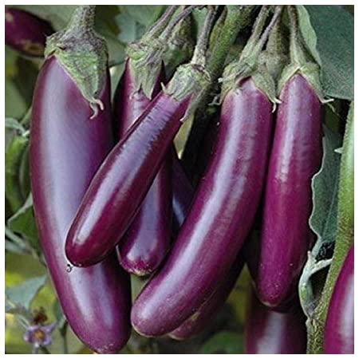
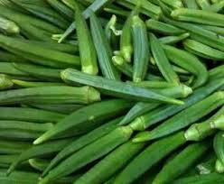
SEED PRODUCTION TECHNIQUES IN O.P. AND HYBRID TOMATO, BRINJAL AND OKRA
Seed Production of Vegetable and Cereal Crops
Dr. Aninda Chakraborty
Assistant Professor
Department of Seed Science and Technology
MSSSoA, CUTM, Paralakhemundi, Odisha, India

Slide 2
TOMATO (Lycopersicum esculentus)
Tomato is one of the most important vegetable crops grown extensively in the tropical and subtropical belts of the world
Tomato is a typical day neutral plant
It requires temperature of 15-20° C for fruit setting
Tomato is self pollinated crop
Self fertilization is favoured by the position of receptive stigma within the cone anthers and the normal pendant position of the flower
Method of seed production : Seed to Seed

Slide 5
Tomato is characterized by two types of plants : (i) Determinate type- Inflorescence occurs more frequently in almost even internode until terminate ones are formed and elongation ceases at this point . (ii) Indeterminate type- Inflorescence cluster occurs at every third internode and the main axis continues growing indefinitely provided the growing conditions remain favourable.

Slide 6
Land requirement
Selection of suitable land for tomato seed production is important where the previous crop should not be the same variety to avoid the contamination due to the volunteer plants.
Isolation requirement:
Varieties require minimum of 50 meter (foundation seed) and 25 meter (certified seed)
For hybrid seed production, it requires minimum of 200 meter (foundation) and 100 meter (certified hybrid seeds)
Seed rate: For i) Varieties - 300- 400 g/ha
ii) For F1 hybrid - Male parent 25 g/ha; Female parent 100 g/ha
Nursery: Sow the seeds in raised nursery bed of 20 cm height, in rows of 5 cm gap and covered with sand
Eight and ten nursery beds will be sufficient to transplant one acre. Apply 2 kg of DAP 10 days before pulling out of seedling
Transplanting:
Transplanting should be done with the seedlings are 20-25 days old, preferably at evening time
Spacing is 60 x 45 cm (90 x 60 cm for female parent and 60 x 45 cm for male parent of hybrids)
Manuring: After thorough preparation of a field to fine tilth Apply 25 tons of FYM per ha. Apply 100 : 100: 100 Kg of NPK/ha of which, 50% of the N is applied.

Slide 7
Climate and Soil: Ideal growing conditions are needed to produce high quality seed.
Day temp 21-25 °c , night temp 15-20 °c, Humidity is an important factor. Humidity levels higher than 60% at the time of fruit maturity will increase disease problems.
Rouging: The roguing should be done based on the plant characters (determinate / indeterminate), leaf, branching and spreading characters and also based on fruit size, shape and color.
Planting ratio: For hybrid seed production, the female and male parents are normally planted in the ratio of 12:1 or 12:2.
Pest and disease management: The early blight rot can be controlled by spraying Benlate or Dithane M-45.
The major pests attacking tomato crop are leaf eating caterpillars and fruit borers, which can be controlled by spraying.
Harvesting seed extraction and processing:
The fruits are harvested after full maturity of the fruit when turn in to red color fruits from first and last one or two harvests should not be used for seed extraction.
Stages of maturation: Mature green, Breaker, Turning, Pink, Red, Dark red / over ripe

Slide 8
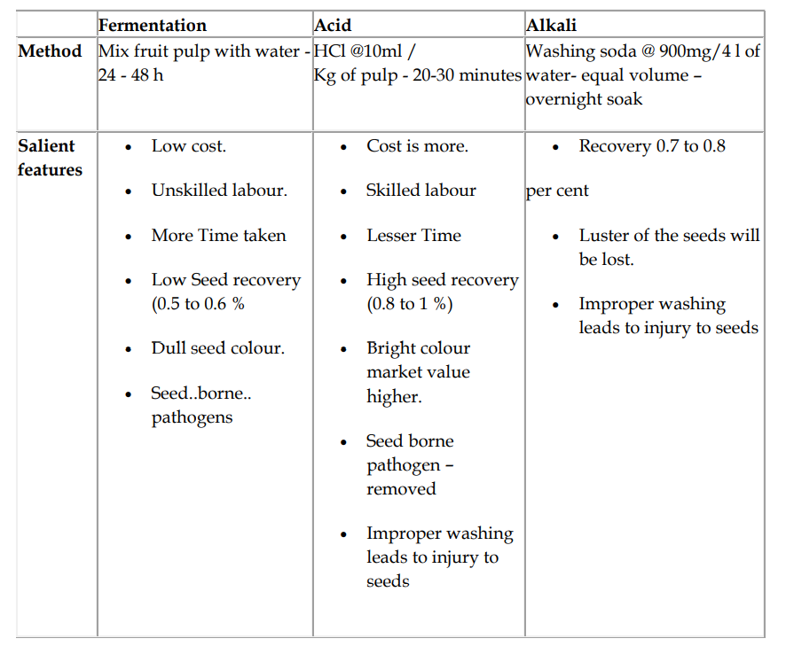
The fruits from in between 6-7 harvest should be used for seed extraction
Comparison of different seed extraction methods

Slide 11
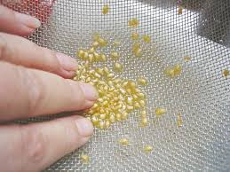
Drying and grading:
Seeds are to be dried in the shade
It should never be dried in hot sun
The safe moisture content of the seed for grading is 8 to 9 per cent
Seeds can be graded using 6/64‟‟ round perforated sieve
Storage:
The seeds dried to safe moisture content after treating either with captan or thiram @ 2 g/kg can be stored for 15 months in moisture vapour pervious containers, while it can be stored in moisture vapour proof containers for 30 months
Hybrid seed production:
In tomato the hybrid seed production is normally done by 'Emasculation and Hand Pollination’
Chemical hybridizing agents (MH-1000 ppm) or CMS lines are also practiced

Slide 12
Emasculation:
Split open the anther cone.
Remove the anther cone out of the bud
To help identify the hybrid fruits from selfed fruits, cut few of the sepals.
Pollen Collection :
Extract pollen
Put flowers in envelops
Dry anthers
Put in plastic cup with fine mesh screen (200- 300mesh) , Shake the cup
Transfer Pollen in convenient-to-
Pollination: When Corolla of the emasculated flower turns bright yellow
• Expose the stigma
• Dip the stigma into the pool of pollen
• Pollination is usually done 3 times weekly

Slide 13
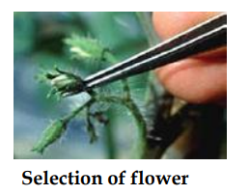
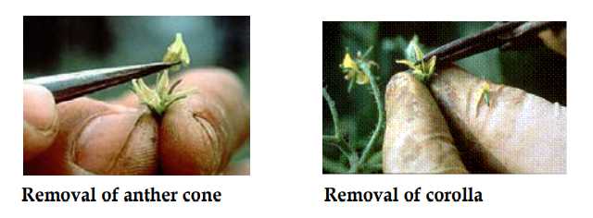
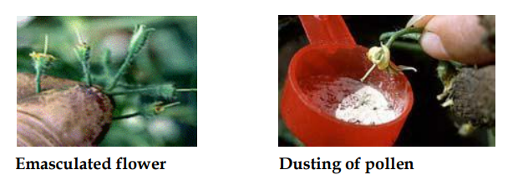
Emasculation and dusting:

Slide 15
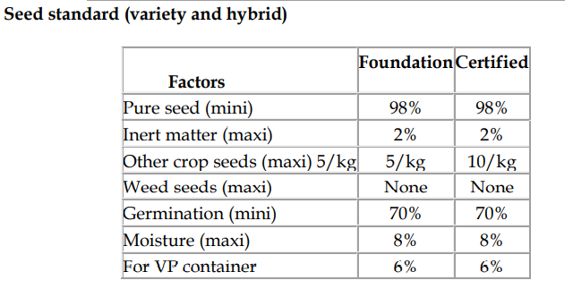
Seed Yield : 100 -120 Kg/ha
Number of Inspections:
First inspection shall be made before flowering
Second inspection shall be made during flowering
Third inspection shall be made at maturity and prior to harvesting

Slide 16
BRINJAL (Solanum melongena)
Botany
Brinjal is often cross pollinated crop
Brinjal flower opens mainly in morning
A few flower open at 16 hr.
Anther dehiscence occurs 15-20 minutes after flowers have opened
The period of receptivity ranges from a day prior to flower opening to 4 days after opening
Brinjal produces 4 types of flowers with different style length. (Long style, short style, medium style and pseudo short style)
For seed production and better yield, the long and medium style is desirable
To increase the production of long and medium style application of more nitrogen or spraying of growth regulators during pre-flowering and flowering stages may be followed

Slide 17
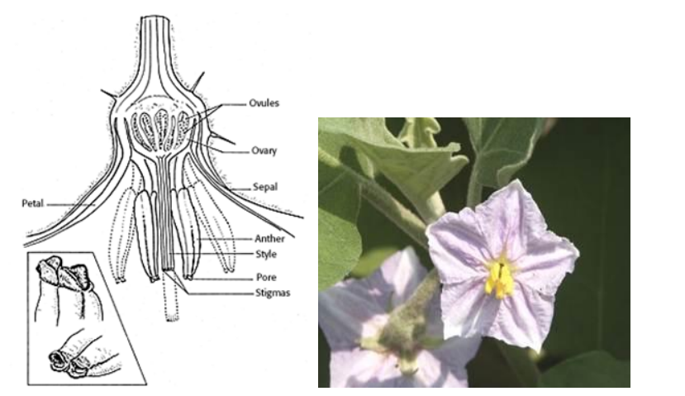

Slide 18
Method of seed production : Seed to Seed
Stages of seed production: Breeder seed à Foundation Seed à Foundation Seed II à Certified Seed
Varieties: Co.1, Co.2. MDU.1, PKM.1, KKM.1, PLR. 1. AU1, Pusa purple long, Arka nidhi, Pant smart
Hybrids: CoBH1,Arka Navneet (IIHR 22-1 x supreme), Pusa H-5, Pusa H-6, MHB 10, MHB 39 (Mahyco), Azad Hybrid
Season: The brinjal seed production can be taken up in the following 2 seasons. May-June and December- January
Land requirement : The land should be free of volunteer plants
Isolation: For varieties, 200 M or 100 M of isolation distance is required for foundation and certified seed, respectively. For hybrid seed production minimum of 200 M isolation distance should be maintained
Seed rate: Varieties - 400 - 500 g/ha Hybrids - 200 g/ha (Female) - 50 g/ha (Male)

Slide 19
Nursery: Sow the seeds in raised nursery bed of 20 cm height, in rows of 5 cm gap and covered with sand. Eight and ten nursery beds will be sufficient to transplant one acre. Apply 2 kg of OAP 10days before pulling out of seedling.
Transplanting: Seedlings are transplanted when they are 30-35 days old (12-15 cm height) preferably in the evening time. Spacing of 75 x 60 cm (non spreading) and 90 x 60 cm (spreading) varieties, 90 x 60 cm for female parent and 60 x 45 cm for male parent of hybrids.
Manuring: The field should be thoroughly ploughed for fine filth and apply 25 tons of FYM/ha. The other fertilizer requirement for brinjal variety and hybrid are same as followed for tomato seed production
Roguing: The roguing should be done based on the plant characters, leaf, branching and spreading characters and also based on fruit size, shape and color. The plants affected by Phomopsis blight, leaf spot and little leaf virus disease should be removed from the seed production field.

Slide 20
Pest and disease management: The pests like fruit borer, shoot borer, beetles, aphids, mealy bug and jassids can be controlled by spraying Nuvacron or Methyl parathion. The red spider mite can be controlled by spraying in Kelthane. The important diseases are damping off and little leaf which can be controlled by spraying fungicide and systemic insecticides, respectively. Powdery mildew, leaf spot and anthracnose diseases can be controlled by spraying Benlate
Hybrid seed production: The planting ratio of female and male parents adopted for hybrid seed production is normally 5:1 or 6:1
For production of hybrid seeds, crossing programme is done using emasculation and dusting methods as followed in tomato.

Slide 21
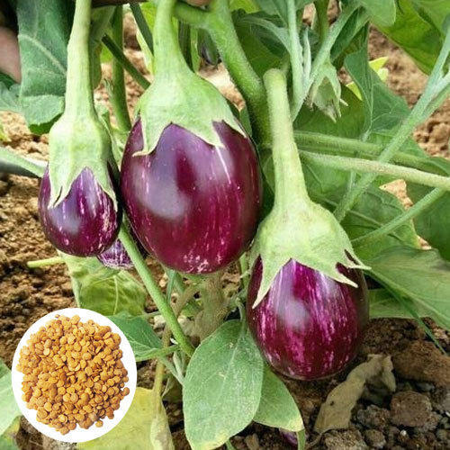
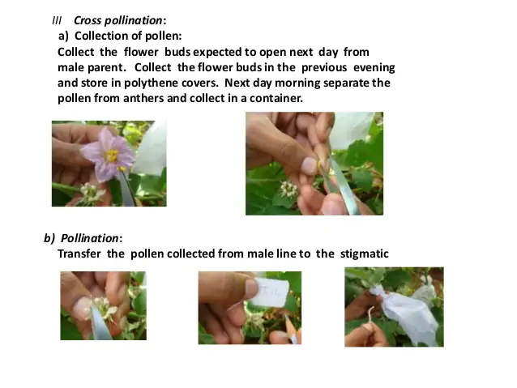
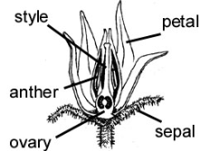
Hybrid seed production of brinjal
The planting ratio of female and male parents adopted for hybrid seed production is normally 5:1 or 6:1.
For production of hybrid seeds, crossing programme is done using emasculation and pollen dusting method.

Slide 22
Harvesting and processing: Harvesting is done when fruits are fully ripe (when the fruits turn into yellow colour) i.e., 405 days after flowering.
The harvested fruits are to be graded for true to type and off type and fruit borer infested fruits are discarded
The graded fruits are cut in 2-3 pieces or whole fruits will be put in a cement tank with water and crushed manually and then allow it for fermentation for 1-2 days.
Then the floating pulp portions are to be removed, the seeds settled at the bottom should be collected and washed with water and then the seeds with equal volume of water is treated with commercial Hydrochloric acid @ 3-5 ml/kg of seed
The mixture is kept for 10-15 minutes with frequent stirring. Then the treated seeds are to be washed with water for 3-4 times
Afterwards seeds are dried under shade for 2-3 days over a tarpaulin and followed by sun drying for 1-2 days to reduce the seed moisture content to 8 per cent
Then the seeds are cleaned and graded with BSS 12 sieve. The processed seeds are treated with fungicides or Halogen mixture @ 5g/kg of seed
Storage: The seeds dried to safe moisture content after treating either with captan or thiram @ 2 g/kg can be stored for 15 months in moisture vapour pervious containers, while it can be stored in moisture vapour proof containers for 30 months
Seed Yield : 100-200 Kg/ha

Slide 23
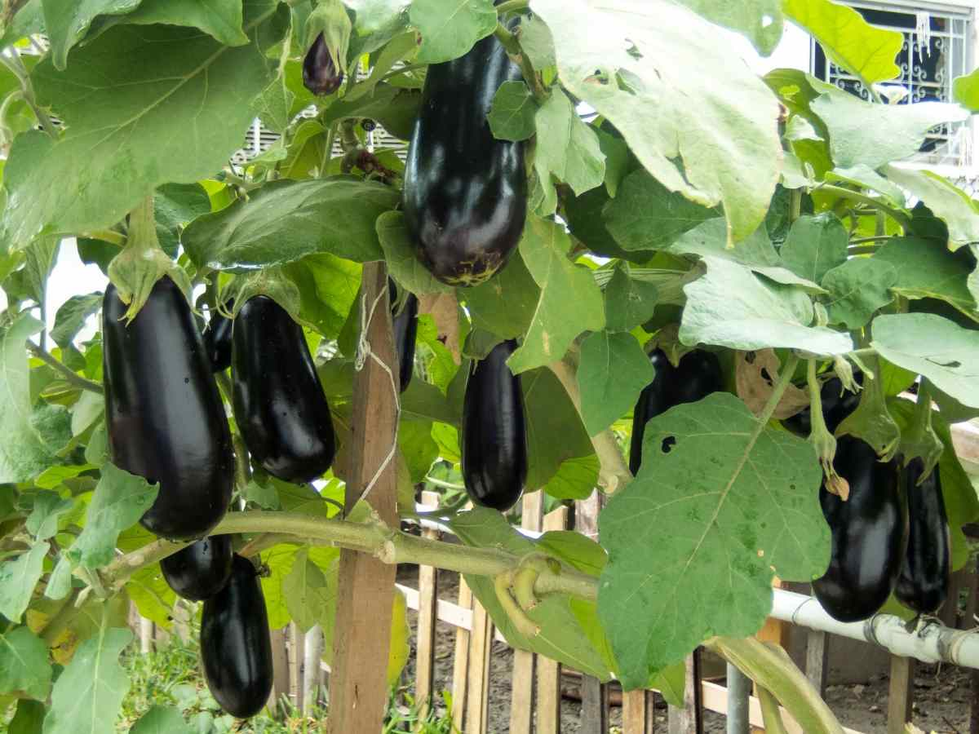
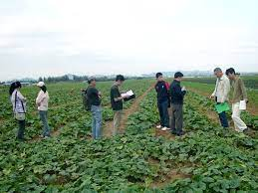
Field Inspection
A. Foundation seed :-
The first inspection shall be made before flowering in order to determine isolation, volunteer plants and other relevant factors
2. The second inspection shall be made during flowering and fruiting stage to check isolation, Off-types and other relevant factors
3. The third inspection shall be made at mature fruit stage and prior to harvesting in order to determine the true characteristics of the fruits.
B. Certified seed :-
The first inspection shall be made before flowering in order to determine isolation, volunteer plants, outcrosses, demarcation between seed parent and pollinator blocks and other relevant factors.
The second and third inspections shall be made during flowering stage to check isolation, Off-types, accuracy in emasculation .
The fourth inspection shall be made at mature fruit stage and prior to harvesting in order to determine the true characteristics of the fruits, and other relevant factors.

Slide 24
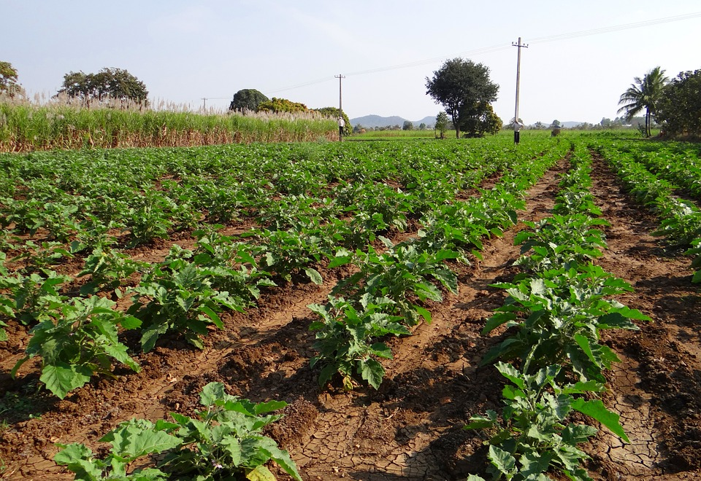
Field Standards
A. General requirements B. Specific requirements
Isolation
Contaminants | Minimum distance (meters)
 | Foundation | Certified
1. Fields of varieties | 200 | 100
2. Fields of the same hybrid | 200 | 200
3. Between blocks of the parental lines in case of seed parent and pollinator are planted in separate blocks. | - | 5
Contaminants | Minimum (Percentage )
 | Foundation | Certified
Off-types – variety | 0.10 | 0.25
2. Hybrid | 0.1 | 0.05
3. Designated diseased plant | 0.1 | 0.5

Slide 25
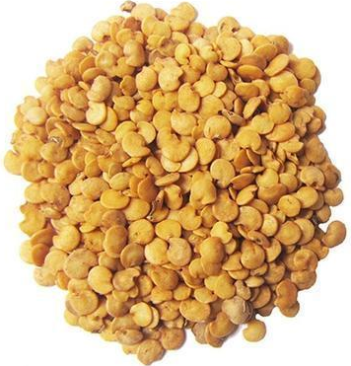
Seed standards
Factor | Standard for each class
 | Foundation | Certified
1. Pure seed (minimum) | 98% | 98%
2. Inert matter (maximum) | 2% | 2%
3. Other crops seeds (maximum ) | None | None
4. Weeds seed ( maximum) | None | None
5. Germination (minimum) | 70% | 70%
6. Moisture (maximum ) | 8% | 8%
7. For vapour-proof containers (maximum) | 6% | 6%

Slide 26
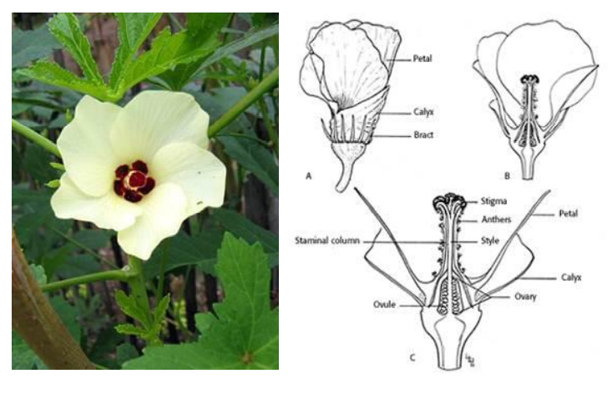
BHENDI (Abelmoschus esculentus)
Anthesis is between 9 and 10 hr. and is preceded by maximum anther dehiscence between 8 and 9 hr.
The stigma remains receptive on the day of anthesis
Bhendi is an often cross pollinated crop
Cross pollination to an extent of 12 per cent is due to protogynous

Slide 28
Method of seed production: Seed to seed
Stages of seed production:Breeder seed, Foundation seed and Certified seed
Varieties : Co.1, MDU.1, Parbhani Kranti, Arka Anamika, Pusa A-4, Pusa Sawani
Hybrids:CO2,CO 3, Mahyco hybrid, Shoba
Season : June-July, September- October and February- March
Land requirement
Isolation requirement: Seed field must be isolated from other varieties at least by 400 M for foundation and hybrid seed production and 200 M for certified seed production
Seed rate : Varieties : 8-10 kg/ha
Hybrids : 4 kg/ha (Female); 1 kg/ha (Male)
Manuring: Apply 12.5 tons of FYM/ha before ploughing. Apply 150:75:75 kg NPK/ha, of which 50% of the N should be applied as top dressing in two split doses at flowering and 10 days later
Planting ratio: For hybrid seed production, female and male parents are normally planted in the ratio of 4:1
Field inspection: Minimum of three inspections for varieties and 4 inspections for hybrids, one at vegetative, two at flowering and one at fruit maturity stages
Roguing: The rouging should be based on the plant characters, hairiness, fruit character like fruit colour, number of ridges, fruit length etc., and the off type and mosaic attacked plants should be removed from the seed field

Slide 29
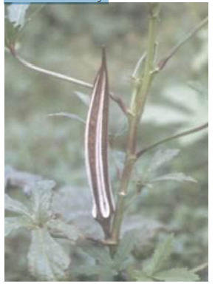
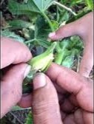
Pest and disease management: The major pest attacking bhendi are jassids, aphids and white fly, which can be controlled by spraying Rogar or Dimecron or Endosulphon
The diseases such as yellow vein mosaic and powdery mildew can be controlled by spraying systemic insecticides and Karathane, respectively
Harvesting: Fruits should be harvested when they have dried (30-35 days after crossing) The pods which expose hairline crack and turn to brown colour on drying alone are cut using sickle manually

Slide 30
Hybrid seed production: The emasculation and dusting can be done as per the methods outlined in tomato. The male and female parents are raised in blocks at the ratio of 9:1 (Female: Male)

Slide 37
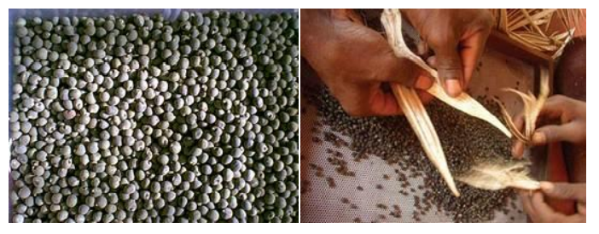
Threshing: The pods are dried and threshed using pliable sticks. Separated seeds are winnowed to remove plant debris and dried over a tarpaulin to 10% moisture content
Processing: See ds are to be processed with BSS 7 wiremesh sieve. Seed Yield: 1000- 1200 Kg/ha

Slide 39
