Slide 1
MESTA HAIRY CATERPILLAR Euproctis scintillans Lymantriidae: Lepidoptera
APPEARANCE
Moth is yellowish with a reddish line and spots on the edges.
Larva has yellowish brown head and yellow dorsal stripe with a mid dorsal red stripe.
There are tufts of black hairs dorsally on the first three abdominal segments.
LIFE HSTORY
Eggs are laid in masses on the undersurface of leaves.
The egg period is 5-9 days.
Eggs hatch into larvae and feed on foliage.

Slide 2
Larva pupates in a cocoon of hairs on the leaves or leaf folds.
Pupal period lasts for 10-12 days.
SYMPTOMS:
Heavy defoliation
MANAGEMENT
Timely sowing at the onset of monsoons, foliar sprays with endosulfan 2 ml/l or methyl demeton 2 ml/l were effective.

Slide 3
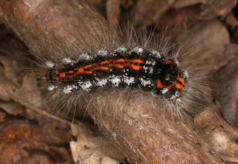

Slide 4
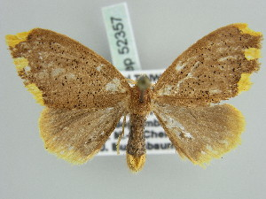

Slide 5
MESTA STEM WEEVIL Alcidodes affaber Curculionidae: Coleoptera
This insect is a common pest on malvaceous plants in India infesting bhendi,gogu, Bombax malabaricum, Althae rosea and Ficus bengalensis etc.
The adult feed on leaf buds, petiols and tender terminal portion. However, serious damage is caused only by the grubs boring into stem and petioles and causing gall like swellings.
Frass is found through holes made on stems. The infested plant gets stunted. Their flowers and fruiting get retarded considerably.
A single plant may harbor as many as 12 grubs. This pest is active from September-December.

Slide 6
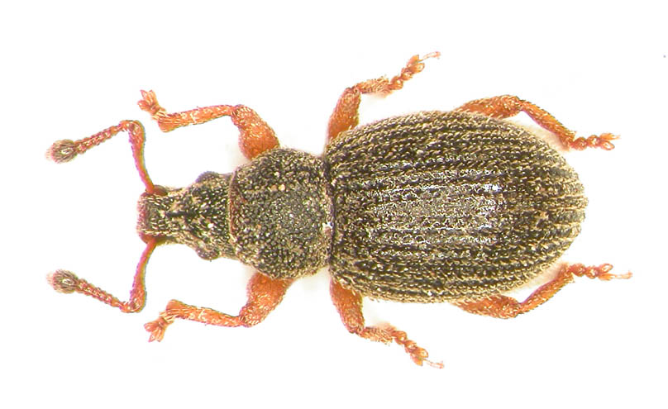
The grubs are parasitised by Aphrastofracon alcidophagus (Braconidae) and Zoridescopus spp (Ichneumonid).

Slide 7
MEALY BUG Meconellicoccus hirsutus Pseudococcidae: Hemiptera
Besides mesta, it also attacks jute, grapevine and guava.
Sac-like pink coloured females are covered by milky white waxy coating.
Eggs are laid in masses.
Upon hatching, crawlers move to succulent parts and suck sap resulting in symptoms like swelling on stem, shortened internodes, bunchy top formation as secondary branches arise.
If growing tips are infested vertical growth is suppressed. Fibre snaps at point of infestation during retting.

Slide 8
Release of Cryptolaemus montronzieri when peak infestation is noticed in sep-oct and foliar spraying with methyl demeton 2ml/l or dimethoate 1.5ml/l is effective.

Slide 9
LEAFHOPPERS
Amrasca biguttula biguttula
Cicadellidae: Hemiptera
APHID
Aphis gossypii
Aphididae: Hemiptera

