Slide 1
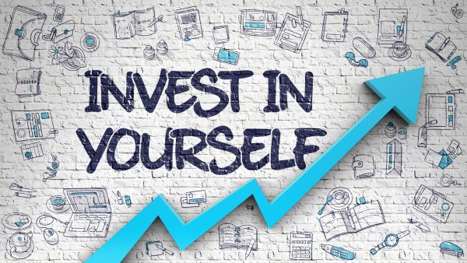
PERSONAL GROWTH

Slide 2
What do U understand by Personal Growth ?

Slide 3
Personal growth
It is a process of developing new skills, attitudes, actions, or reactions that can have a positive impact on your life and increase your overall well-being.
Also known as Self-growth or personal development.
Self-growth is an intrinsic process.

Slide 4
5 area
Mental growth
Social growth
Emotional growth
Physical growth
Spiritual growth

Slide 5
Do U think Personal Growth is IMPORTANT ?

Slide 6
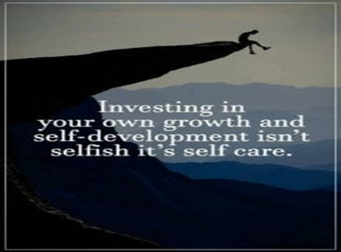

Slide 7
HOW TO START/ DO?
Self Acceptance
Set up Short term Goals
Continuous Learning
Uncover ur Passion

