Slide 1
Medication Errors
Dr S Ponnusankar
JSS College of Pharmacy
Ooty

Slide 2
What is Medication Error ?
“Any preventable event that may cause or lead to inappropriate medication use or patient harm while the medication is in the control of healthcare professionals, patients or consumer”

Slide 3
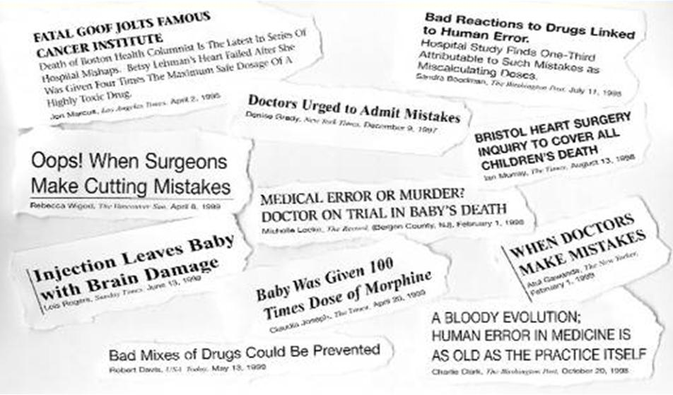
Medication Errors making headlines!

Slide 4
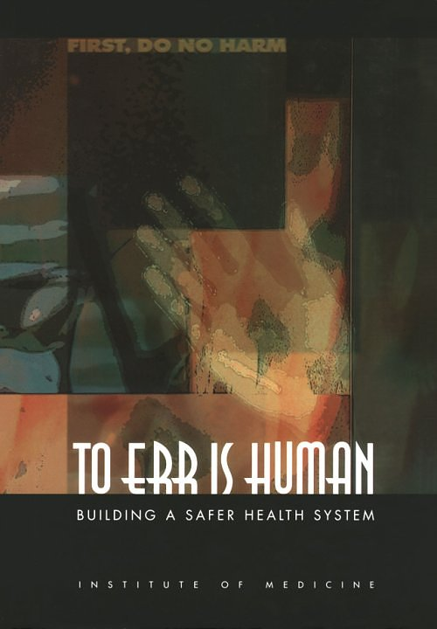
Unknown !
Cotrimoxazole tablets contaminated with Glibenclamide
Glycerol Laced with DEG – Despite the validated GMP and SOP

Slide 5
Prescribing Errors
Type | Example | Impact
Type A (Potentially serious to patient): | Handwriting confusion caused a dispensing of dionil (glibenclamide, antidiabetic) in place of divol (antacid) causing death of the patient. Similarly the poor handwriting will fail to distinguish between chlorpromazine and chlorpropamide. | Serious harm to the patient
Type B (Major nuisance) | The prescription has mentioned the drug but there is no mention of dosage form. | The pharmacist is required to consult back the prescriber before dispensing.
Type C ( Minor nuisance) | The prescription mentions a wrong pack size which is not available. | The dispenser does not require to contact back the prescriber but uses his/her professional judgment in dispensing.
Type D (Trivial) | Spelling Error | The prescription does not conform to the requirements of an ideal prescription, but the intention of the prescriber is well understandable.

Slide 6
Abbreviations
D/C – indicates “Discharge” and “Continue”
One order was written: “ D/C medicines: digoxin, propranolol, regular insulin”. His intention was to continue these medicines after discharge. But was misunderstood as “Discontinue these medicines”

Slide 7
Abbreviations
U may be mistaken as zero (correct meaning is unit);
QD may be mistaken as qid (four times a day) against the correct meaning of every other day;
TIW (three times a week) may be interpreted as tid (three times a day) or twice a week;
HS (half strength) may be interpreted as hour of sleep.
TSF can be interpreted as one teaspoonful (5 ml) or one tablespoonful (15 ml)
The following acronyms too cause confusion. They need to be avoided.
ASA (aspirin) and 5-ASA (5-aminosalicylic acid)
PCM (paracetamol), CPM (chlorphenaramine) and CPZ (chlorpromazine)
ASA (aspirin) an d5-ASA (5- amino salicylic acid)

Slide 8
Prescribing Errors: Causes
Illegible handwriting
Incomplete information in prescription that may cause:
  Misunderstanding of abbreviation
  Misunderstanding of weight/volume /units to be dispensed
  Misunderstanding of drug names
  Problem with decimal (
Inaccurate information in prescription: wrong dose, wrong duration, wrong route etc.
Verbal orders often mistaken by pharmacist/nurse

Slide 9
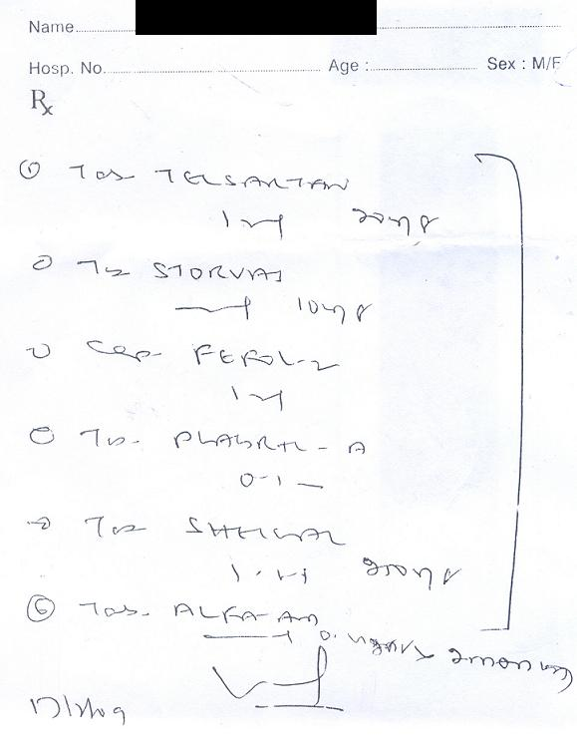

Slide 10
Administration Incidents
Wrong Routes: IV Fluids Given in Artery
Wrong Gas: Oxygen Cylinder Filled with Nitrous Oxide

Slide 11
Dispensing Errors: Causes
Poor handwriting of prescriber: A busy medical practitioner’s handwriting is not clearly readable. This may lead to dispensing a wrong drug, over dose, or not instructing the patient appropriately in proper use of drugs.
In USA once a pharmacist dispensed a tranquilizer against the prescription of oral contraceptive. The patient became pregnant and the pharmacist was asked to pay compensation. In a similar incident, a doctor had written a prescription for Amoxil tablets (amoxicillin). The pharmacist misread this and dispensed Daonil (glibenclamide) in stead. The patient was not a diabetic and suffered permanent brain damage as a result of taking wrong medicine. In another case, the pharmacist dispensed Daonil (glibenclamide) tablets when the patient presented a prescription for Divol (antacid). The pharmacist was not sure of drug name because of poor handwriting and as both the products’ name start with ‘D’ and end with ‘l’, the error occurred. Unfortunately the patient died of hypoglycemia.

Slide 12
Tegretol (carbamazepine, relieves convulsion associated with epilepsy) and Tequin (gatifloxacin, antibacterial for respiratory infection).
LONA (low sodium salt of Dabur Pharma) and LONA (clonazepam of calyx division of Triton Healthcare Private limited).
A-Z (multivitamin of Alkem lab) and AZ (azithromycin of Kopran Lab) and ABZ (albendazole of Kare Health Specialities).
Coumadin (warfarin, anticoagulant used in the treatment of heart or stroke related problem) and Avadia (treatment for type II diabetes)
Isodil (issorbide dinitrate, for treatment of chest pain) and Plendil (felodipine, medication for hypertension).
Cebrex (pain killer) and cerebyx (antiseizure drug).
Premaxin (hormone replacement treatment) and Premaxin (antibacterial).
Ipecac fluid extract (expectorant) and Ipecac syrup (emetic).
Ampicillin (usual frequency four times a day) and Amoxycillin (usual frequency three times a day).
Disprin (effervescent aspirin) and Disprin (a paracetamol product)
Novartis’s ‘Khatika Churna’ is sold as Calcium Sandoz. It does not contain calcium but continuing the use of calcium sandoz trade name.

Slide 13
Wrong Dosage or Dosing Error
A prescription was written for 1.0 mg colchicines, a medicine for gout, but was dispensed 10 mg resulting in death of the patient. This occurred from failure to notice the decimal point. Similarly, “0.1” is easily misread as “1”, a ten fold over dose. On the other hand, appending an unnecessary zero after a decimal point increases the risk of tenfold overdose (explained an example above).

Slide 14
Interchange of Products
[Similar Packaging]

Slide 15
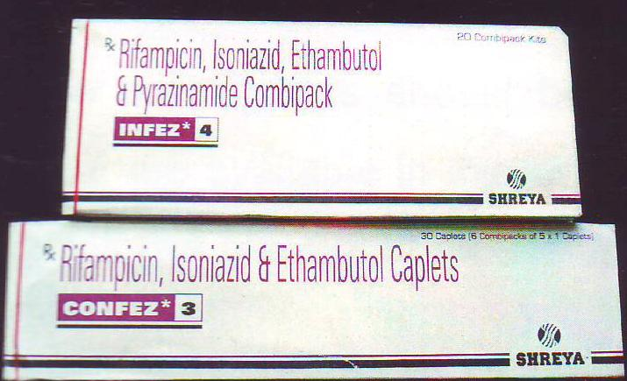
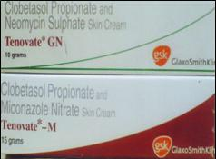
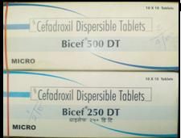
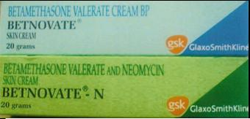
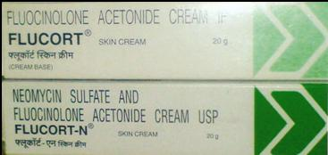
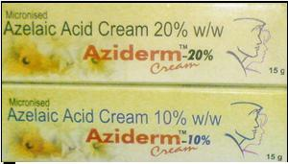
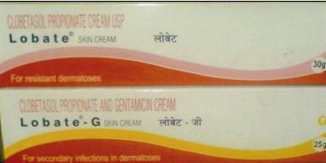
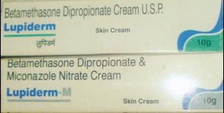

Slide 16
Medicine at Different Strength
Paracetamol Liquid Products: 125 mg/5 ml and 250 mg/5 ml.

Slide 17
Administration Incidents
Wrong Routes: IV Fluids Given in Artery
Wrong Gas: Oxygen Cylinder Filled with Nitrous Oxide

Slide 18
Inappropriate Instruction to Patients
Sublingual tablets are reported to be swallowed resulting without any activity.
The sustained release tablets are broken and divided for children.
The use of domestic measuring spoon for liquid medicines is another concern. As domestic spoons’ size vary widely, it is essential to supply a measuring spoon while dispensing liquid medicines for oral use.

Slide 19
OUR EXPERIENCE
Total number of prescription studied: 11740
No. of Error Total Error (%)
Dispensing Errors 663 25.97
(errors due to look alike 318
Ineligible handwriting 245
Ignorance and Carelessness 80
Extension products 20)
Prescription Errors 1896 74.03
(omission error 986
wrong dosage form 303
wrong dose 209
transcription error 133
Miscellaneous error 265)

Slide 20
Our experience……
Prescribed Dispensed
Leridace 10 mg (Serratopeptidase) Loviden 10 mg (Loratidine)
Azevoc kid Azithromycin adult dose
enteric coated tablet 30 mg enteric coated 60 mg, to break into half and take
Avil Lasix

Slide 21
PROBLEMS OF MEDICATION ERROR
No effects of drug
Harmful effects in patients.
Cost of extended hospitalization.
Litigation problem.

Slide 22
CHALLENGES
Non existence of Documenting and Reporting System
Feeling of embracement or ashamed of divulging medication error.
3. Fearful of legal action

Slide 23
REMEDIES
Acknowledging the cause of error is the first step in preventing future errors.
Error documenting and reporting system.
Effective DTC in health care institution.

Slide 24
CAUSES OF MEDICATION ERROR
Failed Communication – Handwriting , Drugs with similar names, Zeros and Decimal points, Abbreviations etc.
Poor Drug Distribution Practice – Keeping a dangerous product
next to another container that looks just like it may lead to lethal drug mix up.
Dose Miscalculation – Medications for paediatric patients
and with products use intravenously.
Drug and Drug Device related problems – Poor labeling and
packaging accounts for 20% of reports.
Incorrect Drug Administration – Misidentification of Patients, Wrong Route.
Lack of Patient Education –Counseling and Education of . patients at all stages of care.

Slide 25
Preventing Medication Errors
Establishing a consensus group of physicians, nurses and the pharmacists to select best practices.
Introducing punishment –free system to collect and record information about medication errors.
Developing written procedures with guidelines and check lists for the administration of intravenous fluids and high risk medicines: insulin heparin, narcotics etc.
Developing standardized times to administer medicines and a policy to do so only when the patients are on the wards.

Slide 26
Preventing Medication Errors
Requiring that the patients identity be confirmed before administering the medicine.
Allowing verbal and telephonic orders only in emergency.
Requiring legible handwriting and complete spelling of the medicine.
Requiring the use of standardized notation: use of abbreviation, decimal point,
Requiring that prescribers write generic and brand names with SALA medicines.

Slide 27
Minimizing prescribing errors
Ensure knowledge of drug before prescribing
Mention the drug name and patient details clearly on the prescription
Ensure that an accurate drug history is taken.
Include all details of the drug therapy i.e., dosage, directions, duration of treatment.

Slide 28
Minimizing dispensing errors
Implementation of a bar code system
Bar code system has reduced medication error rate by 86% over a nine year period at a Kansas Medical Centre.
Greater use of information technologies
Electronic prescriptions – Computerized Physician Order Entry (CPOE)
Improved labeling and packaging

Slide 29
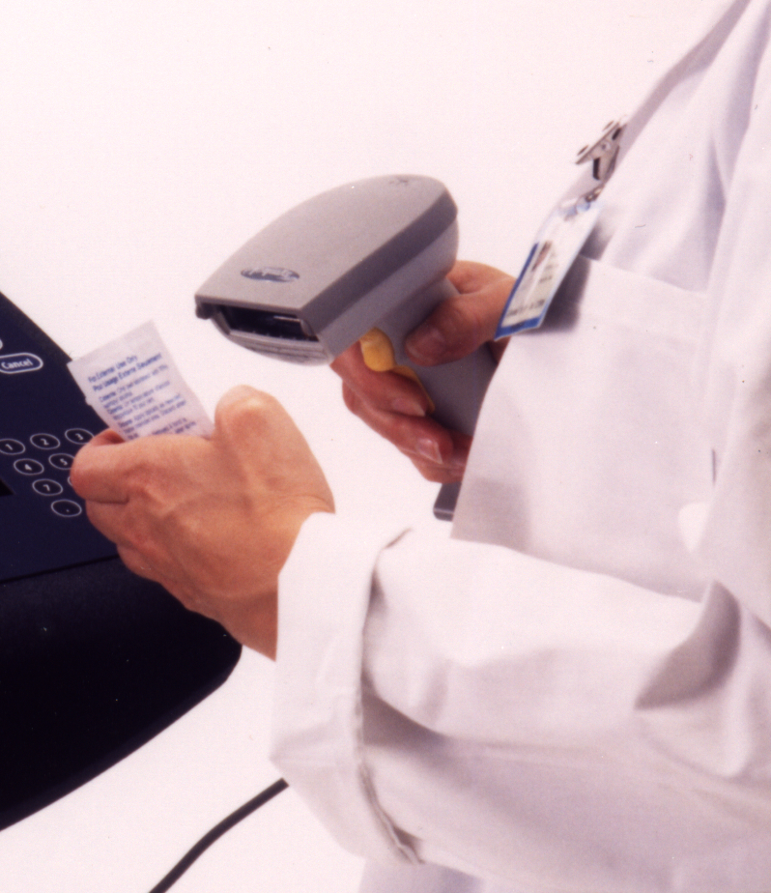
Give the Medication to the Computer before you give it to the Patient !!
Scanning takes time, but it is the best way to prevent a medication error!

Slide 30
Educating Consumers
Good Dispensing Practices with Counselling.
Ensuring that the Patient understands the instructions.
Additional Label: intermixing, correct time.
Advising to keep individual ‘s medicines separately.

Slide 31
Minimizing Administration errors
Check patient’s identity
Update knowledge about medications
Don’t guess! Seek for clarifications.
Minimize interruptions during drug rounds.
Ensure that medication is given at the correct time.
Check dosage calculations.
Have the prescription, drug and the patient at the same location for verification.

Slide 32
Confirm all of the “rights” prior to administering a medication (right patient, right drug, right dose, right dosage form, right route, right time and right education).
Document all medications immediately after administration.

Slide 33
Who tracks Medication Errors?
The Food and Drug Administration (FDA) – MedWatch
Institute for Safe Medication Practices (ISMP) – publishes “Safe Medicine” – Consumer newsletter
US Pharmacopoeia – MedMARX – anonymous medication error reporting program.

Slide 34
Who should report Medication Errors?
Pharmacists
Physician
Other healthcare
Nurses
Consumer

Slide 35
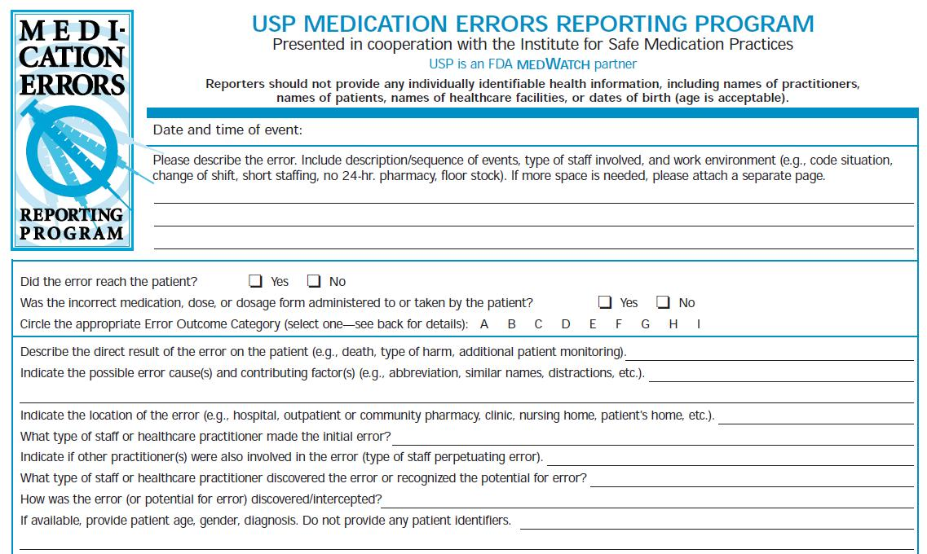
Medication Error Reporting Form

Slide 36
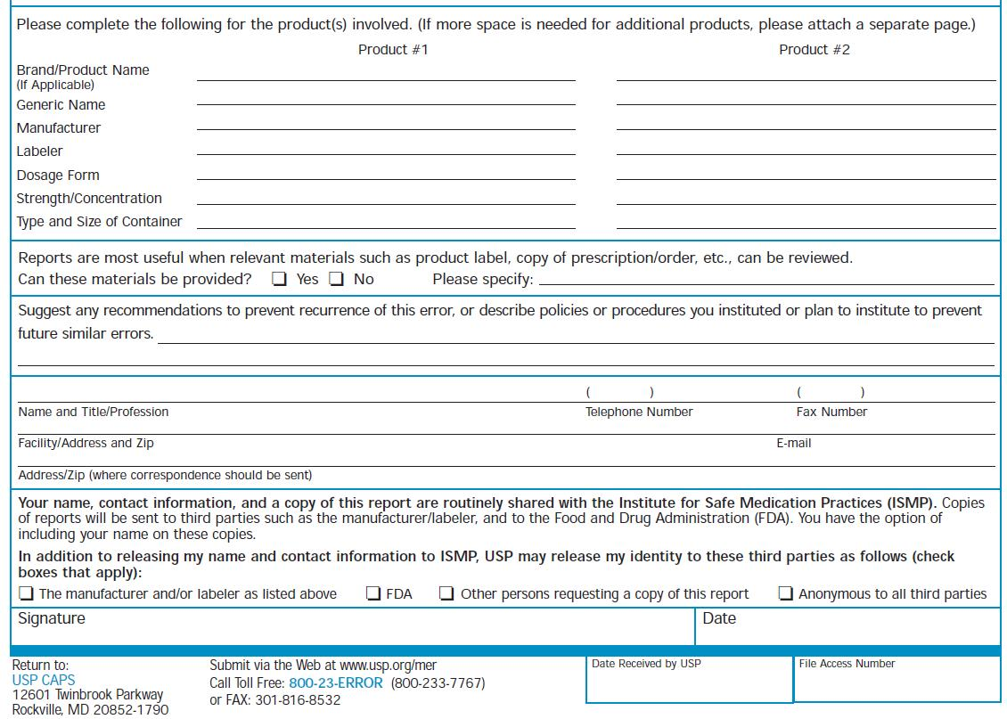

Slide 37
THANKS

Slide 38
TAKE AWAY MESSAGE
KNOWING IS NOT ENOUGH, WE MUST APPLY;
WILLING IS NOT ENOUGH, WE MUST DO.

