Slide 1
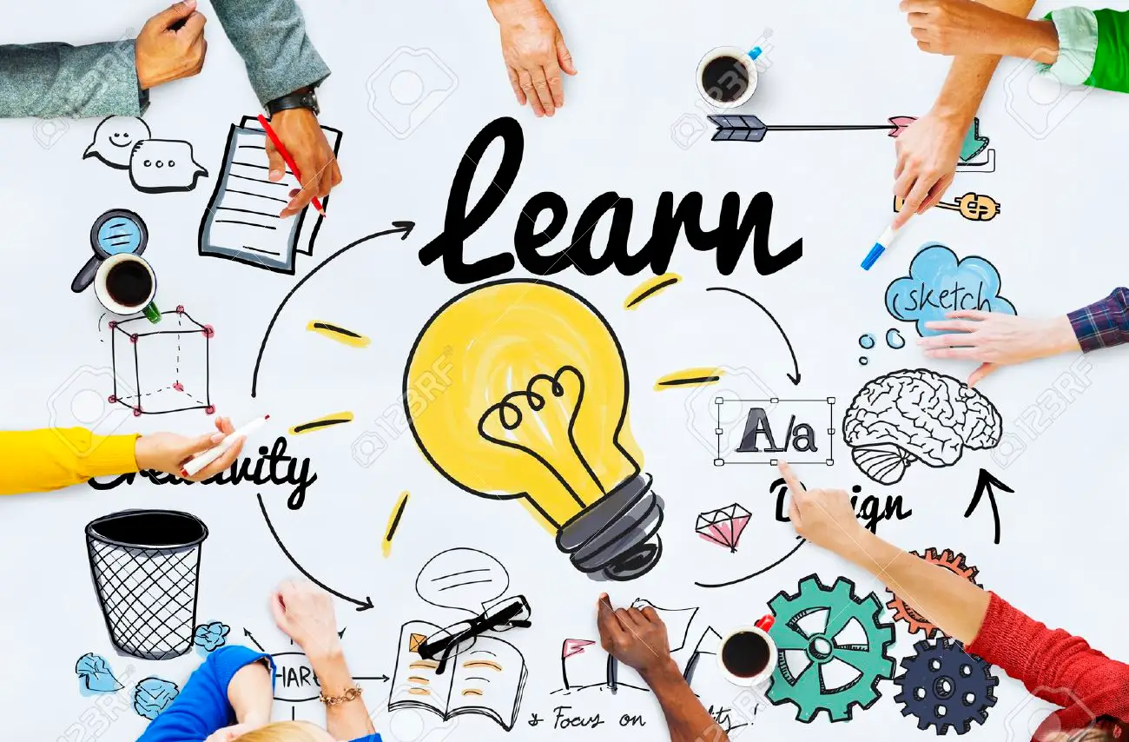

Slide 2
Learning
Learning can be defined as “relatively permanent change in behavior that occurs as a result of experience or reinforced practice”.
Learning can be defined as a relatively permanent change in behaviour or potential behaviour as a result of direct or indirect experience.
Learning is the process of having one’s behavior modified, more or less permanently, by what he does and the consequences of his action, or by what he observes.

Slide 3
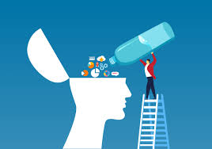
Nature
Learning is a continuous process.
Change due to learning is relatively permanent or long lasting.
Learning takes place as a result of practice or through experience.
It re-establishes the relationship between a stimulus and response.

Slide 4
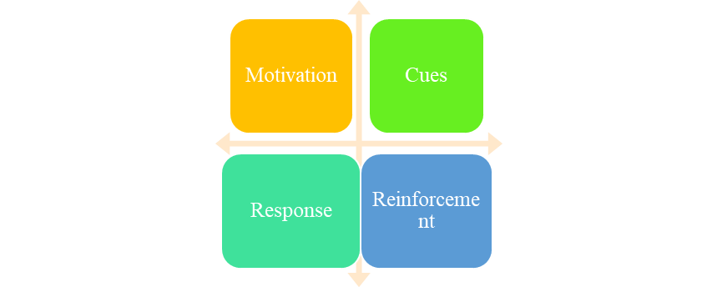
Elements
Motivation- Motivation is based on need and goals
Cues- Cues are the stimuli that give direction to those motives.
Response- How an individual reacts to a drive or cue constitutes his or her response.
Reinforcement- Reinforcement increases the likelihood that a specific response will occur in the future as the result of particular cues or stimuli.

Slide 5
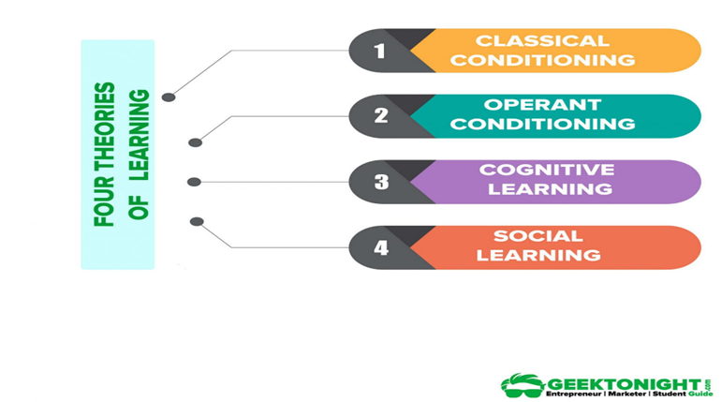

Slide 6
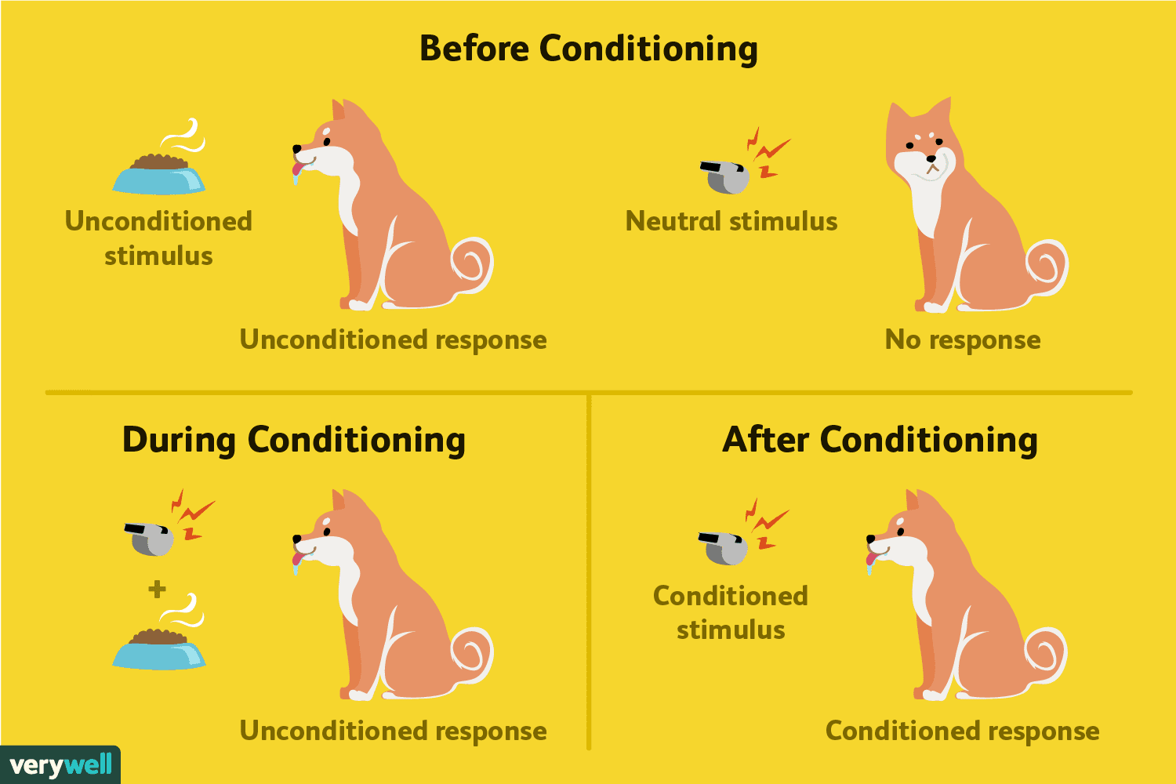
1. Classical Conditioning
Ivan Pavlov, a Russian psychologist developed classical conditioning theory of learning based on his experiments to teach a dog to salivate in response to the ringing of a bell.
In classical conditioning, learning involves a conditional stimulus and unconditional stimulus.
Learn from regular practices.

Slide 7
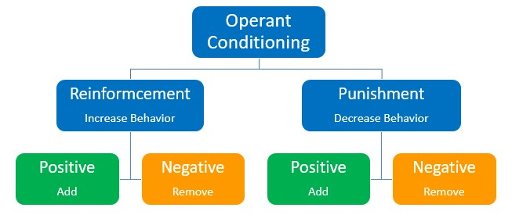
2. Operant Conditioning
Operant Conditioning is concerned primarily with learning as a consequence of behaviour Response-Stimulus (R-S).
We learn from past experience. If the consequences make us happy, we repeat it but if the consequences is unpleasant then we did not repeat it.
This theory was developed by B.F. Skinner.

